Slide 1
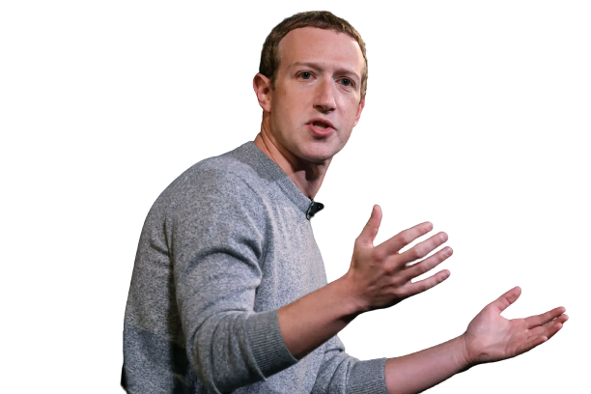


SOCIAL MEDIA BUSINESS SEMINAR
By:
Mark Zuckerberg
Yak ta pake fb ngen ig beu jeut ge ladang besnes urounyo
Monday
22.05.2023
Arun City
01.00 PM

