Slide 1
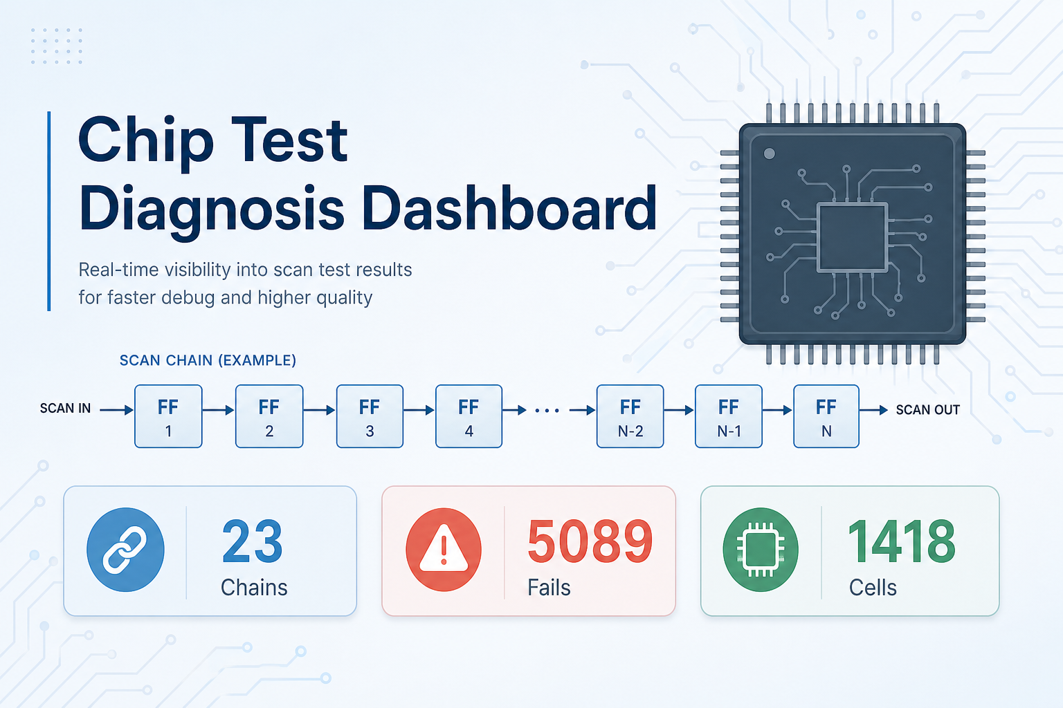
Scan Chain Diagnosis Agent (SCDA)
KPI Cards + 10 Functional Requirements — simple guide with dashboard examples
Real project data: 90 logs · 5,089 failures · 23 chains · 1,418 suspect cells
1 / 12

Slide 2
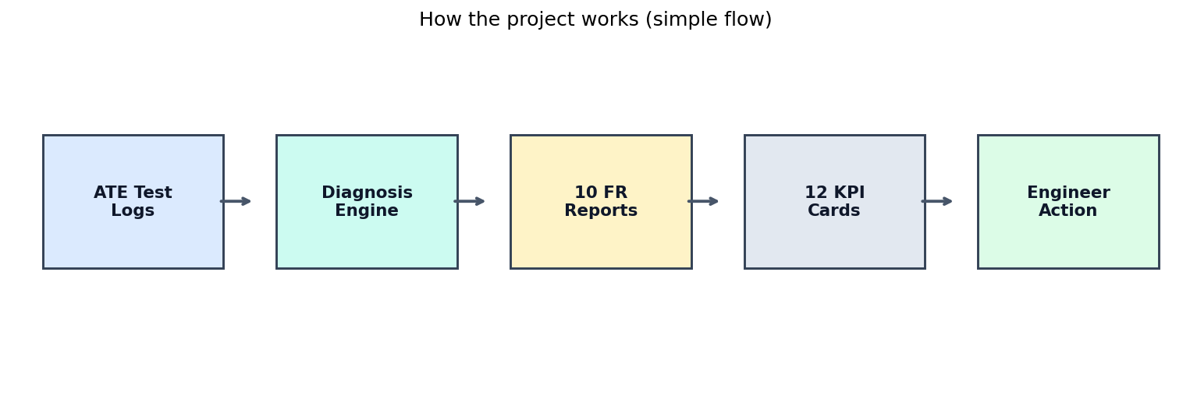
What does this project do?
In plain English: find where a chip’s scan test failed, and why.
• Chip factories run scan tests. When a test fails, the log is hard to read by hand.
• This tool reads the logs, finds bad scan chains and cells, and shows results on a dashboard.
• Dashboard: http://localhost:3000 · API: http://localhost:8000
• You get 12 KPI cards (quick numbers) and 10 requirement reports (detailed answers).
2 / 12

Slide 3
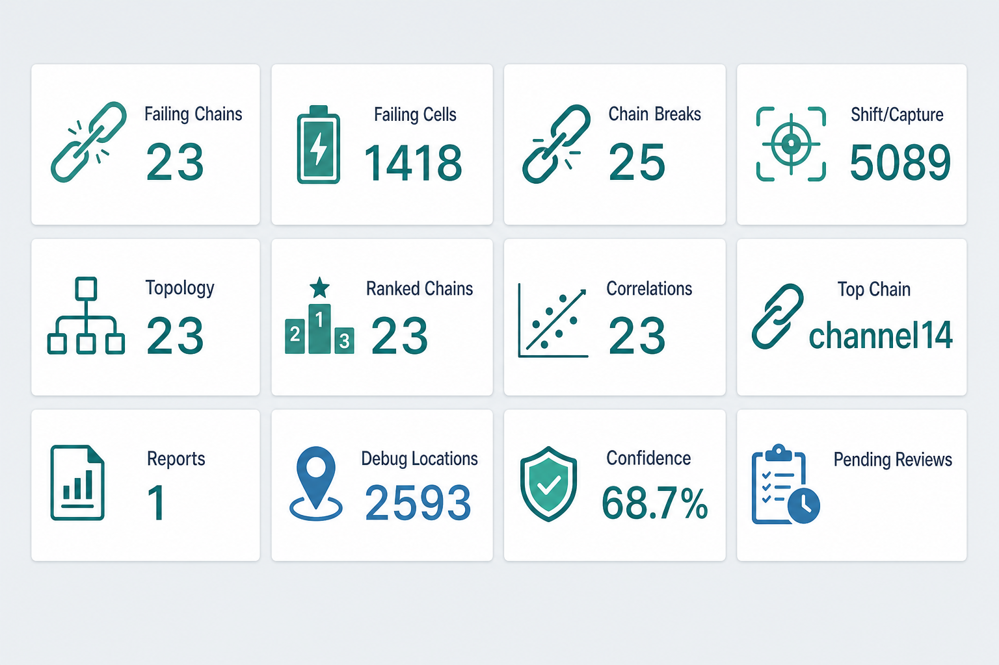
All 12 KPI cards (what you see first)
Each card is a big number. Click a card to open charts and tables.
• Failing Chains = 23 — how many chains failed
• Failing Cells = 1,418 — likely bad cells
• Chain Breaks = 25 — possible broken paths
• Shift/Capture = 5,089 — fail type mix
• Topology = 23 — chains in the design map
• Ranked Chains = 23 — ordered by fail count
• Correlations = 23 — how chains differ
• Top Chain = channel14 (496 fails)
• Reports = 1 HTML report ready
• Debug Locations = 2,593 probe points
• Confidence = 68.7% overall trust
• Pending Reviews — engineer confirm/reject queue
3 / 12

Slide 4
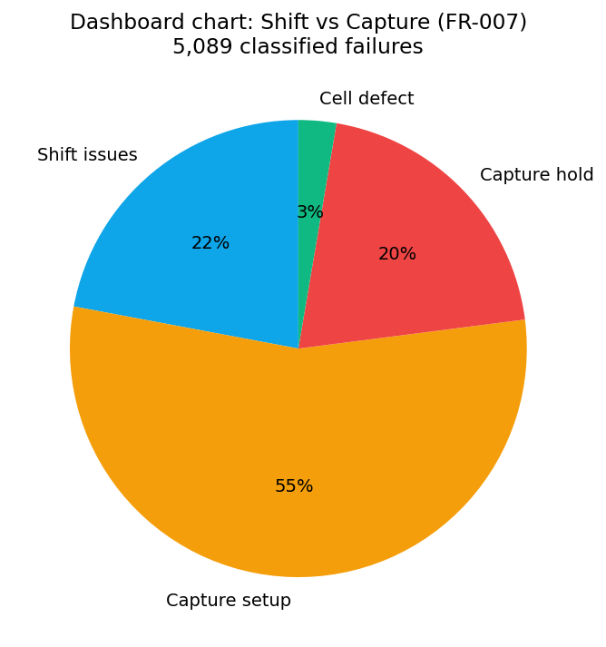
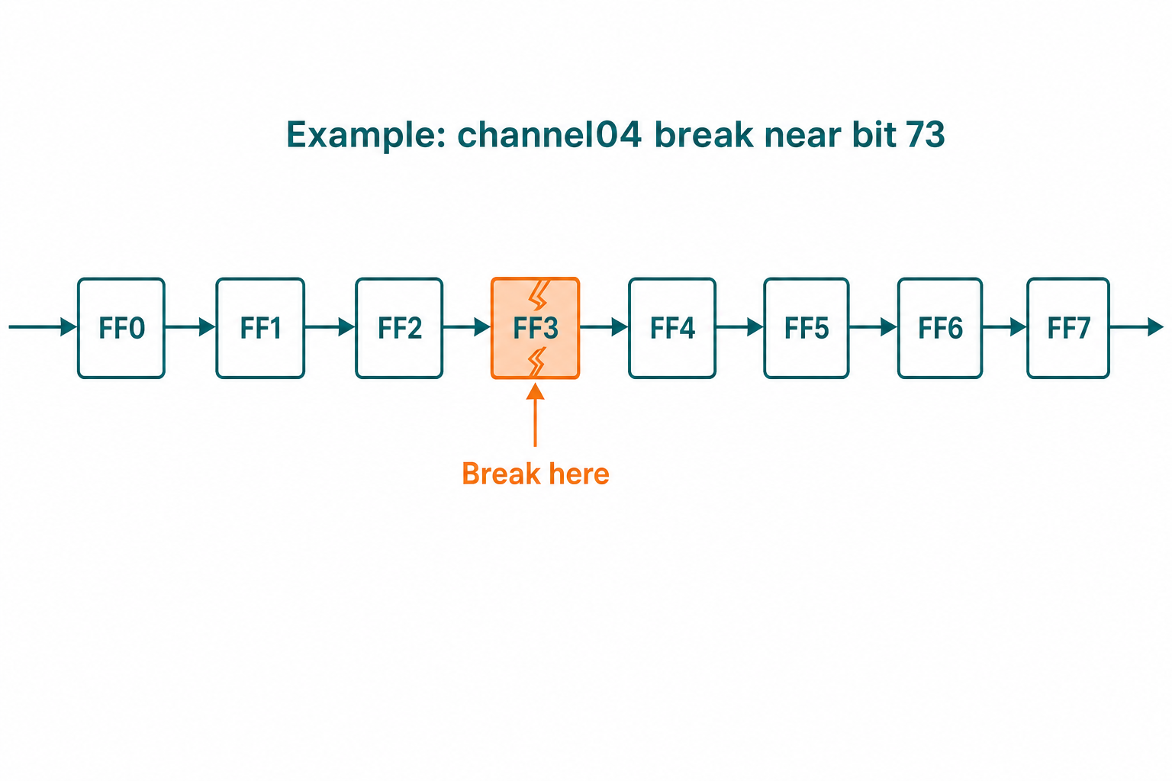
KPI group 1 — Finding the problems
These cards answer: what failed, where, and what kind of fail?
• Distinct failing scan chains (23): counts unique bad chains from FAIL logs. Example: channel14 is one of them.
• Failing Scan Cells (1,418): cells seen failing in at least 2 patterns, so noise is reduced. Confidence is shown per cell.
• Chain Breaks Detected (25): looks for a break in the shift path (EXPECTED vs ACTUAL bits disagree). Many are UNCERTAIN until more patterns agree.
• Shift / Capture Issues (5,089): sorts each fail into shift-path vs capture timing (setup/hold) vs cell defect.
• Dashboard evidence: Shift vs Capture donut chart + Chain Breaks table + Suspected Cells table.
4 / 12

Slide 5
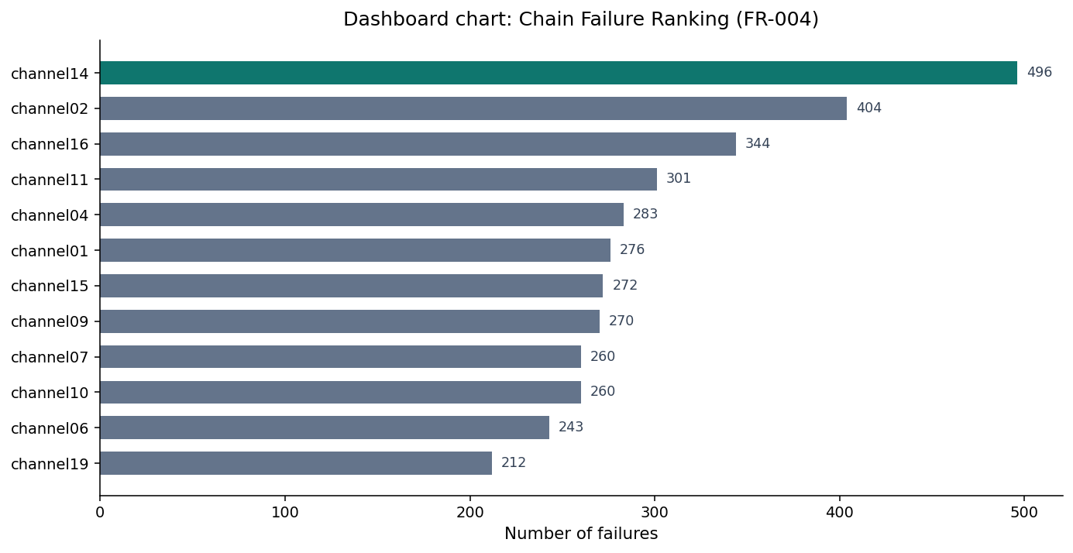
KPI group 2 — Ranking, map, and patterns
These cards answer: which chain is worst, how is the design wired, and what makes a chain special?
• Chains in Topology (23): design map of chains (length, flip-flops, SI/SO). Comes from STIL / topology files.
• Chains Ranked (23): same chains sorted by how often they fail. Pareto idea: top ~14 chains cover ~80% of fails.
• Top Failing Chain = channel14 with 496 failures across 9 lots — start debug here first.
• Failure Correlations (23): compares each chain to the average (IR drop, temperature, slack style signals).
• Dashboard evidence: horizontal Chain Failure Ranking bar chart + Top chain signatures table.
5 / 12

Slide 6
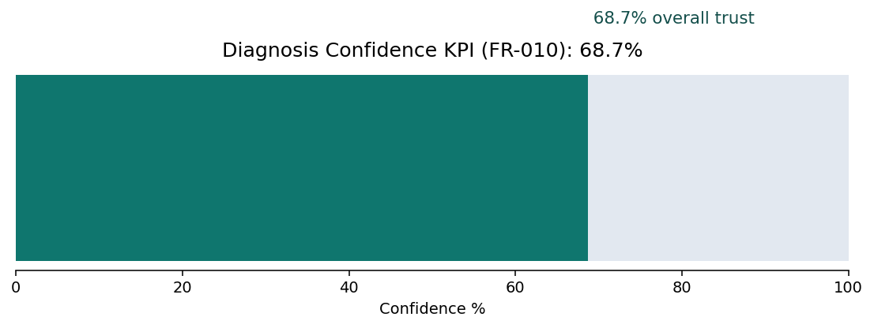
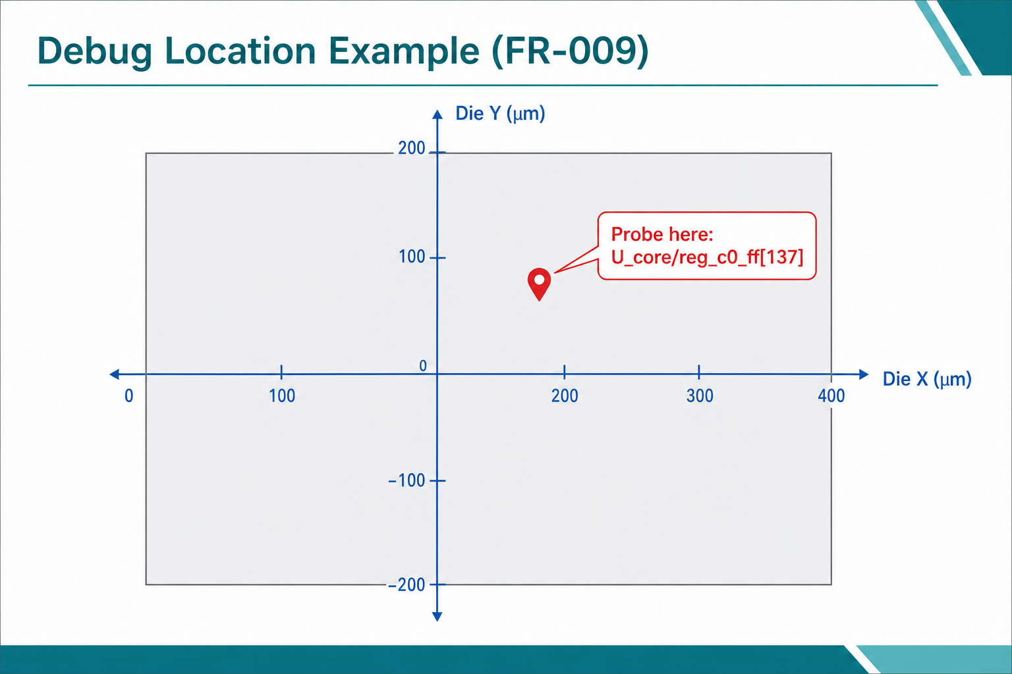
KPI group 3 — Report, probe points, trust, reviews
• Diagnosis Reports (1): one HTML report that packages the findings for sharing/printing (FR-008).
• Debug Locations (2,593): suggested X/Y places on the die to probe (PFA). Example: cell U_core/reg_c0_ff[137] near (215 µm, 87 µm).
• Diagnosis Confidence (68.7%): how much we trust the top answers overall (mix of logic + ML).
• Pending Reviews: engineers confirm or reject top leads; feedback helps improve later runs.
• Dashboard evidence: confidence gauge, debug location cards/table, report preview, review queue.
6 / 12

Slide 7
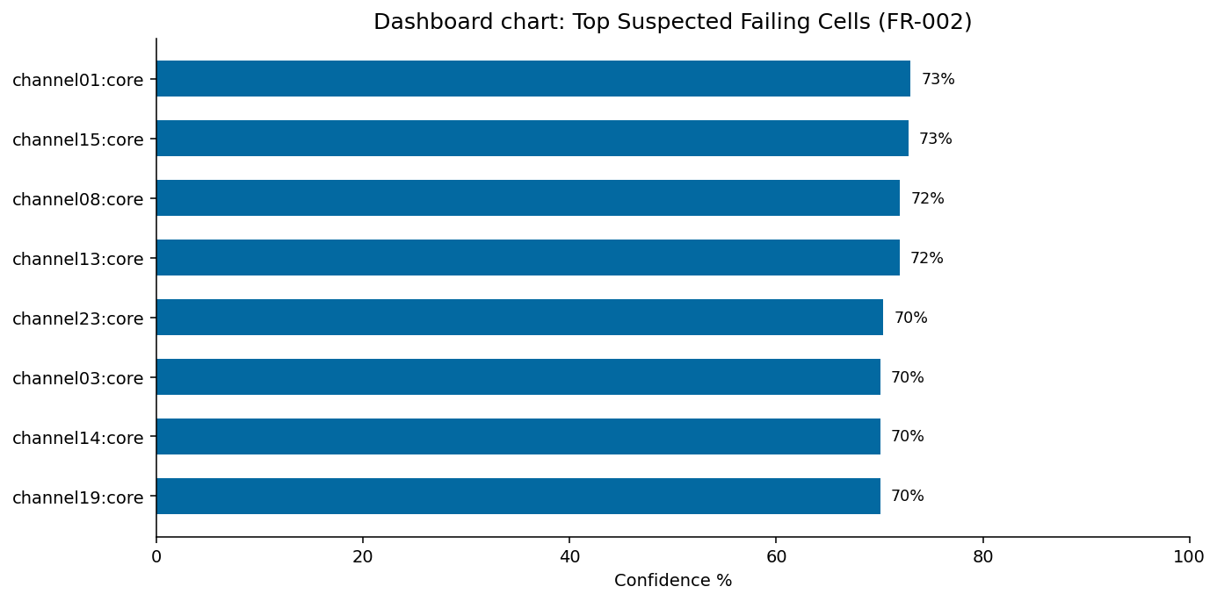
Requirements 1–3 (find chains, cells, topology)
• FR-001 Failing Scan Chains — Reads test logs and lists which scan chains failed and how often. KPI: Failing Chains = 23. Output: SCD-FR-001_failing_scan_chains.json.
• FR-002 Suspected Failing Cells — Maps a fail bit to a real cell name and gives a confidence score. KPI: Failing Cells = 1,418. Example: U_core/reg_c0_ff[137] on channel01 at ~73% confidence.
• FR-003 Scan Topology — Loads the design scan map (chain lengths, clocks, connections). KPI: Topology Chains = 23. Shown as topology stats + length bars / connectivity view.
• Why it matters: first you learn WHAT failed (chains), WHERE (cells), and HOW the design is connected (topology).
7 / 12

Slide 8
Requirements 4–6 (rank, correlate, find breaks)
• FR-004 Chain Failure Ranking — Ranks chains by fail count. Example: #1 is channel14 with 496 fails (about 9.7% of all fails). Chart: horizontal ranking bars.
• FR-005 Failure Correlation — Shows how a chain’s fail pattern differs from the lot average (signatures). Table: Top chain signatures on the dashboard.
• FR-006 Scan Chain Breaks — Finds the first bit where expected vs actual data disagree. Example: LOT_2 / channel04 near bit 73 (cell U_core/reg_c2_ff[73]), status UNCERTAIN until patterns agree (≥70%).
• Why it matters: ranking tells you where to start; correlation gives clues; breaks show possible hard opens in the scan path.
8 / 12

Slide 9
Requirements 7–8 (fail type + HTML report)
• FR-007 Shift vs Capture Diagnosis — Labels each of 5,089 fails:
• Shift issues 1,122 (~22%) · Capture setup 2,664 · Capture hold 974 · Cell defect 136 (+ other variants).
• Simple meaning: shift = problem while shifting data through the chain; capture = problem when storing data (timing/setup/hold).
• Dashboard chart: Shift vs Capture donut/pie.
• FR-008 Diagnosis Report — Builds one shareable HTML report with key tables and charts from the other requirements. KPI: Diagnosis Reports = 1.
• Why it matters: engineers need fail-type mix for root-cause thinking, and one report to send to the team.
9 / 12

Slide 10
Requirements 9–10 (where to probe + how sure we are)
• FR-009 Debug Locations — Turns suspects into probe coordinates (die µm / wafer mm) with priority. KPI: Debug Locations = 2,593.
• Example: probe near (215.05 µm, 87.42 µm) for U_core/reg_c0_ff[137] on channel01 (High priority).
• FR-010 Diagnosis Confidence — Gives a trust score for answers (per cell and overall). KPI: Diagnosis Confidence ≈ 68.7%.
• Higher % = stronger evidence (more matching patterns + model agreement). Lower % = treat as a lead, not a final answer.
• Note: FR-010 does not need its own big JSON file; confidence lives with FR-002 suspects and the dashboard gauge.
• Why it matters: lab time is costly — probe the best X/Y first, and only trust strong scores.
10 / 12

Slide 11
How KPI cards map to the 10 requirements
One worked example from the live dashboard numbers
• Failing Chains card → FR-001 | Failing Cells card → FR-002 | Topology card → FR-003
• Ranked Chains + Top Chain cards → FR-004 | Failure Correlations card → FR-005
• Chain Breaks card → FR-006 | Shift/Capture card → FR-007 | Reports card → FR-008
• Debug Locations card → FR-009 | Diagnosis Confidence card → FR-010 | Pending Reviews → production feedback loop
• Worked example: Start at Top Chain = channel14 (496 fails). Open ranking chart (FR-004). Check signatures (FR-005).
• Then open Suspected Cells for that chain (FR-002), check confidence (FR-010), and pick a Debug Location (FR-009) to probe.
• If EXPECTED/ACTUAL bits look stuck after one position, open Chain Breaks (FR-006) for that lot/chain.
11 / 12

Slide 12
Summary — what to remember
• SCDA turns hard ATE fail logs into a simple dashboard with 12 KPI cards and 10 requirement reports.
• Use KPI cards for a 10-second health check. Click cards for charts: ranking bars, shift/capture pie, topology, breaks, debug XY.
• Key numbers from this project run: 23 failing chains, 1,418 suspect cells, 25 break signatures, 68.7% confidence.
• Best first action: investigate channel14, then high-confidence cells like U_core/reg_c0_ff[137], then probe the suggested XY.
• Outputs live under output/ (SCD-FR-001 … SCD-FR-009 JSON/HTML) and on the UI at localhost:3000.
• Thank you — questions welcome.
12 / 12

