Slide 1
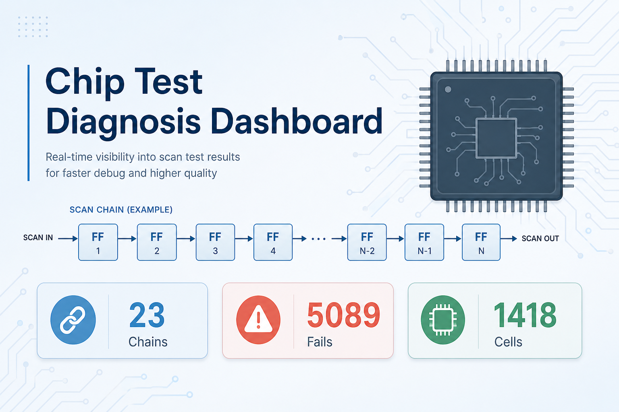
Scan Chain Diagnosis Agent
What this project does — in simple words
1 / 5
Notes:
Say: This project helps chip test engineers understand scan-test failures quickly. Instead of reading huge raw logs, they get a clear dashboard.

Slide 2
In one sentence
This project reads chip scan-test fail logs and shows where the problem is — on a simple dashboard.
The problem it solves
• Factories run scan tests on chips. When a test fails, the log is huge and hard to read.
• Engineers need fast answers: which chain failed? which cell? where to check next?
• Doing this by hand takes too long. This tool does it automatically.
2 / 5
Notes:
Say the bold sentence first. Then explain: scan tests shift data through flip-flop chains. A fail log lists mismatches. Our tool parses those logs and points to likely bad places.

Slide 3
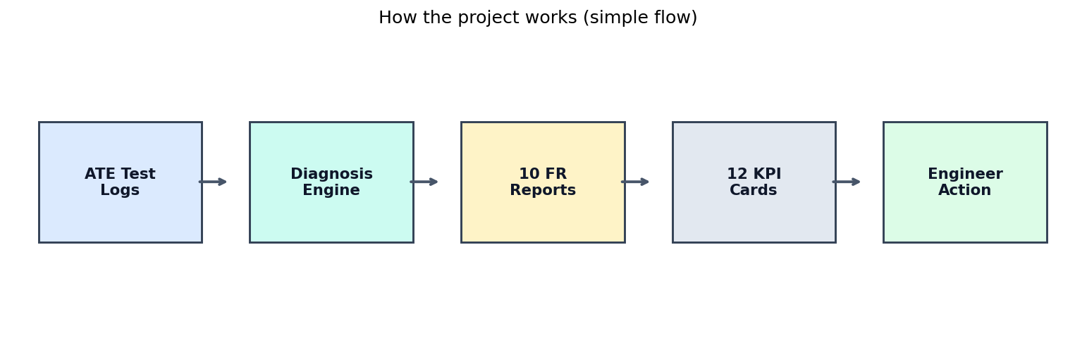
How it works (4 simple steps)
• 1. Take ATE fail logs (tester output).
• 2. Diagnosis engine finds bad chains, cells, and breaks.
• 3. Creates 10 requirement reports + 12 KPI cards.
• 4. Engineer uses the dashboard to decide what to probe or fix next.
3 / 5
Notes:
Walk left to right on the flow. Emphasize: input = logs, output = clear KPIs and charts for action.

Slide 4
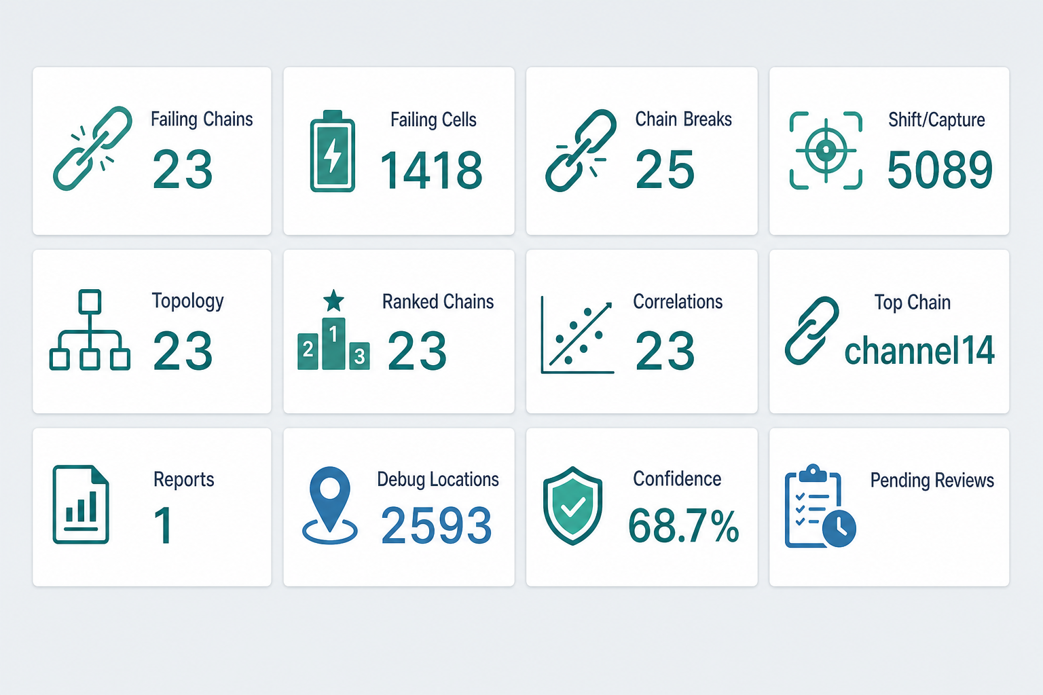
What you get on the dashboard
• Which scan chains failed
• Which cells are likely bad
• Possible chain breaks
• Shift vs capture fail types
• Worst chain to check first
• Where to probe on the chip
• How confident the answer is
4 / 5
Notes:
Point at KPI cards. Example from our data: 23 failing chains, top chain channel14 with 496 fails, confidence about 68.7%. Click a card to see charts and tables.

Slide 5
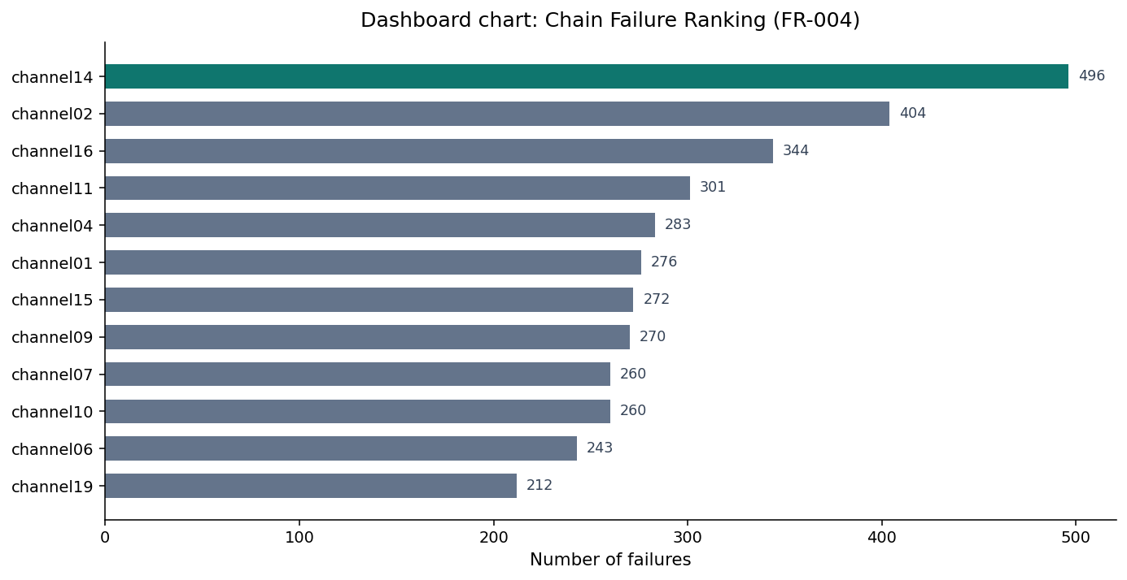
Simple example + takeaway
• Example: channel14 fails most often (496 fails) → start there.
• Tool points to a likely cell and a probe spot on the die.
• Takeaway: less time reading logs, more time fixing real chip issues.
• Open the UI at http://localhost:3000 to demo live.
5 / 5
Notes:
Close with: This is an automated scan-chain diagnosis helper — find failing chains/cells fast, rank what matters most, and guide the next debug step. Ask for questions.

