Slide 1
draft-zone-digest
IETF 102 Montreal

Slide 2
TL;DR
Secure zone files no matter how they are distributed
This is about data security
It is not about channel security
Cryptographic digest (hash) of zone data
Digest added to zone data – ZONEMD RR type
Preferably secured by DNSSEC

Slide 3
Motivation / Use Case
Root zone spreading beyond traditional deployment boundaries
RFC 7706
Talk of “hyper-local root” in ICANN contexts

Slide 4
Non-Use Case
Very large zones
.COM
Very dynamic zones
Although perhaps still useful for ICANN Centralized Zone Data Service (CZDS)?

Slide 5
Why not just use PGP?
Detached signatures only weakly associated with the data they cover
Attached signatures change the file format (no longer a zone file)
Lost when zone is loaded into a name server
Would require DNSSEC to associate key with zone
or web-of-trust (yeah right)
Digest is marginally useful even without DNSSEC
Unlikely that name server implementations would incorporate PGP
Whereas DNSSEC is already there

Slide 6
Simple example
example. 86400 IN A 127.0.0.1
example. 86400 IN NS ns.example.
example. 86400 IN SOA ns.example. admin.example. (
2018031900 1800 900 604800 86400 )
example. 86400 IN ZONEMD 2018031900 2 (
470e532450143fcae448942cd530e3d7
9a303cea62e4c930f2102becb4fe68d8 )
ns.example. 3600 IN A 127.0.0.1

Slide 7
Dynamic Updates
ZONEMD as proposed not compatible with dynamic DNS updates
Digest can be easily calculated where DNSSEC offline signing is used
Not designed for dynamic / online signing
Supporting dynamic digest update could be defined by future protocol enhancement
Perhaps with Merkle trees / hierarchical hashing
Perhaps under a different RR type

Slide 8
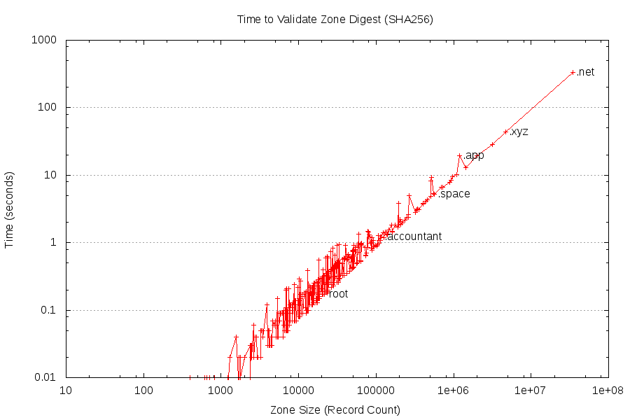

Slide 9
Algorithm for Calculating Digest
Add placeholder ZONEMD record
Sort and canonicalize zone
Optionally sign with DNSSEC
Calculate digest and update ZONEMD record
Update ZONEMD RRSIG if signed

