Slide 1
Craiyon.com
A language to create pictures

Slide 2
Your new job
You, a programmer, start at an ad agency
“Our artists need some guidance when they start an illustration. Write me a program to take a text description of what they want to illustrate and produce some samples to inspire them.”
Use common tropes
Allow for progressive refinement

Slide 3
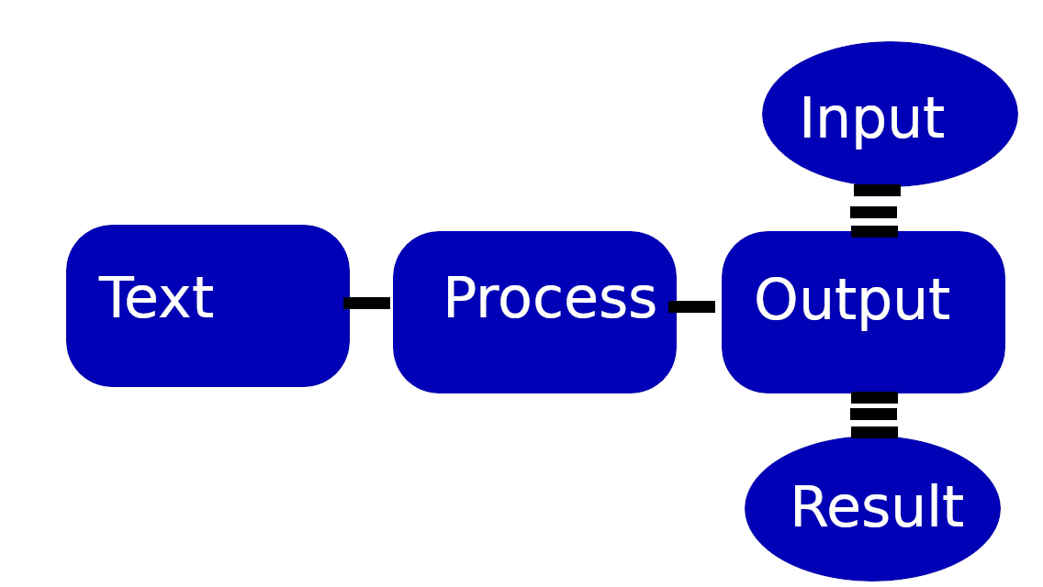
What is a computer language?

Slide 4
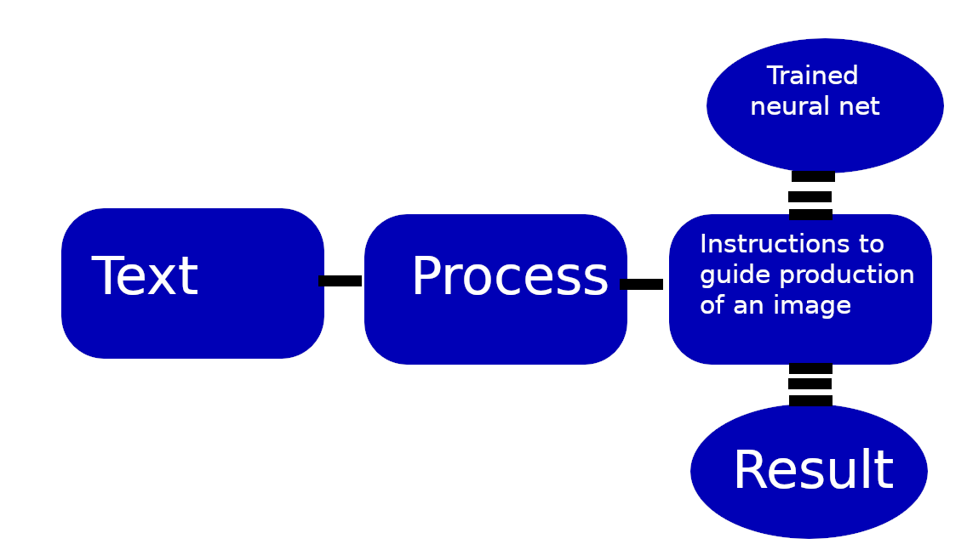
A language producing pictures

Slide 5
Craiyon.com
A website that generates images
Uses a smaller version of the neural network from the DALL-E project. (Google cloud team)
The model is trained by looking at millions of images from the internet with their associated captions.
Text input from a neural network that understands and responds to conversation
Put in a description of what you want to see and it creates pictures.

Slide 6
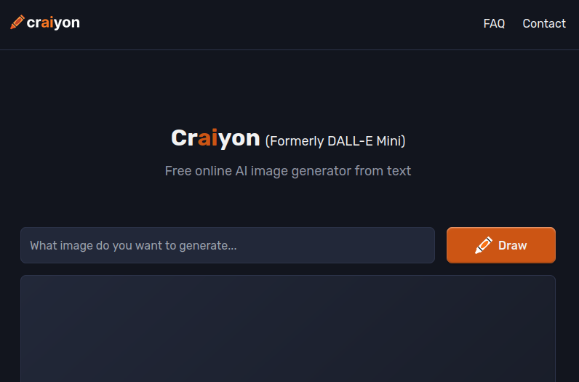
The website

Slide 7
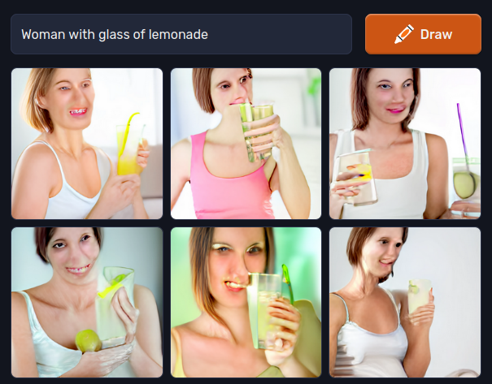
Example1 :
Woman with a glass of lemonade

Slide 8

Example 2
Handsome man placing an order online

Slide 9

Example 2
Sideview of a handsome man placing an order online

Slide 10

Example 2
Sketch of the sideview of a handsome man placing an order online

Slide 11
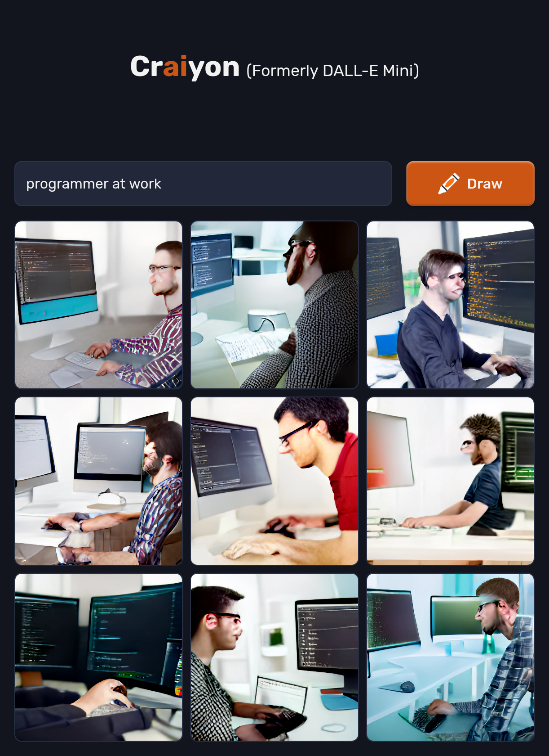
Example 3
Programmer at work

Slide 12
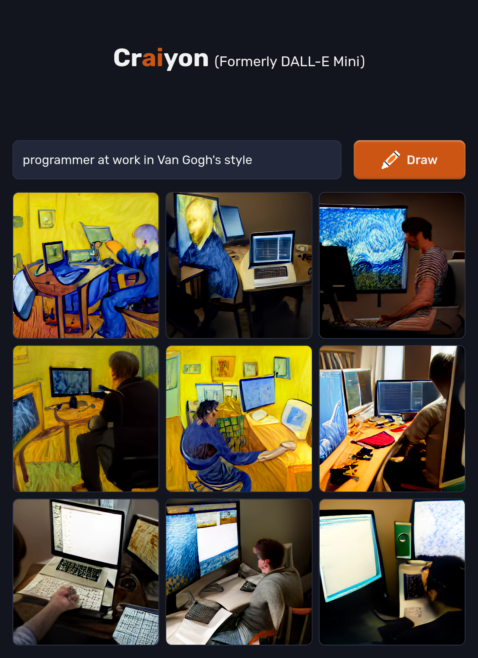
Example 3
Programmer at work in Van Gogh’s style

Slide 13
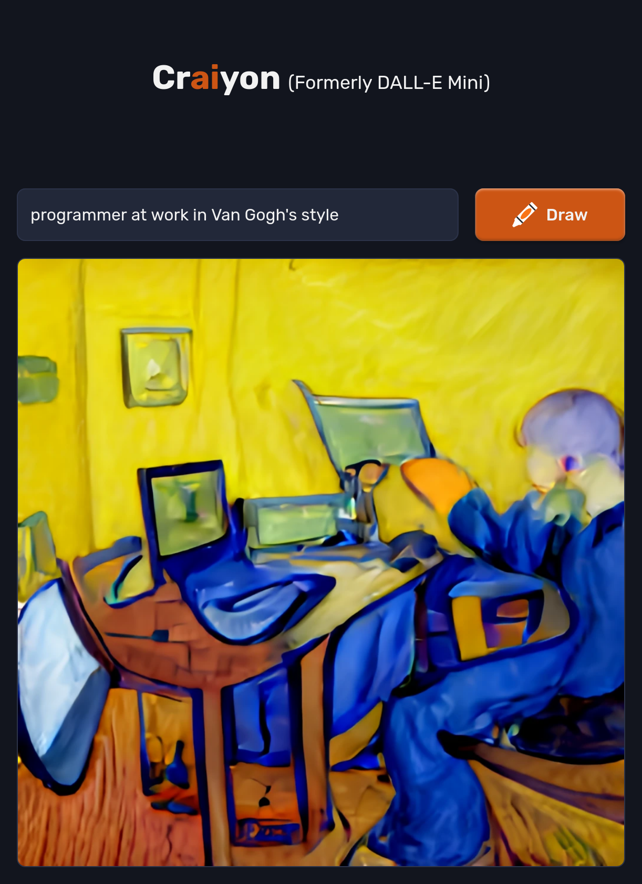

Slide 14

Other similar tools: Stable Diffusion
Programmer at work

Slide 15

Other similar tools: Stable Diffusion

Slide 16

Other similar tools: Stable Diffusion

Slide 17

Other similar tools: Stable Diffusion

Slide 18

Other similar tools: Stable Diffusion

Slide 19
Why am I talking about this?

Slide 20
Why am I talking about this?
It is the future of programming

Slide 21
Why am I talking about this?
It is the future of programming
Or at least one of the futures

Slide 22
Current approach
Plugin for popular editors
Write a doc string
An AI assistant writes a function that accomplishes what you described in the doc string
GitHub CoPilot
AWS CodeWhisperer

Slide 23
GitHub CodePilot
Trained on open-source repositories on GitHub
Has “learned” coding from these examples
Currently available, requires subscription

Slide 24
AWS CodeWhisper
Announced, not yet available
"CodeWhisperer will continually examine your code and your comments, and present you with syntactically correct recommendations"
"The recommendations are synthesized based on your coding style and variable names, and are not simply snippets."

Slide 25
Reviews of CodeGen
Works suprisingly well if doing something common.
Code needs to be carefully read after generation.
Useful for remembering API usages
Wanders off in the weeds if doing something unique

Slide 26
To sum up:
You can ask for something nonsensical and get back nonsense
A HORSE ON A POGO STICK JUMPING A FENCE

Slide 27


Slide 28


Slide 29


Slide 30


Slide 31
The End
Enough horsing around

Slide 32


