Slide 1
FROM NON-CODER TO BUILDER
Coding with AI for Engineers

Slide 2
PART 1
FOUNDATIONS

Slide 3
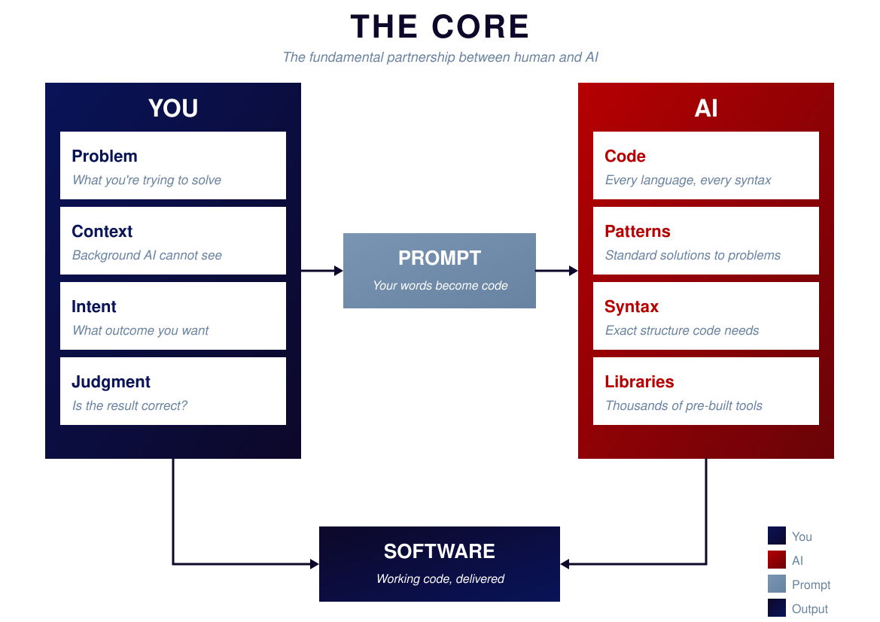
Notes:
THE CORE PARTNERSHIP
You don't need to become a programmer. You need to become a builder.
Four elements form this partnership:
YOU — the engineer. You bring domain knowledge, judgment, and understanding of what you actually need.
AI — your coding partner. It knows syntax, patterns, and can generate code quickly.
PROMPT — the bridge. How you communicate with AI. Quality of prompt = quality of output.
SOFTWARE — the output. Working code that solves your problem.
Key insight: You provide direction. AI provides code. Together, you build.
You're not replacing yourself with AI. You're amplifying yourself.

Slide 4
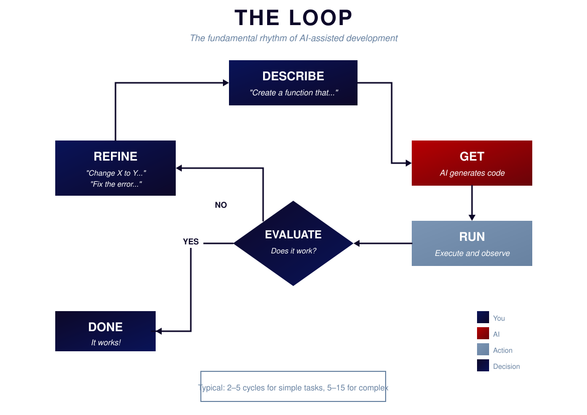
Notes:
THE LOOP
This is how every coding session with AI actually works. Memorize this loop.
DESCRIBE — Tell AI what you want.
GET — AI gives you code.
RUN — Actually run the code. See what happens.
EVALUATE — Does it work? Does it do what you wanted?
Then decide: Done or Refine?
If it works, move on. If not, go back to DESCRIBE with more information.
Key insight: Every problem is solvable through iteration. You don't need to get it right the first time.

Slide 5
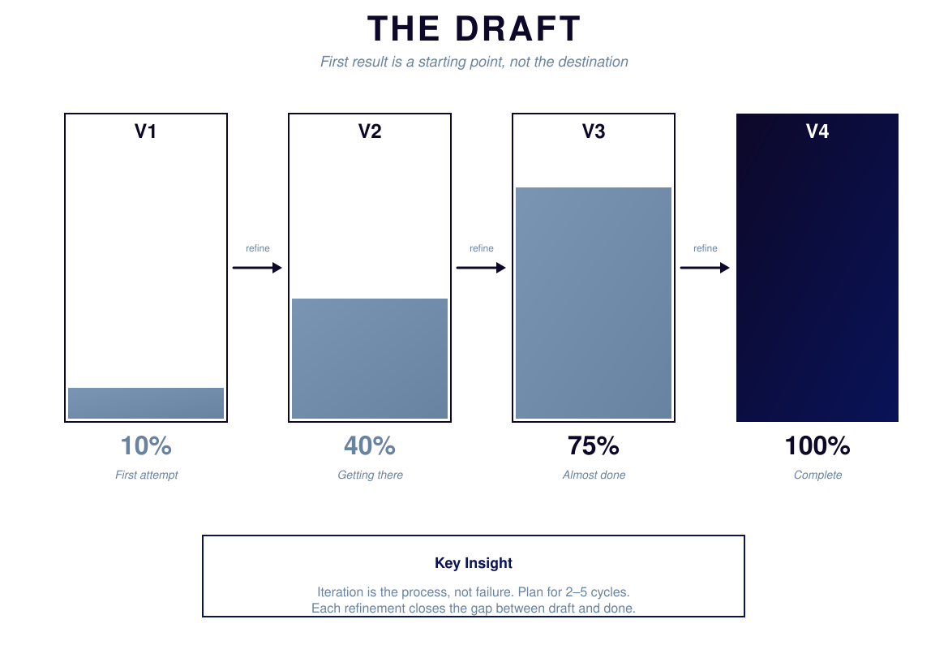
Notes:
THE DRAFT
Most beginners expect perfection on the first try. That's wrong.
Version 1: 10% — Rough draft, might not even run
Version 2: 40% — Basic structure works
Version 3: 75% — Right calculation, missing edge cases
Version 4: 100% — It works. Ship it.
Treat AI output like a first draft, not a final answer.
Stop asking "why didn't AI give me perfect code?" and start asking "what do I need to tell AI to make this better?"

Slide 6
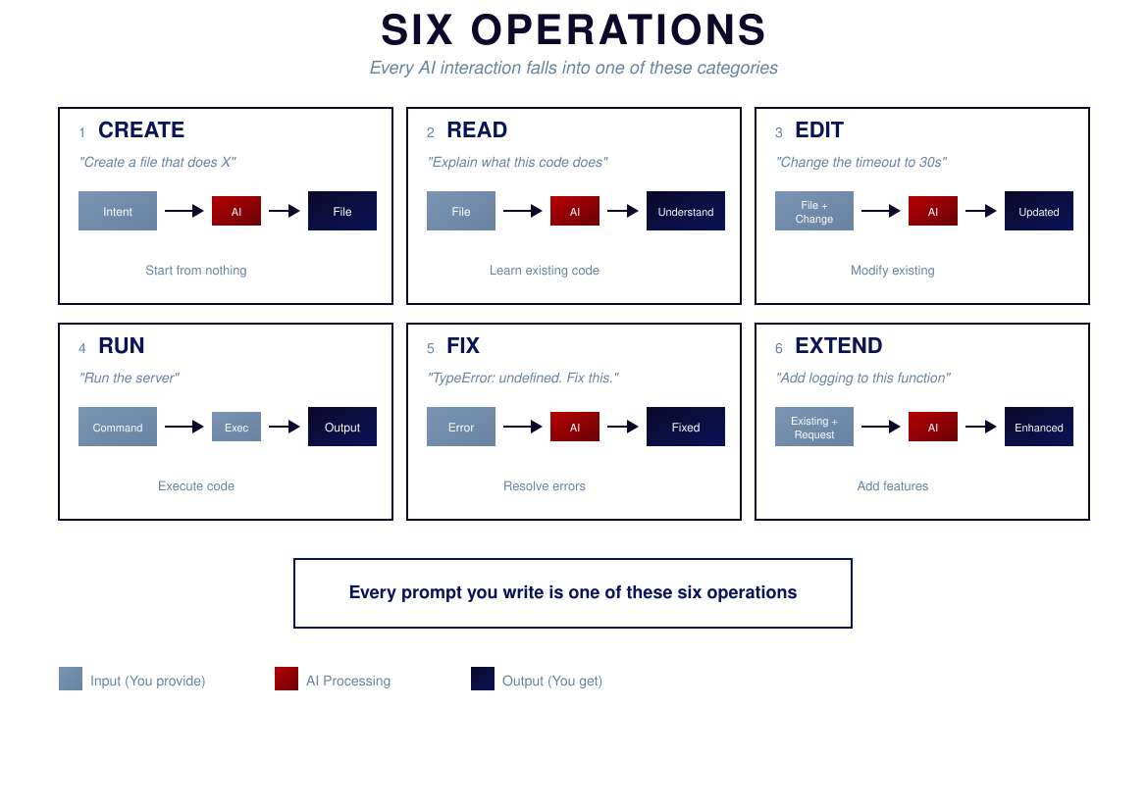
Notes:
SIX OPERATIONS
Everything you'll ever do with AI coding falls into six categories:
CREATE — Making something new
READ — Understanding existing code
EDIT — Changing existing code
RUN — Executing code (you do this)
FIX — Debugging errors
EXTEND — Adding to existing code
When stuck, ask yourself: "Which operation am I trying to do?"
Then structure your prompt around that operation.

Slide 7
PART 2
SKILLS

Slide 8
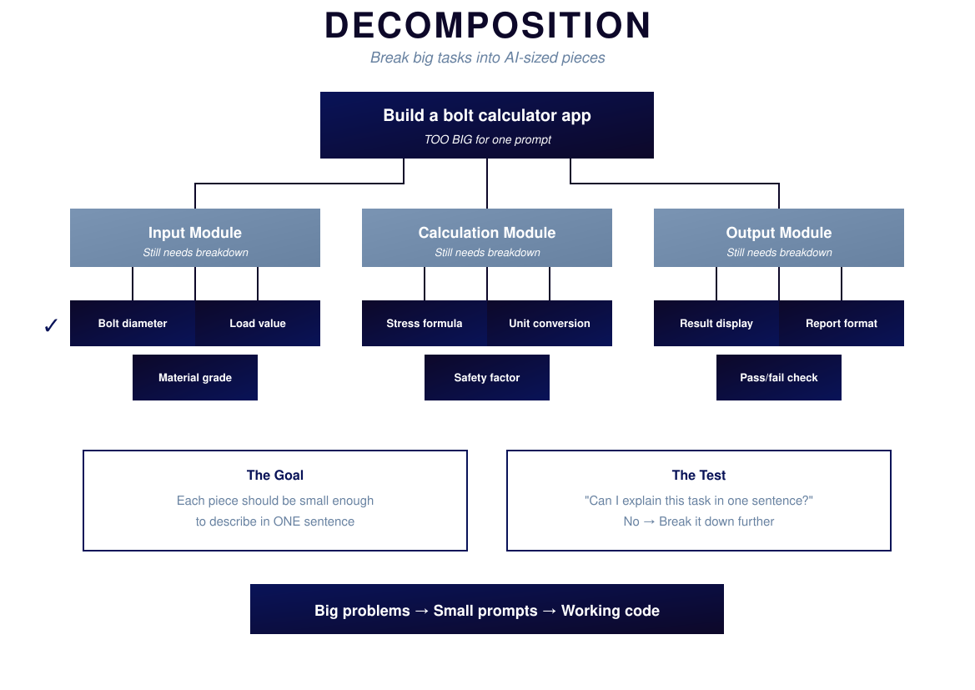
Notes:
DECOMPOSITION
The single most important skill: breaking big things into small things.
Big task: "Build a bolt calculator app" — Too vague for AI
Break it down:
- Input section → Get force, Get area, Validate
- Calculation engine → Calculate stress, Check limits
- Results display → Format output, Show warnings
Big tasks confuse AI. Small tasks get perfect results.
Think of it like engineering drawings. You don't hand someone a napkin sketch. You provide detailed drawings of each component.

Slide 9
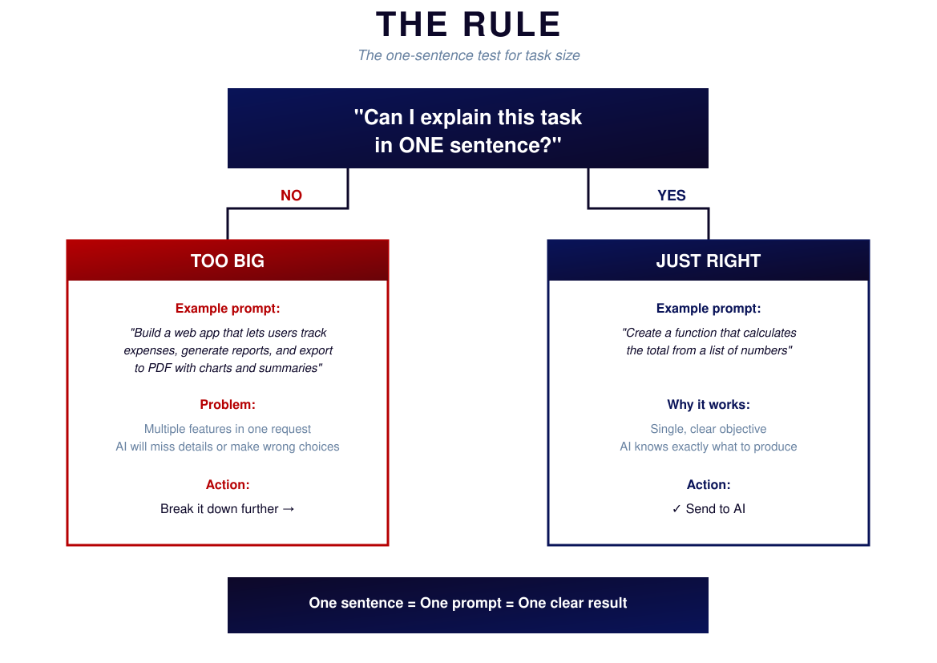
Notes:
THE ONE-SENTENCE RULE
Simple test: Can I explain this task in ONE sentence?
If NO → Task is too big. Break it down.
If YES → Task is just right. Give it to AI.
TOO BIG: "Build me an app that handles all our bolt calculations with a UI and database and reports"
JUST RIGHT: "Create a function that calculates tensile stress from force and area"
When you find yourself writing a paragraph, stop. Decompose first.

Slide 10
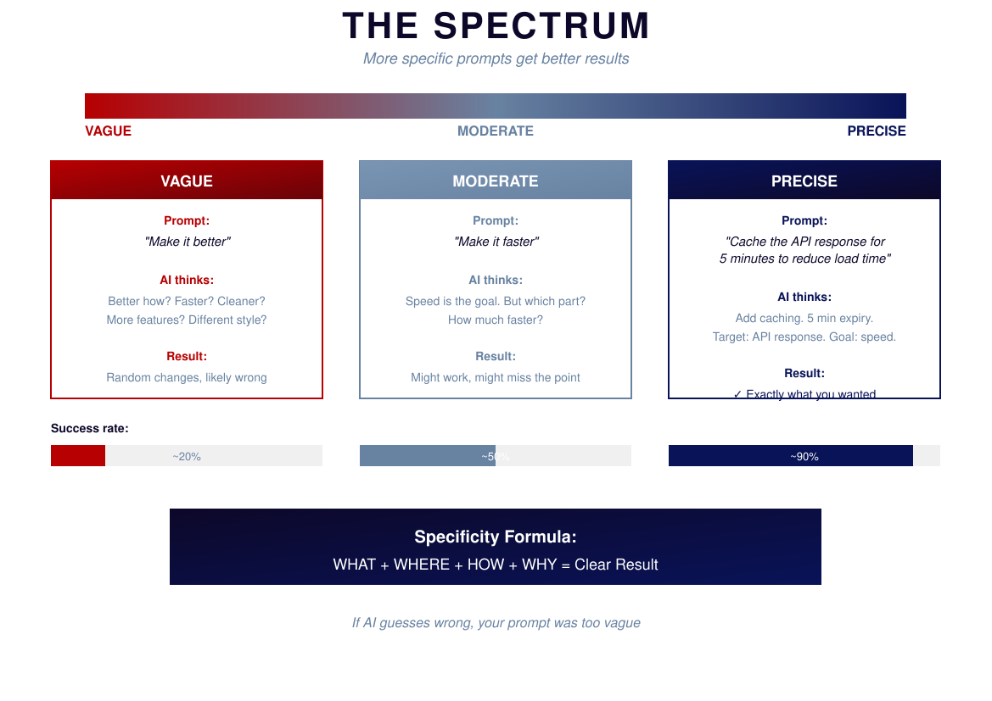
Notes:
THE SPECIFICITY SPECTRUM
Not all prompts are equal.
VAGUE: "Help me with calculations" — 20% success
MEDIUM: "Write a stress calculation function" — 50% success
PRECISE: "Write a Python function called calculate_tensile_stress that takes force in Newtons and area in mm², returns stress in MPa, raises error if negative" — 90% success
More specific prompts = Fewer iterations = Better results
Spend 2 minutes on a good prompt, get working code. Or spend 30 seconds on a vague prompt and 20 minutes fixing it.

Slide 11
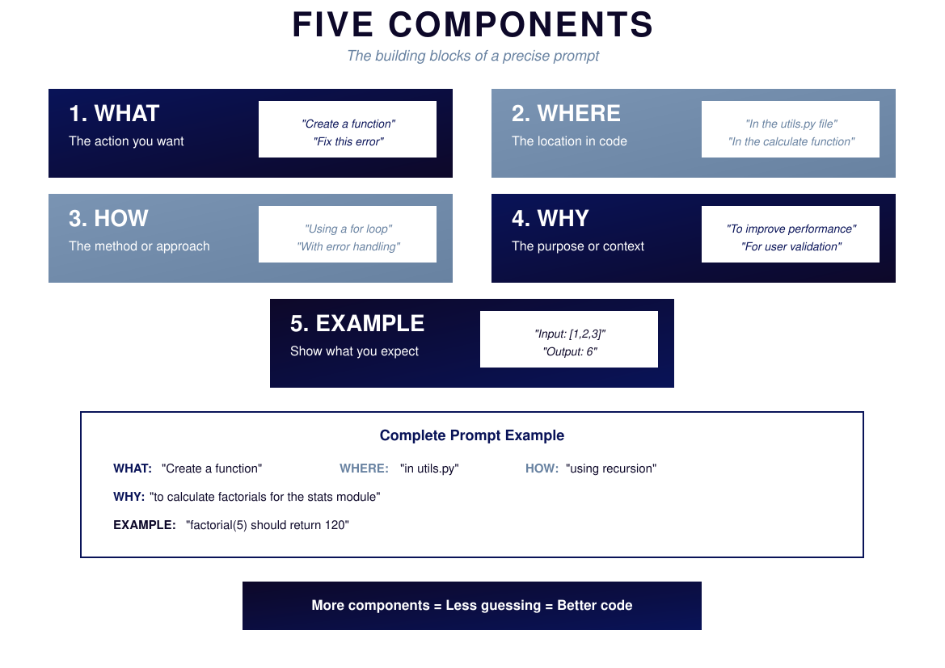
Notes:
FIVE COMPONENTS OF A PRECISE PROMPT
WHAT — The action: "Create a function"
WHERE — The location: "in utils.py"
HOW — The method: "using recursion"
WHY — The purpose: "to calculate factorials for the stats module"
EXAMPLE — Show expected: "factorial(5) should return 120"
You don't always need all five. But the more you include, the better your results.
More components = Less guessing = Better code

Slide 12
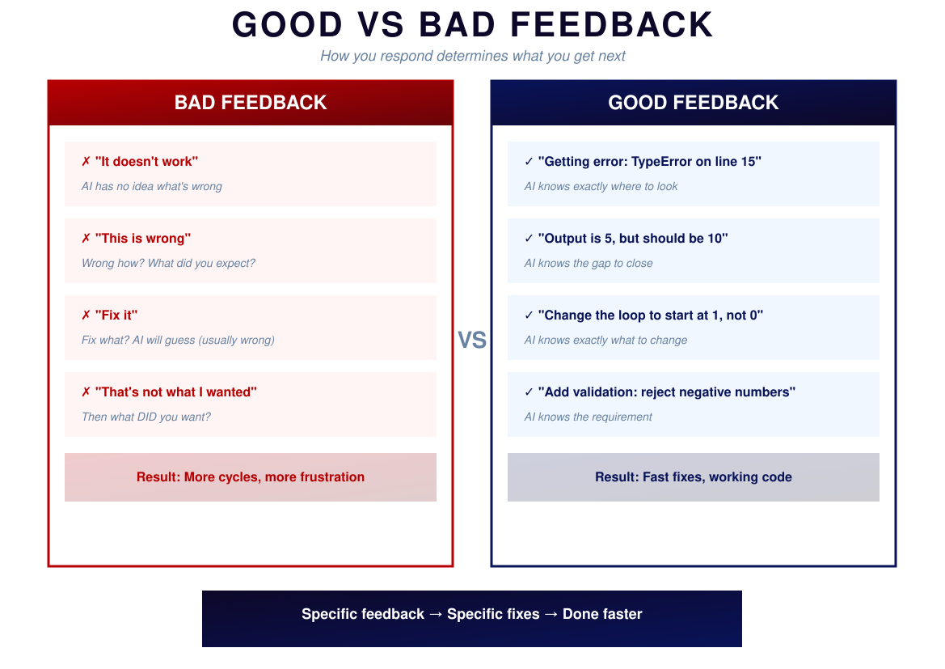
Notes:
GOOD VS BAD FEEDBACK
When AI gives you something that's not quite right, how you respond matters.
BAD FEEDBACK:
- "It doesn't work" — AI has no idea what's wrong
- "This is wrong" — Wrong how?
- "Fix it" — Fix what? AI will guess wrong
- "That's not what I wanted" — Then what DID you want?
GOOD FEEDBACK:
- "Getting error: TypeError on line 15" — AI knows where to look
- "Output is 5, but should be 10" — AI knows the gap
- "Change the loop to start at 1, not 0" — AI knows the fix
Specific feedback → Specific fixes → Done faster

Slide 13
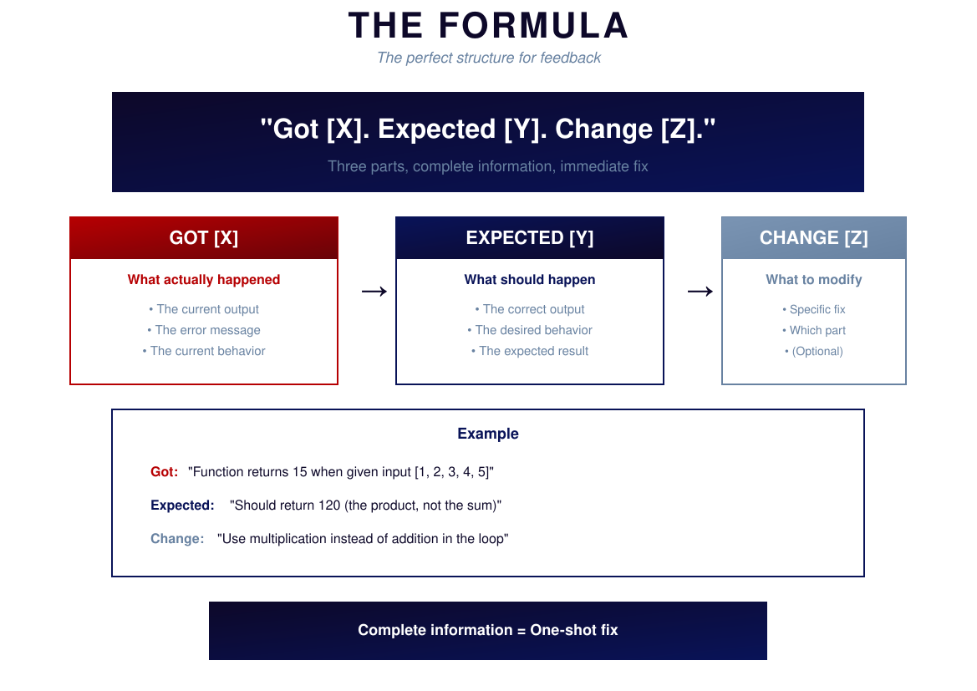
Notes:
THE FEEDBACK FORMULA
"Got [X]. Expected [Y]. Change [Z]."
GOT [X] — What actually happened
EXPECTED [Y] — What should happen
CHANGE [Z] — What to modify (optional but helpful)
Example:
Got: "Function returns 15 for input [1,2,3,4,5]"
Expected: "Should return 120 (product, not sum)"
Change: "Use multiplication instead of addition in the loop"
Complete information = One-shot fix

Slide 14
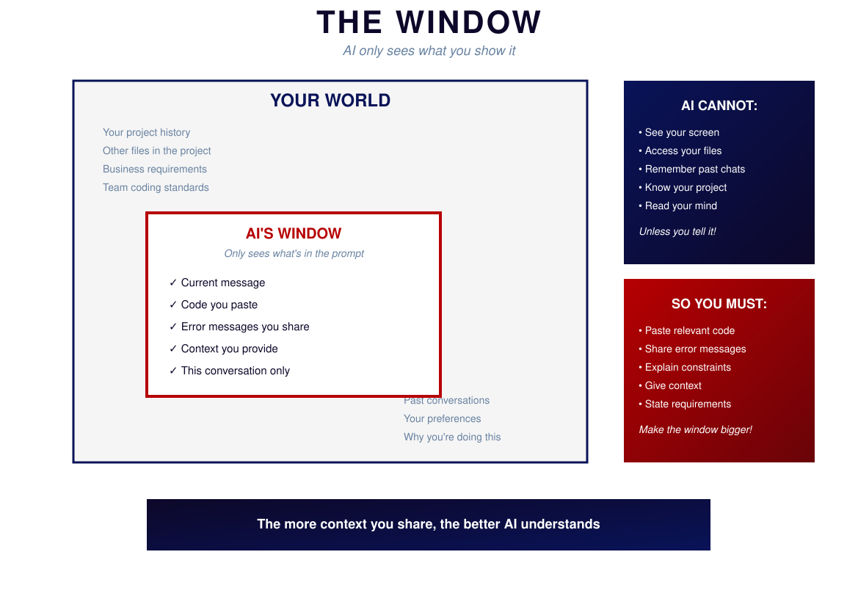
Notes:
THE WINDOW
AI only sees what's in the prompt.
Your world contains: project history, other files, business requirements, team standards, past conversations, your preferences.
AI's window contains: ONLY what you put in this prompt.
AI cannot see your screen, access your files, remember past chats, know your project, or read your mind. Unless you tell it.
The more context you share, the better AI understands.

Slide 15
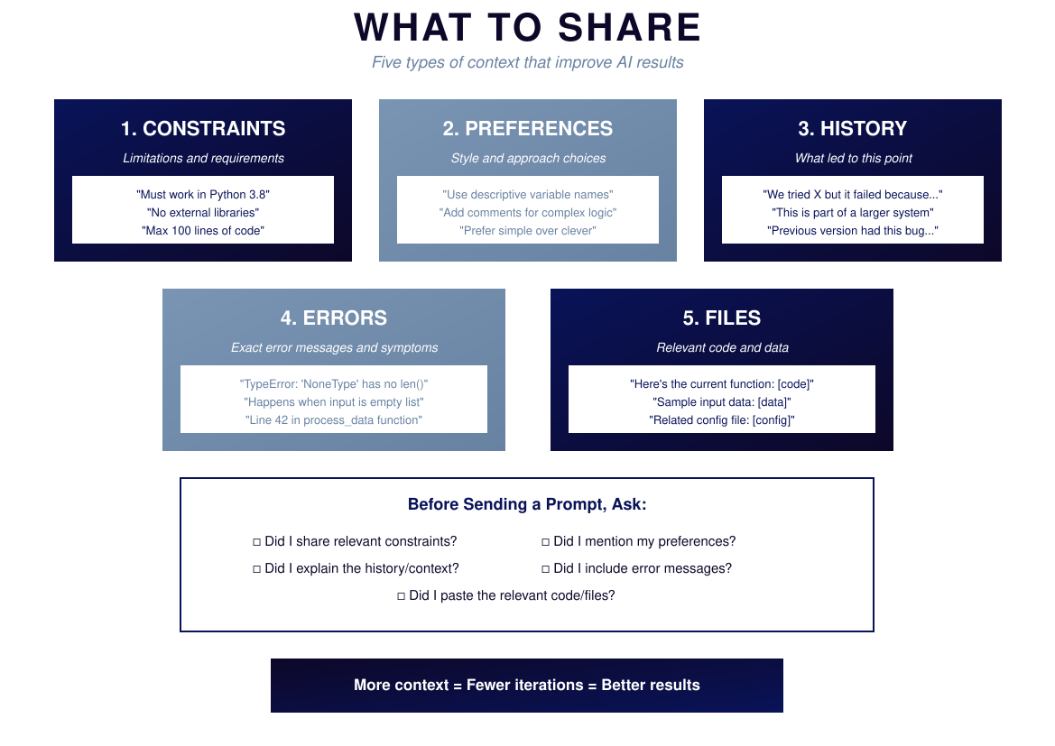
Notes:
WHAT TO SHARE
Five types of context that improve AI results:
1. CONSTRAINTS — "Must work in Python 3.8", "No external libraries"
2. PREFERENCES — "Use descriptive variable names", "Prefer simple over clever"
3. HISTORY — "We tried X but it failed because...", "Part of a larger system"
4. ERRORS — Exact error messages, line numbers, when it happens
5. FILES — Current code, sample data, config files
Before sending: Did I share constraints? Preferences? History? Errors? Files?
More context = Fewer iterations = Better results

Slide 16
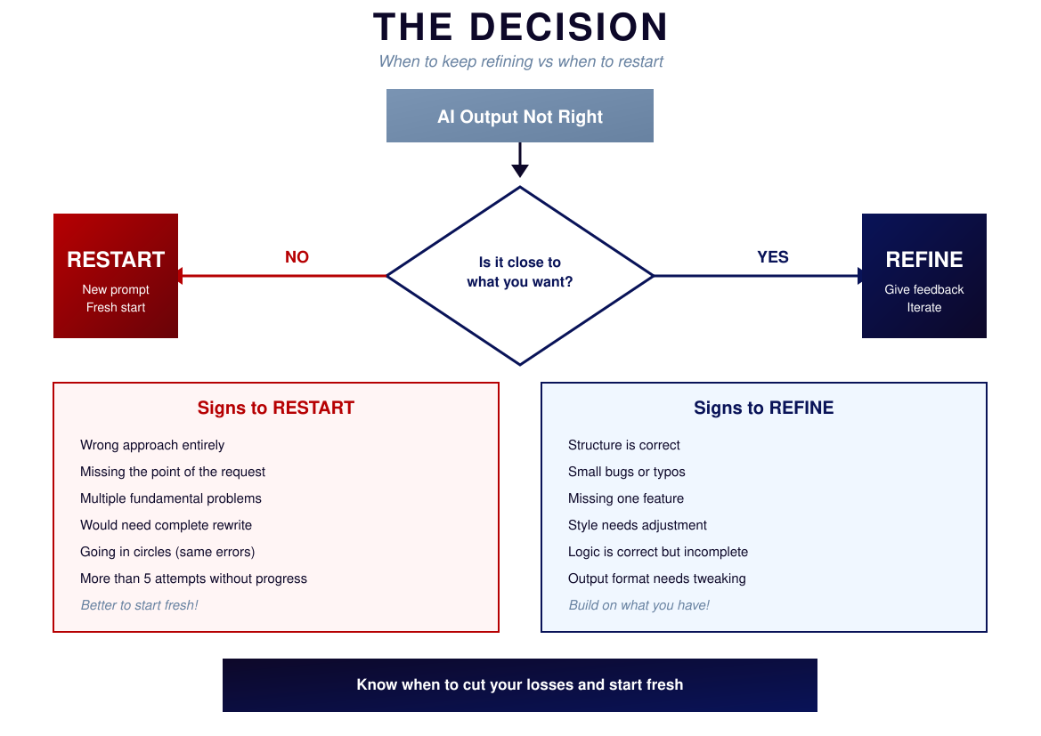
Notes:
THE DECISION
Sometimes you need to know when to stop refining and start fresh.
Is AI's output close to what you want?
YES → REFINE
Signs: Structure correct, small bugs, missing one feature, style needs adjustment
NO → RESTART
Signs: Wrong approach entirely, missing the point, multiple fundamental problems, going in circles
Starting fresh isn't failure. It's efficiency. Sometimes the fastest path is to abandon and try again with a better prompt.

Slide 17
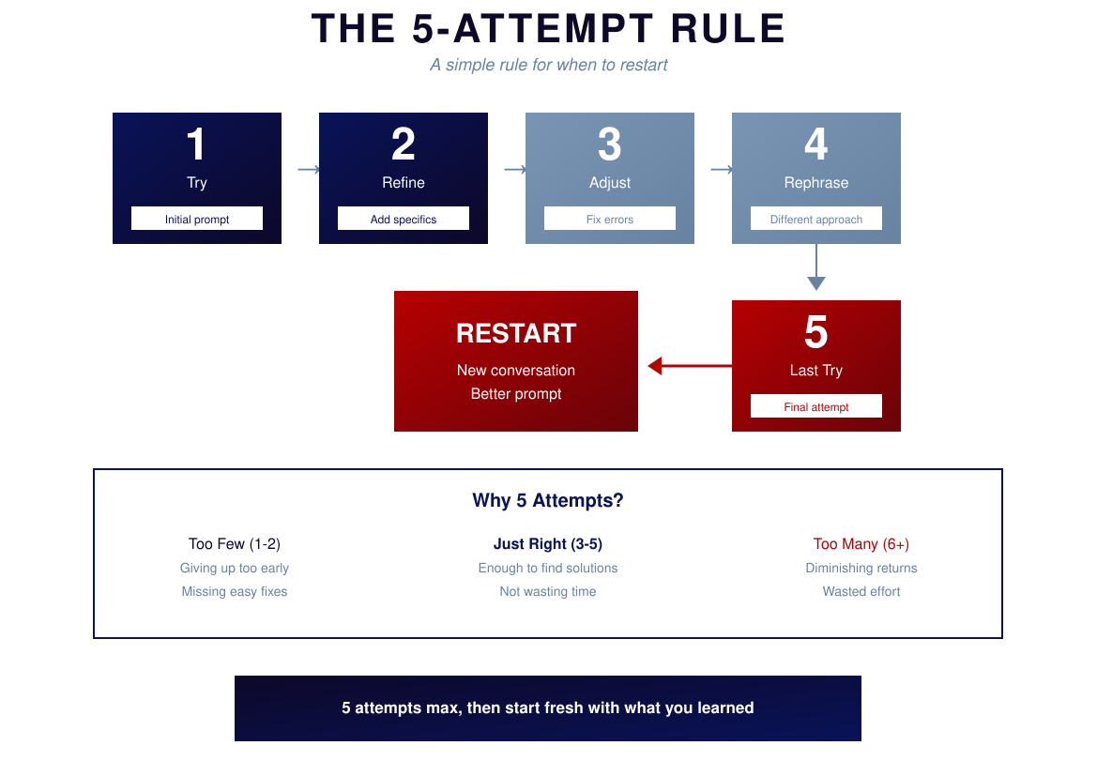
Notes:
THE 5-ATTEMPT RULE
Simple rule: Five attempts maximum, then restart.
Attempt 1: TRY — Initial prompt
Attempt 2: REFINE — Add specifics
Attempt 3: ADJUST — Fix errors
Attempt 4: REPHRASE — Different approach
Attempt 5: LAST TRY — Everything you've learned
Still not there? RESTART with a new conversation and better prompt.
Too few (1-2): Giving up too early
Just right (3-5): Enough to find solutions
Too many (6+): Diminishing returns, going in circles

Slide 18
PART 3
PROBLEMS

Slide 19
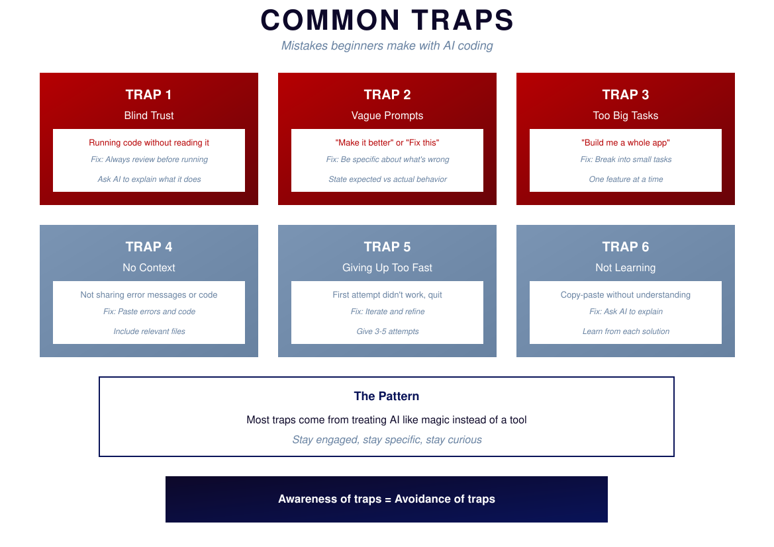
Notes:
COMMON TRAPS
TRAP 1: BLIND TRUST — Running code without reading it
Fix: Always review before running
TRAP 2: VAGUE PROMPTS — "Make it better"
Fix: Be specific about what's wrong
TRAP 3: TOO BIG TASKS — "Build me a whole app"
Fix: Break into small tasks
TRAP 4: NO CONTEXT — Not sharing errors or code
Fix: Paste errors, include code
TRAP 5: GIVING UP TOO FAST — First attempt didn't work
Fix: Give 3-5 attempts
TRAP 6: NOT LEARNING — Copy-paste without understanding
Fix: Ask AI to explain
Most traps come from treating AI like magic instead of a tool.

Slide 20
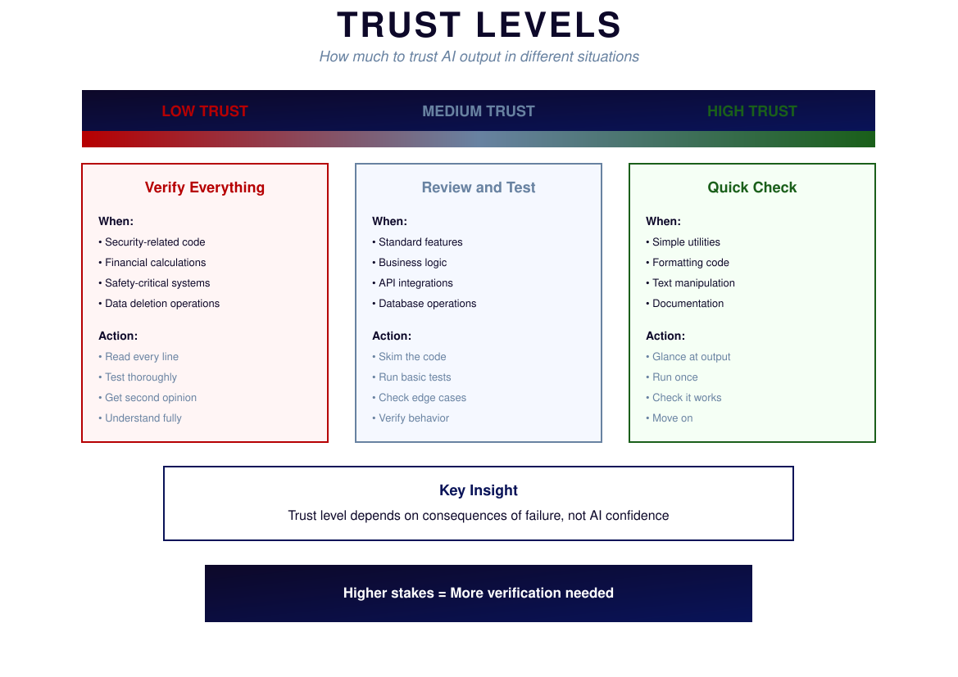
Notes:
TRUST LEVELS
How much to trust AI output depends on consequences of failure.
LOW TRUST — Verify Everything
When: Security code, financial calculations, safety-critical, data deletion
Action: Read every line, test thoroughly, get second opinion
MEDIUM TRUST — Review and Test
When: Standard features, business logic, API integrations
Action: Skim code, run basic tests, check edge cases
HIGH TRUST — Quick Check
When: Simple utilities, formatting, text manipulation
Action: Glance at output, run once, move on
Trust level depends on consequences, not AI confidence.
Higher stakes = More verification needed

Slide 21
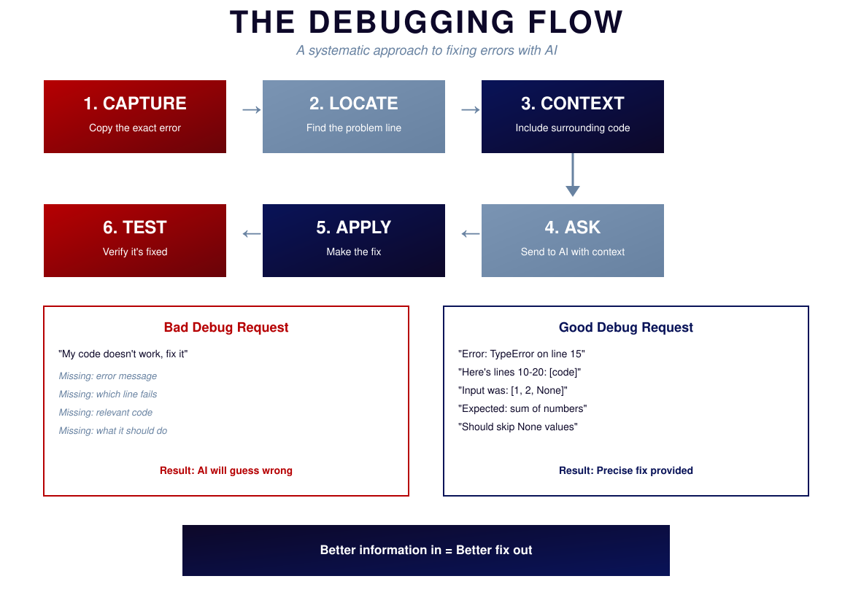
Notes:
THE DEBUGGING FLOW
1. CAPTURE — Copy the exact error message
2. LOCATE — Find the problem line
3. CONTEXT — Include surrounding code
4. ASK — Send to AI with all context
5. APPLY — Make the fix
6. TEST — Verify it's fixed
BAD: "My code doesn't work, fix it"
GOOD: "Error: TypeError on line 15. Here's lines 10-20. Input was [1, 2, None]. Should skip None values."
Better information in = Better fix out

Slide 22
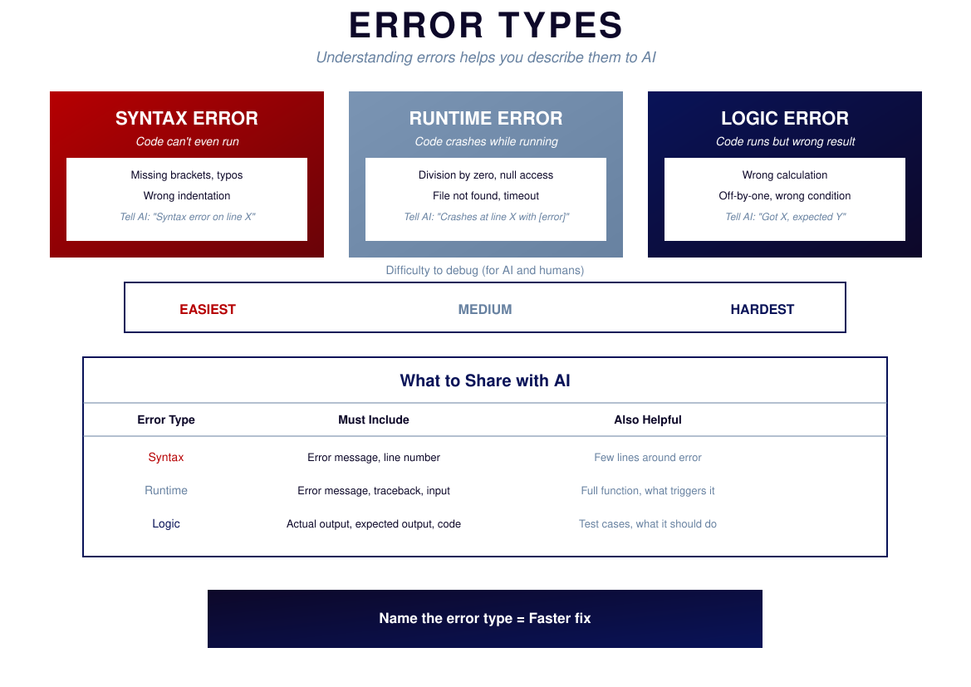
Notes:
ERROR TYPES
SYNTAX ERROR — Code can't even run
Examples: Missing brackets, typos, wrong indentation
Tell AI: "Syntax error on line X"
Easiest to fix
RUNTIME ERROR — Code crashes while running
Examples: Division by zero, null access, file not found
Tell AI: "Crashes at line X with [error]"
Medium difficulty
LOGIC ERROR — Code runs but wrong result
Examples: Wrong calculation, off-by-one, wrong condition
Tell AI: "Got X, expected Y"
Hardest to fix
Name the error type = Faster fix

Slide 23
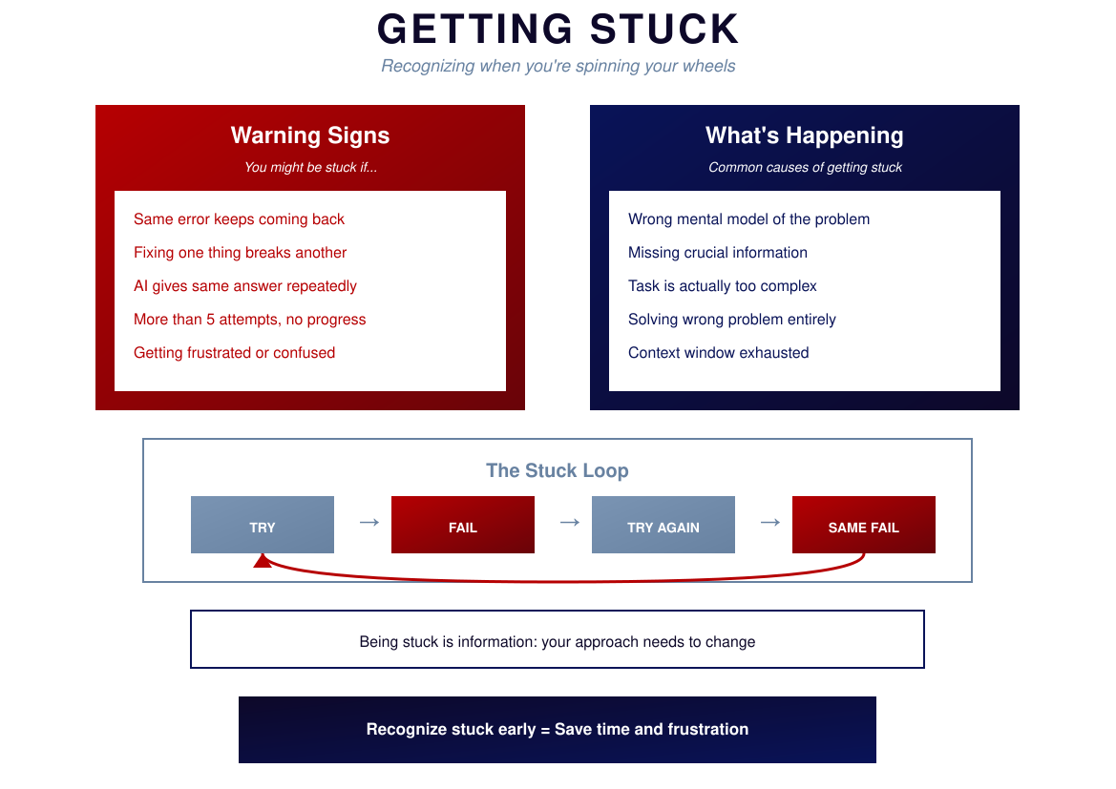
Notes:
GETTING STUCK
Warning signs:
- Same error keeps coming back
- Fixing one thing breaks another
- AI gives same answer repeatedly
- More than 5 attempts without progress
- Getting frustrated
What's happening:
- Wrong mental model of the problem
- Missing crucial information
- Task is too complex
- Solving wrong problem entirely
The stuck loop: TRY → FAIL → TRY AGAIN → SAME FAIL → repeat
Being stuck is information: your approach needs to change.

Slide 24
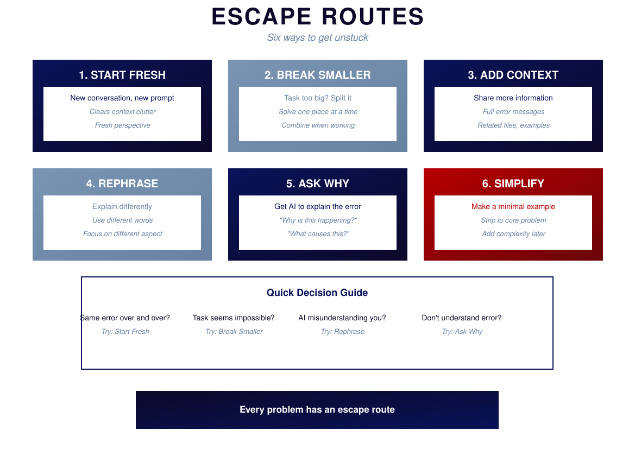
Notes:
ESCAPE ROUTES
1. START FRESH — New conversation, new prompt
Use when: Same error repeating
2. BREAK SMALLER — Split the task
Use when: Task seems impossible
3. ADD CONTEXT — Share more information
Use when: AI seems confused
4. REPHRASE — Different words, different angle
Use when: AI misunderstanding you
5. ASK WHY — Get AI to explain the error
Use when: You don't understand
6. SIMPLIFY — Make a minimal example
Use when: Too many things could be wrong
Every problem has an escape route.

Slide 25
PART 4
BUILDING

Slide 26
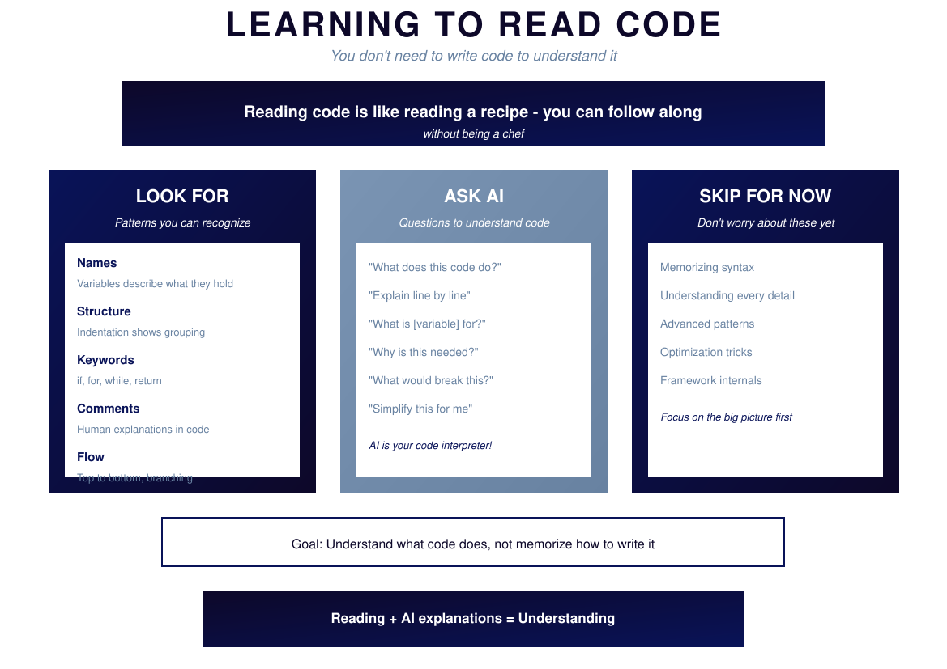
Notes:
LEARNING TO READ CODE
You don't need to write code to understand it.
LOOK FOR:
- Names: Variables describe what they hold
- Structure: Indentation shows grouping
- Keywords: if, for, while, return
- Comments: Human explanations
- Flow: Top to bottom, branching
ASK AI:
- "What does this code do?"
- "Explain line by line"
- "What is [variable] for?"
- "Why is this needed?"
SKIP FOR NOW:
- Memorizing syntax
- Understanding every detail
- Advanced patterns
Goal: Understand what code does, not memorize how to write it.

Slide 27
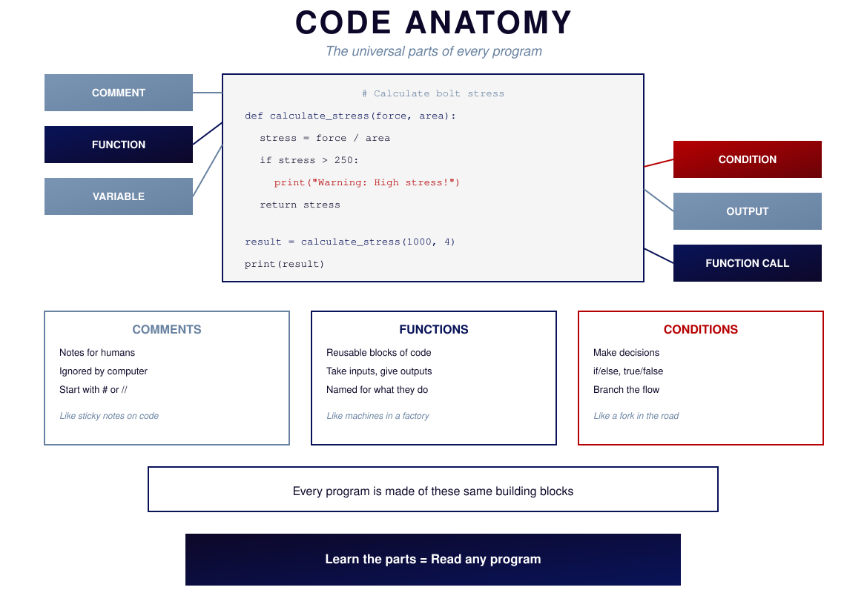
Notes:
CODE ANATOMY
Universal parts of every program:
COMMENT — Notes for humans, ignored by computer
Like sticky notes on code
FUNCTION — Reusable blocks of code
Take inputs, give outputs
Like machines in a factory
VARIABLE — Named containers for data
The name tells you what's inside
CONDITION — Makes decisions
if/else, true/false
Like a fork in the road
OUTPUT — Shows results to user
Makes the invisible visible
Every program is made of these building blocks.

Slide 28
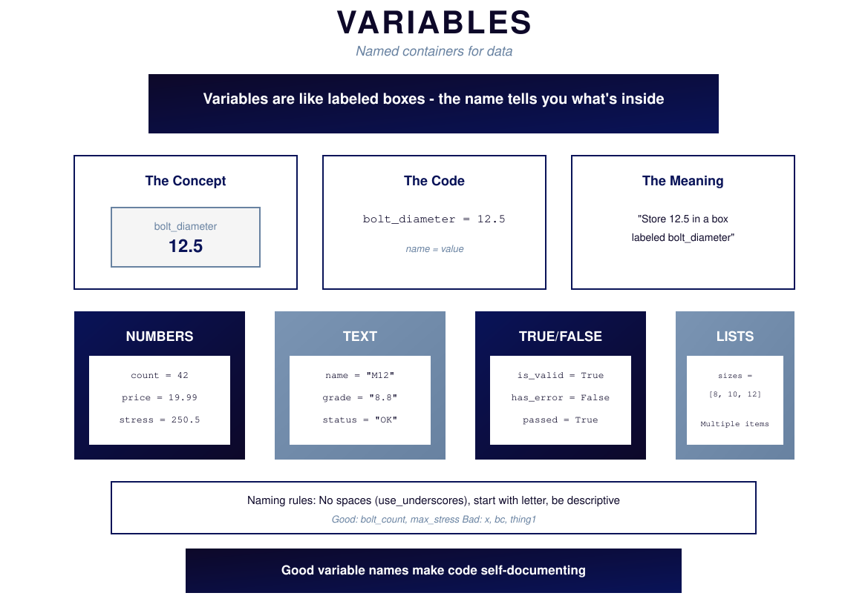
Notes:
VARIABLES
Variables are named containers for data. Like labeled boxes.
bolt_diameter = 12.5
Creates a box labeled "bolt_diameter" with 12.5 inside.
Types:
- NUMBERS: count = 42, price = 19.99
- TEXT: name = "M12", status = "OK"
- TRUE/FALSE: is_valid = True
- LISTS: sizes = [8, 10, 12]
Naming rules:
- No spaces (use underscores)
- Start with letter
- Be descriptive
Good: bolt_count, max_stress
Bad: x, bc, thing1
Good variable names make code self-documenting.

Slide 29
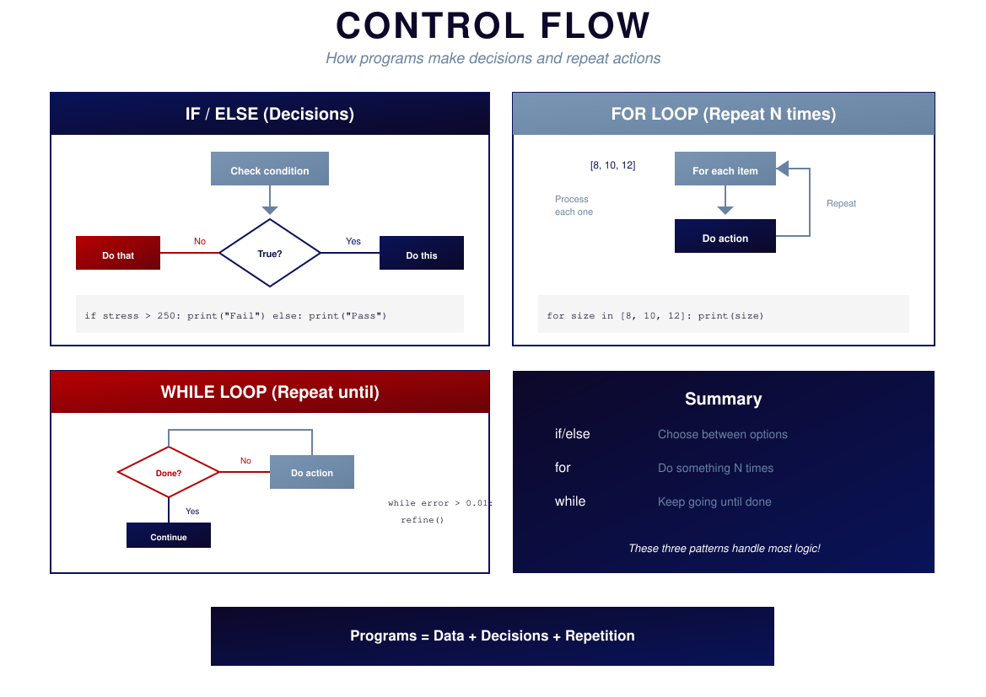
Notes:
CONTROL FLOW
Three patterns handle most logic:
IF/ELSE — Decisions
if stress > 250:
print("Fail")
else:
print("Pass")
FOR LOOP — Repeat N times
for size in [8, 10, 12]:
print(size)
WHILE LOOP — Repeat until done
while error > 0.01:
refine()
Summary:
- if/else: Choose between options
- for: Do something N times
- while: Keep going until done
Programs = Data + Decisions + Repetition

Slide 30
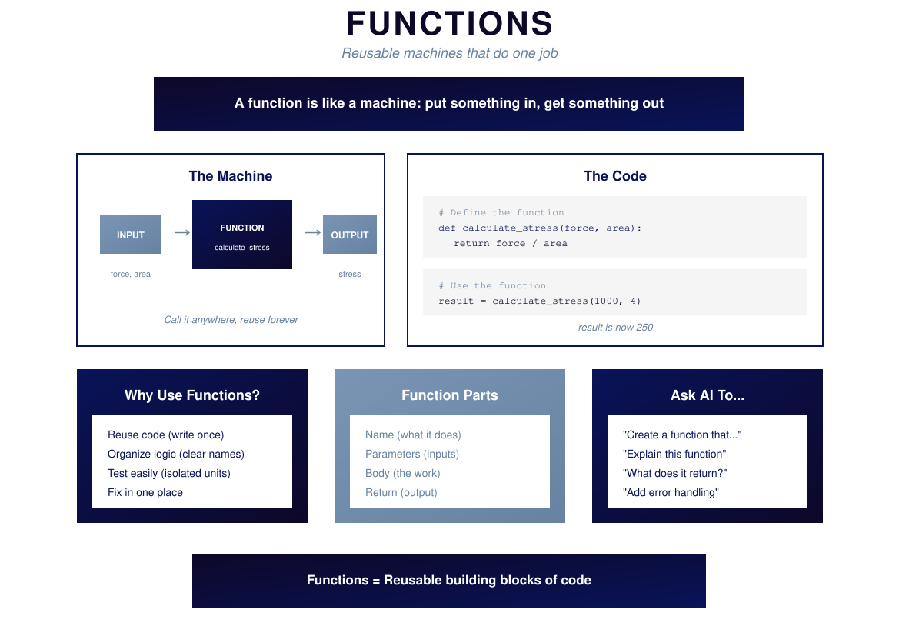
Notes:
FUNCTIONS
A function is like a machine: put something in, get something out.
def calculate_stress(force, area):
return force / area
result = calculate_stress(1000, 4)
# result is now 250
Parts:
- Name: what it does
- Parameters: inputs
- Body: the work
- Return: output
Why use functions:
- Reuse code (write once)
- Organize logic (clear names)
- Test easily (isolated units)
- Fix in one place
Functions = Reusable building blocks

Slide 31
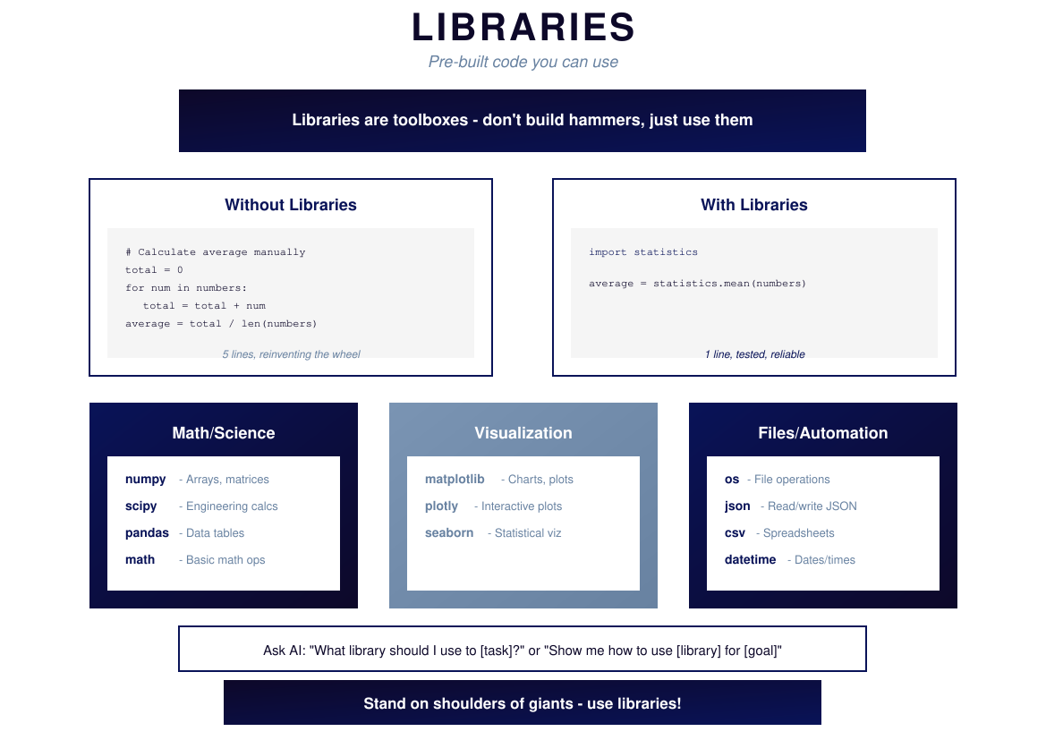
Notes:
LIBRARIES
Libraries are pre-built code. Don't reinvent the wheel.
WITHOUT: 5 lines to calculate average manually
WITH: 1 line using statistics.mean()
Useful libraries:
Math/Science: numpy, scipy, pandas, math
Visualization: matplotlib, plotly, seaborn
Files: os, json, csv, datetime
Ask AI: "What library should I use to [task]?"
Stand on shoulders of giants — use libraries!

Slide 32
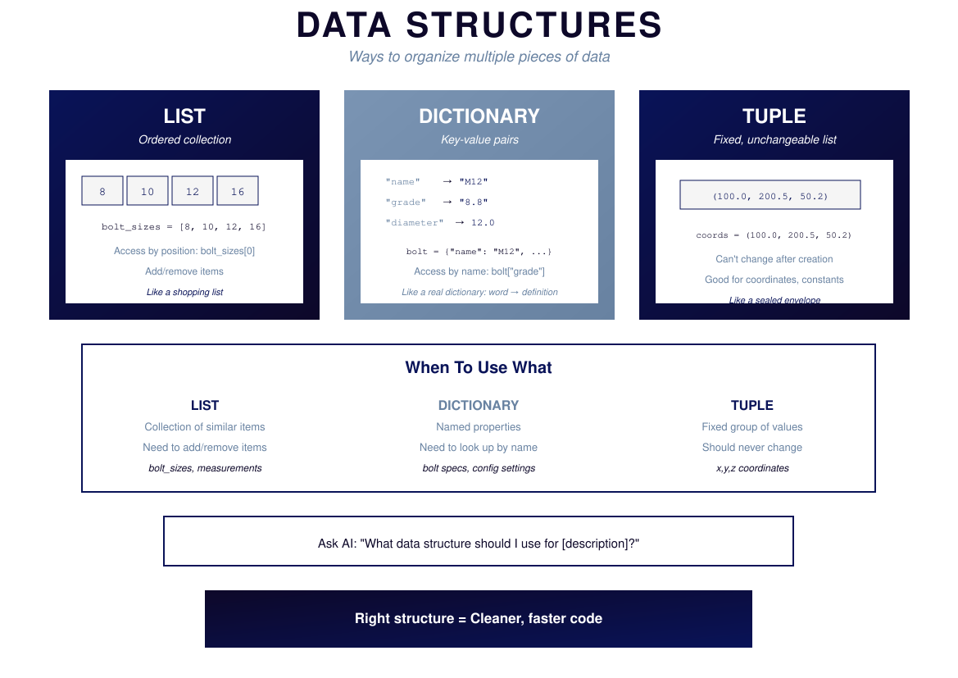
Notes:
DATA STRUCTURES
LIST — Ordered collection
bolt_sizes = [8, 10, 12]
Access by position: bolt_sizes[0]
Like a shopping list
DICTIONARY — Key-value pairs
bolt = {"name": "M12", "grade": "8.8"}
Access by name: bolt["grade"]
Like a real dictionary
TUPLE — Fixed, unchangeable
coords = (100.0, 200.5)
Can't change after creation
Like a sealed envelope
Use LIST for collections that change
Use DICT for named properties
Use TUPLE for fixed values
Right structure = Cleaner code

Slide 33
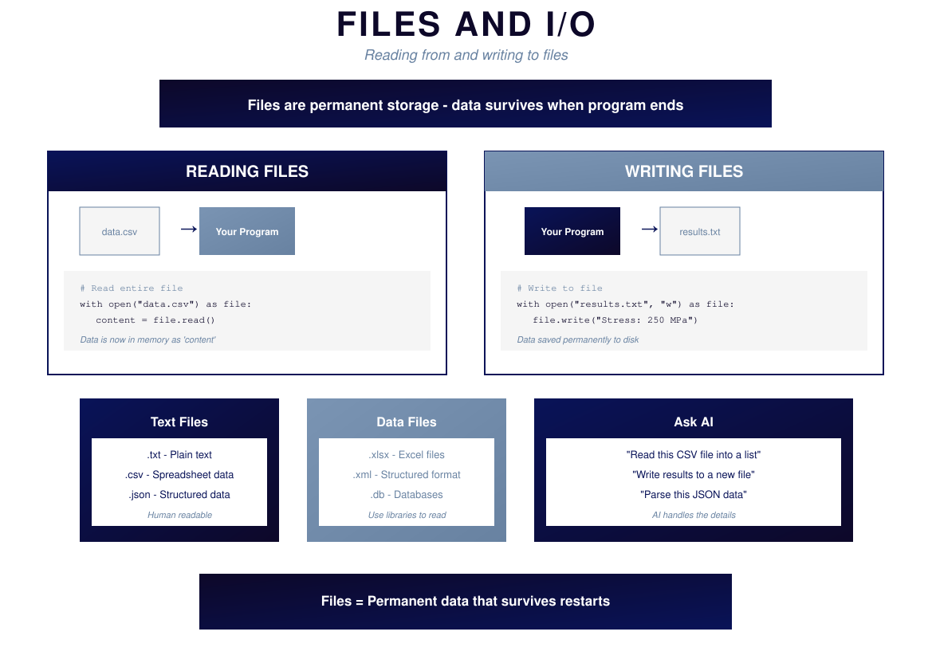
Notes:
FILES AND I/O
Files are permanent storage. Data survives when program ends.
READING:
with open("data.csv") as file:
content = file.read()
WRITING:
with open("results.txt", "w") as file:
file.write("Stress: 250 MPa")
File types:
- .txt, .csv, .json — Human readable
- .xlsx, .xml, .db — Use libraries
Ask AI: "Read this CSV into a list" or "Write results to file"
Files = Permanent data that survives restarts

Slide 34
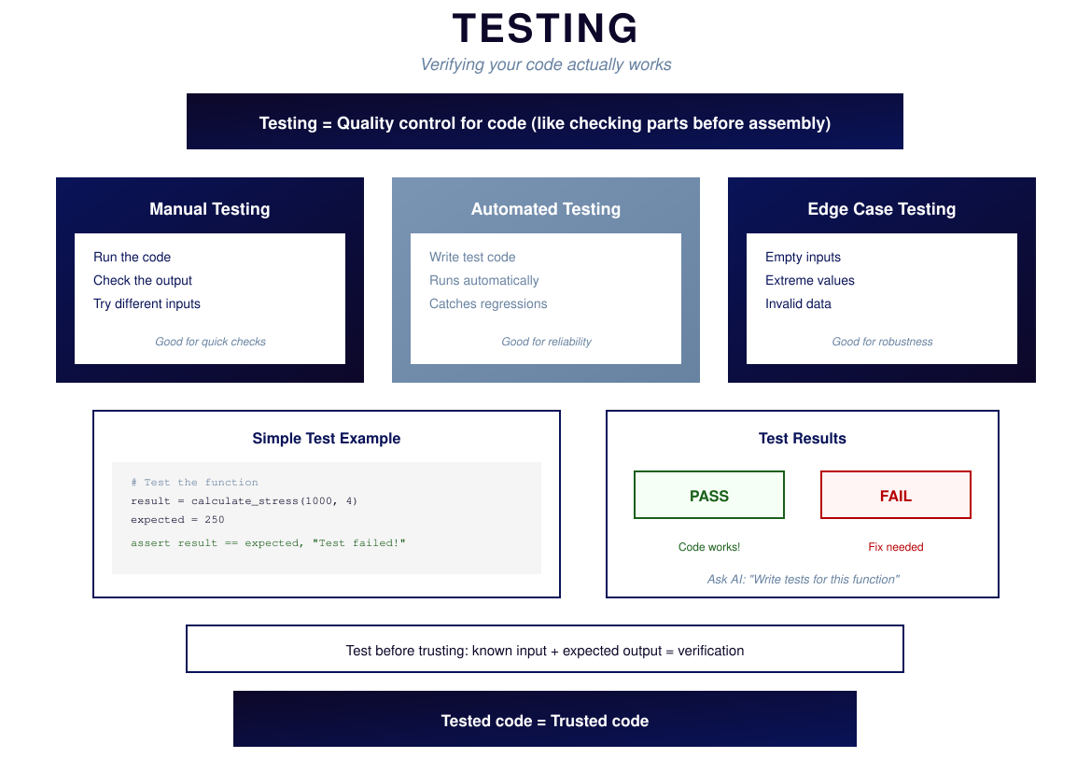
Notes:
TESTING
Testing is quality control for code.
Types:
- Manual: Run, check output, try different inputs
- Automated: Write test code, runs automatically
- Edge cases: Empty inputs, extreme values
Simple test:
result = calculate_stress(1000, 4)
expected = 250
assert result == expected
PASS = Code works
FAIL = Fix needed
Ask AI: "Write tests for this function"
Tested code = Trusted code

Slide 35
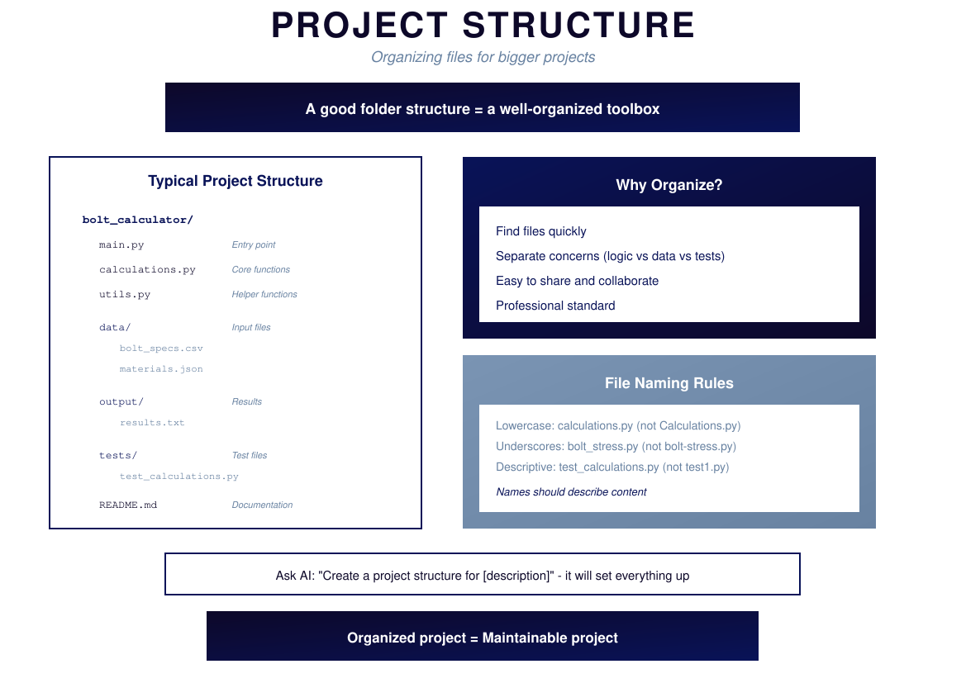
Notes:
PROJECT STRUCTURE
Typical structure:
bolt_calculator/
main.py # Entry point
calculations.py # Core functions
utils.py # Helpers
data/ # Input files
output/ # Results
tests/ # Test files
README.md # Documentation
Why organize:
- Find files quickly
- Separate concerns
- Easy to share
- Professional standard
File naming: lowercase, underscores, descriptive
Ask AI: "Create project structure for [description]"
Organized project = Maintainable project

Slide 36
PART 5
APPLICATION

Slide 37
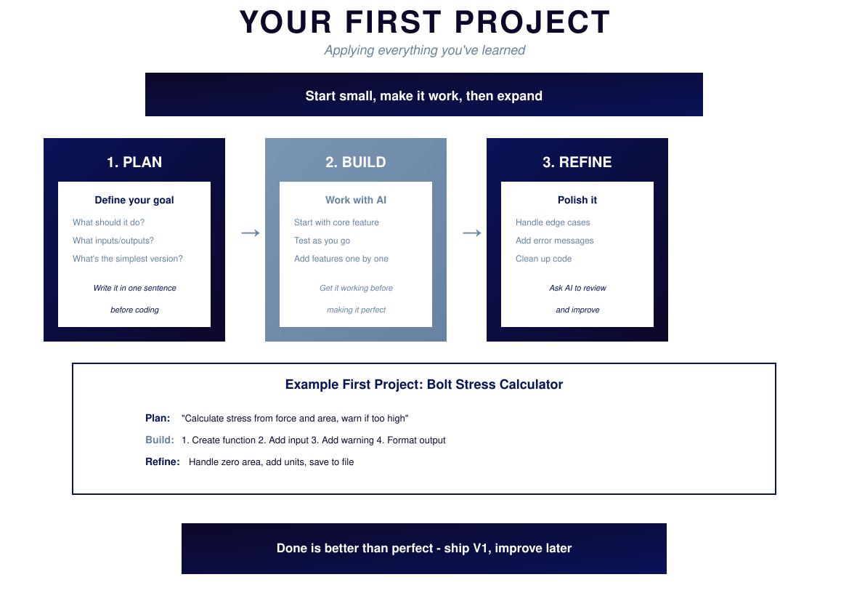
Notes:
YOUR FIRST PROJECT
Start small, make it work, then expand.
Phase 1: PLAN
Define goal, inputs/outputs, simplest version
Write it in one sentence before coding
Phase 2: BUILD
Start with core feature, test as you go, add features one by one
Get it working before making it perfect
Phase 3: REFINE
Handle edge cases, add error messages, clean up
Ask AI to review
Example: Bolt Stress Calculator
Plan: "Calculate stress from force and area, warn if too high"
Build: Create function, add input, add warning, format output
Refine: Handle zero area, add units, save to file
Done is better than perfect — ship V1, improve later

Slide 38
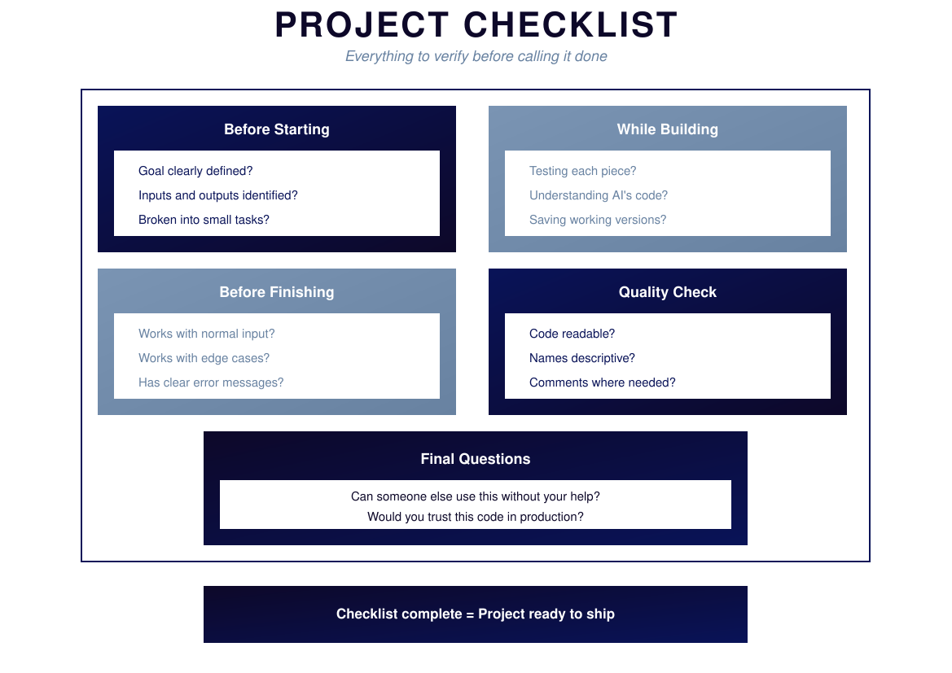
Notes:
PROJECT CHECKLIST
Before Starting:
□ Goal clearly defined?
□ Inputs and outputs identified?
□ Broken into small tasks?
While Building:
□ Testing each piece?
□ Understanding AI's code?
□ Saving working versions?
Before Finishing:
□ Works with normal input?
□ Works with edge cases?
□ Has clear error messages?
Quality Check:
□ Code readable?
□ Names descriptive?
□ Comments where needed?
Final Questions:
- Can someone else use this without help?
- Would you trust this in production?
Checklist complete = Ready to ship

Slide 39
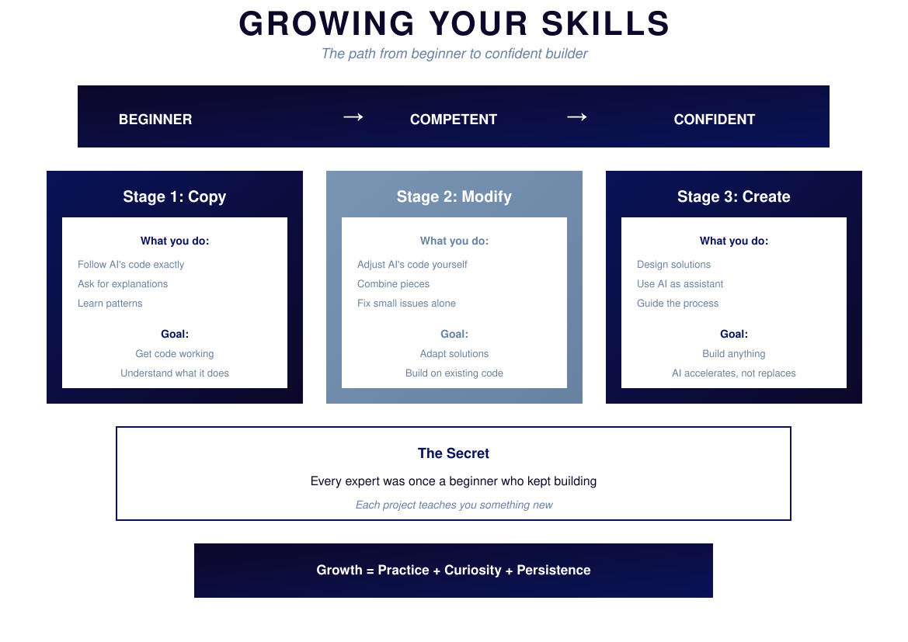
Notes:
GROWING YOUR SKILLS
Stage 1: COPY
Follow AI's code exactly, ask for explanations, learn patterns
Goal: Get code working, understand what it does
Stage 2: MODIFY
Adjust AI's code yourself, combine pieces, fix small issues
Goal: Adapt solutions, build on existing code
Stage 3: CREATE
Design solutions, use AI as assistant, guide the process
Goal: Build anything, AI accelerates but doesn't replace you
The secret: Every expert was once a beginner who kept building.
Growth = Practice + Curiosity + Persistence

Slide 40
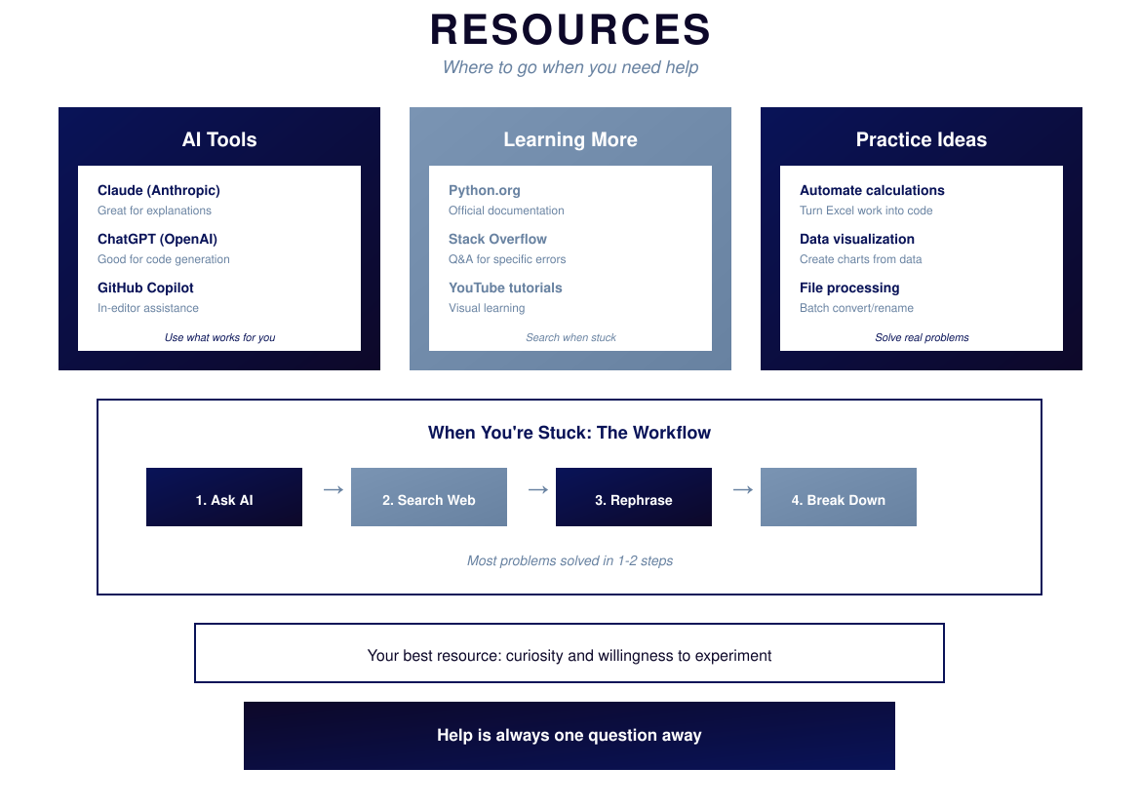
Notes:
RESOURCES
AI Tools:
- Claude — Great for explanations
- ChatGPT — Good for code generation
- GitHub Copilot — In-editor assistance
Learning More:
- Python.org — Documentation
- Stack Overflow — Q&A for errors
- YouTube — Visual learning
Practice Ideas:
- Automate calculations
- Data visualization
- File processing
When Stuck:
1. Ask AI → 2. Search Web → 3. Rephrase → 4. Break Down
Most problems solved in 1-2 steps.
Help is always one question away.

Slide 41
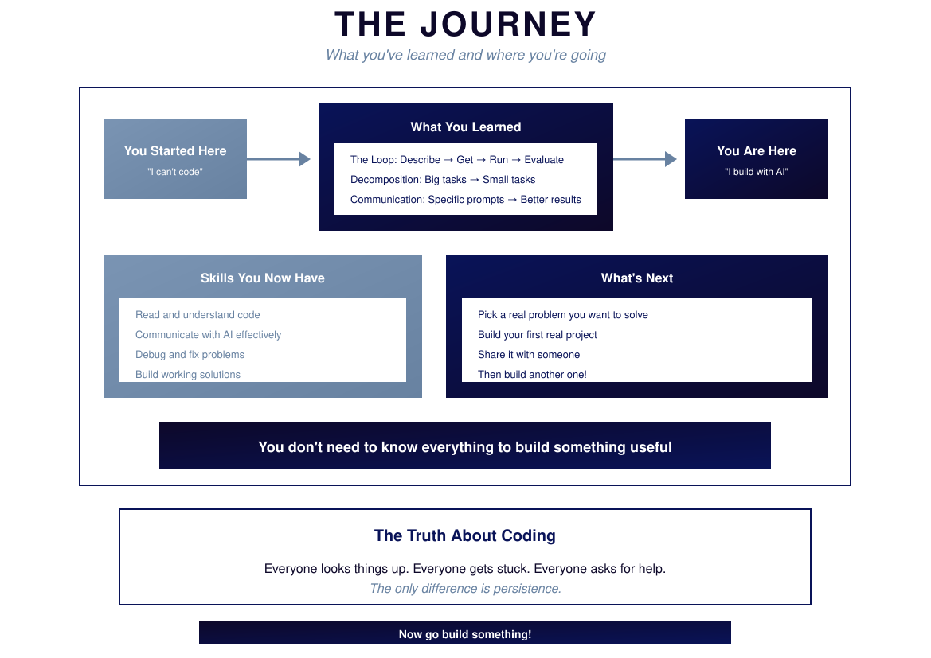
Notes:
THE JOURNEY
You started: "I can't code"
You learned:
- The Loop: Describe → Get → Run → Evaluate
- Decomposition: Big → Small tasks
- Communication: Specific prompts → Better results
You are now: "I build with AI"
Skills you have:
- Read and understand code
- Communicate with AI effectively
- Debug and fix problems
- Build working solutions
What's next:
- Pick a real problem
- Build your first project
- Share it with someone
- Build another one!
The truth: Everyone looks things up. Everyone gets stuck. Everyone asks for help.
The only difference is persistence.

Slide 42
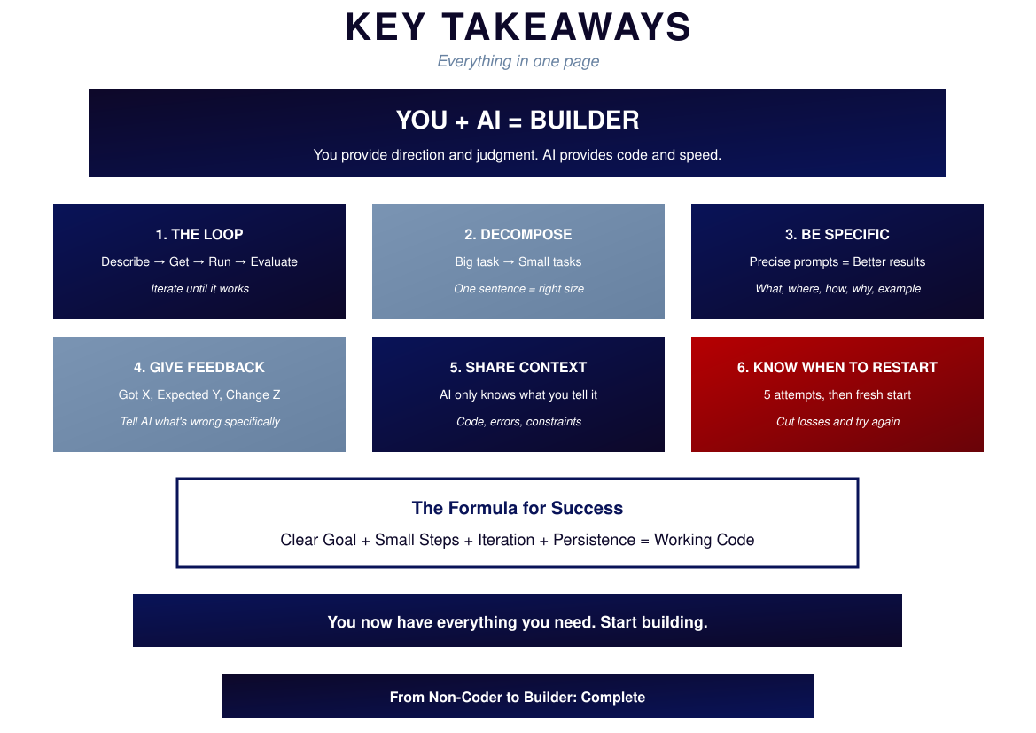
Notes:
KEY TAKEAWAYS
YOU + AI = BUILDER
Six Principles:
1. THE LOOP — Iterate until it works
2. DECOMPOSE — One sentence = right size
3. BE SPECIFIC — What, where, how, why, example
4. GIVE FEEDBACK — Got X, Expected Y, Change Z
5. SHARE CONTEXT — AI only knows what you tell it
6. KNOW WHEN TO RESTART — 5 attempts then fresh start
The Formula:
Clear Goal + Small Steps + Iteration + Persistence = Working Code
You now have everything you need.
Start building.

Slide 43
Now Go Build Something!
You have everything you need.

