Slide 1

Dipping toes in mixed effects modelling in R
Won Lee
R seminar Day 2
January 16, 2020

Slide 2

Resources
https://peerj.com/articles/4794/
https://ourcodingclub.github.io/2017/03/15/mixed-models.html
https://web.stanford.edu/class/psych252/section/Mixed_models_tutorial.html
https://ase.tufts.edu/gsc/gradresources/guidetomixedmodelsinr/mixed%20model%20guide.html

Slide 3

Heads up
What I am going to show you…
- why we want to use mixed effects model
- lmer and lmerTest packages in R
- Linear mixed effects model (LMM): exemplar data
- tip of the iceberg
What I am NOT going to show you…
- mathematical background, formula
- Generalized mixed effects model (GLMM)
- the rest of the iceberg
But I’ll show you where to find out more about it!

Slide 4
What is mixed effects model?
sometimes called “multilevel models” or “hierarchical models”, depending on the context
a fixed effect factor if data has been collected from all levels of interest (e.g., gender – female, male; treatment – stressed, no stress)
a random effect factor if the variable has a bunch of possible levels but you only sample a random collection (e.g., subjects, classrooms) and you generally won’t care about them, with the goal of generalizing to the broader population (e.g., all people, all scenarios, all classrooms
https://web.stanford.edu/class/psych252/section/Mixed_models_tutorial.html

Slide 5
Andrew Gelman “Here are the five definitions I’ve seen”
(1) Fixed effects are constant across individuals, and random effects vary. For example, in a growth study, a model with random intercepts a_i and fixed slope b corresponds to parallel lines for different individuals i, or the model y_it = a_i + b t. Kreft and De Leeuw (1998) thus distinguish between fixed and random coefficients.
(2) Effects are fixed if they are interesting in themselves or random if there is interest in the underlying population. Searle, Casella, and McCulloch (1992, Section 1.4) explore this distinction in depth.
(3) “When a sample exhausts the population, the corresponding variable is fixed; when the sample is a small (i.e., negligible) part of the population the corresponding variable is random.” (Green and Tukey, 1960)
(4) “If an effect is assumed to be a realized value of a random variable, it is called a random effect.” (LaMotte, 1983)
(5) Fixed effects are estimated using least squares (or, more generally, maximum likelihood) and random effects are estimated with shrinkage (“linear unbiased prediction” in the terminology of Robinson, 1991). This definition is standard in the multilevel modeling literature (see, for example, Snijders and Bosker, 1999, Section 4.2) and in econometrics.

Slide 6


Why do we want to use mixed effects model?
We want to give the statistical models more information, directing the model to properly do what it’s supposed to do
A statistical model will be a mathematical structure used to imitate, and approximate, the data generating process.
Quantify uncertainty
Inference
Measure support for hypotheses
Prediction

Slide 7
Why do we want to use mixed effects model?
Linear regression assumes each data point is independent from each other
BUT!
Biological data are often highly structured
within-individual, repeated measurements: multiple responses from the same subject cannot be regarded as independent from each other
(G)LMM can model non-independence in biological datasets
Reduces the probability of false positives (Type 1 error) and false negatives (Type 2 error)
Improved parameter estimation accuracy
Harrison et al. (2018), PeerJ, DOI 10.7717/peerj.4794

Slide 8






Examples

Slide 9
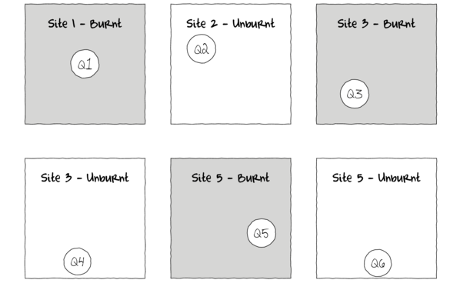
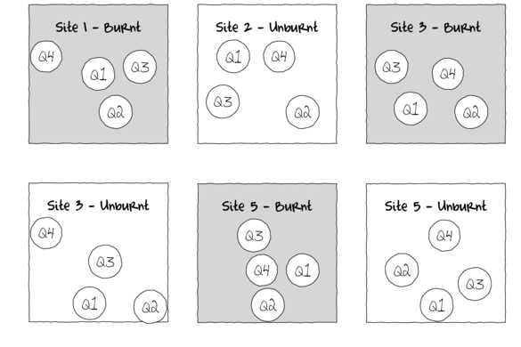
Examples
http://www.flutterbys.com.au/stats/tut/tut9.1.html

Slide 10
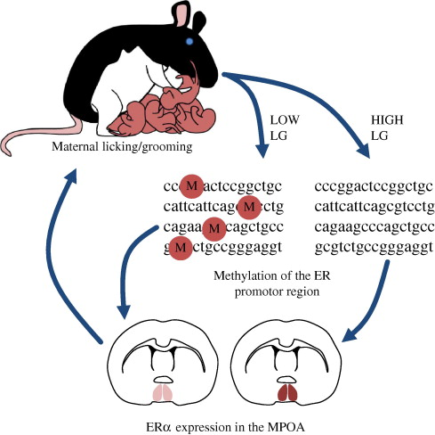
Examples
Champagne (2008). Frontiers in Neuroendocrinology

Slide 11
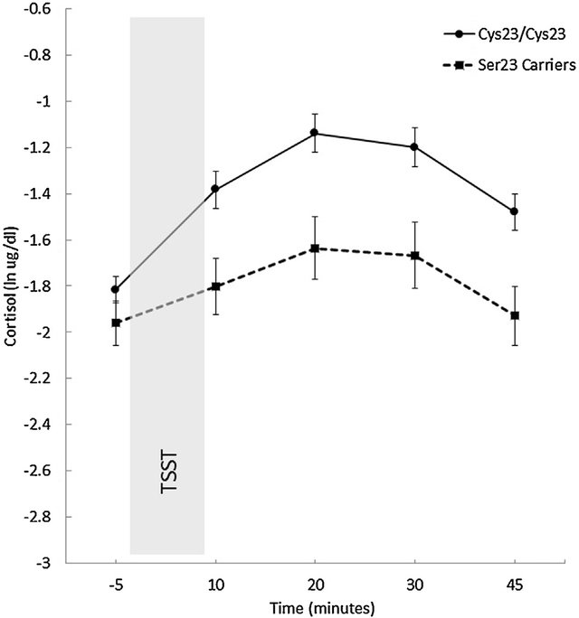
Examples
Way et al., (2016). Psychoneuroendocrinology

Slide 12
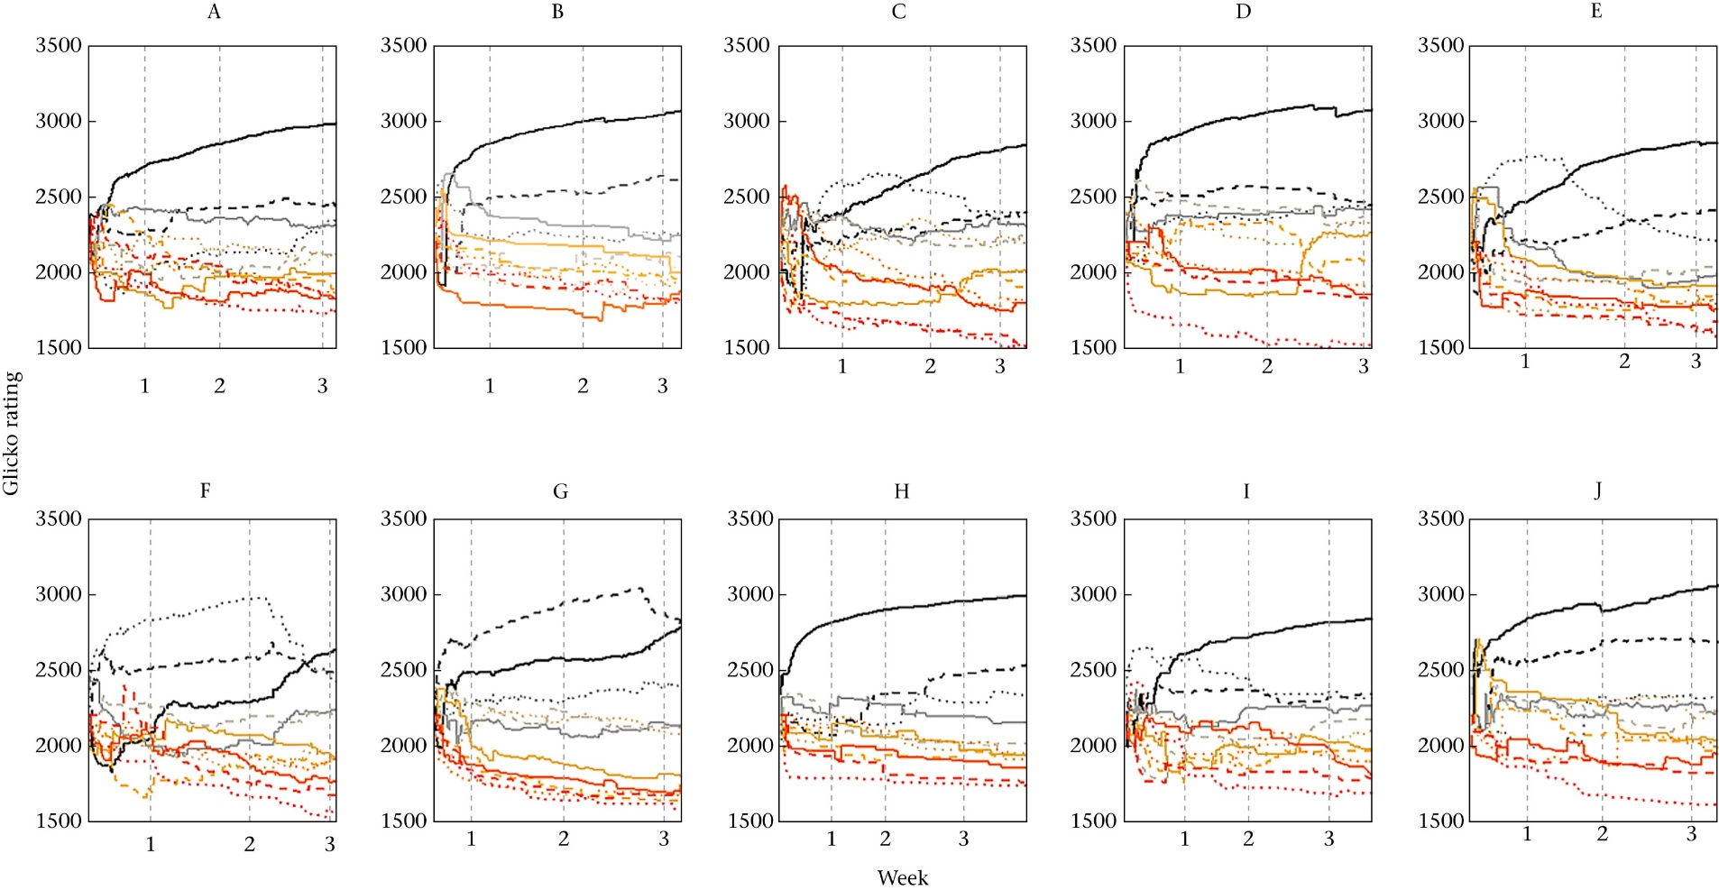
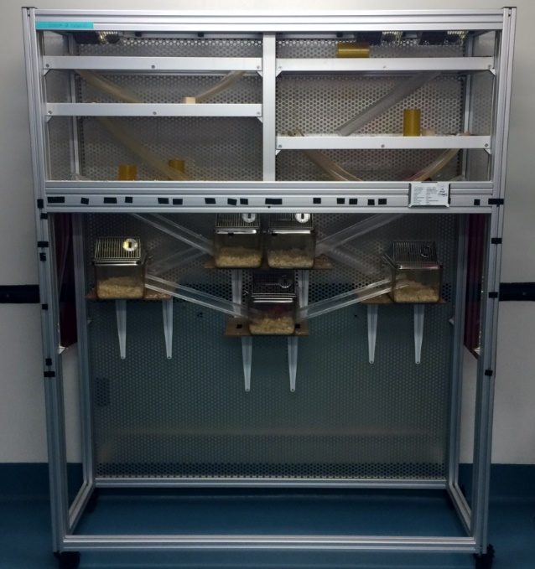
Why I (had to) use mixed effects model
Group ID as a random factor
Group, batch effects:

Slide 13
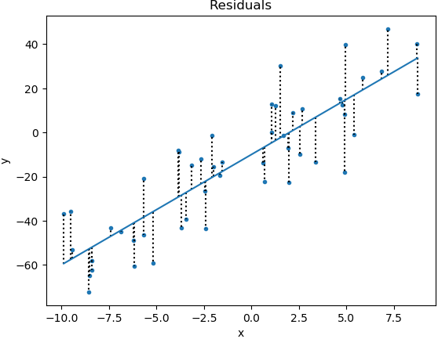
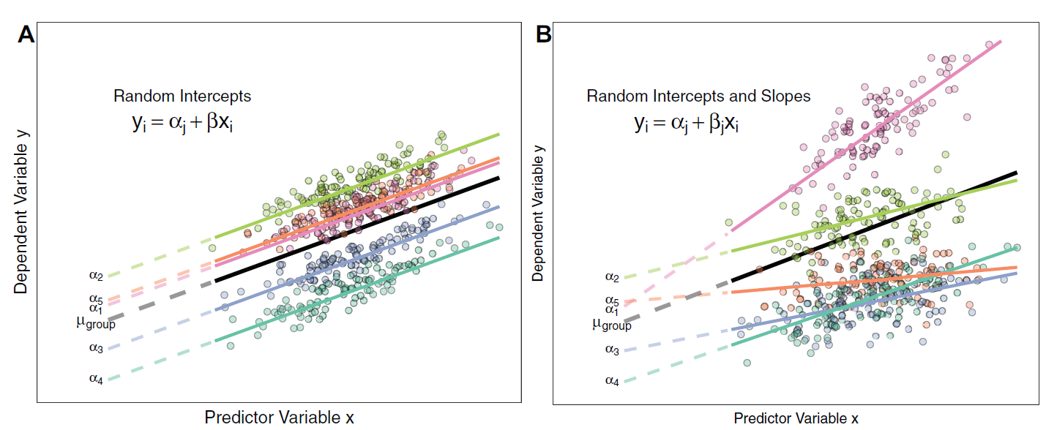
Back to, what is the mixed effects model?
Harrison et al. (2018), PeerJ, DOI 10.7717/peerj.4794

Slide 14
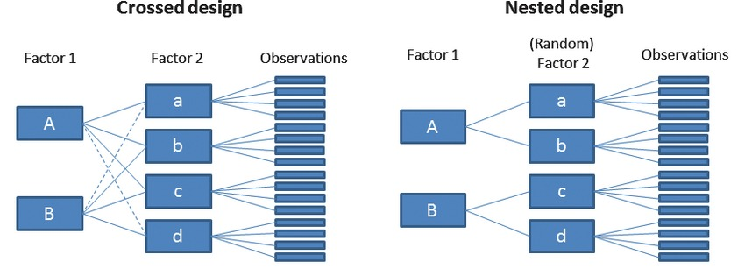
Crossed or Nested
(Schielzeth & Nakagawa, 2013; Fig. 1)
Notes:
https://www.theanalysisfactor.com/multilevel-models-with-crossed-random-effects/

Slide 15
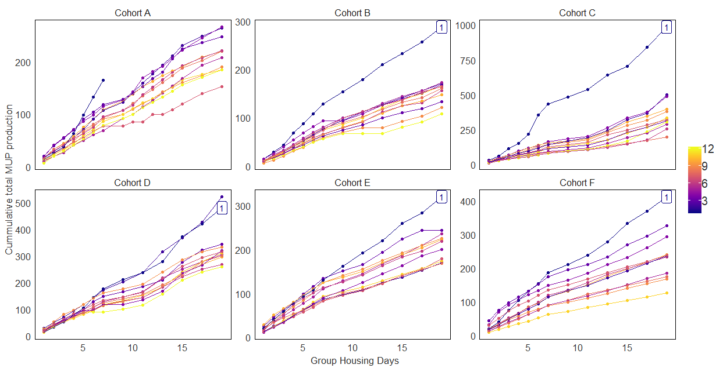
Why I (had to) use mixed effects model
Repeated, within-individual measures:
Group ID & mouse ID as random factors
X 6 groups
Cumulative MUP production
Social rank
Subordinate
Dominant
Group housing day

Slide 16

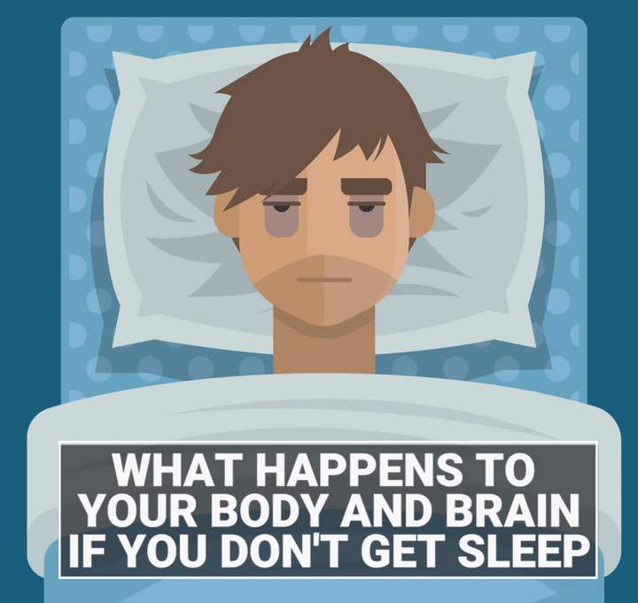
Let’s actually do this in R
R notebook

Slide 17
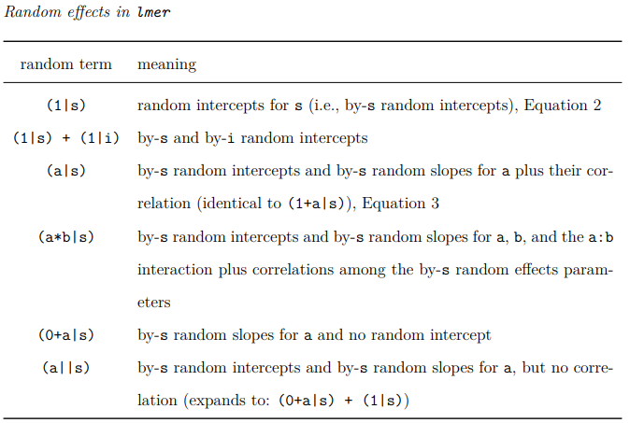
There’s more in case you need it
https://cran.r-project.org/web/packages/afex/vignettes/introduction-mixed-models.pdf

Slide 18
Generalized Linear Mixed Effects (GLMM) modelling
https://bbolker.github.io/mixedmodels-misc/ecostats_chap.html
Notes:
https://bbolker.github.io/mixedmodels-misc/ecostats_chap.html
https://www.rdocumentation.org/packages/lme4/versions/1.1-21/topics/glmer

Slide 19
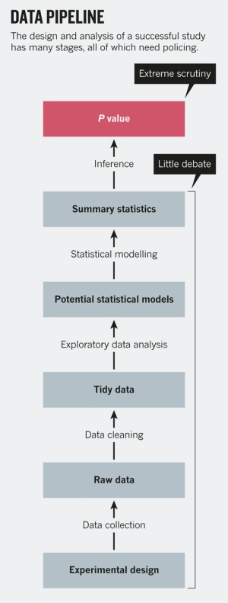
Take home messages
Know your data
- What should be fixed effects and random effects?
Discuss which variable should be fixed/random effects → Lab meeting, UT stat consulting, Google (Scholar)
Find published studies with similar experimental designs
Visualize, visualize, visualize!
- Come up with multiple ideas to look at your data in different angles
Interpret it properly - Is your mixed effects model built properly?
- Check assumptions in regression
https://www.nature.com/news/statistics-p-values-are-just-the-tip-of-the-iceberg-1.17412

