Slide 1
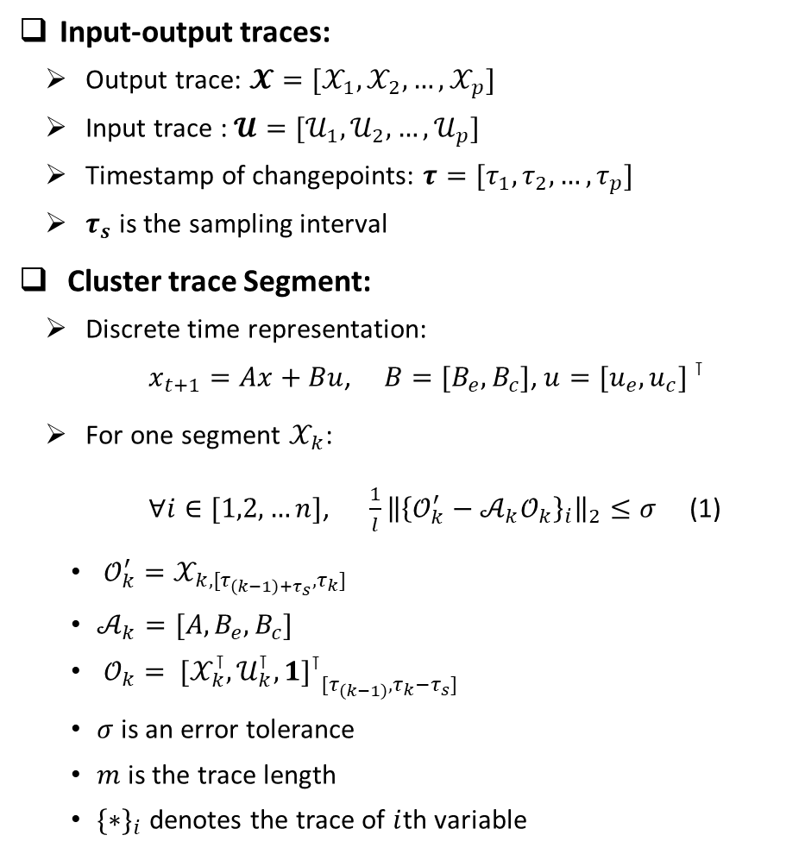
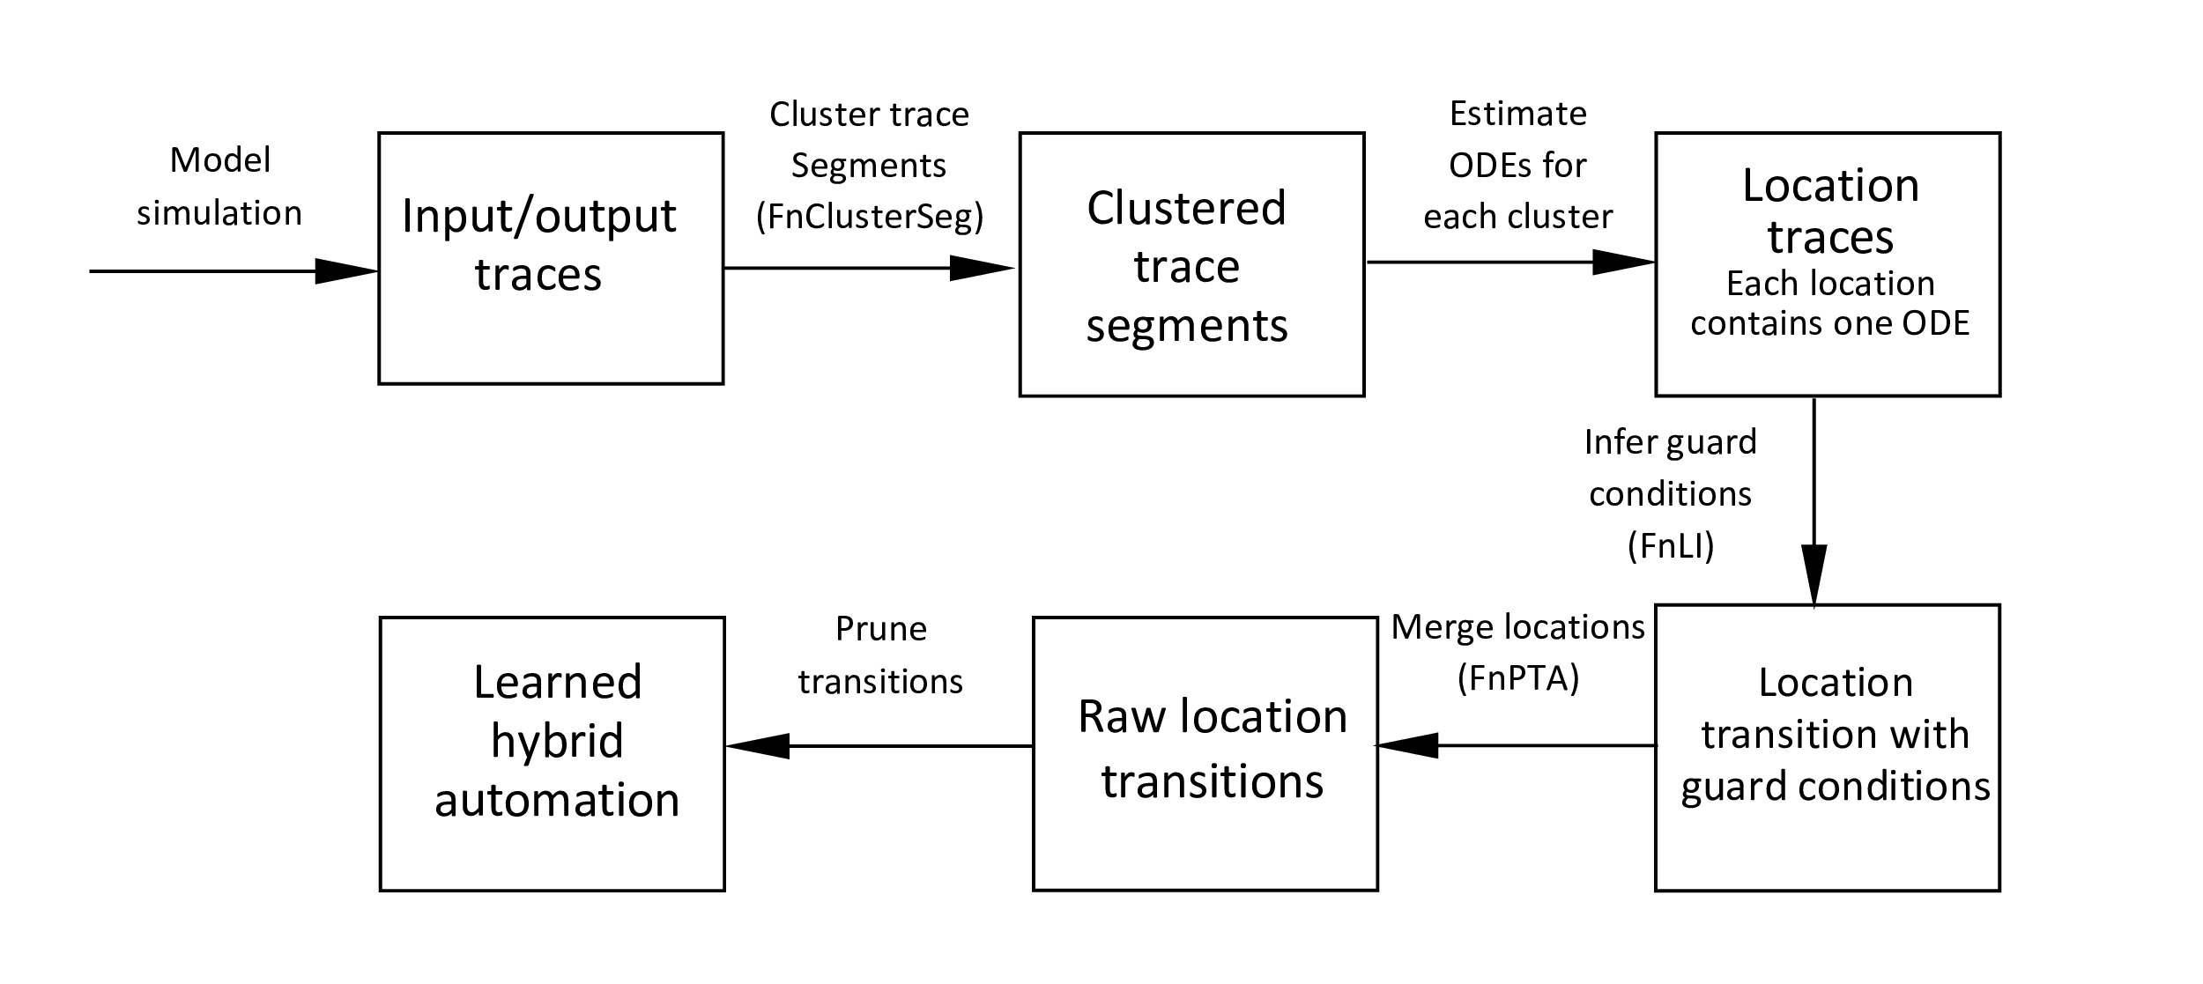











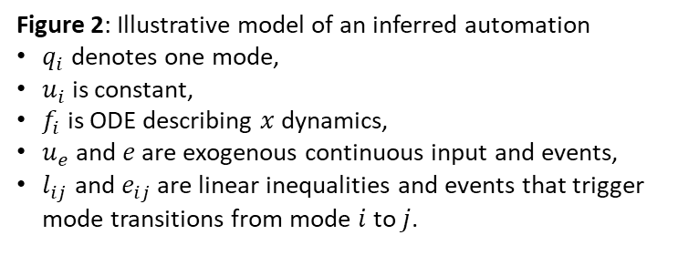
Hybrid System Identification from Input-Output Traces
Figure 1: Overview of the framework

Slide 2
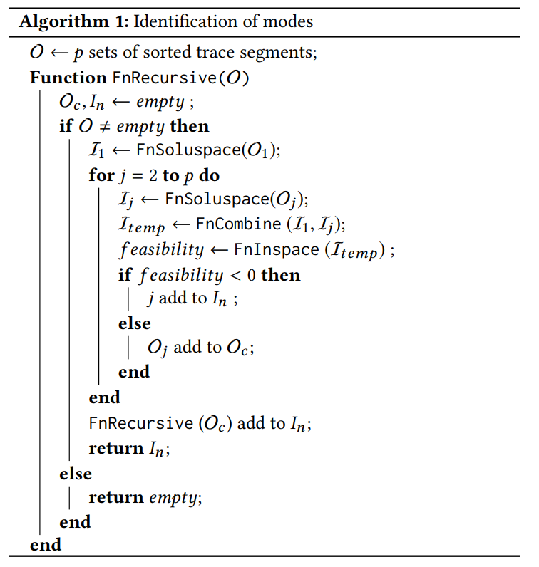
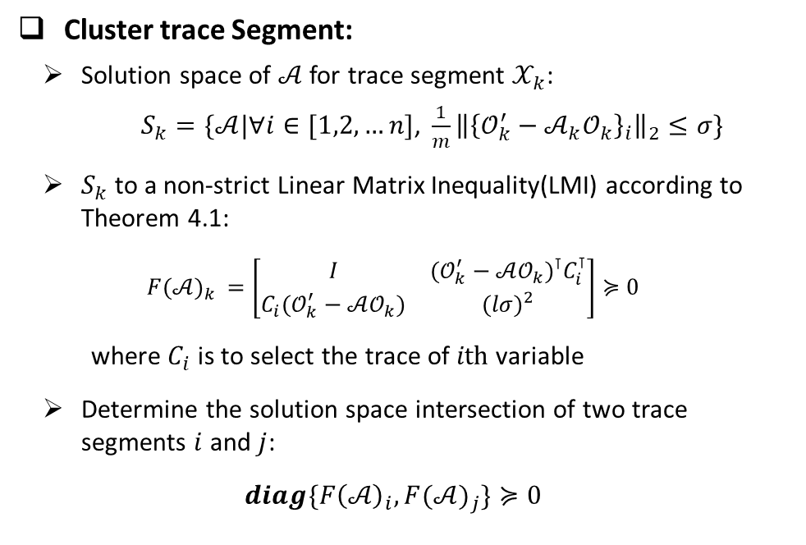
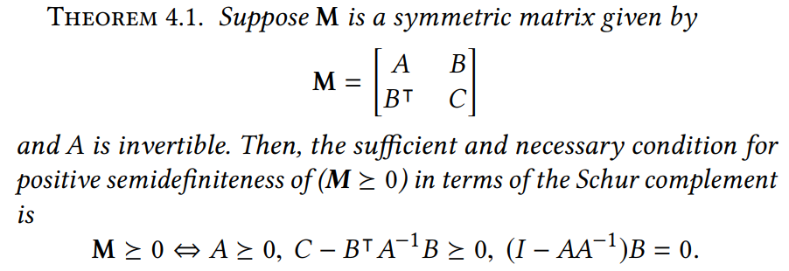
Hybrid System Identification from Input-Output Traces
Returns solution space in LMI
Merge two LMIs
Solve LMI
Store segment IDs that belongs to one cluster

Slide 3
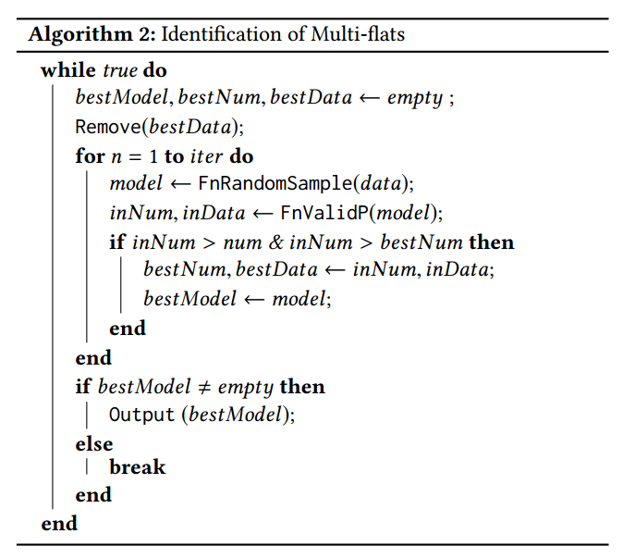
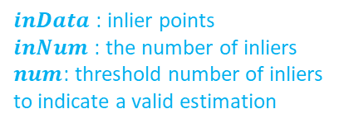
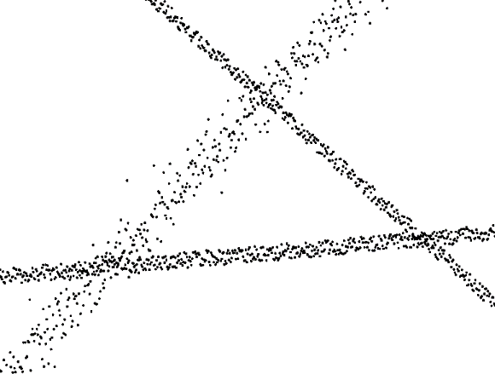

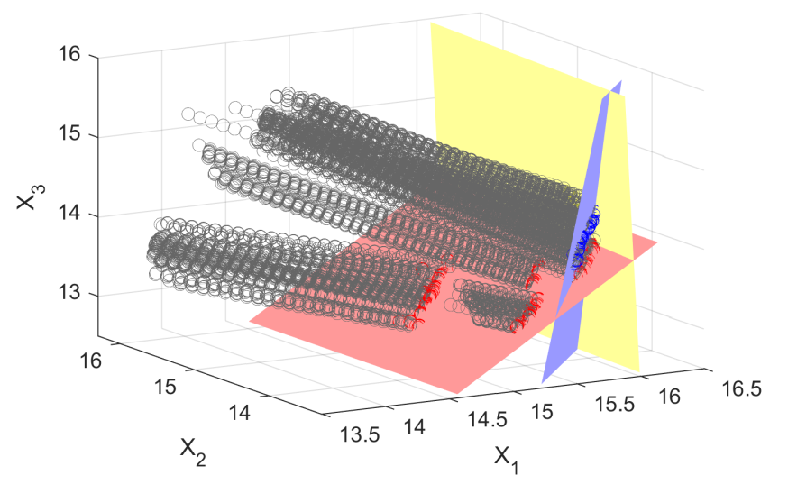
Hybrid System Identification from Input-Output Traces
Inference of Guard Conditions
Sequential Random Sample Consensus:
The changepoints having the same source ODE and the same destination ODE are collected into one date set.
Inequality sign is determined by data trajectory
Randomly selects a model candidate
Return points that are compatible with the model candidate.
Estimated linear inequality
outlier
inlier
Figure 3: Demonstration of sequential RANSC
Figure 4: Linear inequality estimation and data trajectory.

Slide 4
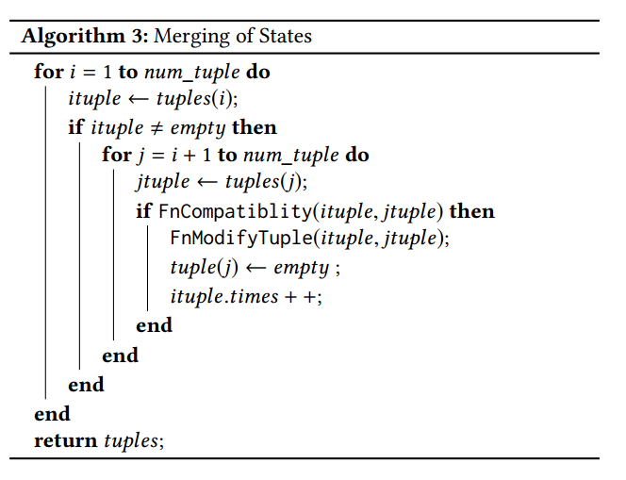
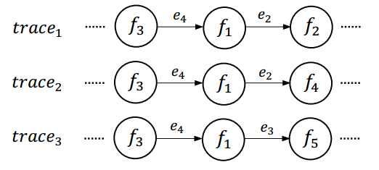
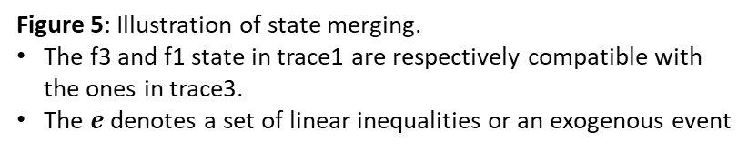
Hybrid System Identification from Input-Output Traces
Merging of Locations
Compatibility criterion
The source ODE, destination ODE and guard conditions of two transitions are the same, and meanwhile, in the subsequent transition, there doesn’t exist diﬀerent transitions triggered by the same guard condition.
The first states in each trace are compatible.
Check compatibility
Merge states

Slide 5
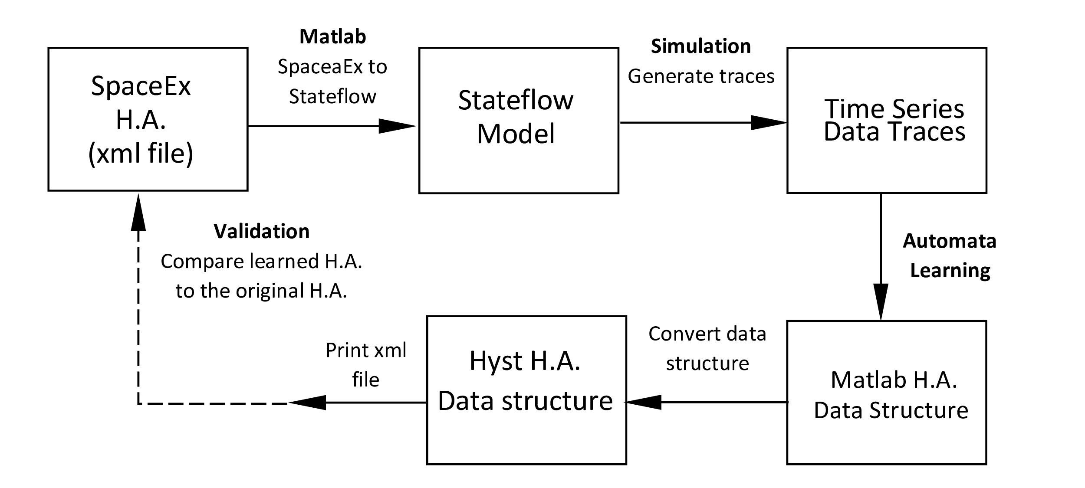
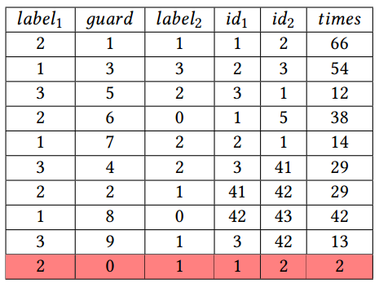
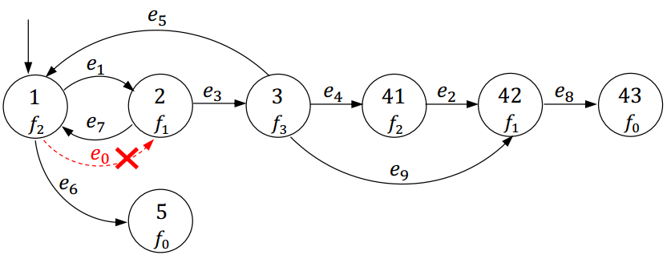
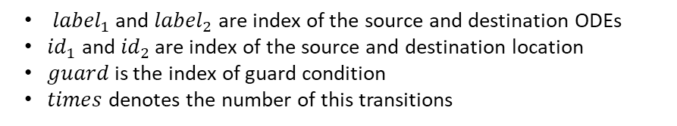
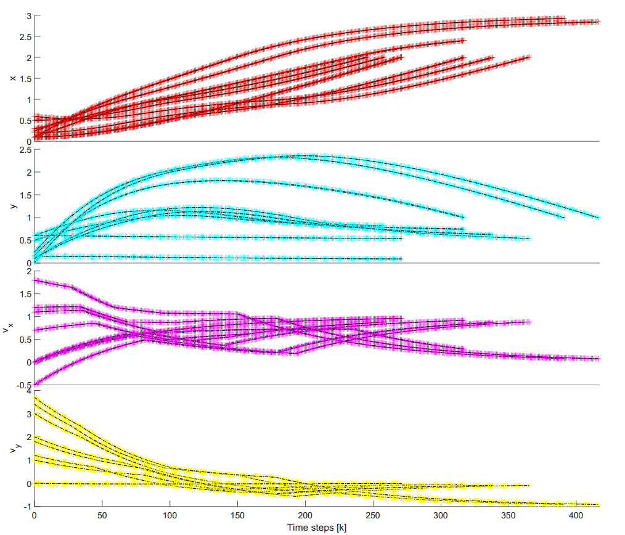
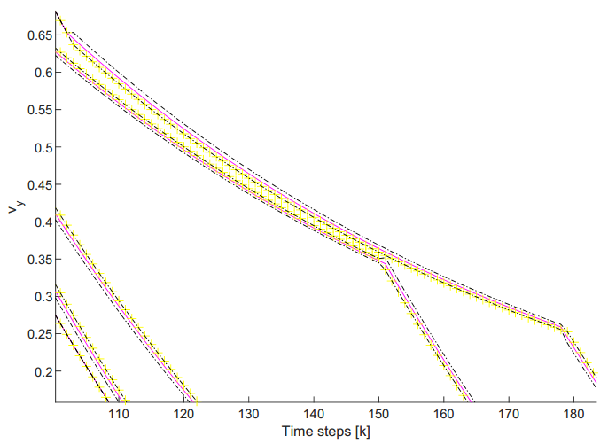
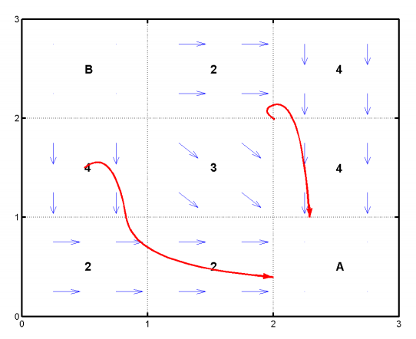

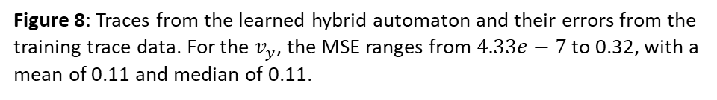
Validation Framework
Table 1: Estimated state transitions expressed in a list of 6 tuples
Figure 7: Estimated hybrid automaton
Navigation system

Slide 6
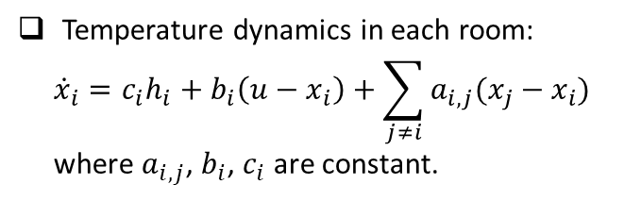
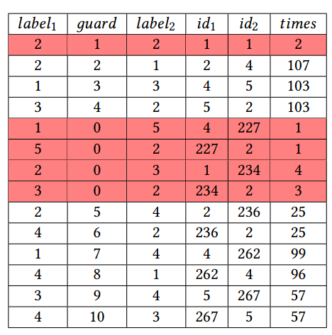
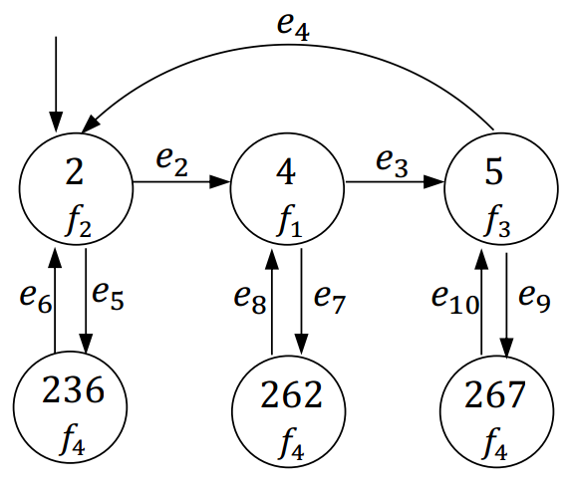
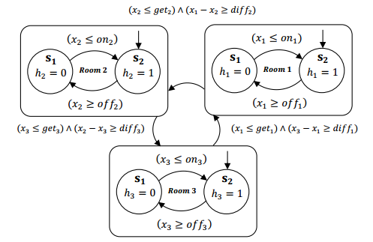
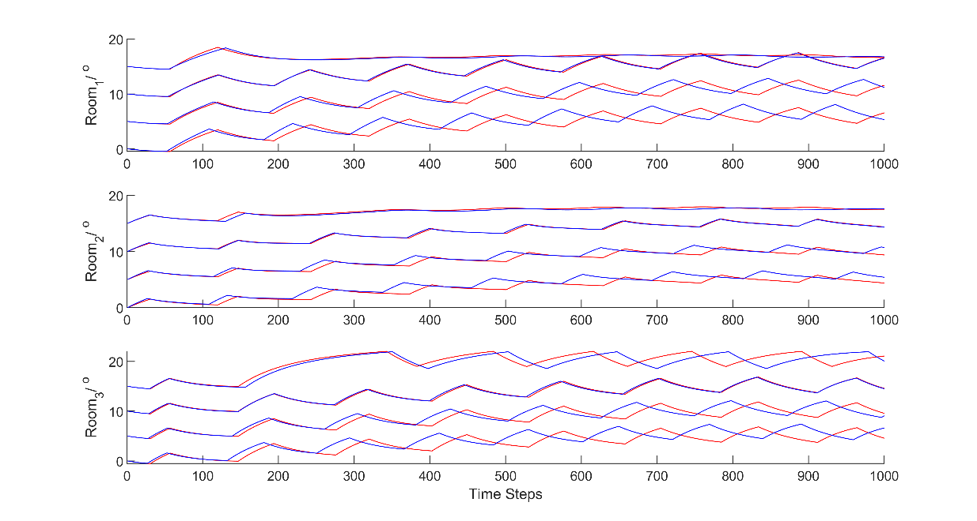
Multi-room Heating System
Table 2: Estimated state transitions
Figure 10: Estimated hybrid automaton
Original system
Figure 9: Controller of the heating system
Estimated system
Figure 11: Traces from the learned hybrid automaton

