Slide 1



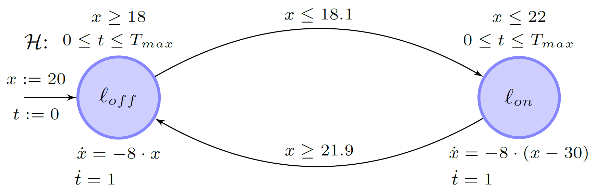
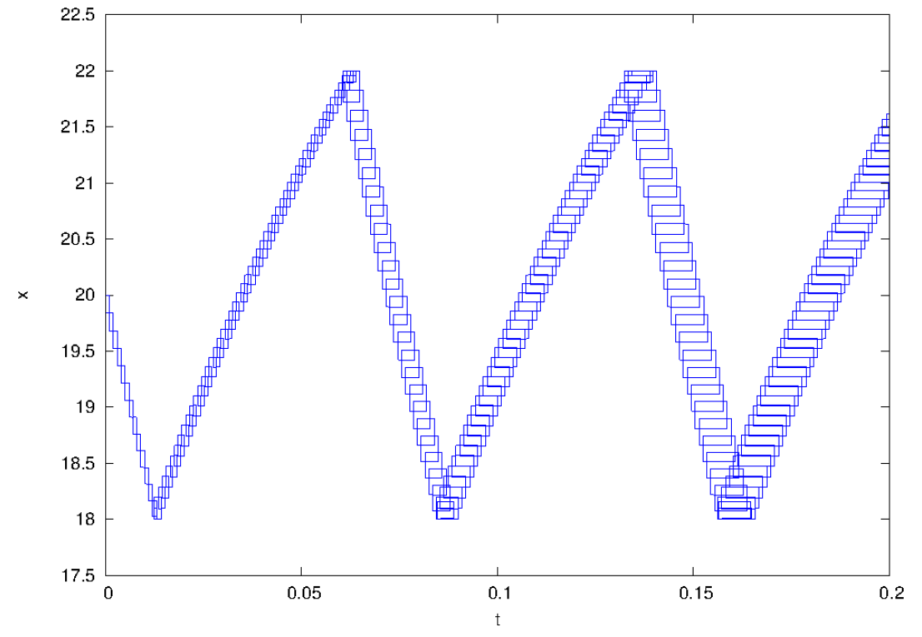
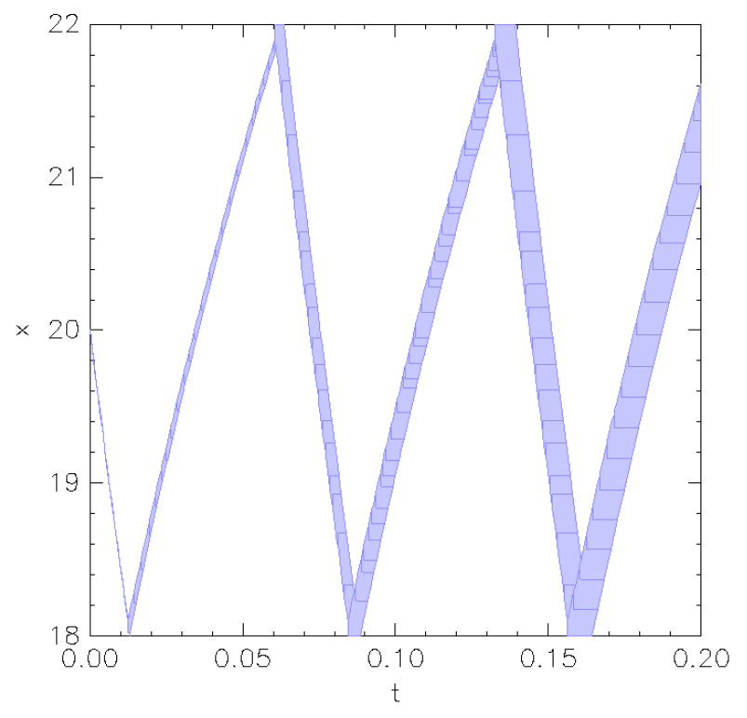
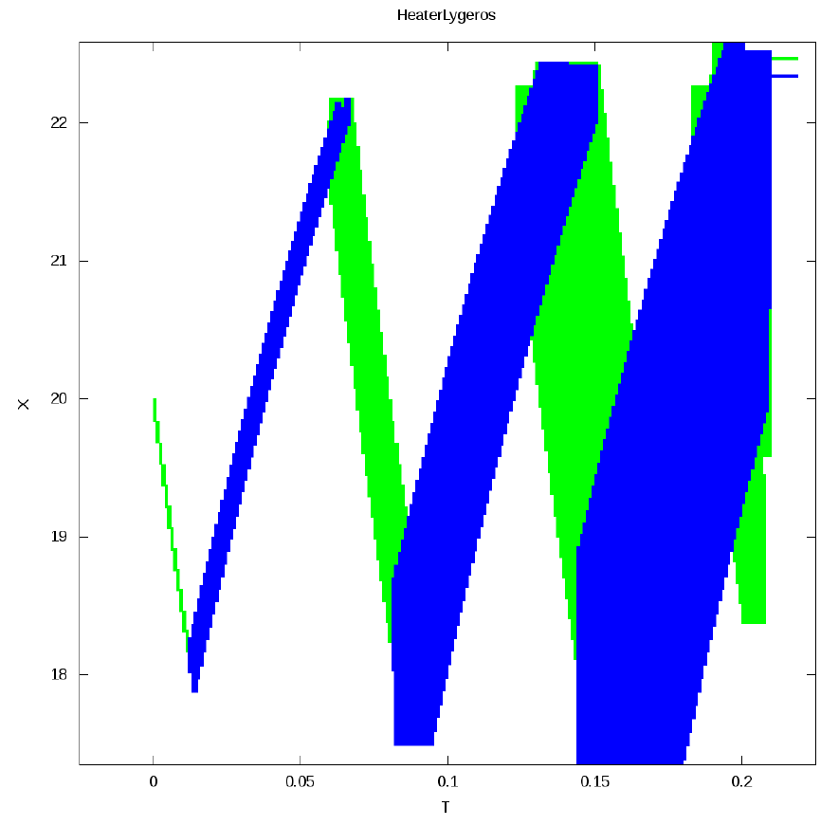
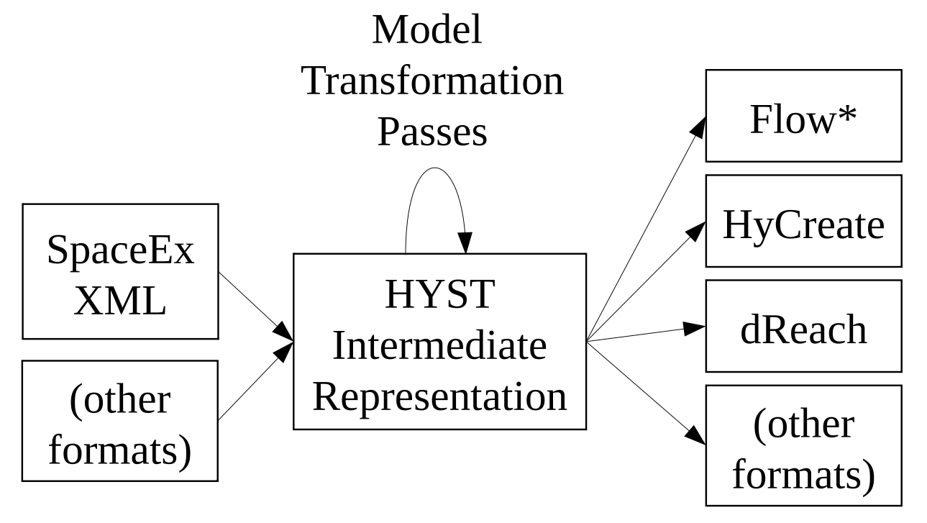
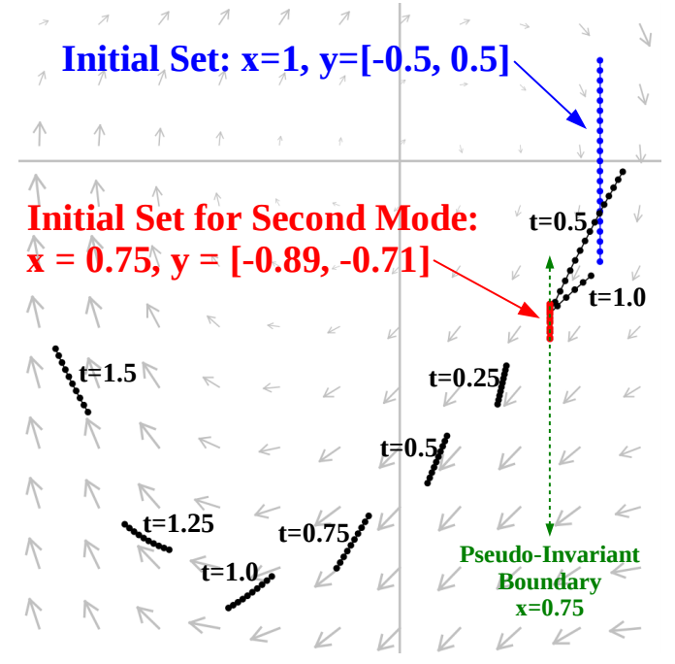
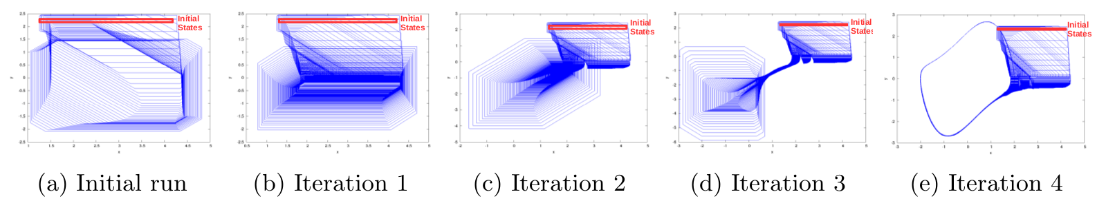
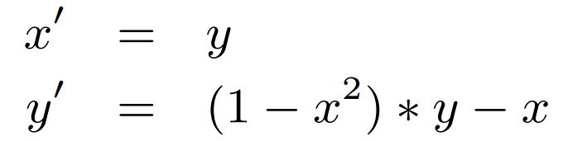
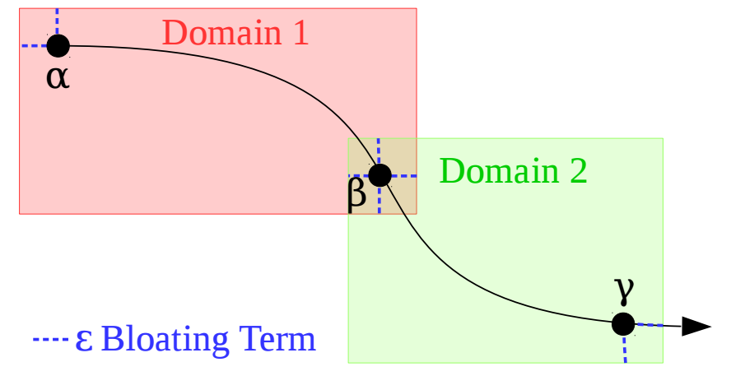
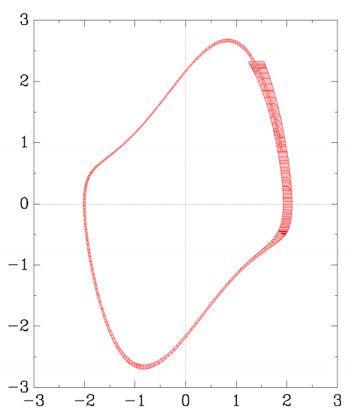
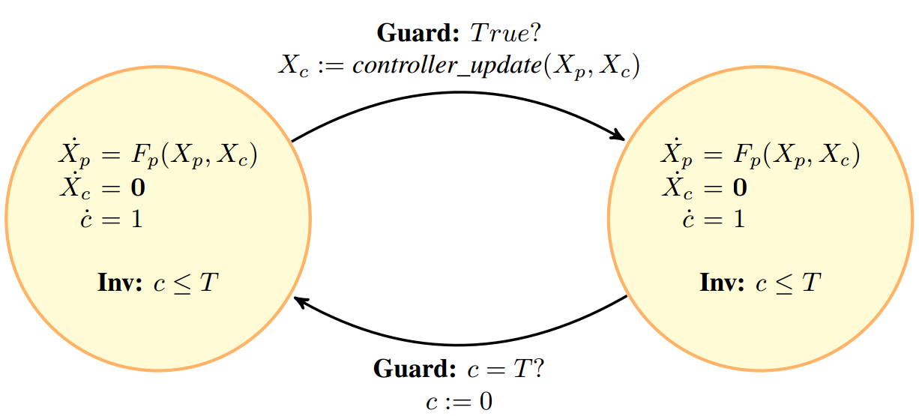
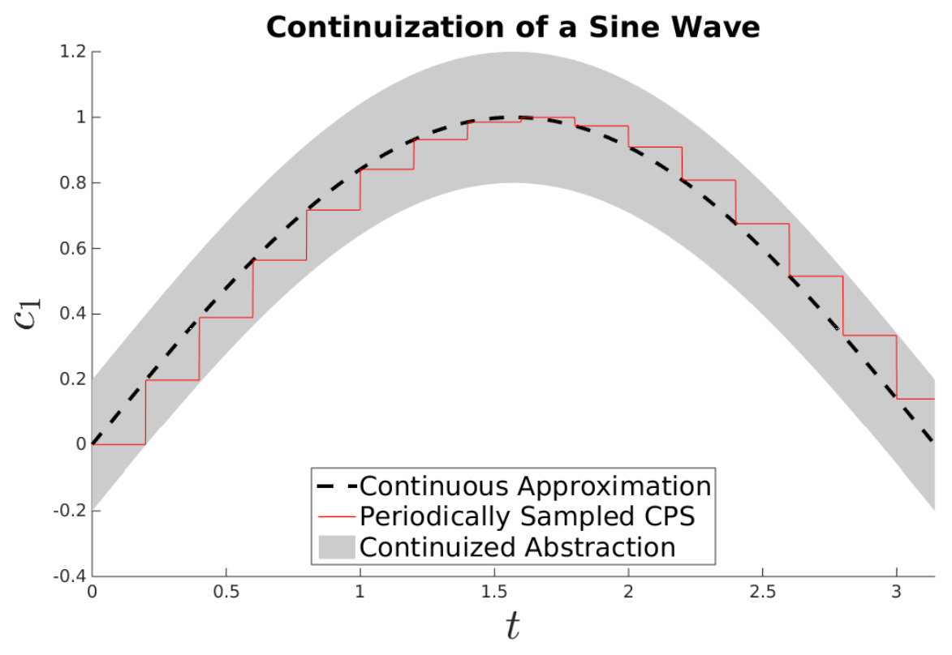
Hybrid Systems Model Transformations with HYST
Stanley Bak¹, Sergiy Bogomolov², Taylor T. Johnson³
¹Air Force Research Laboratory (AFRL), USA, ²Institute of Science and Technology (IST) Austria, ³University of Texas at Arlington (UTA), TX USA
Overview
Experimental Results
HYST and examples are available online at: http://verivital.uta.edu/hyst/
Reach set visualizations for on/off heater system in different target tools
HYST: a source-to-source translation tool for hybrid automaton models. Two main functions:
- Model translation
- Model transformation
Hybrid Automaton
Flow*
SpaceEx STC
HyCreate2
Transformation: Automated
Pseduo-Invariants
HYST Conversion Architecture
Model transformations ease modeling and improve reachability analysis:
- Model Optimization
- Hierarchy Flattening
- Look-up Table Conversion
- Model-Order Reduction
- Automated Pseudo-Invariants
- Continuization of Real-Time Controllers
- Simulation-Guided Hybridization
Multiple Iterations may be Necessary
Simulations are used to determine the placement of auxilary hyperplanes, improving accuracy.
Vanderpol Dynamics
Auxiliary Hyperplane
Transformation: Static Simulation-Guided Hybridization
Transformation: Continuization of Real-Time Controllers
Real-time scheduling guarantees periodic actuation for low-level controllers. Continuization enables analysis of such systems using continuous dynamics approximations with additional bounded noise.
Recent Publications
"HYST: A Source Transformation and Translation Tool for Hybrid Automaton Models", S. Bak, S. Bogomolov, T. Johnson, Tools Paper, ACM/IEEE 18th International Conference on Hybrid Systems: Computation and Control (HSCC 2015)
"Periodically-Scheduled Controller Analysis using Hybrid Systems Reachability and Continuization", S. Bak, T. Johnson, 36th IEEE Real-Time Systems Symposium (RTSS 2015)
"Scalable Static Hybridization Methods for Analysis of Nonlinear Systems", S. Bak, S. Bogomolov, T. Henzinger, T. Johnson, P. Prakash, 19th International Conference on Hybrid Systems: Computation and Control (HSCC 2016)
Hoang-Dung Tran, Luan Viet Nguyen, Taylor T. Johnson, "Benchmark: A Nonlinear Reachability Analysis Test Set from Numerical Analysis", In Applied Verification for Continuous and Hybrid Systems Workshop (ARCH 2015)
Model of a Real-Time
Low-Level Controller
Simulation-Guided Domains
SpaceEx Result
Time-triggered transitions and limited linearization domains enable scalable abstractions for nonlinear systems.
DISTRIBUTION A. Approved for public release; Distribution unlimited. (Approval AFRL PA #88ABW-2015-0468, PA #88ABW-2015-5083)
Enclosing Abstraction

