Slide 1
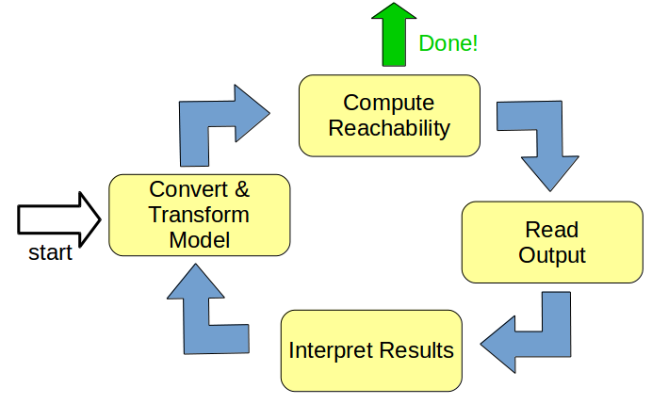
Computational Methods to Aid
Hybrid Automaton Reachability Analysis
Stanley Bak
Air Force Research Lab (AFRL)
March 2016

Slide 2
Outline
Background: Hybrid Automata Verification
Hyst: Model Translation and Transformation
Scalable Static Hybridization
Hypy: Automated High-Level Analysis

Slide 3
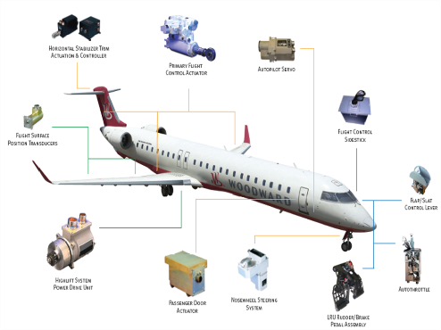
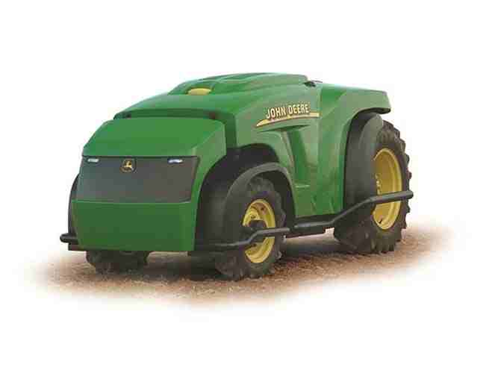
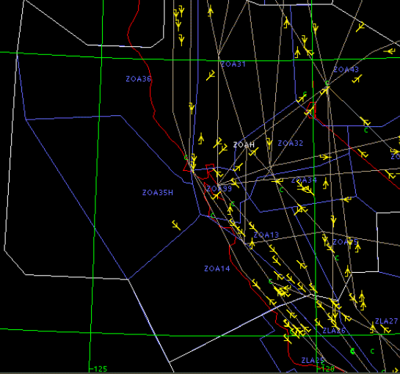
Cyber-Physical Systems
Cyber-Physical Systems (CPS) combine discrete elements with continuous behaviors
Formal Analysis of CPS design is done using a mathematical model of the system such as a hybrid automaton
Fault-Tolerant
Power Distribution
Autonomous Vehicles
Air Traffic Control

Slide 4
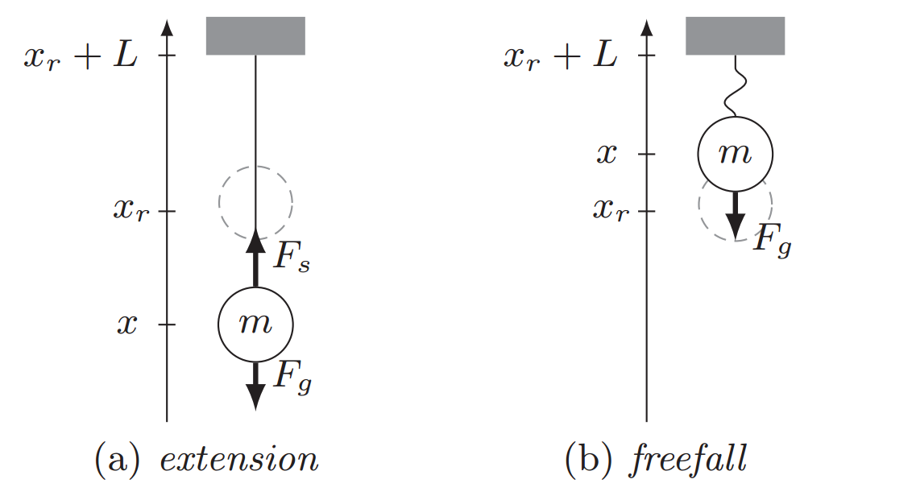
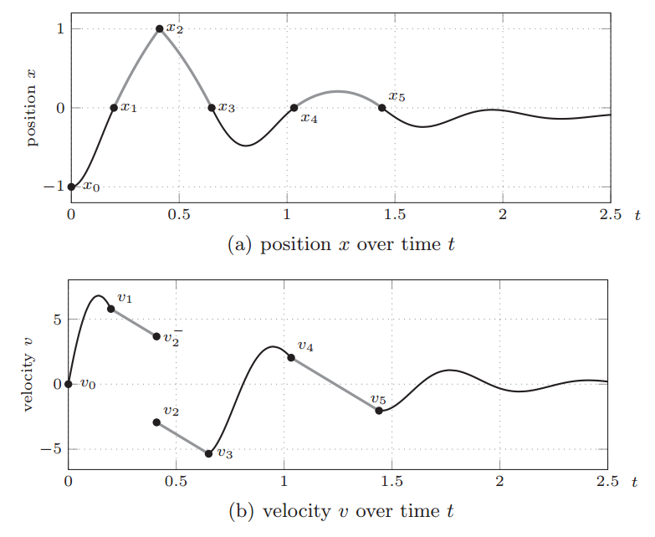
Simple Hybrid System
Example: Ball and Elastic String (suspended from the ceiling)
From "An Introduction to Hybrid Automata, Numerical Simulation and Reachability Analysis", Goran Frehse, 1st International Summer School on Methods and Tools for the Design of Digital Systems, Bremen, Germany, September 2015

Slide 5
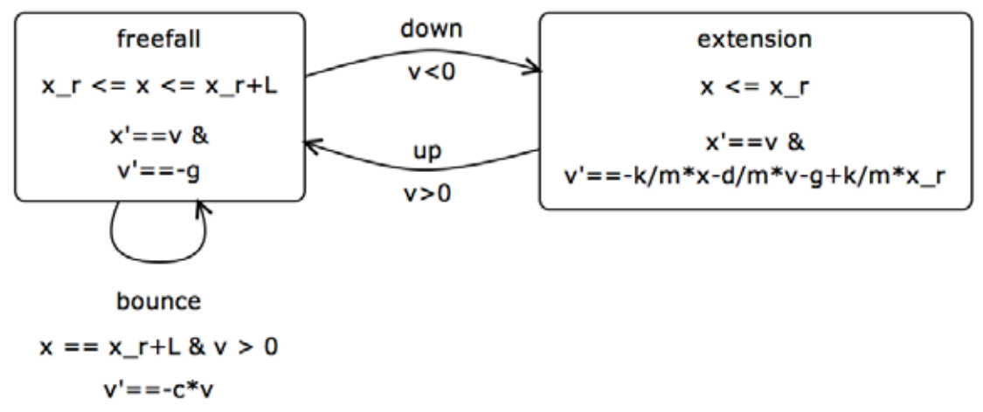
Hybrid Automaton
Finite state machine with
continuous dynamics in each mode

Slide 6
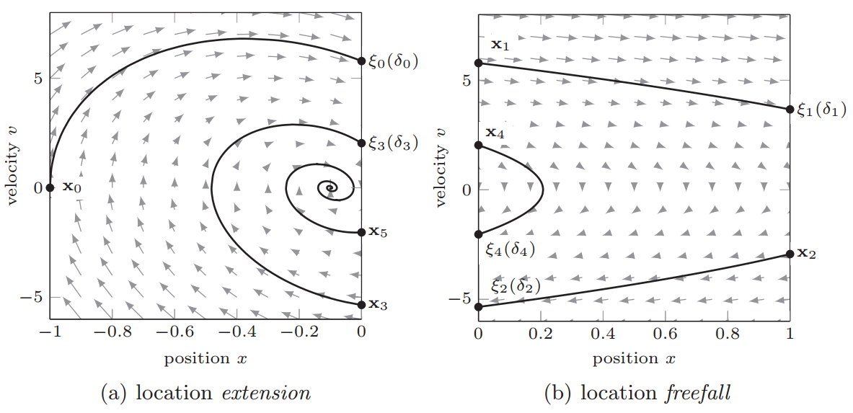
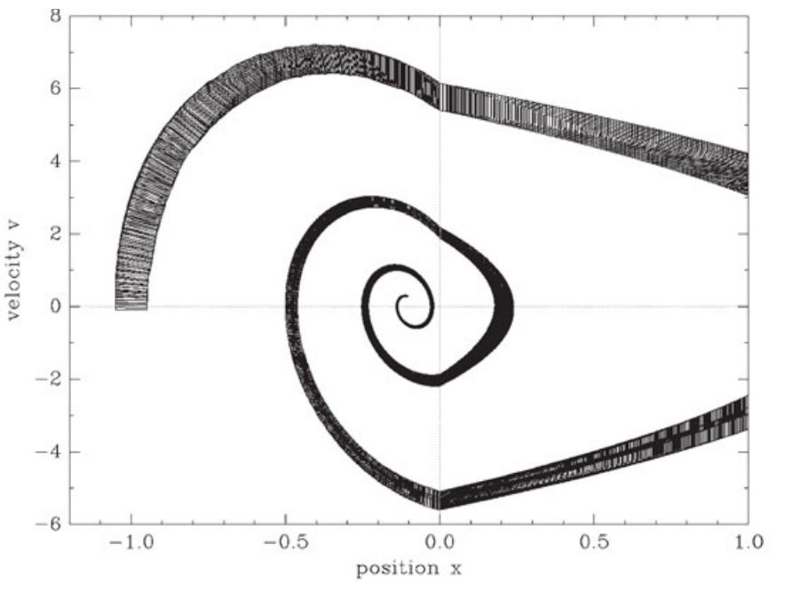
Simulation vs Reachability
Simulation
Reachability

Slide 7
Verification
Reachability is important for verification
Reachable
States
Initial
States
Unsafe
States

Slide 8
Verification
Reachability accuracy is important for verification
Reachable
States
Initial
States
Unsafe
States
Overapproximation of
Reachable States

Slide 9
Verification
Reachability accuracy is important for verification
Reachable
States
Initial
States
Unsafe
States
Overapproximation of
Reachable States

Slide 10
Flowpipe Construction
Flowpipe construction explores the reachable states symbolically
  Continuous Post
  Discrete Post
Error during computation accumulates during
  Continuous Post
  Discrete Post
Different algorithms exists for different classes of
hybrid automata

Slide 11
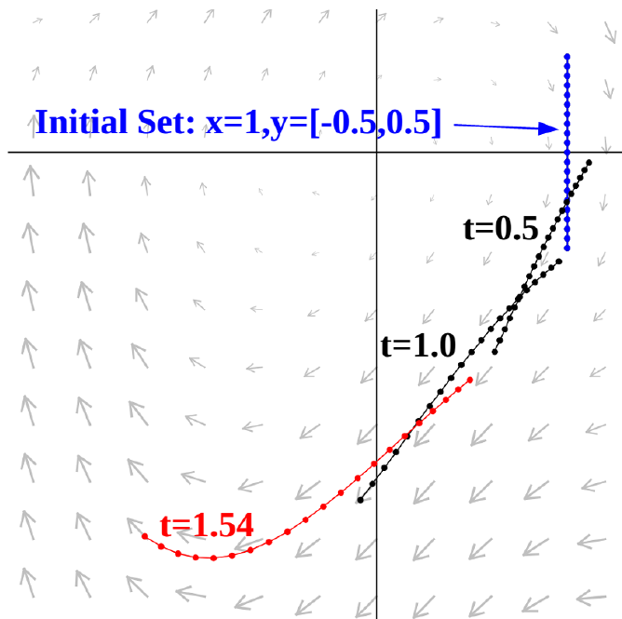
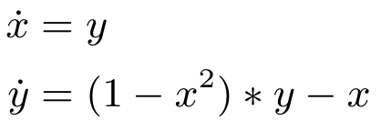
Continuous Post
A currently-tracked set of states is propagated through different instants in time

Slide 12
Discrete Post
A different set representation might be necessary to compute guard / invariant intersections
Overapproximation
for intersection

Slide 13
Aiding Reachability
Talk title: “Computational Methods to Aid Hybrid Automaton Reachability Analysis”
If reachability fails (or error is too large), other strategies can be applied:
  Change tool parameters
  Try a different tool
  Simplify or modify the model
  Break up the computation into parts

Slide 14
Outline
Background: Hybrid Automata Verification
Hyst: Model Translation and Transformation
Scalable Static Hybridization
Hypy: Automated High-Level Analysis

Slide 15
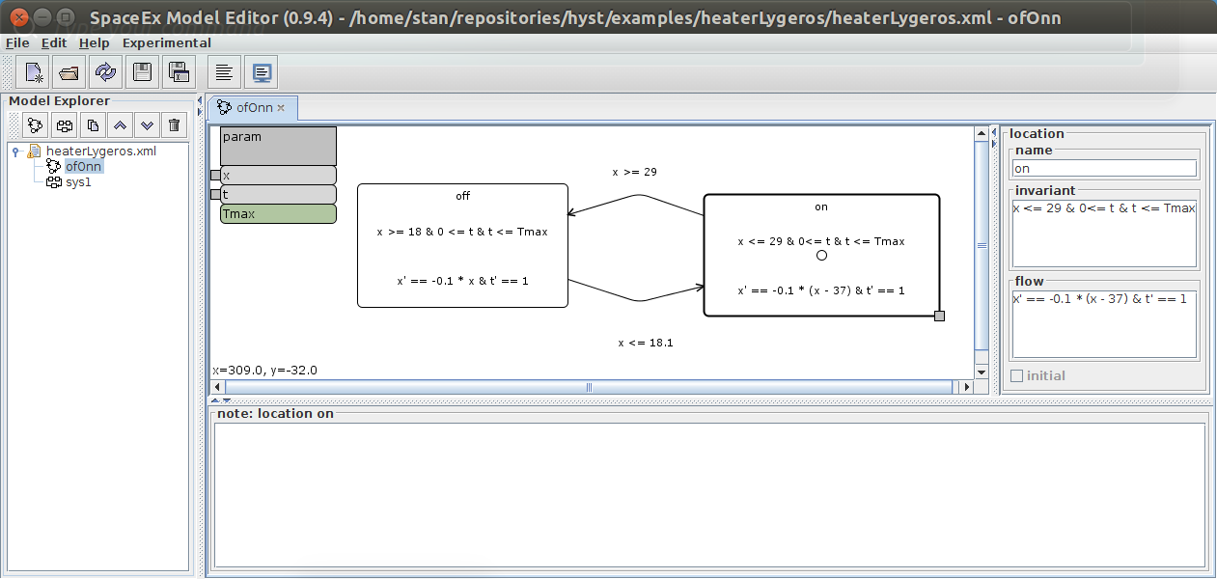
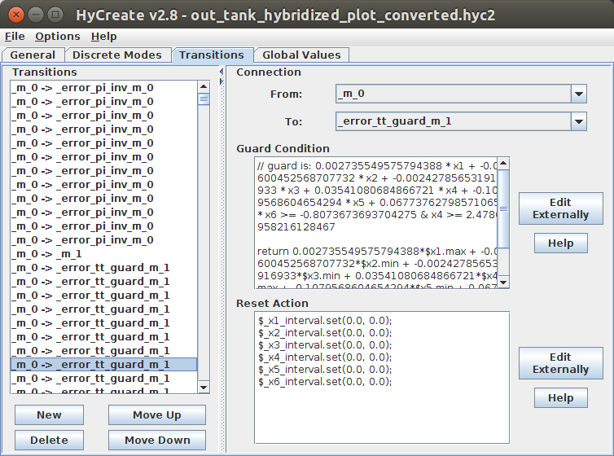
Input Format Problem
hybrid reachability
{
# Vars
state var x, t
setting
{
fixed steps 0.001
time 25
remainder estimation 1e-4
QR precondition
...
}
modes
{
off
{
nonpoly ode
{
x' = -0.1 * x
t' = 1
}
inv
{
x >= 18 0 - (t) <= 0 t <= 50
}
}
SpaceEx
Flow*
HyCreate2

Slide 16
Input Format Solutions
Interchange Formats
  Compositional Interchange Format (CIF)
  Hybrid Systems Interchange Format (HSIF)
  Relies on each tool developer to add support
  Common semantics issues?
Conversion
  Hyst
  Conversion can be done external to each tool
  Semantics issues?

Slide 17
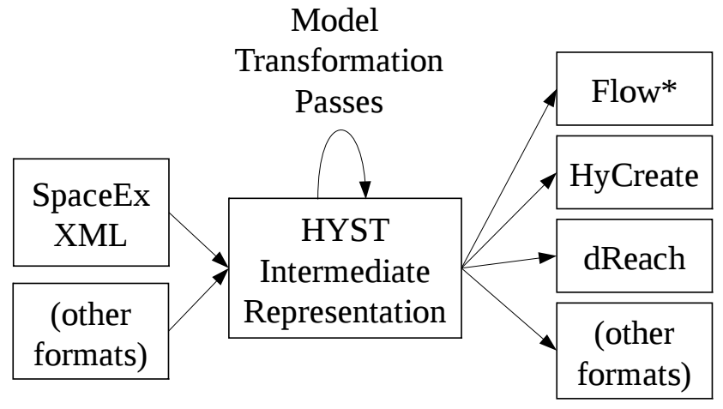
Hyst
Hyst: A Hybrid Source Transformation and Translation Tool

Slide 18
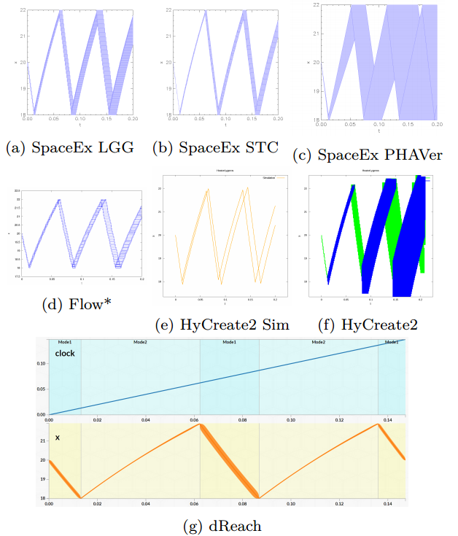
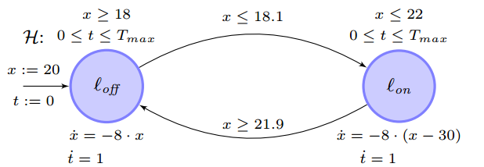
Rapid Model Translation
On/off heater in a room
hybrid automaton

Slide 19
Hyst Internals
Internally, Hyst maintains an internal representation of the hybrid automaton (IR)
A ToolPrinter object converts from Hyst IR to text (which is then typically written to a file)
A TransformationPass converts from Hyst IR to Hyst IR

Slide 20
ToolPrinters
A ToolPrinter can have parameters passed to it which modify the output.
Generic parameters:
  desired reachability time
  time step
  max jumps
Tool-specific parameters (Flow*):
  Remainder estimate
  Orders
  ...

Slide 21
Hyst
Hyst: A Hybrid Source Transformation and Translation Tool
A TransformationPass converts from Hyst IR to Hyst IR

Slide 22
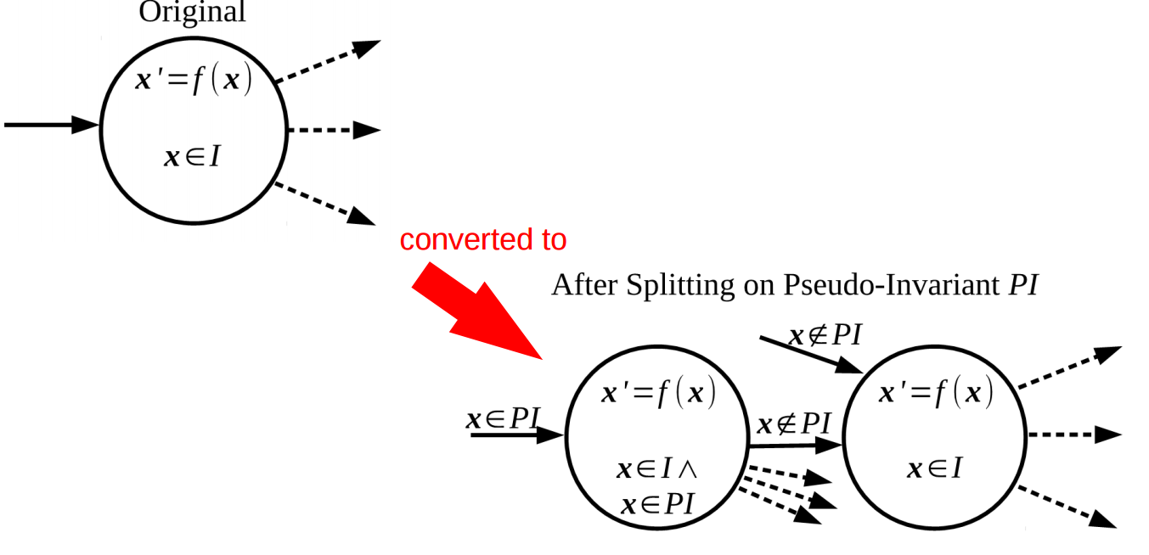
Example Transformation
A Pseudo-Invariant Transformation Pass splits a single mode of a hybrid automaton into two based on a user-provided hyperplane

Slide 23
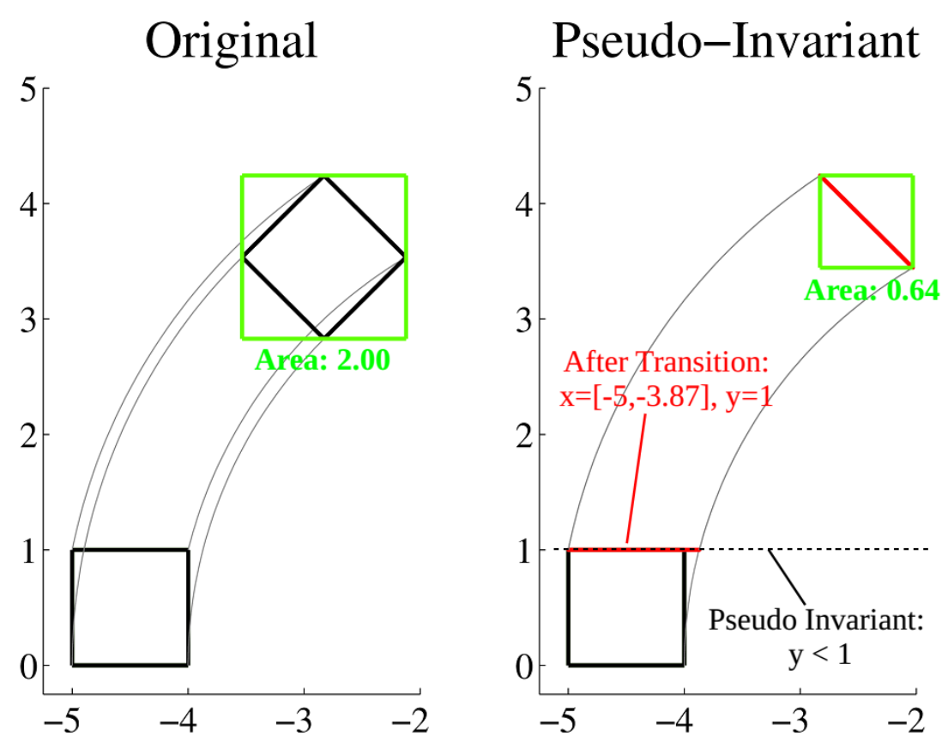
Effect On Reachability

Slide 24
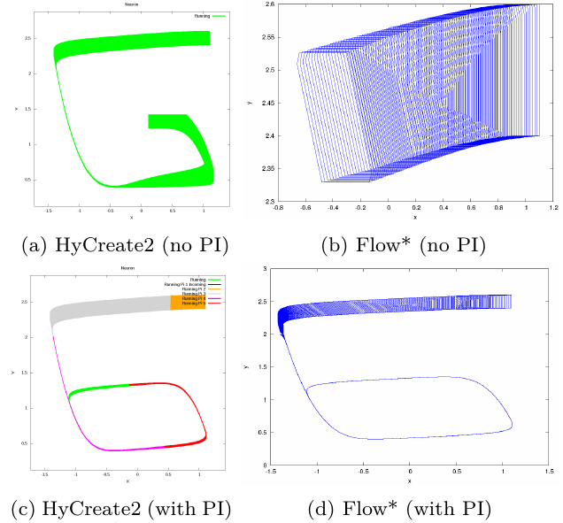
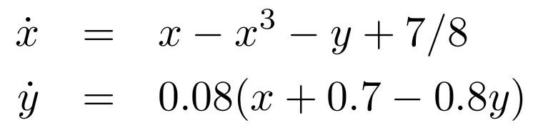
Nonlinear Example
FitzHugh-Nagumo Neuron Model*
  2-d nonlinear model
“Reachability analysis for polynomial dynamical systems using the Bernstein expansion” T. Dang and R. Testylier, 2012

Slide 25
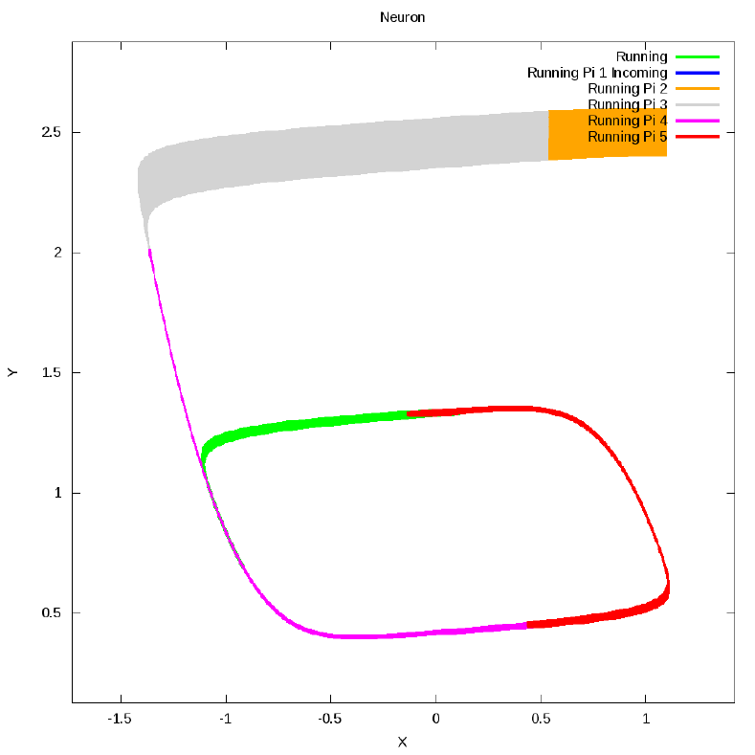
Pseudo-Invariant Params
The previous pseudo-invariant transformation pass needs a user-provided hyperplane (defined using a point + normal direction)
A second pseudo-invariant transformation pass was written which runs a simulation of the system in order to create PI-hyperplanes
  User provides only the times
  at which to create the
  hyperplane parameters

Slide 26
Other Passes
Other Transformation Passes available in Hyst:
  Add Identity Resets
  Scale Time
  Substitute Constants
  Simplify Expressions
  Remove Unsat Invariants
  Shorten Mode Names
  Flatten Network Automaton
  Convert Look-up-Table Dynamics (submission in progress)
  Model Order Reduction (submission in progress)
  Continuization (RTSS 2015)
  Mixed-Triggered Hybridization (HSCC 2016)

Slide 27
Other Passes
Other Transformation Passes available in Hyst:
  Add Identity Resets
  Scale Time
  Substitute Constants
  Simplify Expressions
  Remove Unsat Invariants
  Shorten Mode Names
  Flatten Network Automaton
  Convert Look-up-Table Dynamics (submission in progress)
  Model Order Reduction (submission in progress)
  Continuization (RTSS 2015)
  Mixed-Triggered Hybridization (HSCC 2016)

Slide 28
Outline
Background: Hybrid Automata Verification
Hyst: Model Translation and Transformation
Scalable Static Hybridization
Hypy: Automated High-Level Analysis

Slide 29
Hybridization
Hybridization is related to the idea of linearization, as in, “linearize a nonlinear system.”
Main idea: instead of a single linearization domain, multiple domains are used, with rules for switching added between them. Also the error in each domain is bounded to get an overapproximation.
x' = f_{nonlinear}(x)
x'=f_{linear1}(x) + I₁
x'=f_{linear2}(x) + I₂
x'=f_{linear3}(x) + I₃
x'=f_{linear4}(x) + I₄
x'=f_{linear5}(x) + I₅
x'=f_{linear6}(x) + I₆
x'=f_{linear7}(x) + I₇
x'=f_{linear8}(x) + I₈
original
hybridized

Slide 30
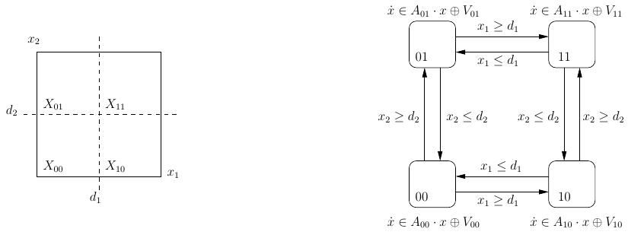
Hybridization: Why?
In the past, no generic ways to analyze nonlinear hybrid systems existed. Hybridization allows you to soundly analyze nonlinear systems, using algorithms which require linear dynamics.
Current motivations may be scalability, and accuracy comparisons with nonlinear analysis algorithms.
Image from: T. Dang, C. Le Guernic, and O. Maler. “Computing reachable states for nonlinear biological models”,
Computational Methods in Systems Biology, pages 126–141. Springer, 2009.

Slide 31
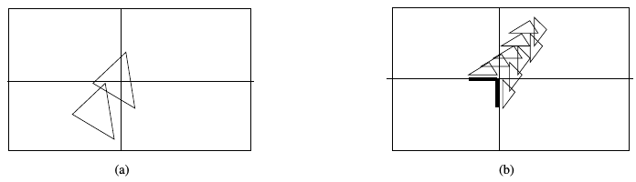
Hybridization: Review
Early hybridization methods (~1998) were static and space-triggered
  Doesn't scale well, exponential in number of dimensions when done over entire domain
  Small domains better approximation dynamics, but lead to more discrete transitions
  Currently-tracked set may need to be split and
  possibly later re-merged
Image from: T. Dang, C. Le Guernic, and O. Maler. “Computing reachable states for nonlinear biological models”,
Computational Methods in Systems Biology, pages 126–141. Springer, 2009.

Slide 32
Hybridization: Review (2)
Hybridization methods were developed that were dynamic and space-triggered
  Rather than doing the linearization over the entire domain, do it on-the-fly as the currently-tracked set of states encounters new modes
  Still suffers from the other two problems (accumulated intersection error and
  split/merge complexity)

Slide 33
Hybridization: Review (3)
Next, hybridization methods were developed that were dynamic and time-triggered
  Rather than doing the linearization over the entire domain, do it on-the-fly as the currently-tracked set of states encounters new modes
  Rather than switching domains along space boundaries, the domains are changed at specific instances in time
  For example, the domains can be updated at each time step, or once any part of the currently-tracked set of states leaves the previous domain

Slide 34
Hybridization: Review (4)
The main drawback of dynamic time-triggered approaches is that performing an accurate linear approximation may be computationally intensive
  Generally this is a bounded, global nonlinear optimization problem
  This expensive step must be done serially, because the next domain is not known ahead of time
  In static methods, this was an
  “embarassingly parallel” problem
  The runtime is dominated by this step (60%-95%)

Slide 35
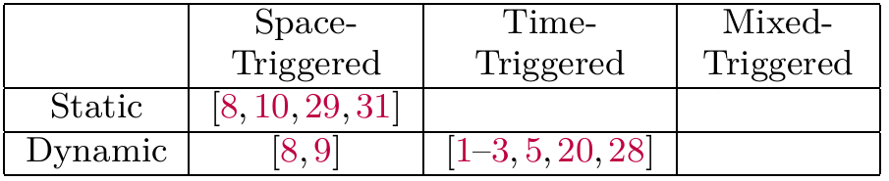
Hybridization Summary
Our research initially focused on the gap of
static, time-triggered approaches
However, from pseudo-invariants, we know that occasional space-triggered transitions can help
Mixed-triggered approaches use time-triggered transitions, with occasional space-triggered ones
References from: "Scalable Static Hybridization Methods for Analysis of Nonlinear Systems", S. Bak et al.,
19th International Conference on Hybrid Systems: Computation and Control (HSCC 2016)

Slide 36
Other Factors
Other factors clearly affect hybridization results, but are orthogonal to our investigation
  Domain shape (manual / rectangle / simplex)
  Simpler dynamics (rectangular / affine / polynomial)
For simplicity of optimization, we use rectangle domains
We target an unmodified version of SpaceEx, so we use affine dynamics as the 'simpler' ones

Slide 37
Mixed-Triggered Hybridization
Static time-triggered + space-triggered hybridization
  Which times? Which space boundaries? Is it correct?
Four simple sub-transformations are used to perform mixed-triggered hybridization
  Time-triggered splitting
  Space-triggered splitting
  Domain contraction
  Dynamics abstraction
Later, a simulation-based algorithm is used to create the parameters for each of these transformations

Slide 38
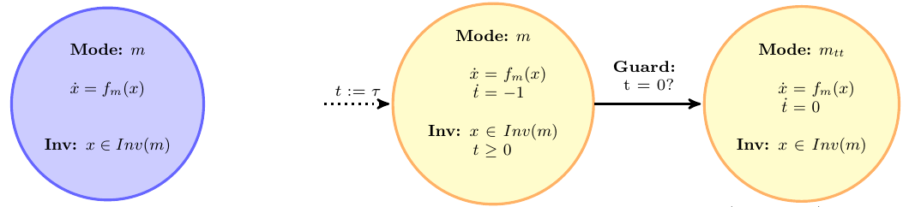
Mode Splitting Transformations
Time-triggered splitting (shown below), adds a clock variable and transitions when it gets to zero.
Space-triggered splitting is similar, except the transition occurs the first time the system state reaches some hyperplane (similar to pseudo-invariants)
Time-triggered Splitting Transformation

Slide 39
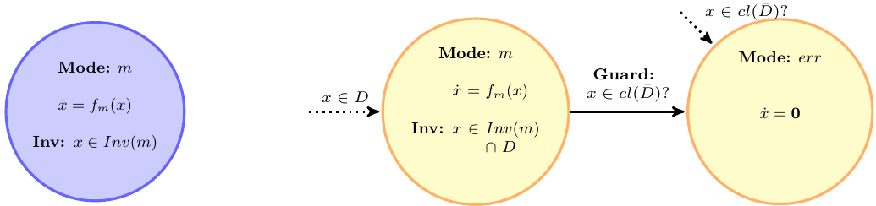
Domain Contraction &
Dynamics Abstraction
Domain Contraction (shown below) adds a domain D to the mode's invariant. A domain-contraction error mode (DCEM) is used to check (which performing reachability) that the domain is respected).
Dynamics Abstraction modifies the flows in a mode to ones which are a strict superset of the original flows, within the invariant condition
Domain Contraction Transformation

Slide 40
Mixed-Triggered Hybridization
Mixed-Triggered Hybridization is an application of the four previous sub-transformations
1. A single-mode automaton is first split (multiple times) using time-triggered or space-triggered splitting, producing a chain of modes to be entered sequentially
2. Domain contraction is then applied to each mode in the chain
3. Dynamics abstraction is applied to each mode, which converts the original nonlinear dynamics to affine dynamics within each domain

Slide 41
Mixed-Triggered Hybridization
Mixed-Triggered Hybridization is an application of the four previous sub-transformations
1. A single-mode automaton is first split (multiple times) using time-triggered or space-triggered splitting, producing a chain of modes to be entered sequentially
  How are the times / hyperplanes chosen?
2. Domain contraction is then applied to each mode in the chain
  Which domains are used?
3. Dynamics abstraction is applied to each mode, which converts the original nonlinear dynamics to affine dynamics within each domain
  How is this optimization performed?

Slide 42
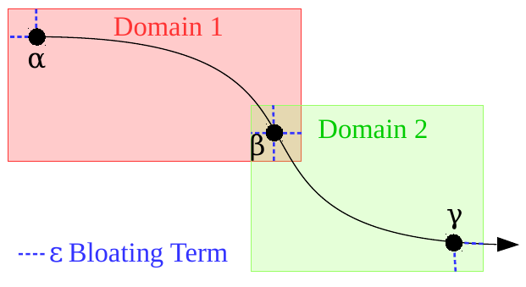
Simulation-based Algorithm
The user still provides a time-triggered step and the number of space-triggered transitions to do
Simulation(s) are performed from the initial states, recording the predicted domains at various points in time / after space-triggered steps
The rectangular hull of the simulations is bloated (by a user-defined term), to produce the candidate domains

Slide 43

Evaluation
Evaluation Goals:
  Demonstrate that parameters derived from simulations can avoid domain-contraction error modes (DCEM)
  Demonstrate the benefit of occasional space-triggered transitions
  Demonstrate scalability, despite being a
  static method
Two examples systems:
  Vanderpol Oscillator (2-d)
  Cyclical N-tank system (n-d)

Slide 44
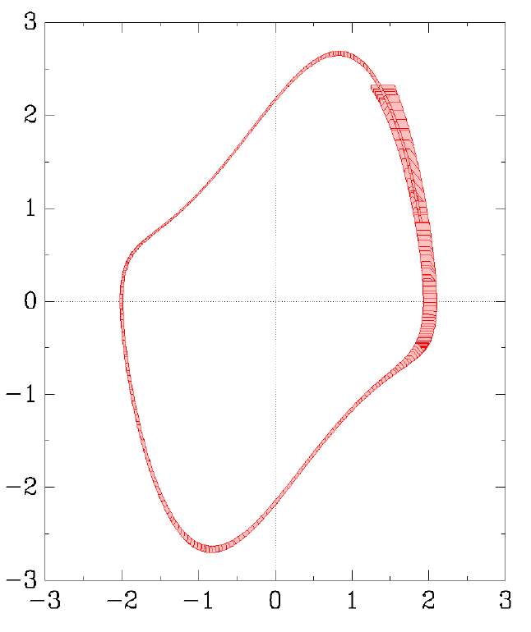
Vanderpol Oscillator
Nonlinear Dynamics:
Initial States:
Total Reach Time: 5.5
TT-step: 0.05, #ST: 31
Total Runtime (Hybridization
+ SpaceEx):
~10.3 seconds
No DCEMs were reached

Slide 45
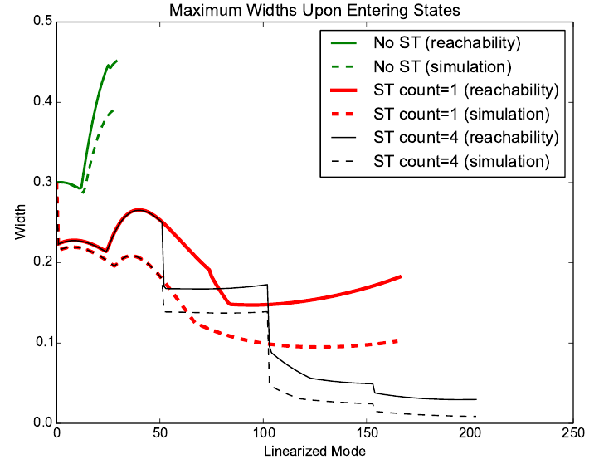
Estimating the
Currently-Tracked Set of States
We examine the width of
the bounding rectangle of
the tracked states upon
entering each mode
The bloating term was 0.05,
so the difference between
simulation and reachability
must stay less than 0.1
Space-triggered transitions reduce the
tracking error between simulations and reachability

Slide 46
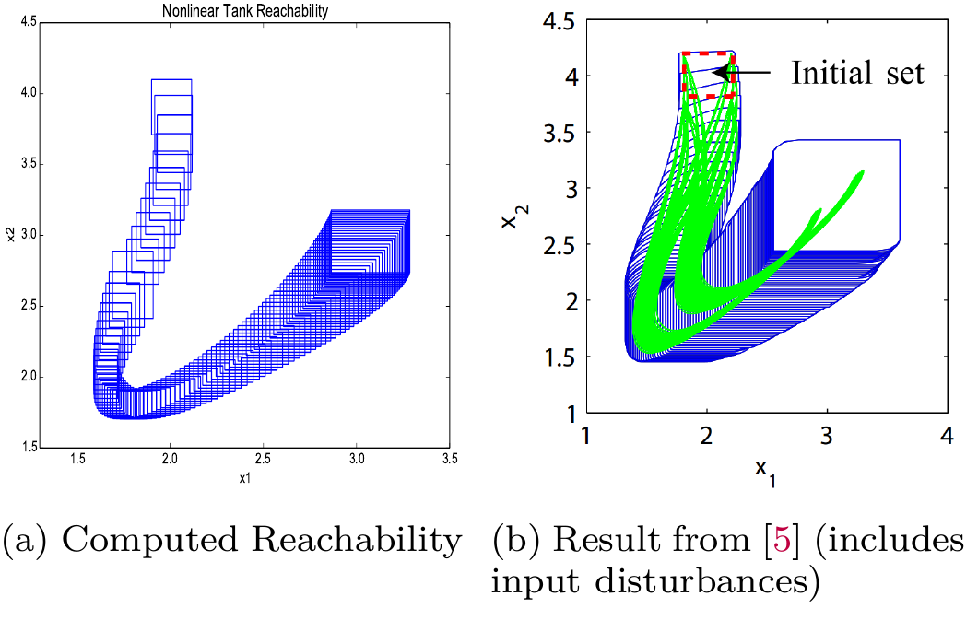
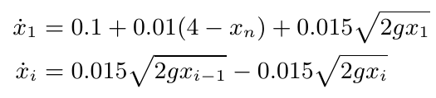
Initial Scalability Demonstration
N-tank system:
We evaluated on n = 6
Completed in 430 seconds,
No DCEM's were reachable
The average domain width is about 0.2. If the total width for each dimension is 3, the number of modes required for a static approach would be (3/0.2)⁶ = 11390625 (11 million!). This scales significantly better than any existing static approach.
Example from: M. Althoff et al., "Computing reachable sets of hybrid systems using a combination of zonotopes and polytopes",
Nonlinear Analysis: Hybrid Systems, 4(2), 2010.

Slide 47
Outline
Background: Hybrid Automata Verification
Hyst: Model Translation and Transformation
Scalable Static Hybridization
Hypy: Automated High-Level Analysis

Slide 48
Why Hypy?
Techniques like Pseudo-Invariants, Continuization, or Mixed-Triggered Hybridization can be used to analyze models
  But is anyone actually using them?
To be truly usable, they must be fully automated
To evaluate if they actually make a difference (on a large set of benchmarks), they must be fully automated

Slide 49
Hypy: Python Library
Hypy attempts to present a generic interface to run a number of tools, in order to enable high-level analysis approaches
Tool-specific scripts are needed to:
  Run each tool
  Produce a plot
  Create a python output object from the tool's output files and/or stdout
Hyst's model conversion and transformation can be used from Hypy

Slide 50
Hypy: Overview
Done!
Compute
Reachability
Convert &
Transform
Model
Read
Output
start
Interpret Results

Slide 51
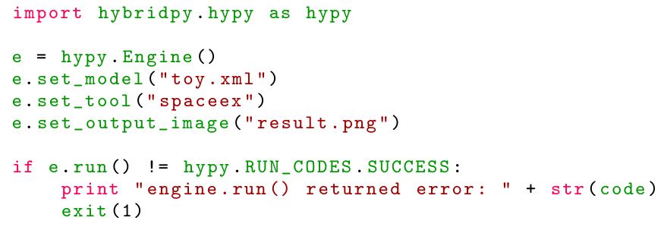
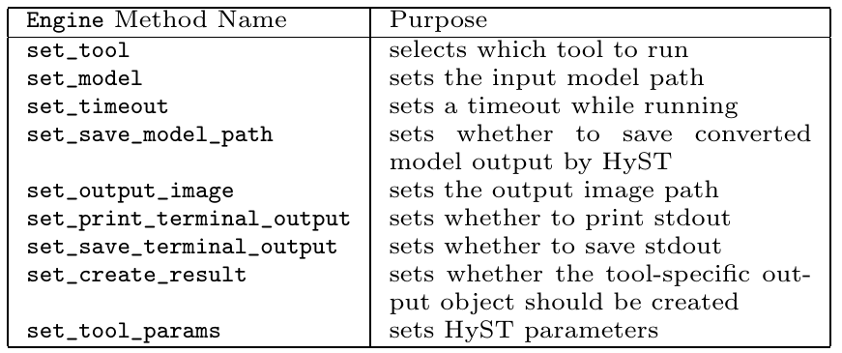
Hypy Example

Slide 52
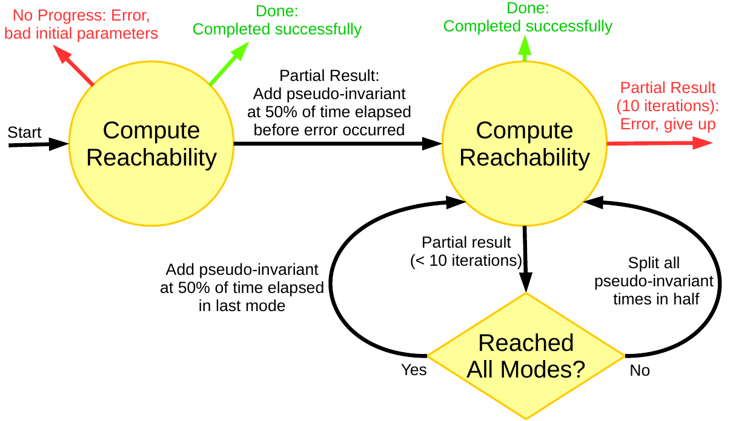
Automated Pseudo-Invariants
Encoded in a ~120 line python script

Slide 53
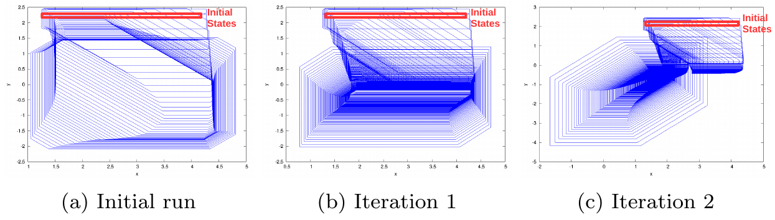
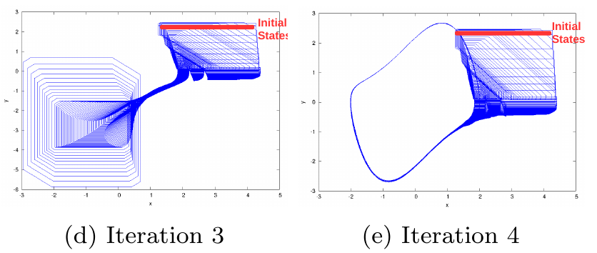
Automated Result
Vanderpol system with large initial set
F. Immler, "Verified reachability analysis of continuous systems",
Tools and Algorithms for the Construction and Analysis of Systems (TACAS), 2015

Slide 54
Automated Parameter Tuning for Flow*
...
for splits in [100, 400, 800, 3200, 12800]:
if done or timeout_reached:
break
step = max_time / splits
for order in ["2", "4", "6"]:
if done or timeout_reached:
break
for rem in ["1e-9", "1e-5", "1e-2"]:
print "trying '" + model + "' with step = " + str(step) + ", order = " + order + ", rem = " + rem
before_last_run = time.time()
e = hypy.Engine()
e.set_model(MODEL_DIR + model + ".xml")
e.set_tool('flowstar')
e.set_timeout(timeout_sec)
e.set_create_result(True)
e.set_tool_params(['-tp', 'plot=gnuplot interval:orders=' + order + ':time=' + str(max_time) + ':step=' + str(step) + ':remainder=' + rem])
...

Slide 55
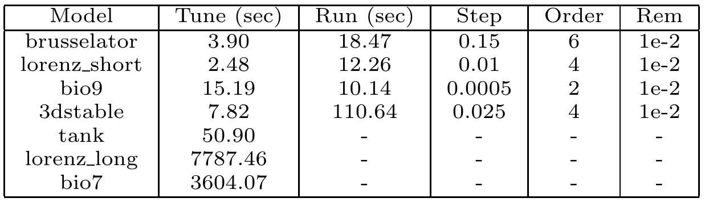
Autotune Sample Results
Failures:
  lorenz_long reached 1 hour timeout
  bio7 appeared to be stuck (bug?)
  tank hand-tuned model used per-variable remainder estimates

Slide 56
Summary
Talk Title: “Computational Methods to Aid Hybrid Automaton Reachability Analysis”
Strive to automatically make adjustments to increase success of reachability computations
  Change tool parameters
  Try a different tool
  Simplify or modify the model
  Break up the computation into parts

Slide 57
Long-Term Vision
Comparison / Competition
  Different tools / tuning approaches / automated application of model transformations
Generalizability / Repeatability
  Model Transformations coded using Hyst
  Results plots made using Hypy scripts
Thought Transformation
  Start thinking in terms of model transformations and high-level analysis strategies

