Slide 1



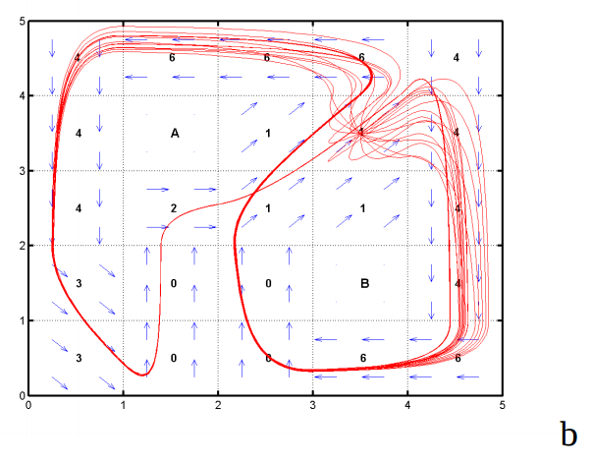
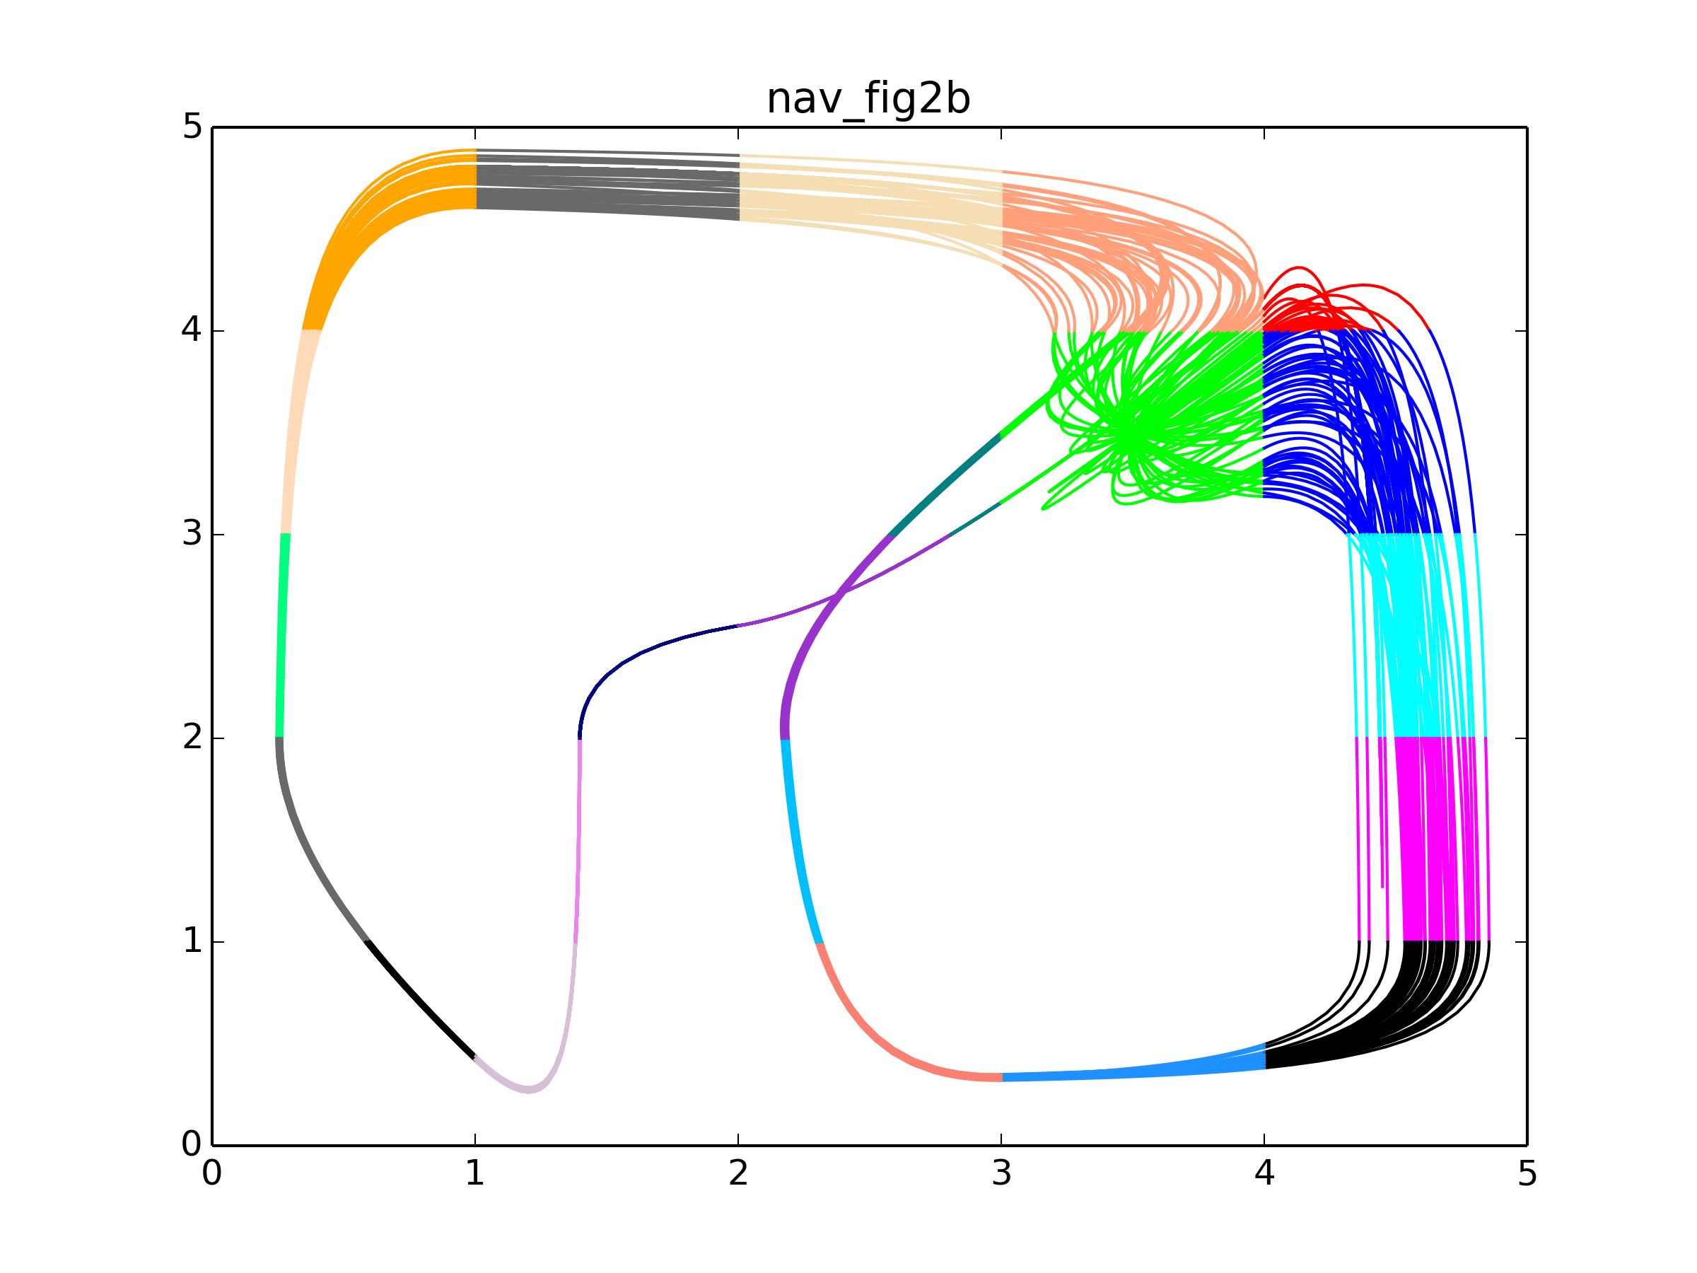

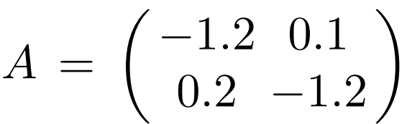
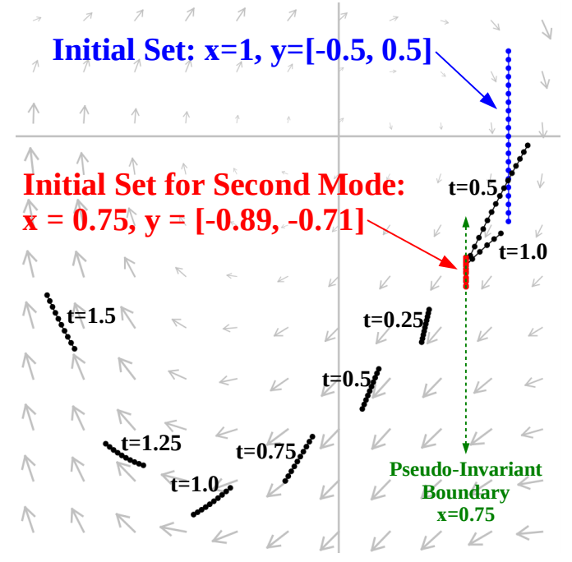
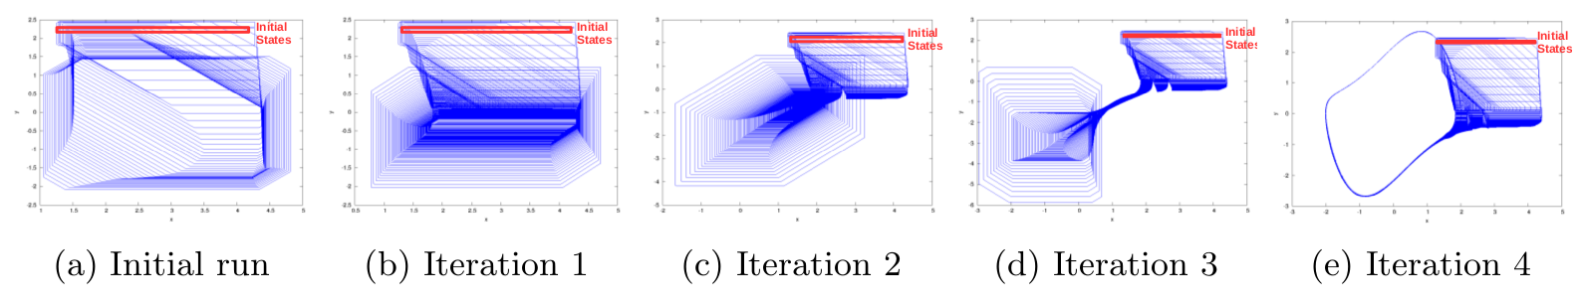
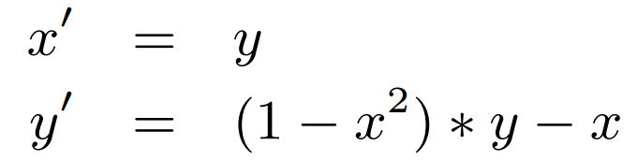
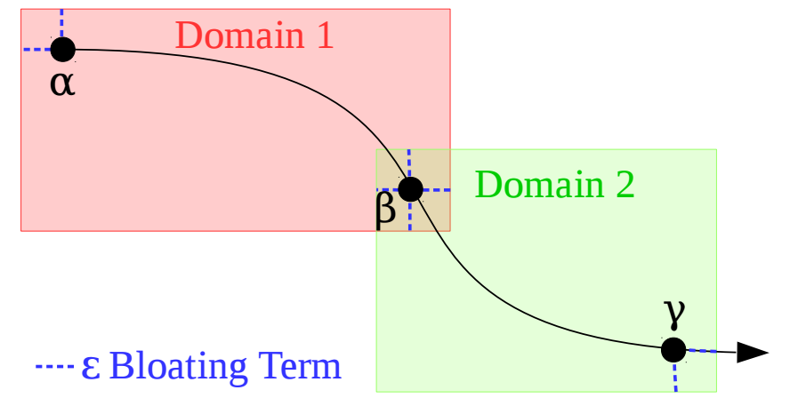
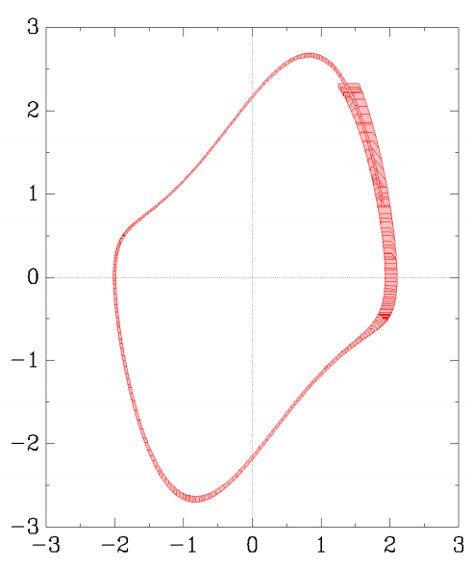
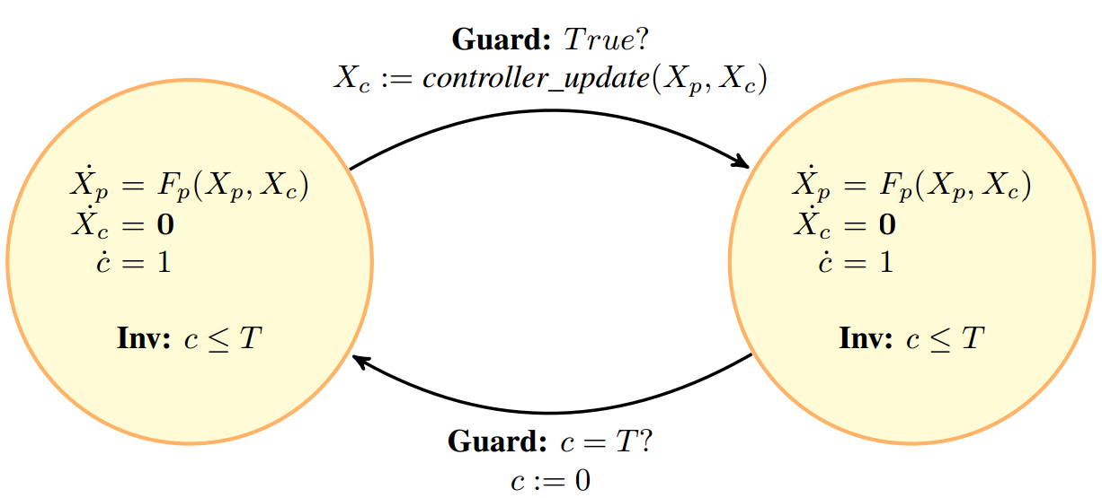
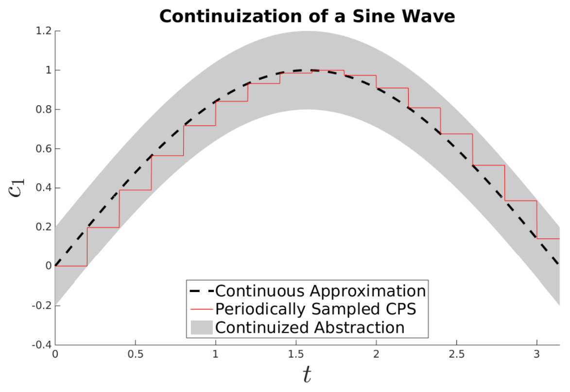
Model Generation for Hybrid Systems Verification in HYST
Stanley Bak¹, Sergiy Bogomolov², Taylor T. Johnson³
¹Air Force Research Laboratory (AFRL), USA, ²Institute of Science and Technology (IST) Austria, ³University of Texas at Arlington (UTA), TX USA
Overview
Model Generation
HYST: a source-to-source translation tool for hybrid automaton models [4]. Three main functions:
- Model translation
- Model transformation
- New: Model Generation
Navigation Benchmark [6] (others: Chains of Integrators Benchmark [2])
Dynamics: Velocities are steered towards target velocities:
NAVIGATION BENCHMARK GENERATOR PARAMETERS:
-i_list i1 i2 ... : space-separated list of target
velocity i value for each mode
, each i is 0-8 or 'A' or 'B'
-matrix a11 a12 a21 a22 : space-sepeated values of four-
element matrix A, like
'-1.2 0.1 0.1 -1.2'
-noise VAL : amount of input noise [-val,val]
to add to xvel and yel
(default: 0.0)
-prefix NAME : mode name prefix (default: mode_)
-startx REAL : x start position
-starty REAL : y start position
-width WIDTH : width of the grid (# of modes)
Generated
Model
Flow*
HYST
Intermediate
Representation
HyCreate
From Original Paper
Generated and Simulated
SpaceEx
XML
dReach
Model Transformation
SpaceEx
Transformation: Automated
Pseduo-Invariants[1]
(others)
Model transformations ease modeling and improve reachability analysis:
- Model Optimization
- Hierarchy Flattening
- Look-up Table Conversion
- Model-Order Reduction
- Automated Pseudo-Invariants [1]
- Continuization of Real-Time Controllers [5]
- Simulation-Guided Hybridization [3]
Multiple Iterations may be Necessary
Simulations are used to determine the placement of auxilary hyperplanes, improving accuracy.
Vanderpol Dynamics
Auxiliary Hyperplane
Transformation: Static Simulation-Guided Hybridization [3]
Transformation: Continuization of Real-Time Controllers [5]
References
Real-time scheduling guarantees periodic actuation for low-level controllers.
Continuization enables analysis of such systems using continuous dynamics approximations with additional bounded noise.
HYST is open source: https://github.com/verivital/hyst
[1] “High-level Hybrid Systems Analysis with Hypy”, S. Bak, S. Bogomolov and C. Schilling, ARCH 2016, Best Tool Award
[2] “Chains of Integrators as a Benchmark for Scalability of Hybrid Control Synthesis”, S. Livingston and V. Raman, ARCH 2016
[3] "Scalable Static Hybridization Methods for Analysis of Nonlinear Systems", S. Bak, S. Bogomolov, T. Henzinger, T. Johnson, P. Prakash, HSCC 2016, Best Repeatability Evaluation Award
[4] "HYST: A Source Transformation and Translation Tool for Hybrid Automaton Models", S. Bak, S. Bogomolov, T. Johnson, Tools Paper, HSCC 2015
[5] "Periodically-Scheduled Controller Analysis using Hybrid Systems Reachability and Continuization", S. Bak, T. Johnson, RTSS 2015
[6] "Benchmarks for Hybrid Systems Verification", Fehnker et. al, (HSCC 2004)
Model of a Real-Time
Low-Level Controller
Simulation-Guided Domains
SpaceEx Result
Time-triggered transitions and limited linearization domains enable scalable abstractions for nonlinear systems.
Enclosing Abstraction
DISTRIBUTION A. Approved for public release; Distribution unlimited. (Approval AFRL PA #88ABW-2016-3196)

