Slide 1
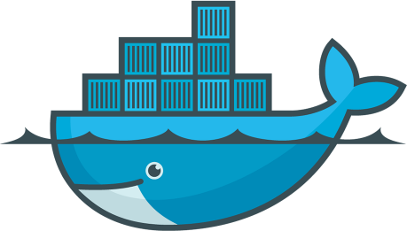
DevOps & Cloud Infrastructure SEIS 665 Containers Review
Jason Baker
Adjunct Instructor
Graduate Programs in Software
University of St. Thomas
St. Paul, MN

Slide 2
Agenda
Questions
Assignment 9 solution
Lecture review
Classroom project

Slide 3
Lecture Review
Containers
A way to encapsulate an application and its dependencies in a lightweight and portable environment.
A super process
Container benefits:
Write once and run anywhere.
Eliminate dependency conflicts.
Easy to deploy.
A container isn't a VM.
Containers use the same kernel as the host.
Containers have their own process space and networking stack.
Containers can't emulate physical devices
Containers can start up in seconds.

Slide 4
Lecture Review
Docker
A client-server technology which manages containers.
Think of this as an API wrapper around kernel-based container technologies.
Docker daemon/server
Docker client
Docker registry (Hub)
Working with Docker containers
Run in interactive vs. detached mode
List, start, stop, remove containers

Slide 5
Lecture Review
Docker image
Consists of layers -- unified file system
Designed to optimize downloading and building of images
Image is read-only
Building Docker images
Create an image starting from an existing image.
Image tags
Dockerfile

Slide 6
Lecture Review
Dockerfile commands
FROM, LABEL, CMD, ENTRYPOINT, COPY, WORKDIR, ENV, EXPOSE
Networking
Port mapping
Drivers: bridge, null, host, container
Volumes
Allow data to persist outside of container.
Bind mount: map host directory to container directory
Docker compose

Slide 7
Classroom Project
Attendance
Overview:
Create a basic Docker container using a Dockerfile.
Show me your work when completed!

Slide 8
Homework
Assignment 10: Docker
Read Infrastructure as Code Chapter 15
Watch Lecture 12 videos

