Slide 1
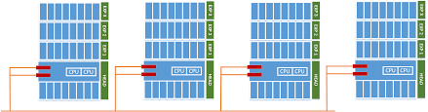
DevOps & Cloud Infrastructure SEIS 665 Lecture Review Week 3: Virtualization
Jason Baker
Adjunct Instructor
Graduate Programs in Software
University of St. Thomas
St. Paul, MN

Slide 2

Agenda
Questions
Assignment 2 solution
Lecture review
Distributed infrastructure patterns
NoSQL
Virtualizations
VirtualBox demo
Vagrant demo
Classroom project

Slide 3
Lecture review
Distributed infrastructure patterns
Load balancing
Proxy systems
Server trees
Database sharding
CAP Principal
Consistency, Availability, Partition tolerance (pick 2 of 3)
NoSQL
Key/value
Columnar
Document
Graph

Slide 4
Lecture review
Virtualization: software which emulates hardware
Hardware virtualization
Software virtualization
Type 1 vs type 2 hypervisor
OS Partitioning

Slide 5
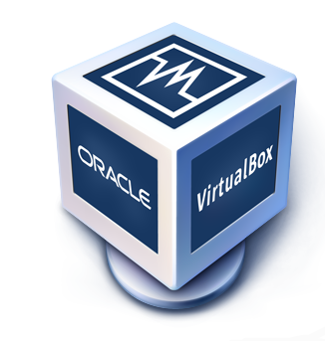
VirtualBox
Hypervisor for x86 systems originally developed by Innotek, acquired by Sun, acquired by Oracle.
Core package is open source, extensions are licensed by Oracle for personal/educational use.
Not quite as fast as some commercial offerings but fast enough for most development.

Slide 6
VirtualBox Demo
Create Linux virtual machine.
Type: Linux
Version: Other Linux (64-bit)
512 MB memory
Add Alpine Linux disk image to virtual optical drive.
Settings -> Storage
Power on new VM and login as root

Slide 7
Virtual machine challenges
Creating virtual machines is time-consuming, repetitive, and mistake prone.
Imagine needing to stand up dozens or hundreds of test environments a day.
Sharing virtual machines is kind of a pain.
Traditionally, you would create machine images and store image versions in a repository.
What if we could just share the description of a VM without having to share the actual image?

Slide 8

Vagrant
Vagrant automates the creation of virtual machines using infrastructure as code practices.
Started by Mitchell Hishimoto in 2010 as a personal project.
HashiCorp founded in 2012 for commercial support.
Allows a user to programmatically launch virtual machines using a definition file (Vagrantfile).
Launch one or many VMs on VirtualBox, VMWare, Hyper-V, Docker and AWS.
Works as a “wrapper” around virtualization software and written in Ruby.
Share complete virtual machines with a simple Vagrantfile.

Slide 9
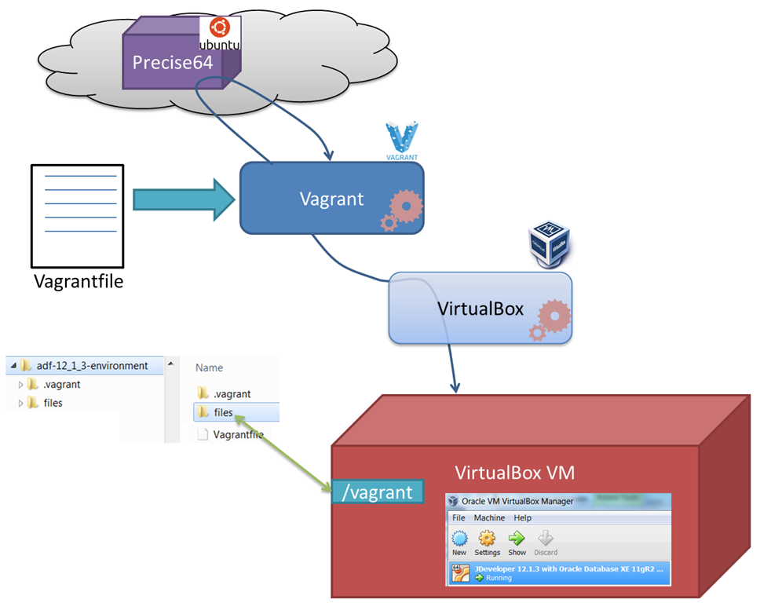
Vagrant architecture

Slide 10
Vagrant Commands
$ vagrant init <optional box>
Create a new Vagrantfile and working directory.
$ vagrant up
Launch a new VM using the Vagrantfile configuration.
$ vagrant ssh
Create an ssh connection to the VM.
$ vagrant destroy
Remove the VM.

Slide 11
Vagrant Demo #1
Create a new ubuntu VM
$ vagrant init ubuntu/trusty64
Review Vagrantfile configuration options.
Launch the new VM:
$ vagrant up
Review the VM ssh configuration:
$ vagrant ssh-config
SSH into the new VM:
$ vagrant ssh
Review the default shared directory:
$ cd /vagrant
$ touch foo
Delete the VM:
$ vagrant destroy

Slide 12
Vagrant Demo #2
Review provisioning Vagrantfile
Launch the vm:
$ vagrant up
Watch provisioning process.
View webserver running on vm:
http://localhost:8081
Remove the virtual machine:
$ vagrant destroy

Slide 13
Classroom Project
Overview:
Setup a VirtualBox and Vagrant environment on your workstation. Build a simple webserver VM using Vagrant.
VirtualBox is not supported on campus lab workstations.
Work with another classmate on this project.
Show me your completed Vagrantfile.
Project link is in Canvas.

Slide 14
Homework
Assignment 3: Shell Scripting
Read Overview of Amazon Web Services (April 2017)
Watch Lecture 4 videos

