Slide 1
Simulation technique for cache performance analysis
Abhijeet Kumar (amk7371)
Abhishek Kumar (azk6085)

Slide 2
Outline
Introduction
Why matmul is so important?
Sparse Matrix Multiplication
Matmul kernel
ijk algorithm
ikj algorithm
Strassen
SPGEMM
SMASH
Simulation Infra
Intel Pin tool
Cache Simulator overview
Quick Demo
Results
Project Overview

Slide 3
Why Matmul is so important?
It is one of the most important matrix operation and used in multiple domains like AI, computer vision, network theory etc.
Because of it being bottleneck in many workloads, computer architects always look for a way to optimize their system for to mat-mul operator.

Slide 4
Sparse Matrix multiplication
Newer workload tends to work on Sparse data
Recommendation System (Recsys)
Graph Analytics
Graph Neural network
Real world matrices have high sparsity
Embedding table used in real workload of FB/YouTube having 0.0003% non-zero element
Thus, it is important for architects to optimize their memory system to make it friendly to sparse matrix

Slide 5
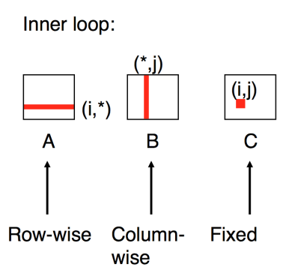
Matrix Multiplication (ijk)
for (i=0; i<n; i++) {
for (j=0; j<n; j++) {
sum = 0;
for (k=0; k<n; k++) {
sum += a[i][k] * b [k][j];
}
c[i][j] = sum;
}
}

Slide 6
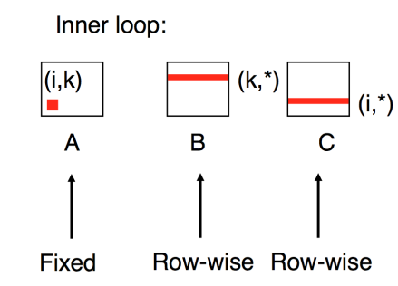
Matrix Multiplication (ikj)
for (i=0; i<n; i++) {
for (k=0; k<n; k++) {
const = a[i][k];
for (j=0; j<n; j++) {
c[i][j] += const * b [k][j];
}
}
}

Slide 7
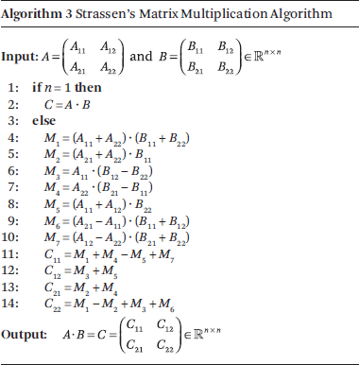
Strassen Algorithm
It is based on divide and conquer rule.
It reduce the number of multiplication by 1 (i.e., instead of 8 multiplier Strassen have only 7)
Initially it was estimated to perform well with matrix size of 32 and above but as Huang et. al. [1] in the modern architecture Strassen outperform standard algorithm only in case of 1000+ matrix size.
[1] Huang, Jianyu; Smith, Tyler; Henry, Greg; van de Geijn, Robert (2016). Strassen's Algorithm Reloaded. International Conference for High Performance Computing, Networking, Storage and Analysis (SC'16)

Slide 8
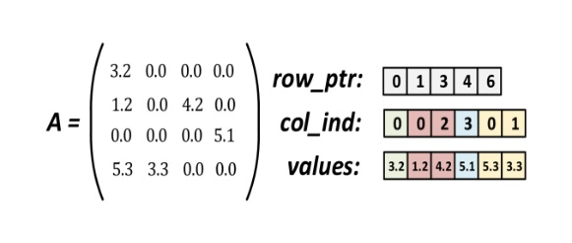
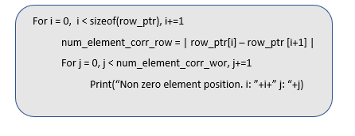
Sparse Matrix Multiplication (in CSR format)
Key points about CSR format storage:-
N dimension sparse matrices get converted to three 1D array
Since it make use of row access it consume less numbers of cycle to access non-zero element

Slide 9
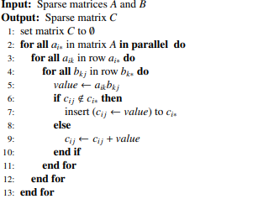
SpGEMM
Find nnz entry of matrix A and B
Row of output matrix is constructed by accumulating partial output from each iteration
F. G. Gustavson, Two fast algorithms for sparse matrices: Multiplication and permuted transposition, ACM TOMS 4 (3) (1978) 250–269

Slide 10
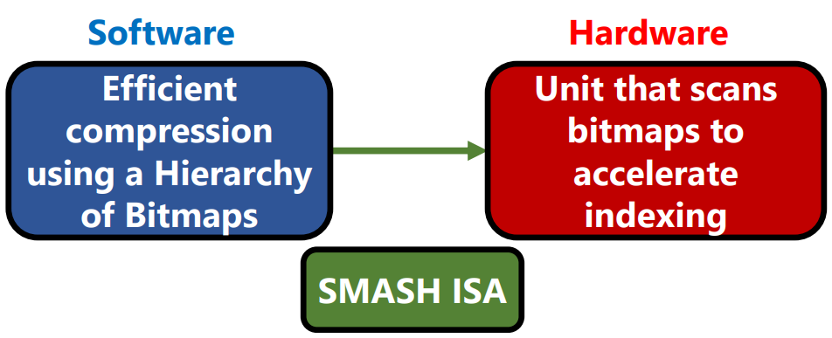
SMASH[1]
HW/SW co-designed method aims at efficient storage and computation of sparse matrices
[1] Konstantinos Kanellopoulos, Nandita Vijaykumar, Christina Giannoula, Roknoddin Azizi, Skanda Koppula, Nika Mansouri Ghiasi, Taha Shahroodi, Juan Gomez-Luna, and Onur Mutlu, SMASH: Co-designing Software Compression and Hardware-Accelerated Indexing for Efficient Sparse Matrix Operations
Proceedings of the 52nd International Symposium on Microarchitecture (MICRO), Columbus, OH, USA, October 2019.

Slide 11
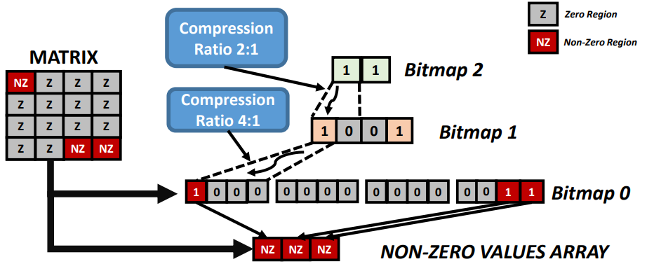
Software Compression Scheme

Slide 12
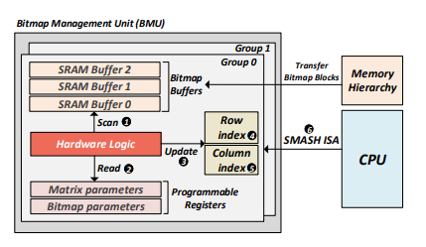
Hardware Acceleration unit
Interprets the bitmap hierarchy used in software
Buffers the Bitmap hierarchy and scans it using bitwise operations

Slide 13
Intel Pin framework
Pin is a dynamic binary instrumentation framework for the IA-32,x86-64 and MIC instruction-set architecture that enabled the creation of dynamic program analysis tool.
Pin Framework provide APIs that can add probes to the already compiled executable for dump memory access traces.
Notes:
Intel Xeon CPU E5 @3.5GHz

Slide 14
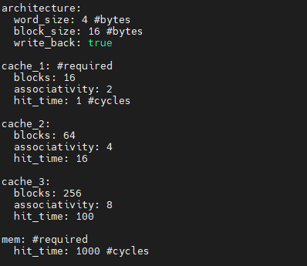
Cache Modelling
Python based simulator which take cache config(yaml file) and traces (pintool output) as input to estimate the cycle and cache stats.
3-level Cache Config file

Slide 15
Simulator
Init Stage
Parse YAML file passed as input from user
Sanity Check and Memory hierarchy creation
Rd
Wr
Parse Addr
Check if exist in current level
If not available, in current level issue rd to the next level. If available, then read and exist from method.
Write response to the current level
Repeat step ii-iv till you find the data or done walking over all level of cache
Parse Addr
Check if block exist
If block exist, then write in cache. If not, then check if space available and create corresponding block.
If space not available, then evict oldest from the cache and try creating block again.

Slide 16
Project Overview
Implement multiple kernel on C++
Modify existing pintool to add hooks in the traces
Develop infra to automate the process
Develop Matmul Kernel and infra to dump memory access traces
Develop easily configurable cache model on python
Add utility scripts to convert matrices in multiple format
Add sanity checks to increase confidence on simulator
Feed traces to cache analytical model
Evaluate cache behavior for multiple kernel
Perf Analysis for different scenarios
Profiling simulator to gain simulation speed

Slide 17
Simulator Sanity Check
Matmul 10X10 Sparsity: 10%
 | L1 Hit % | L2 Hit % | L3 Hit % | Cycle (in millions)
ijk algo | 75.56 | 65 | 78 | 11.9
Boost lib | 81 | 96 | 77.35 | 4.5
Strassen | 86 | 84 | 76 | 4.9
ikj algo | 85 | 81 | 64.94 | 1.8
SpGEMM | 85 | 50 | 42 | 1.7
SMASH | 73.79 | 73.3 | 46.3 | 1.06
Matmul 10X10 Sparsity: 50%
ijk algo | 75 | 65.8 | 77.3 | 12.1
Boost lib | 80.63 | 96.7 | 74.84 | 4.1
Strassen | 86.8 | 84 | 75.36 | 4.9
ikj algo | 85 | 80 | 65 | 1.8
SpGEMM | 85 | 51.1 | 42 | 1.08
SMASH | 73.1 | 75.38 | 43.98 | 1.07

Slide 18
Simulator Sanity Check
Matmul 10X10 Sparsity: 80%
 | L1 Hit % | L2 Hit % | L3 Hit % | Cycle (in millions)
ijk algo | 75.3 | 64.83 | 78.73 | 11.9
Boost lib | 80.87 | 96.2 | 76.9 | 4.1
Strassen | 86.78 | 83.46 | 76 | 4.9
ikj algo | 85.4 | 80.19 | 64.54 | 1.8
SpGEMM | 83.08 | 50.65 | 42.71 | 1.06
SMASH | 73.77 | 73.4 | 43.4 | 1.06

Slide 19
Matmul 50x50 Sparsity: 10%
 | L1 Hit % | L2 Hit % | L3 Hit % | Cycle (in millions)
SpGEMM | 96.82 | 94.30 | 55.42 | 4.2
SMASH | 80.92 | 97.64 | 51.76 | 2.9
Matmul 50x50 Sparsity: 50%
SpGEMM | 96.65 | 95.23 | 51.49 | 4.3
SMASH | 81.60 | 93.89 | 73.28 | 2.9
Matmul 50x50 Sparsity: 80%
SpGEMM | 96.59 | 97.18 | 45.46 | 4.2
SMASH | 81.7 | 97.57 | 47.83 | 2.7

Slide 20
Matmul 100X100 Sparsity: 10%
 | L1 Hit % | L2 Hit % | L3 Hit % | Cycle (in millions)
SpGEMM | 96.85 | 97.35 | 72.2 | 23.06
SMASH | 86.15 | 90.42 | 96.75 | 23.57
Matmul 100X100 Sparsity: 50%
SpGEMM | 96.98 | 97.06 | 75.5 | 23.06
SMASH | 86.95 | 91 | 95 | 15.56
Matmul 100X100 Sparsity: 80%
SpGEMM | 96.24 | 97.24 | 68.5 | 23.06
SMASH | 86.71 | 90.6 | 92 | 7.85

Slide 21
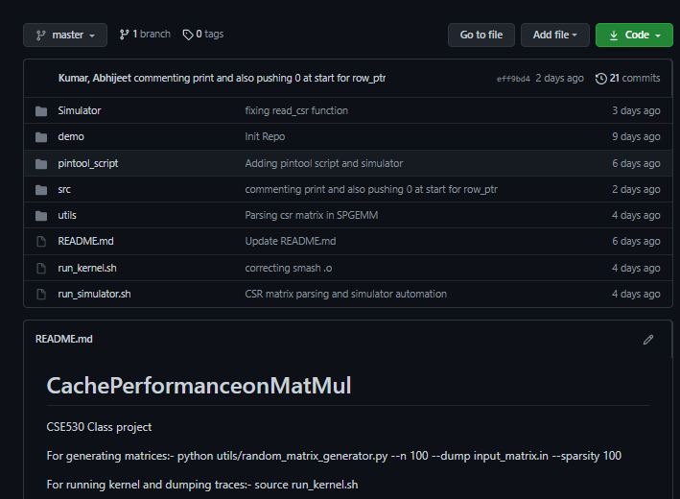
Repo Structure

Slide 22
Future work
On-the-fly memory access trace parsing
Profiling simulation speed
Evaluate cache performance when sparse matrix is store in LinkedList format

