Slide 1

Group 6 - Stock Exchange
Tuesday, June 29, 2021
Team members: Barry, Chinanu, Sirisha and Ritesh

Slide 2
Agenda
Overview & Problem Statement
Dataset Description
Glimpse of Data
Design Process
Shiny App
Demo
Continuous Learning
Observations

Slide 3
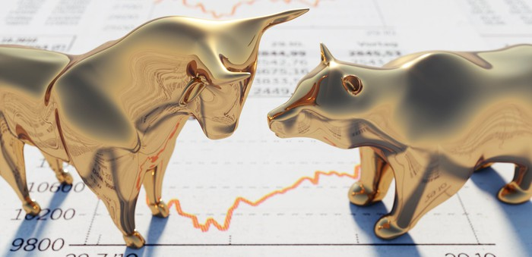
Stock Exchange Data
Problem Statement:
Analyze volatility of 13 stock indexes and its comparison and then predict future trend of stock market.
Notes:
Problem statement: if trend of stock goes down how it impacts other indexes
bullets

Slide 4
Dataset Description
indexData - Raw index price information, prices are quoted in each exchanges national currency
IndexInfo - Stock exchange info including location, name of exchange, index ticker, and currency index is quoted in
indexProcessed - index price information with null values removed and closing prices in USD added as a column
Dataset | Description | Observations
1 | indexData | 112458
2 | indexInfo | 15
3 | indexProcessed | 104225

Slide 5
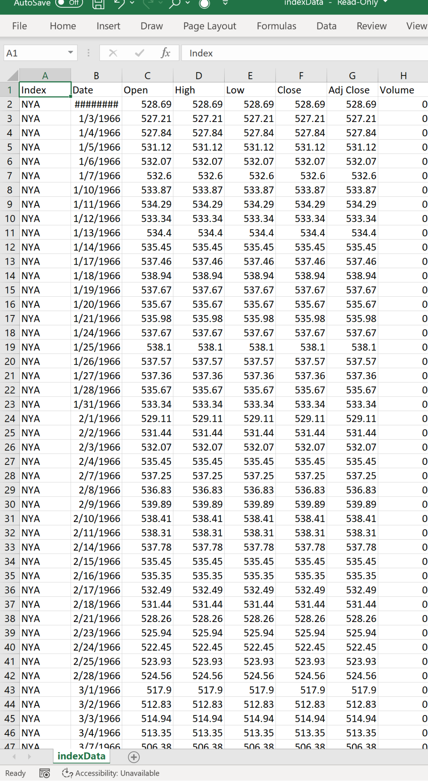
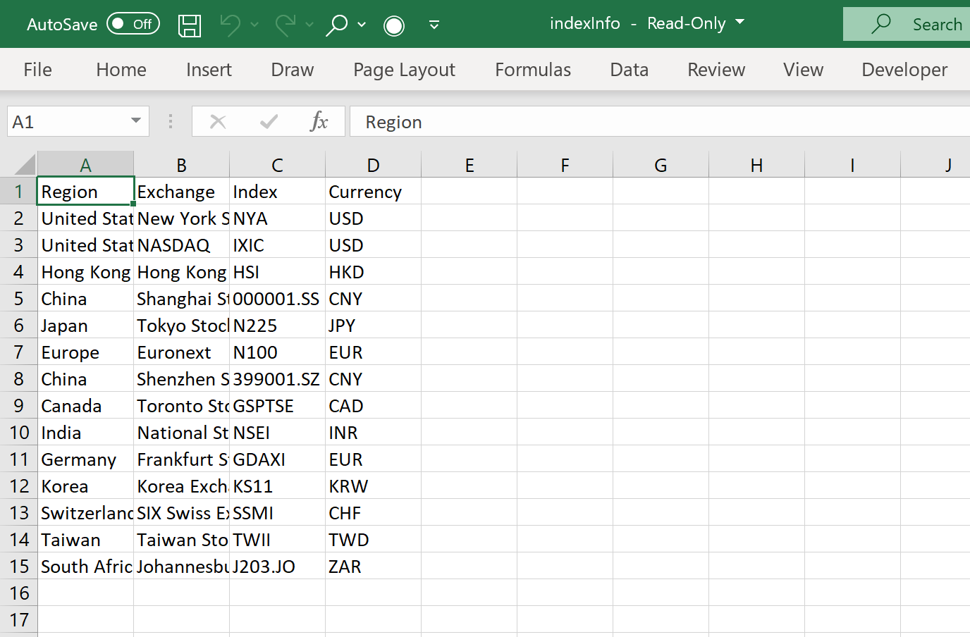
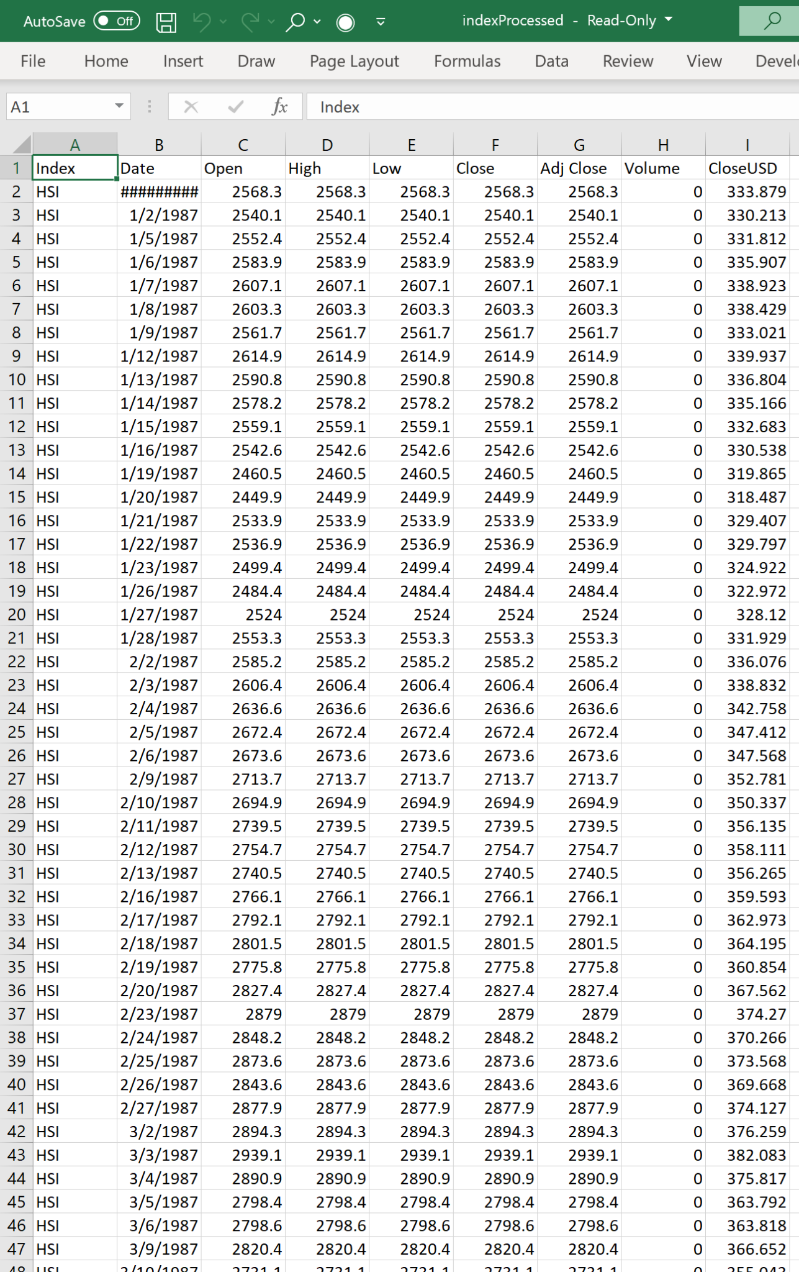
Glimpse of DataSets

Slide 6
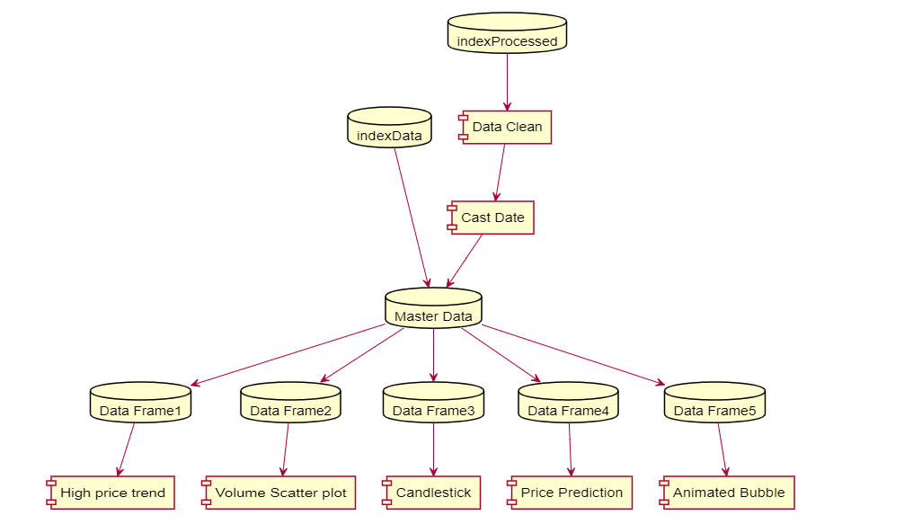
Design Process
Notes:
Put into words how we created the ShinyApp. Need help from Ritesh and Sirisha here. I am not sure how you all designed the shiny app

Slide 7
Shiny App
The objective of Shiny App is to create interactive graphical representations of Stock Index. Here are the charts:
High price trend
Overall Stock Index trend and their comparison on a given time.
Scatter plot
Overall Stock Index volume and their comparison on a given time.
Candlestick
Fluctuation of Stock Index on each day, month and year and their comparison
ARIMA price prediction plot
Prediction of future months Fluctuation of Stock Index based on Closing price.
Animation plot
Depicts overall closing price changed in comparison with other.
Link to shiny app
Notes:
explain each tab

Slide 8
Continuous Improvement
Include external factor like inflation, crude oil index, gold and silver index for prediction future stock index trend
Include dollar index
Include Country name in left navigation as oppose to index name
Include more left navigation options to help predict future trend
Include user friendly print and email options on these charts
Include bootstrap as oppose to fluidpage for the charts so that it is responsive.

Slide 9
Observation Report
This report is developed using HTML based RMarkdown and bookdown. We created six sections to capture following:
Introduction
Data/Operation Design
Encoding/Interaction
Algorithm design
User evaluation
Future work
Appendix
Navigate to bookdown report

