Slide 1
Common Plants And Trees In Finland
Here you will find some facts about Common plants in Finland.
Shubh Verma 4'S

Slide 2
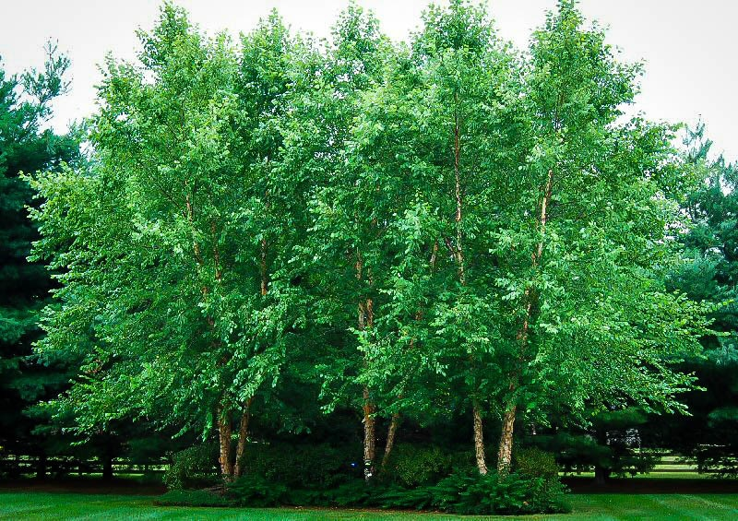
Birch Tree
A birch is a thin-leaved deciduous hardwood tree of the genus Betula (silver birch). The birch is common in forested and treeless bogs throughout the country. In Lapland, it can also be found in mountain heaths.

Slide 3
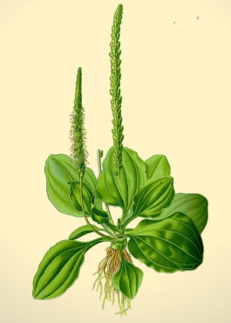
Plantain low profile and non-aggressive habit often leave it protected from the homeowner.
Common plantain’s rise in Finland and practically everywhere that has a similar climate as one of the most common and abundant plants around inhabited areas is based on its astonishing ability to stand human turmoil.
Common Plantain

Slide 4
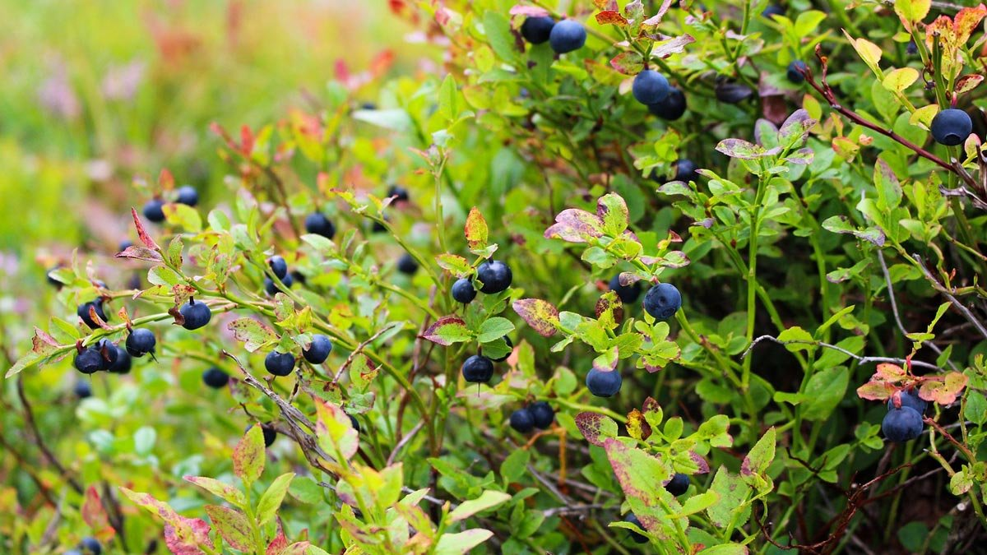
Every year Finns roam to forests to forage for blueberries.
Blueberries taste delicious, Finnish everyman’s rights allow you to pick them for free in our country’s vast forests, and the berries are packed with essential nutrients that are good for you.
Blue-Berry Plants

Slide 5
Thank You For Watching
Shubh Verma 4's

