Slide 1
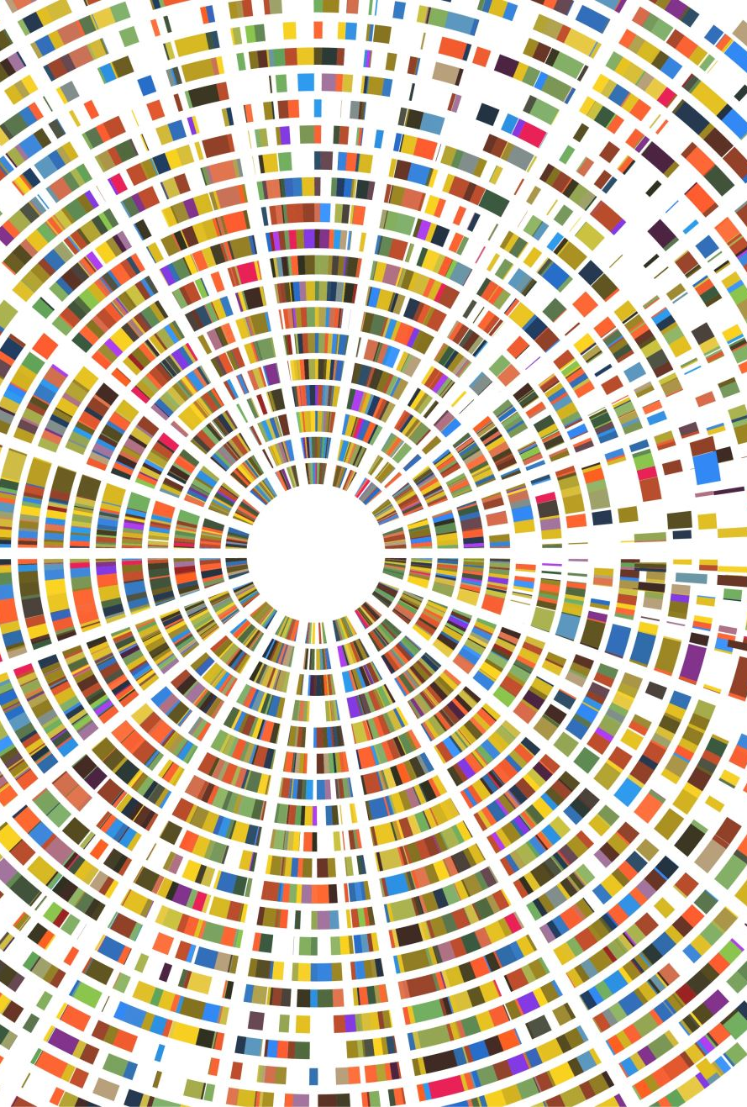
The Impact of AI
Using NLP techniques and methods
Yash Verma
05/12/2023

Slide 2

Agenda
Executive Summary
Actionable Recommendations
Data Processing and Text Cleaning
Sentiment Analysis
Sentiment Analysis with Time
Entity Detection
Target Entity Sentiment

Slide 3
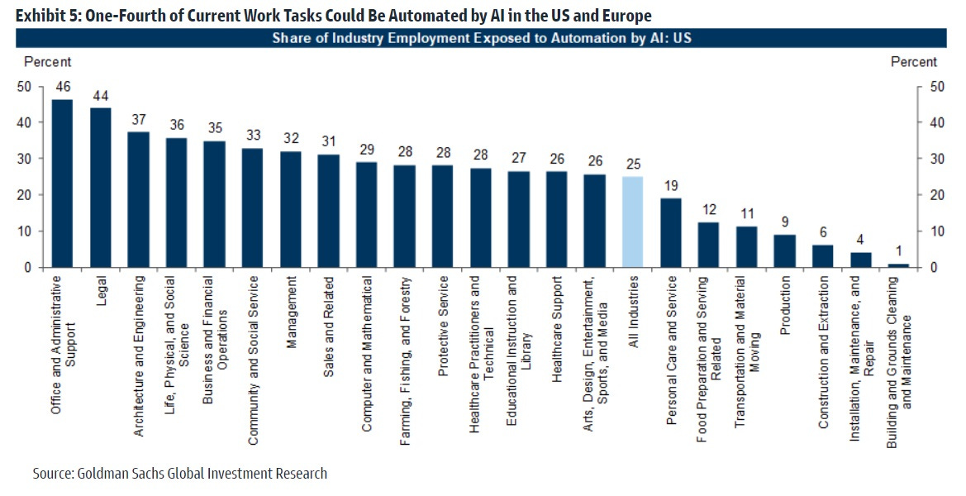
Executive Summary
Introduction - Goldman Sachs released an analysis of how AI will affect the industries and jobs in the market by automating the jobs.
Purpose – The executable task or goal for us is to verify or explore the actual effect of AI on the industries and the jobs through 200k+ articles that are related to Data Science, Machine Learning and Artificial Intelligence.
Key Points –
The articles were very widely distributed in terms of actual relation to the topic.
The important factors like the industries and the sentiment related to the topic of AI in relation to the companies is needed.
The distribution of these sentiments over time will also clarify the wave of AI
In the graph from Goldman, we can see the automation room every industry has according to the company

Slide 4
Executive Summary
4. Sentiment - Over time, sentiment analysis showed a consistently positive view of data science technologies, despite privacy and legal concerns. The study highlights how advancements in deep learning, natural language processing, and reinforcement learning are reshaping the field. To stay relevant, individuals in data science roles should take proactive steps to avoid AI-driven job displacement.
5. Techniques & Findings:
I used multiple NLP based techniques to filter out the text column of all the special characters and remove email ids, links, social media handles etc..
Then after the filtering sentiment analysis was done on overall data frame to know the major theme of the articles in terms of AI’s impact.
Over time analysis was used to see the consistency of the topic’s relevance.
Entity and Region segregation analysis was used to understand the top companies that have been discussed in the articles.
Topics were segregated to know the top topics for positive and negative themes
After the process of analysis, it was found that majorly the sentiment have been more positive and less negative, which would indicate the people that are getting affected according to media is not as true as it seems.

Slide 5

Actionable Recommendations
Learning for Collaboration: Embrace ongoing learning and adaptability to stay ahead. Explore AI trends like ChatGPT and OpenAI and consider reskilling to align with evolving job market demands.
Human-AI Synergy: Prioritize collaborative roles were AI augments human skills. Invest in retraining and create positions that leverage AI's potential while retaining human insight.
Strategic AI Skill Enhancement: Invest in AI training to enhance data literacy and decision-making. Upgrading knowledge of AI concepts, algorithms, and best practices will boost value in an AI-driven workplace.
Regulation and Ethical AI: Champion robust regulations for AI usage, privacy, and media roles. That will help the public and media to get behind the inevitable helper that is AI.

Slide 6

Data Processing and Text Cleaning
The total amount of articles were 200k+ and for the analysis it was a lot and also the articles were not clean for the analysis, so the processing of the data was needed to filter out and extract only the important articles:
From the column “language” only English was selected.
The date column was changed into the DateTime format and was then used to pull out the days, months and years from the column.
Regex technique was used to clean the “text” and “title” column for clearing the text of all email ids, special characters, filler words etc..
A highly customized and specific set of keywords were used to filter out the articles that match with the keywords so that the topic was still relevant to AI that left me with 1,57,235 relevant articles
The number of articles is still high for processing on my machine so using the length further articles were filtered and then finally a random sample was taken.

Slide 7
Sentiment Analysis
There are a lot of different ways in which I could analyze the sentiment using the clean and filtered text column that has been tokenized and using lemmatization technique the words were broken down to their most simple form for better and faster analysis.
I used 2 different approaches that yielded 2 different results, one approach was using a custom sentiment prediction model and training it on already labeled Yelp data which based on the text classified the sentiments.
The other method was a dictionary-based method called Vader (Valence Aware Dictionary and Sentiment Reasoner) unlike the trained model above, Vader uses sentiment scores which allows it to distinguish sentiments more accurately rather than being binary.
The dictionary-based method was found to have performed better as its classification covers more spectrum in better details.

Slide 8
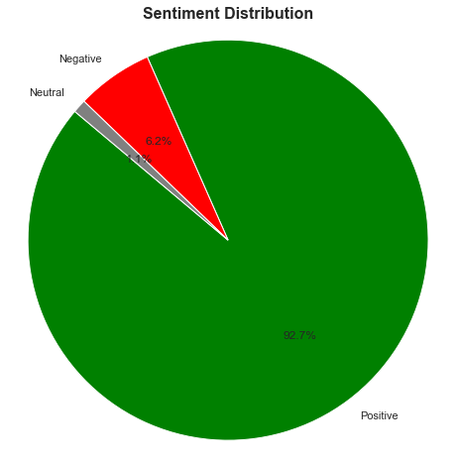
Sentiment Analysis
As we can see from the pie chart that the sentiment analysis shows that ~93% sentiment was positive and very few percentage of the sentiment was negative and just 1% was classified as neutral
It shows us that the articles carrying the information about the AI and Data science related topics have not too bad of sentiments in the eyes of the media and public.

Slide 9
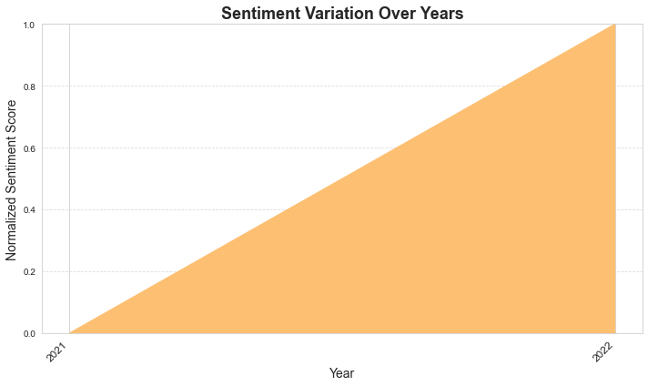
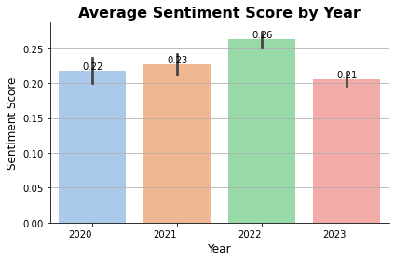
Sentiment Analysis Over Time
The sentiment trend for data science and machine learning technologies shows an initial upward trajectory until 2022, followed by a subsequent decline in sentiment from 2022 to 2023. This shift could be attributed to the release of so many LLM’s that does so much work for us, and it changed the point of the view of the media. Despite these fluctuations, the overall sentiment towards data science technologies remains largely positive.

Slide 10
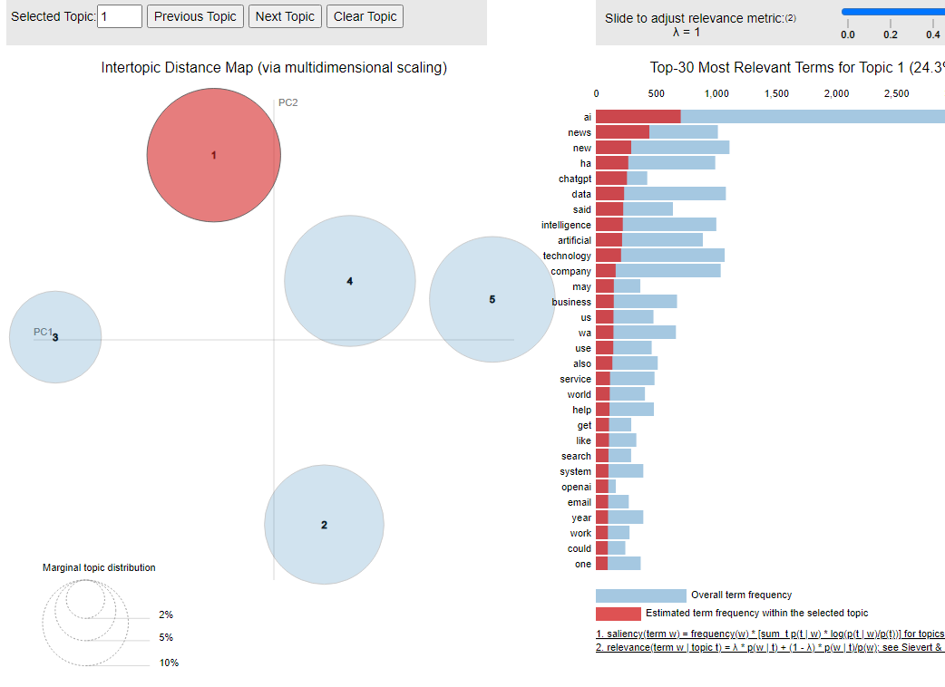
Positive Topic Detection using LDA
The top positive topics that came up after topic modeling and detection were:
AI
ChatGPT
Technology
Data
These topic represent the positive aspects of AI and gets reflected in the articles.

Slide 11
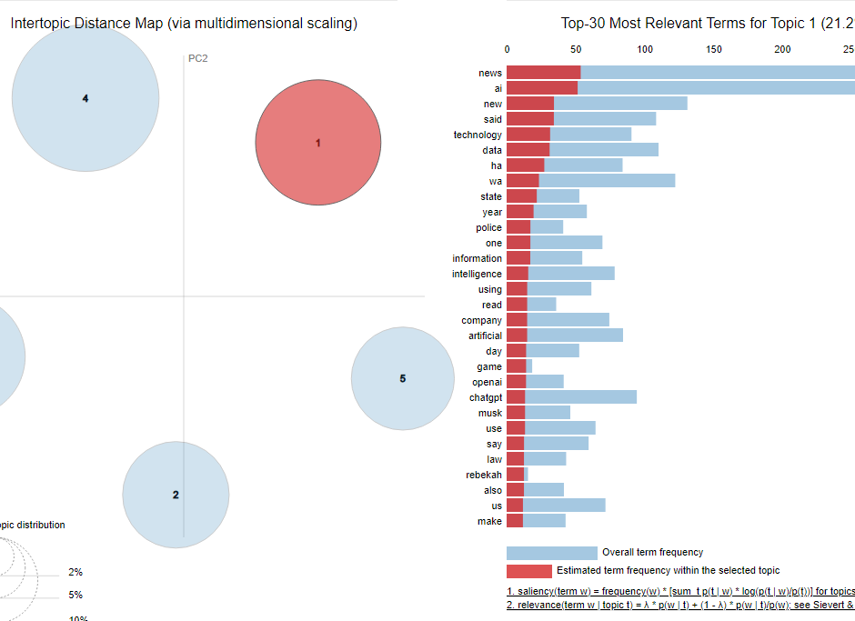
Negative Topic Detection using LDA
The top negative topics that came up after topic modeling and detection were:
News
Media
Artificial Intelligence
Data
As this topic is new thing for the whole world the relation with the fear of change gets reflected here.

Slide 12
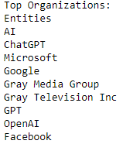
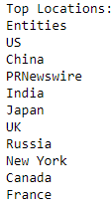
Entity Identification
The top entities/ Organizations that were mentioned were mostly the Tech giants like Microsoft, Google and of course with the big wave of ChatGPT OpenAI also gets added to the list.
Surprisingly Gray Media Group also came in the list, as it is a television broadcasting company, but after digging deeper I found that they covered some news about AI changing the news industry.
The top countries were US, China and India. Which makes sense because these are the top tech countries.

Slide 13
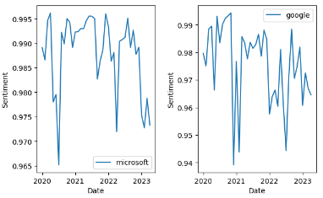
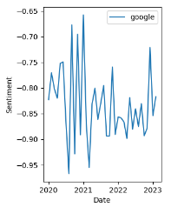
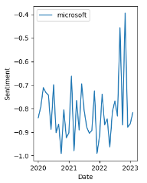
Target Entity Sentiment Over Time
POSITIVE
For the Targeted entities, the top-most were Microsoft and Google and as we can see the sentiment have dropped after 2022, which I am guessing must be related to their involvement with AI models like ChatGPT and BARD
NEGATIVE
The companies received some drastically high negative sentiments as Microsoft invested in ChatGPT and Google produced Bard, making people wonder about the AI effect more

