Slide 1

Books Recommendation System
Yash Verma
24/05/2023

Slide 2
CONTENT
1. Problem Statement
2. Data
3. Exploratory Data Analysis
4. Feature Engineering & Transformations
5. Proposed Approaches
6. Model Selection
7. Results and Learnings from the methodology
8. Future Work

Slide 3
Problem Statement
The problem we aim to solve is the overwhelming task of finding the right book amidst a vast array of choices. With the ever-increasing availability of books, users often struggle to identify titles that align with their interests and tastes.
This challenge calls for an intelligent recommendation system that can analyze user preferences, understand book characteristics, and generate accurate and relevant recommendations.

Slide 4
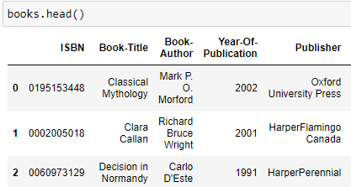
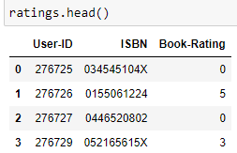
Data
The project involved three distinct datasets: Books, Users, and Ratings, each containing relevant information such as "Book-Author," "Book-Title," and "User-ID."
The underlying assumption was the availability of common identifiers across datasets, facilitating their integration for collaborative filtering purposes.
It was anticipated that the datasets would exhibit high data quality standards, including minimal missing values and empty columns, to ensure robust analysis and accurate recommendations.
https://www.kaggle.com/datasets/arashnic/book-recommendation-dataset

Slide 5
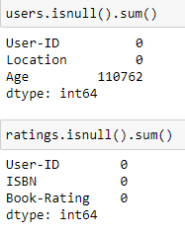
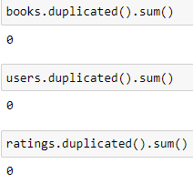
Exploratory Data Analysis
During the exploratory data analysis (EDA) phase, the focus was narrowed to specific columns required for the recommender model: "User-ID," "Book-Rating," and "Book-Title."
The analysis primarily involved examining null and duplicate values within these columns. The objective was to ensure maximum utilization of ratings data while excluding duplicate user entries to maintain data integrity and accuracy in the recommendation process.

Slide 6
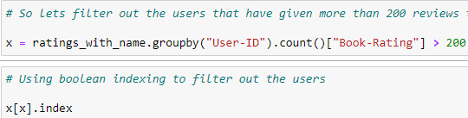
Feature Engineering & Transformations
After merging the datasets based on common columns, the primary features utilized were "User-ID," "Book-Rating," and "Book-Title." These features were used to create a table with the respective indexes for each value
To refine the dataset, feature engineering techniques were applied to identify users who provided more than 100 and 200 reviews, as well as books that received at least 50 reviews
Boolean indexing was employed to transform the columns using conditional arrays, enabling the extraction of targeted indexes from the filtered datasets.

Slide 7
Proposed Approaches
Collaborative Filtering: Pros: Leverages user behavior, but cold-start problem and popularity bias. Cons: User behavior-driven, limited information for new users/items.
Content/Popularity-Based Filtering: Pros: Uses item characteristics, but limited serendipity and potential over-specialization. Cons: Item-driven, overlooks broader user preferences.
Hybrid Approaches: Pros: Combines collaborative and content-based filtering, accurate and diverse recommendations. Cons: Complex integration, challenges in balancing components effectively.

Slide 8
Model Selection
The decision to adopt a balanced approach of Collaborative filtering was based on its ability to consider user preferences rather than solely focusing on the weight or popularity of selections, as observed in content/popularity-based filtering.
While hybrid approaches offer potential benefits, considering the project scope and dataset, a simple yet accommodating approach was deemed preferable due to ease of implementation and maintenance.
Collaborative filtering strikes a perfect balance by providing personalized recommendations while maintaining simplicity in the model.

Slide 9

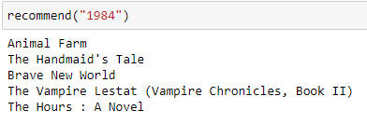
Results and Learnings
Before
Some users on Kaggle did not use proper selection of the ratings and the book features, which lead to poor results.
However, considering the variations in books in terms of authors and content, the feature thresholds were increased to users who gave > 200 ratings.
This adjustment led to impressive improvements in the recommendation outcomes, indicating a more refined and accurate system.
After

Slide 10
Future Work
Improve content filtering: Enhance the content-based filtering by incorporating more comprehensive data on book attributes like genre, keywords, and summaries for more precise and personalized recommendations.
Hybrid system integration: Explore the integration of collaborative and content-based filtering techniques to develop a hybrid recommender system, combining their strengths for improved recommendation accuracy and addressing the limitations of individual approaches.

