Slide 1



House Prices Forecasting
Yash Verma
25/05/2023

Slide 2


Content
Problem statement
Data
Data Properties
Data processing
Proposed approaches
Results and learnings from the methodology
Future work

Slide 3

Problem statement
The House Price Forecasting Project aims to develop a predictive model for accurately forecasting house prices. The challenge lies in the volatility and complexity of the real estate market, necessitating a reliable tool to assist buyers, sellers, and investors in making informed decisions. By leveraging historical data and key features, the project seeks to provide accurate predictions of future house prices, empowering users to navigate the market with confidence.

Slide 4
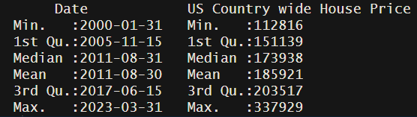
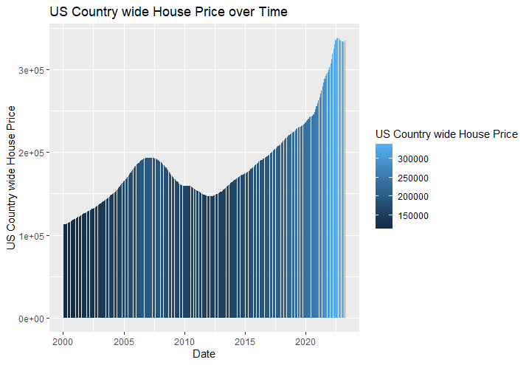
Data
I acquired this data from Zillow Housing data website
From Zillow, US House Price including 897 different regions, I selected the United States country data as my dataset
The dataset contains The Year/Month and the House Prices column
279 Total Observations, No missing data
Train Data: 1/31/2000 - 3/31/2022
Test Data: 4/1/2022 - 3/31/2023
https://www.zillow.com/research/data/

Slide 5
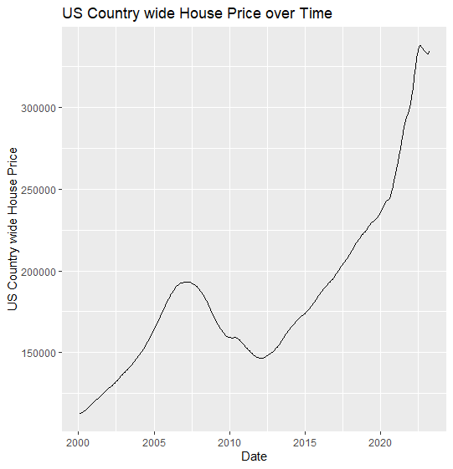
Data properties
Up and Down trend
Upward trend between 2000 - 2008
Downward trend between 2008 - 2012
Upward trend after 2012 until Fed rate increasing
No seasonality
Variance does not increase over time, therefore, NO Boxcox transformation is needed to stabilize variance
We can apply differencing to make data stationary

Slide 6

Data processing
The data was already in good format to be used for modelling, the “Year/Month” Column was in time format so, had to change it up in terms of date format
KPSS test – For the test when differencing once the P value(o.01) is less than 0.05, so continued with the 2nd order differencing .
P value (0.1) is greater than 0.05, therefore 2nd order differencing is needed to make data stationary.

Slide 7

Proposed approaches
ARMA: Suitable for forecasting time series data with autoregressive and moving average components. Trade-off: Assumes stationarity and may not capture non-stationary behavior.
Regression with ARMA: Combines regression analysis with ARMA models to capture predictors and temporal dependencies. Trade-off: Assumes constant relationships over time.
Exponential Smoothing: Models future values based on weighted past observations. Suitable for trend and seasonality patterns. Trade-off: Ignores external factors and may struggle with non-linear patterns.

Slide 8
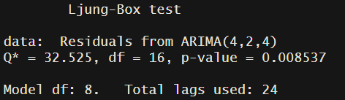
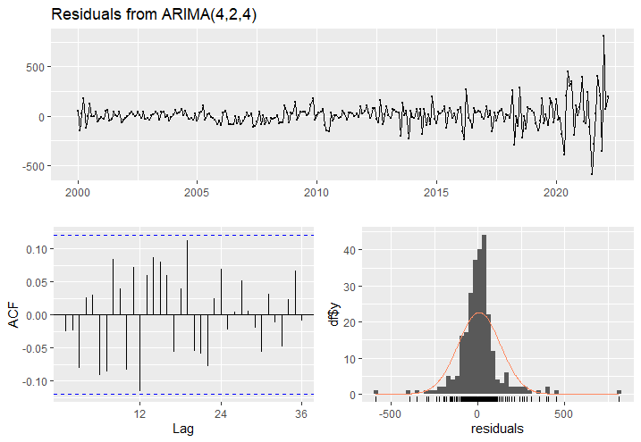
Arima
I ran 3 models to compare our P values and the ACF Plots
(6,2,2) , (6,2,3) , (4,2,4)
We will use (4,2,4) Arima Model as the ACF is in the range only for this model out of the 4
P - value in this model fails the test
RMSE value for all the models is similar so this is the best selected out of the 4 ARMA models
RMSE – 122.0328 & MAPE – 0.03937618

Slide 9
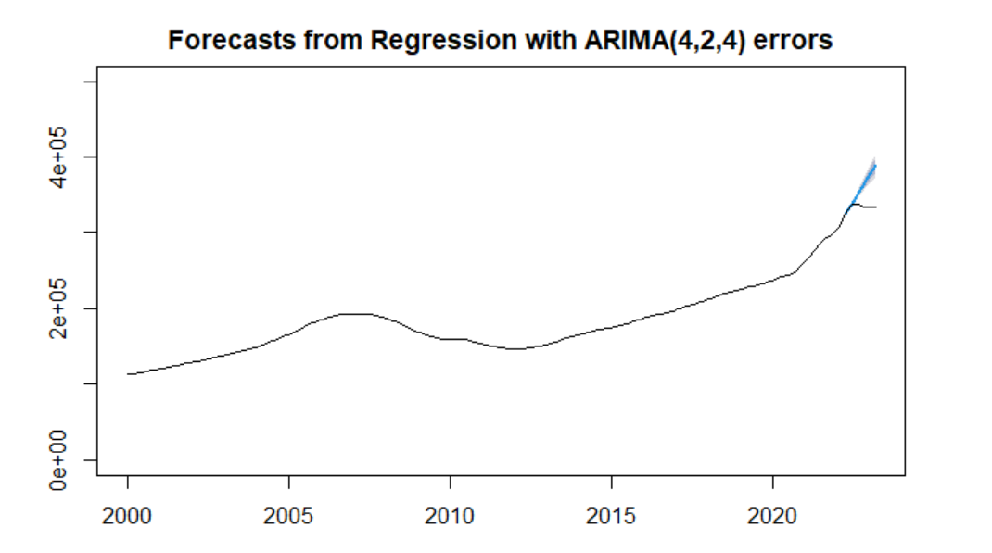
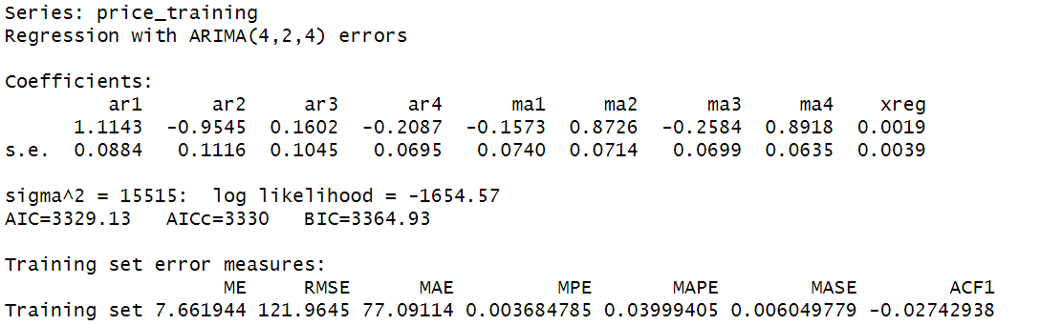
Arima with Regression
Try two predictors: GDP and interest rate
Since we concluded that there is no seasonality in the data, seasonality is turned off when running ARIMA model
Models tried within Regression with ARMA:
Model 1: auto.arima picks order with GDP as predictor
Model 2: Arima(4,2,4) with GDP as predictor
Model 3: auto.arima picks order with GDP + Interest Rate as predictor
Model 4: Arima (4,2,4) with GDP as predictor
For Model 1 & 3 the ACF was out of range and Model 4 is more complex with one additional predictor and not improving the accuracy so we will choose model 2.

Slide 10
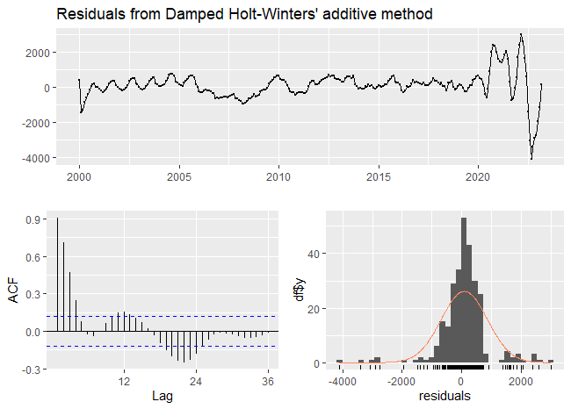
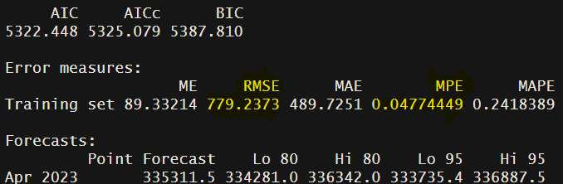
Exponential Smoothing
Cross Check Model select:
ETS (Exponential Smoothing State Space Model）
Holt-Winters model with additive
Holt-Winters model with multiplicative
Holt-Winters model with additive and damping
Holt-Winters model with multiplicative and damping
Holt-Winters model with additive and damping performed the best with the lowest RMSE – 779.23 and MAPE – 0.2418

Slide 11
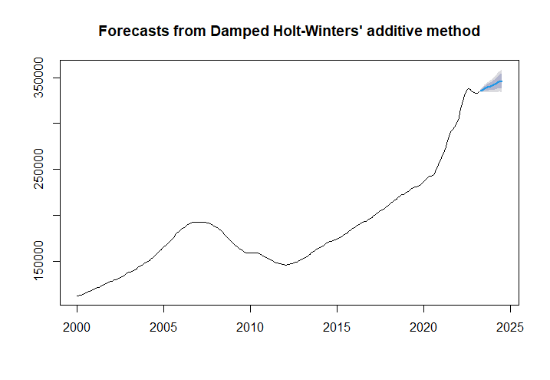
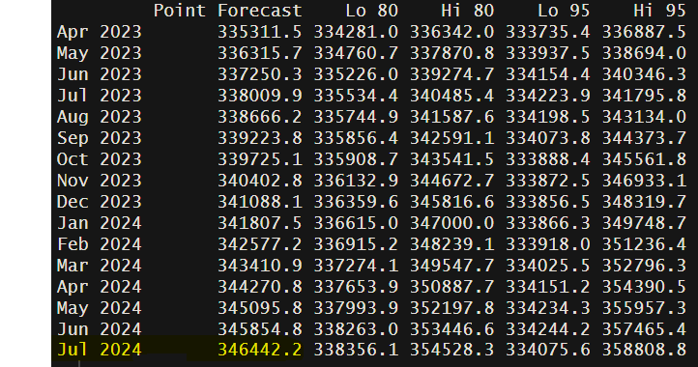
Results / Evaluation
I used the Holt-Winters model (additive and damping) to fit the model on all the data and predicted the future changes in the US housing prices
According to the model's prediction, US housing prices will continue to rise steadily over the next 12 months and reach $346,442 by July 2024

Slide 12

Future Work
Conducting outlier analysis for unique events that cannot be replicated and utilizing extrapolation to identify and remove outlier periods.
Expanding the predictive model by incorporating additional predictors such as the number of houses for sale, population, employment rate, and other relevant factors.
Narrowing the focus to a specific region rather than considering the entire United States.

