Slide 1
Spring Boot
By Ashish Verma

Slide 2
Agenda for today
Introduce Spring
Introduce Spring boot
Create an end to end Restful api using Spring boot
Connect with a database using spring data

Slide 3
Some History
Developed by Rod Johnson
Initial Organisation: Spring Organisation
Taken over by Pivotal
Spring came against EJBs
Spring was named after Spring season(comparing EJBs to winter)
Spring is easy and lightweight
No Application server dependency

Slide 4
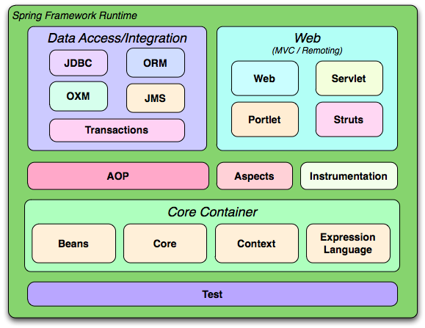
Modules

Slide 5
Introducing Spring Boot
What is Spring boot?
Two words – Spring and boot
We already know what Spring is
the word boot came for boot strapping a Spring application from the scratch
Official definition –
Spring Boot makes it easy to create stand-alone, production grade Spring based applications that you can “Just Run”

Slide 6
Problems with Spring
Huge Framework
Multiple setup steps
Multiple configuration steps
Multiple build and deploy steps
Can we abstract these steps ?

Slide 7
Spring Boot
Opinionated Framework
Convention over configuration
Stand alone
Production Ready

Slide 8
How to create a Spring boot application
Spring Initializr
Start.spring.io
Spring boot CLI
http://docs.spring.io/spring-boot/docs/current/reference/html/getting-started-installing-spring-boot.html#getting-started-installing-the-cli
STS IDE
https://spring.io/tools

Slide 9
Spring Initializr
Go to site start.spring.io
Choose the dependencies
Create the project and import it

Slide 10
Pom.xml
<project xmlns="http://maven.apache.org/POM/4.0.0" xmlns:xsi="http://www.w3.org/2001/XMLSchema-instance"
xsi:schemaLocation="http://maven.apache.org/POM/4.0.0 http://maven.apache.org/xsd/maven-4.0.0.xsd">
<modelVersion>4.0.0</modelVersion>
<groupId>com.infy</groupId>
<artifactId>course-api</artifactId>
<version>0.0.1-SNAPSHOT</version>
<name>INfy Course API</name>
<parent>
<groupId>org.springframework.boot</groupId>
<artifactId>spring-boot-starter-parent</artifactId>
<version>1.4.2.RELEASE</version>
</parent>
<dependencies>
<dependency>
<groupId>org.springframework.boot</groupId>
<artifactId>spring-boot-starter-web</artifactId>
</dependency>
</dependencies>
<properties>
<java.version>1.8</java.version>
</properties>
</project>
Step 1
Step 3
Step 2

Slide 11
Start Point
@SpringBootApplication
public class StartPoint {
public static void main(String[] args) {
SpringApplication.run(StartPoint.class, args);
}
}

Slide 12
What Start point actually do!
SpringApplication.run(StartPoint.class, args);
Sets up default configuration
Starts Spring application context – the Spring bean container
Performs class path scan – Beans, stereotypes
Starts Tomcat server – No need to download and install

Slide 13
Adding a controller!
A Java Class
Marked with Annotation @RestController
Has Info about
What URL access triggers it
What method to run when accessed

Slide 14
First Rest Controller
@RestController
public class HelloController {
@RequestMapping("/hi")
public String sayHi() {
return "Hi";
}
}

Slide 15
Using application.properties
For all the properties:
https://docs.spring.io/spring-boot/docs/current/reference/html/common-application-properties.html

Slide 16
Connect to MySQL
Changes in application.properties
spring.datasource.url = jdbc:mysql://localhost:3306/sample2?useSSL=false
spring.datasource.username = root
spring.datasource.password = passw0rd
spring.datasource.testWhileIdle = true
spring.datasource.validationQuery = SELECT 1
spring.jpa.show-sql = true
spring.jpa.hibernate.ddl-auto = update
spring.jpa.properties.hibernate.dialect = org.hibernate.dialect.MySQL5Dialect

Slide 17
Thank You

