Slide 1
UART Protocol Design and Verification Using Verilog
Presenter
Sandeep Kumar Verma
NIT-Silchar

Slide 2
Outline
Introduction
Key Objectives
Technology
Architecture
Software Simulation
Synthesis on Vivado 2020.2 Suit
Results
References

Slide 3
Introduction
Implements a UART serial communication interface using Verilog HDL.
Operates at 115200 baud rate with a 50 MHz clock.
Includes baud rate generator, transmitter, and receiver modules.
Uses 16× oversampling in the receiver for reliable data reception.
Supports 8-bit data transmission and reception for FPGA-based systems.

Slide 4
Key Objectives:
To Design and Verify UART using Verilog.
Software simulation of the UART on Xilinx-Vivado v.2022.2.
Synthesis of UART using for Xilinx NEXYS 4 DDR FPGA Board (XC7A100T-CSG324).
Technology:
UART (Universal Asynchronous Receiver Transmitter) is an asynchronous serial communication technology.
It transfers data bit-by-bit over a single data line without a shared clock.
Communication uses start bit, data bits, optional parity, and stop bit for framing.
Baud rate defines the data transfer speed (e.g., 115200 bps).
Receiver uses oversampling to accurately detect incoming bits.
Widely used in microcontrollers, FPGAs, embedded systems, and debugging interfaces.

Slide 5
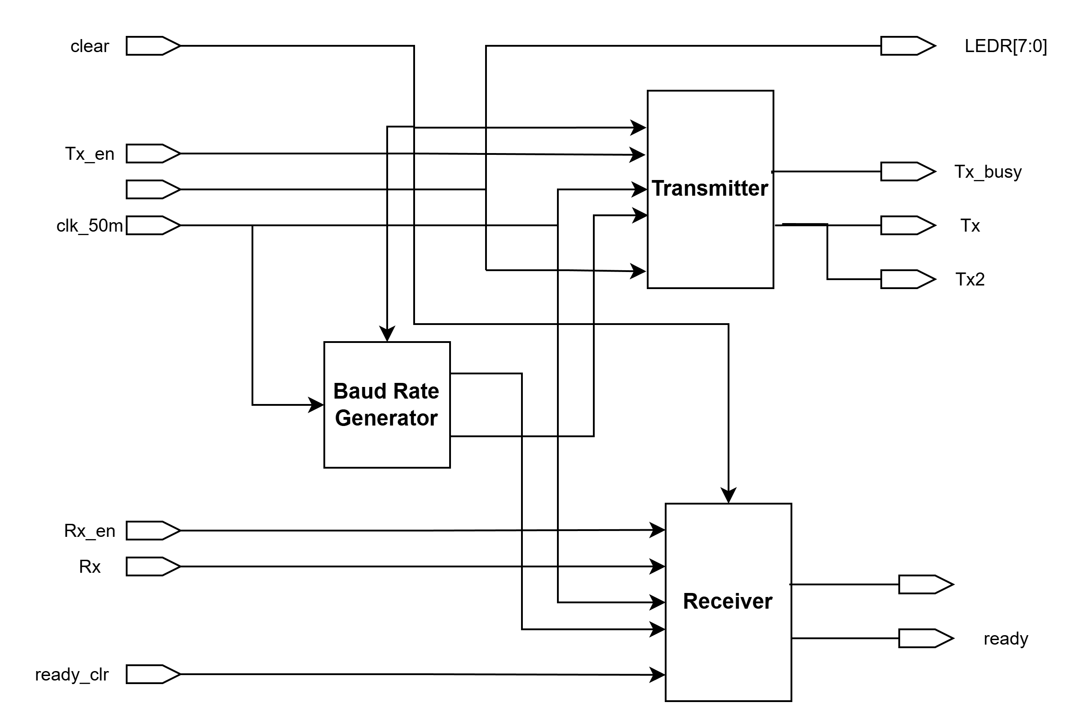
Architecture:
Universal Asynchronous Receiver Transmitter (UART):
Baud Rate Generator: Divides the system clock to generate timing enables for Tx and Rx.
Transmitter (Tx): Converts 8-bit parallel data into serial form using start, data, and stop bits.
Receiver (Rx): Converts incoming serial data back into 8-bit parallel data using oversampling.
Control Logic (FSMs): Manages data flow, bit timing, and state transitions.
Status Signals: Indicate transmission busy state and data-ready condition.
Fig. 1. UART Architecture

Slide 6
Continued…
UART Module Descriptions (Every Block):
Top-level module integrating baud rate generator, transmitter, and receiver.
Provides interface signals for data input, data output, enable, and status.
Routes clock and control signals to submodules.
Transmitter (Tx)
Converts 8-bit parallel data into serial data.
Uses FSM states: IDLE, START, DATA, STOP.
Sends data LSB first with proper UART framing.
Provides Tx_busy signal during transmission.
Receiver (Rx)
Receives serial data and converts it into 8-bit parallel data.
Detects start bit, samples data using oversampling, and checks stop bit.
Stores received data and asserts ready signal.
Clears ready status using ready_clr signal.
Baud Rate Generator
Divides the 50 MHz system clock to generate baud timing.
Produces separate Tx clock enable and Rx clock enable signals.
Supports 115200 bps with 16× oversampling for the receiver.

Slide 7
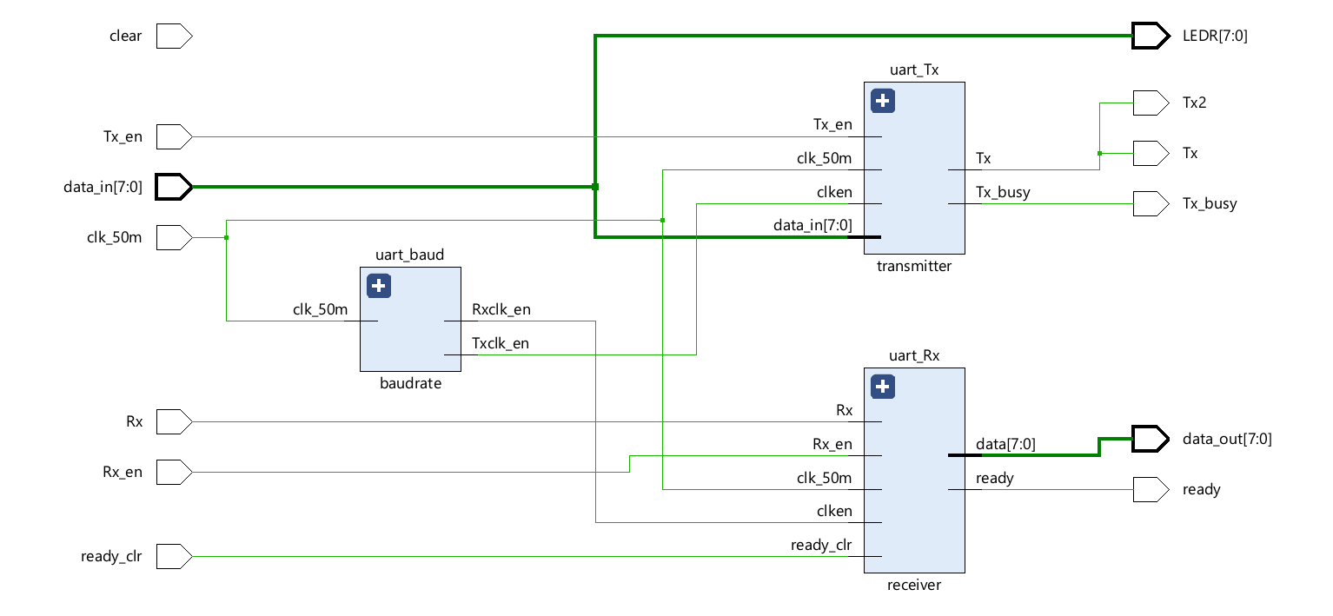
Software Simulation:
In this paper, the model has been designed using
Verilog and simulated in Xilinx Vivado v.2022.2.
Fig. 2. RTL Schematic Diagram of UART

Slide 8
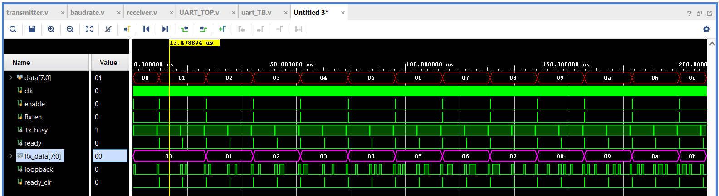
Continued…
Fig. 2. Behavioral of UART

Slide 9
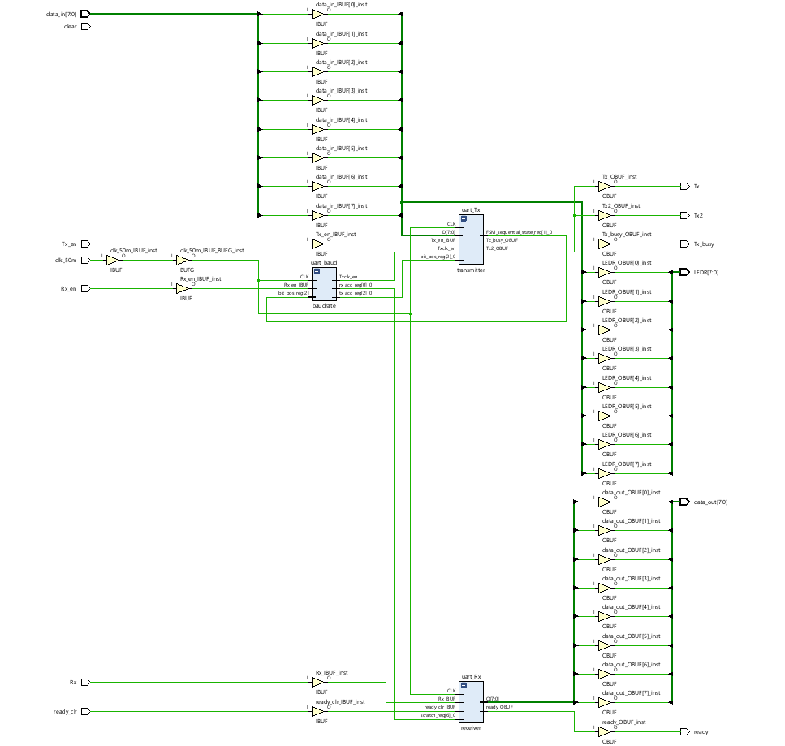
Synthesis
Fig. 10. Schematic view of Synthesized UART Module

Slide 10
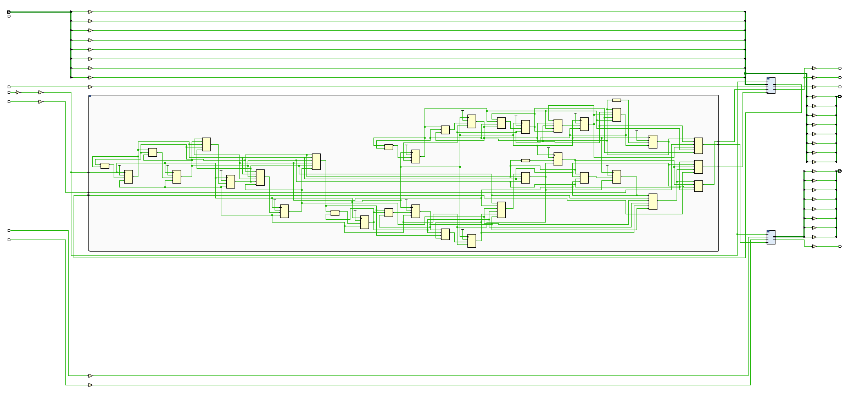
Continued…
Fig. 10. Schematic view of Baud Rate Generator

Slide 11
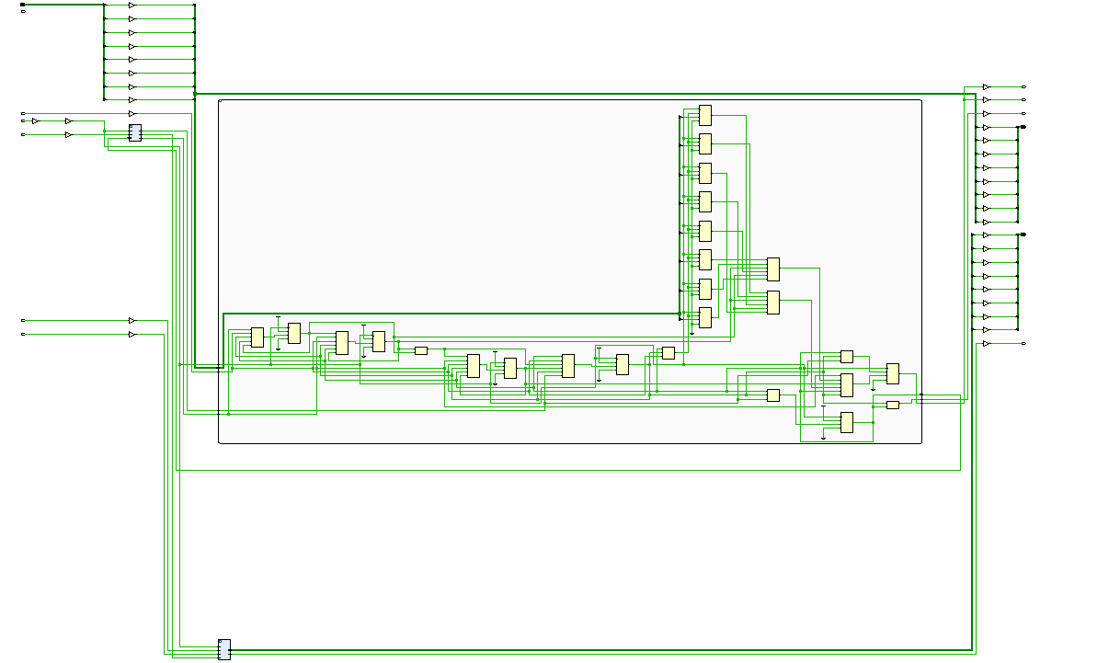
Continued…
Fig. 10. Schematic view of Transmitter (Tx)

Slide 12
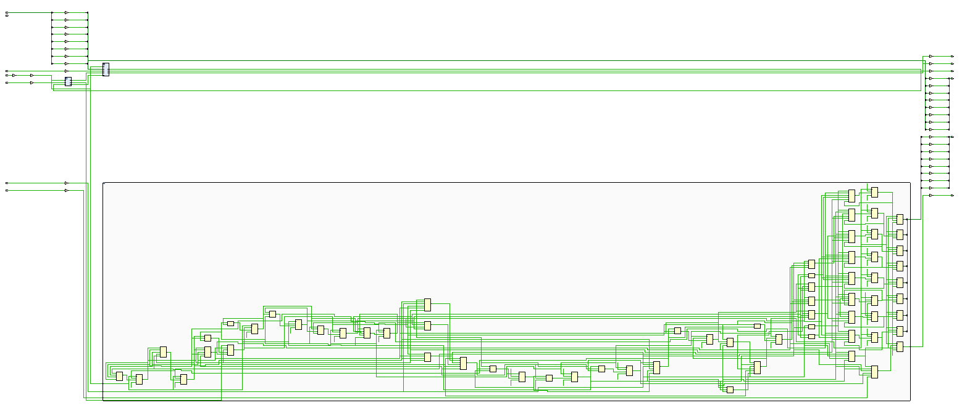
Hardware Implementation:
Fig. 10. Schematic view of Receiver (Rx)

Slide 13
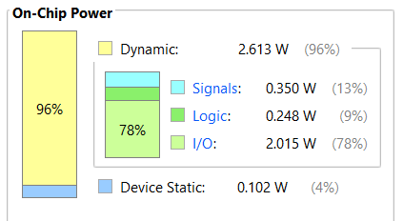
Results:
Successful UART data transmission and reception at 115200 bps.
Accurate baud rate generation from a 50 MHz system clock.
Transmitter correctly sends start, data, and stop bits in sequence.
Receiver reliably detects and reconstructs 8-bit data using 16× oversampling.
Tx_busy signal properly indicates transmission activity.
ready signal correctly flags valid received data.
Stable and error-free operation verified through simulation and waveform analysis.
Fig. 12. Power Representation of DDFS1
The total resource utilization for the proposed design including with debug Hub, VIO, ILA IP’s is shown in Table 1 and 2.
TABLE I. Resource Used In DDFS1 Using IPs:
Parameters | Used | Utilisation Percentage (in %)
Number of Slices | 56 | 0.04
Number of LUTs | 55 | 0.09
Number of Bonded IOBs | 33 | 15.71
Number of BUFGCTRL | 1 | 3.13

Slide 14
References:
Texas Instruments, Understanding UART Communication, Application Note.
ARM, Serial Communication Protocols – UART Overview.
Digital Design and Computer Architecture, David Harris & Sarah Harris, Morgan Kaufmann.

Slide 15
THANK YOU

