Slide 1
DIGITALLY ASSISTED LDOs
HARSH VERMA
ESHWAR ALLAMPALLY

Slide 2
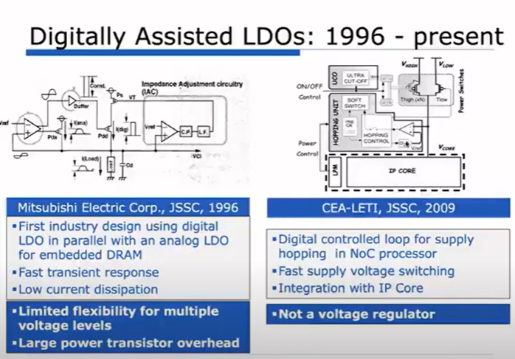
History

Slide 3
Consists of 2 loops, digital and analog(IAC)
IAC is responsible for supplying current, whereas Digital Loop will throttle the current as needed to maintain node voltage
Firstly shown for DRAM for high flexibility with multiple discrete voltage levels
CEA-LETI:
Dual Supply Voltage Operation, high switching between high voltage levels and low voltage levels

Slide 4
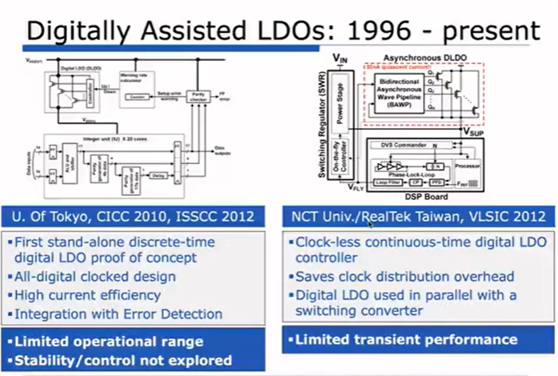

Slide 5
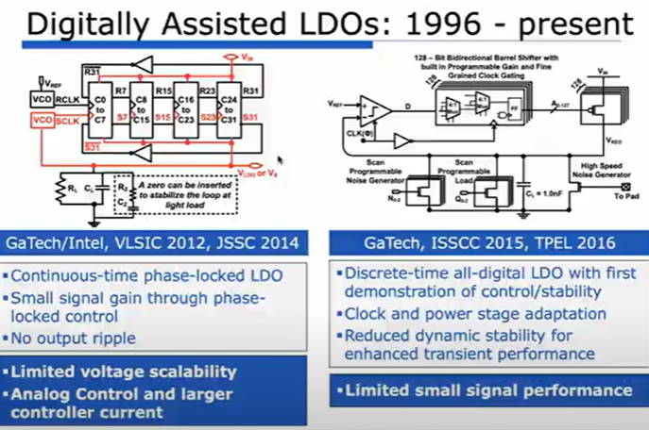
VLSIC 2012 – Uses Whale pipelining meaning MOSs are not synchronous but whale pipelined as power device is turned ON
Comparison – Control – Linear device turn ON/OFF

Slide 6
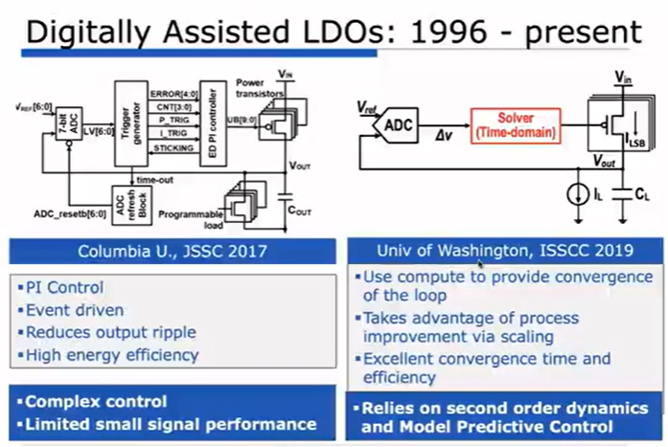
Pure Synchronous
All digital loop
Event/Transient
Given on Vout
Will only trigger the
Loop, saves Transient
Steady state power

Slide 7
Replaced Comparator with an ADC
Instead of PI control, a Solver is used(solves no of pmos devices needs to be turned ON.
Uses 2nd order model of a system
Adaptive control depends on Fload/Fs
Digital Calibration of Reference Voltages
Compensation for PVT variations
challenges in designing a digitally assisted LDO:
Managing noise and quantization errors from ADC.
Achieving low latency in the digital feedback loop.
Balancing power consumption of digital blocks with the overall efficiency.

