Slide 1
Digitally Assisted
Low Dropout Regulator (DA-LDO)

Slide 2
With vs. Without Digital Assistance
Without Assistance:
- Slow transient response
- Higher undershoot
With Assistance:
- Fast settling
- Reduced undershoot

Slide 3
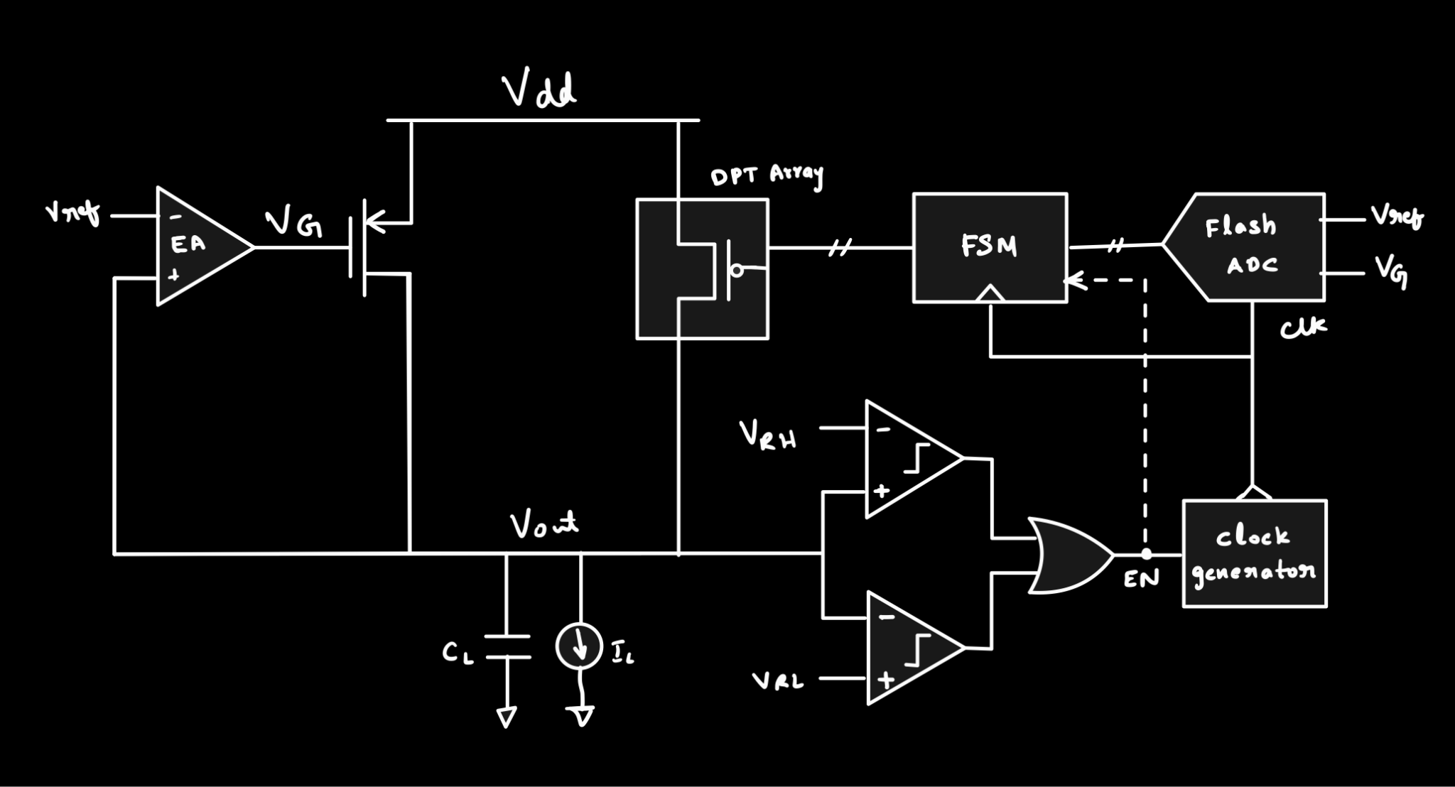
DA-LDO Architecture

Slide 4
What is the 'Assistance' Helping?
- Faster response to transient loads
- Energy efficiency (digital loop off in steady state)
- Reduction in voltage variations
- Area savings compared to full analog

Slide 5
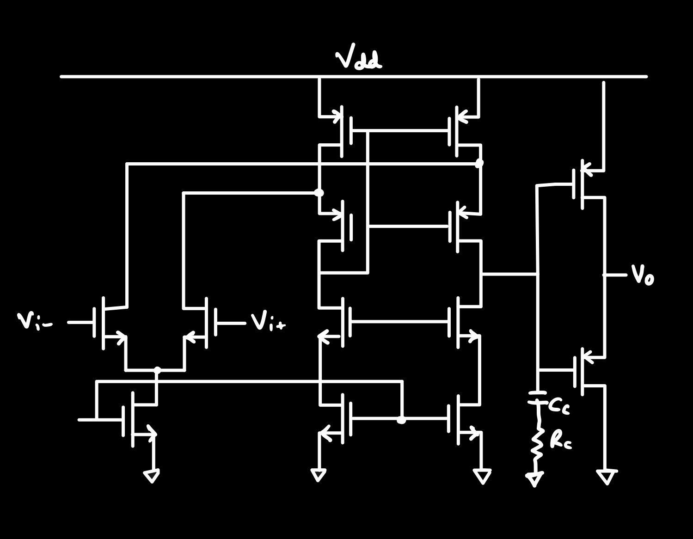
EA continuously controls APT to sample output voltage directly and produce continuous analog current.
RC network helps cancel the second pole, ensuring a good phase margin even in worst-case scenarios.
folded cascode amplifier provides a dominant pole at a lower frequency, which helps in stability.
The high gain-bandwidth product (GBW) of the folded cascode design ensures fast transient response to sudden load variations
Error Amplifier - Folded Cascode Amplifier

Slide 6
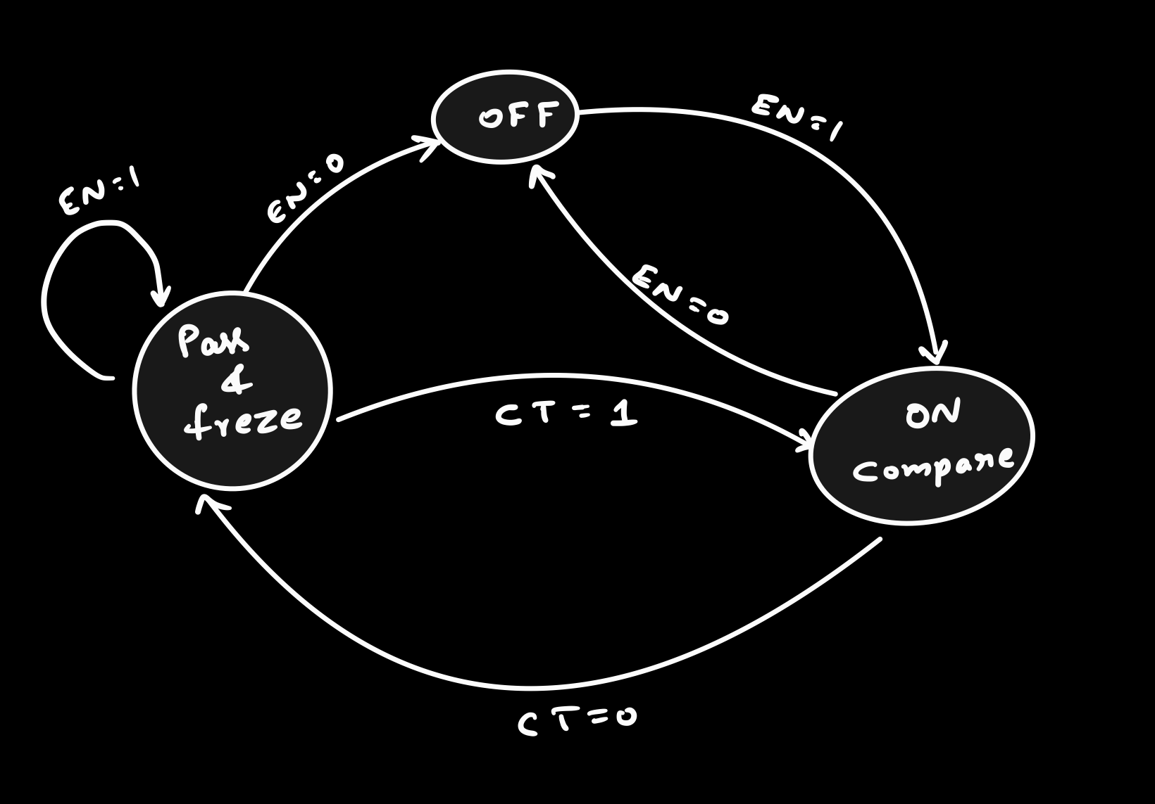
FSM STATE DIAGRAM

Slide 7
DA-LDO Across Technology Nodes
Low Nodes (≤65nm):
- Helps compensate for low intrinsic gain
Higher Nodes (130nm – 180nm):
- Useful for high-current applications
- Area optimization, better transient response

