Slide 1
ICT Skills Workshop
CYBERAWARE ACADEMY
Cybersecurity Awareness
Training Program
CyberAware
Academy
A browser-based workshop project designed to teach essential cyber awareness in a simple, student-friendly way.
Learn safe digital habits through short lessons, a simple quiz, and an easy result-recording flow.
Learn
Assess
Record
Certify
Presented by
Project idea
Mridu Verma
Roll No. 231303060
MBS College of Engineering and Technology
Small, practical, and easy to demonstrate — built as a working student project rather than just a concept.
Workshop Presentation

Slide 2
01 / INTRODUCTION
Why CyberAware Academy?
A practical mini-project focused on day-to-day cybersecurity awareness.
The problem
The response
Phishing, weak passwords, unsafe browsing habits, and social-engineering tricks often succeed because users do not recognise the warning signs in time.
CyberAware Academy turns these common risks into short lessons, a ten-question assessment, understandable feedback, and a simple completion flow.
Scope
This is an educational awareness tool. It supports learning and practice, but it does not replace enterprise-grade training platforms or formal verification systems.
CyberAware Academy • Cybersecurity Awareness Training Program
02

Slide 3
02 / OBJECTIVES
Project objectives
A compact training workflow that is easy to build, demonstrate, and understand.
Educate
Assess
Four lesson modules explain phishing, passwords & MFA, safer browsing, and social engineering.
A ten-question quiz measures understanding and gives instant explanations.
Validate
Track
Unanswered questions are blocked and clearly highlighted before scoring.
Students can record quiz results using Google Forms and Google Sheets.
CyberAware Academy • Cybersecurity Awareness Training Program
03

Slide 4
03 / DEVELOPMENT
Development trajectory
How the project moved from idea to working deployment.
01 DEFINE
02 BUILD
03 IMPROVE WITH BOB
04 DEPLOY & DOCUMENT
Selected a topic that was available, fast to build, and meaningful for a cybersecurity workshop.
Created a browser-based app using HTML, CSS, and JavaScript for lessons, quiz logic, and certificate flow.
Used IBM Bob to review the architecture, identify a quiz edge case, and improve validation.
Published on GitHub Pages, added tracking through Google Forms/Sheets, and completed documentation.
CyberAware Academy • Cybersecurity Awareness Training Program
04

Slide 5
04 / ARCHITECTURE
How the system works
A static website with browser-side logic and a separate result-recording workflow.
Browser UI
JavaScript modules
Local state
Result tracking
Lessons, assessment, feedback, and certificate pages are shown in the browser.
content.js provides lesson and quiz data; quiz.js handles scoring; app.js controls rendering.
Progress is saved in localStorage so lesson completion and latest score persist on that device.
Students click “Record My Result” to open Google Forms, and responses are saved in Google Sheets.
Note: website quiz attempts are not automatically stored online. Only Google Form submissions are recorded in the Sheet.
CyberAware Academy • Cybersecurity Awareness Training Program
05

Slide 6
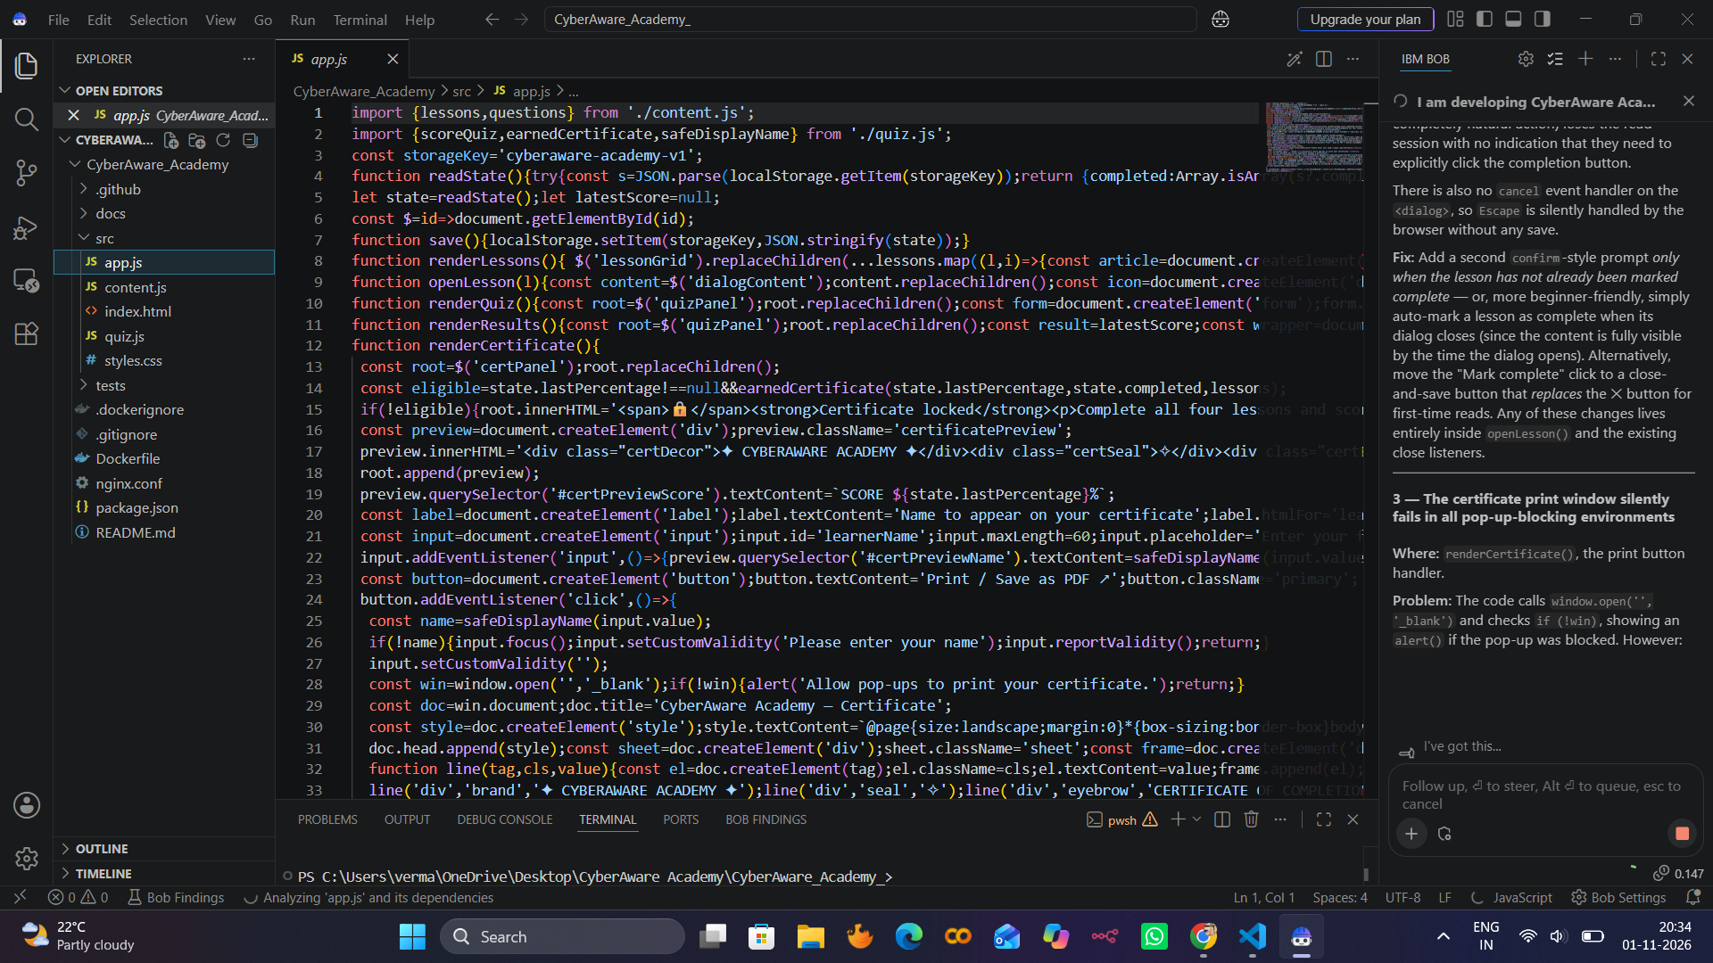
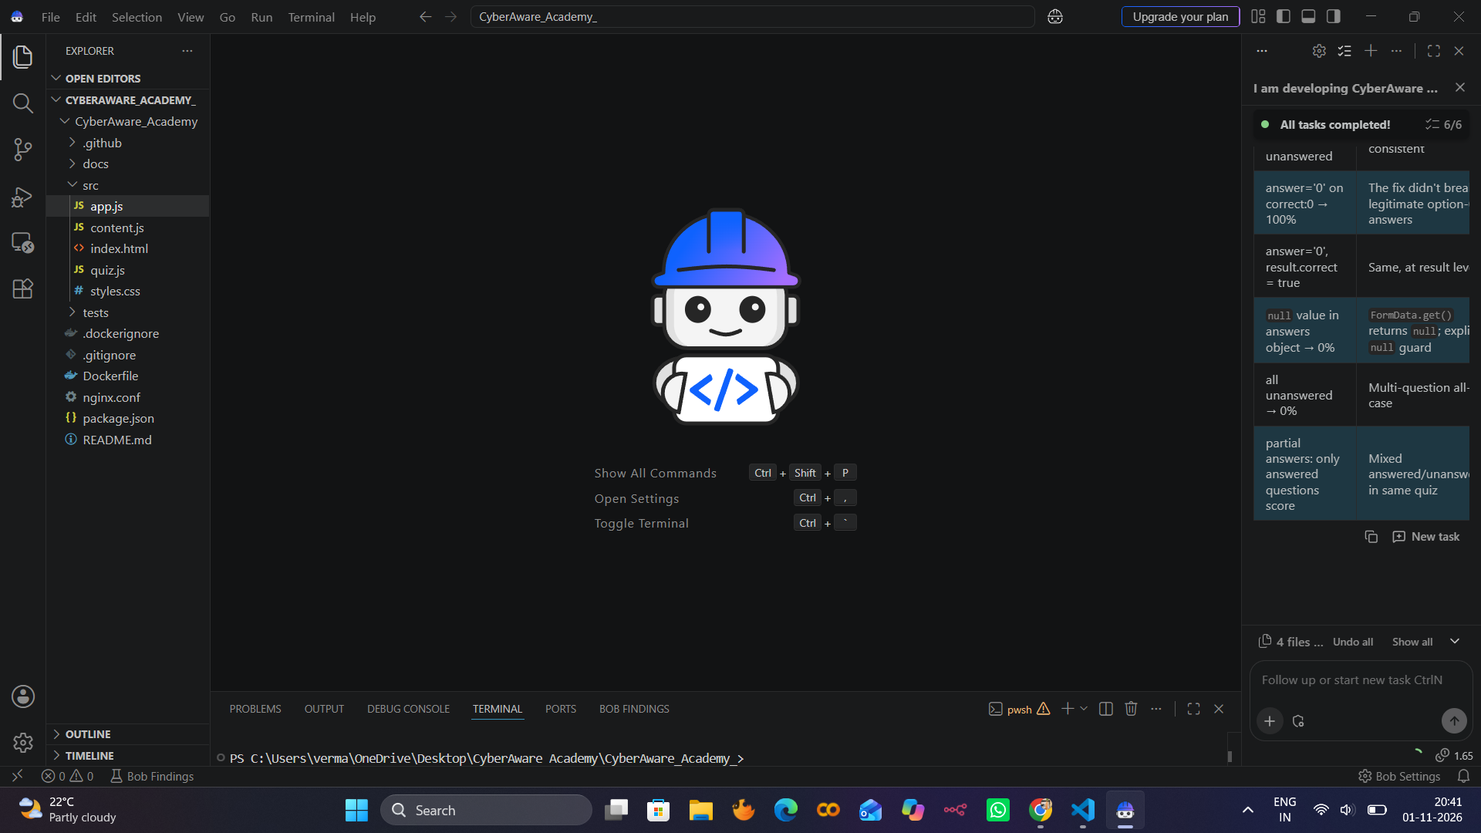
05 / DEVELOPMENT SUPPORT
IBM Bob: debugging and testing
AI assistance was used for review, improvement, and documentation — but the project remained a student-built implementation.
What Bob helped improve
It detected that unanswered questions could create a scoring edge case, suggested a safer answer check, and supported regression-style validation.
CyberAware Academy • Cybersecurity Awareness Training Program
06

Slide 7
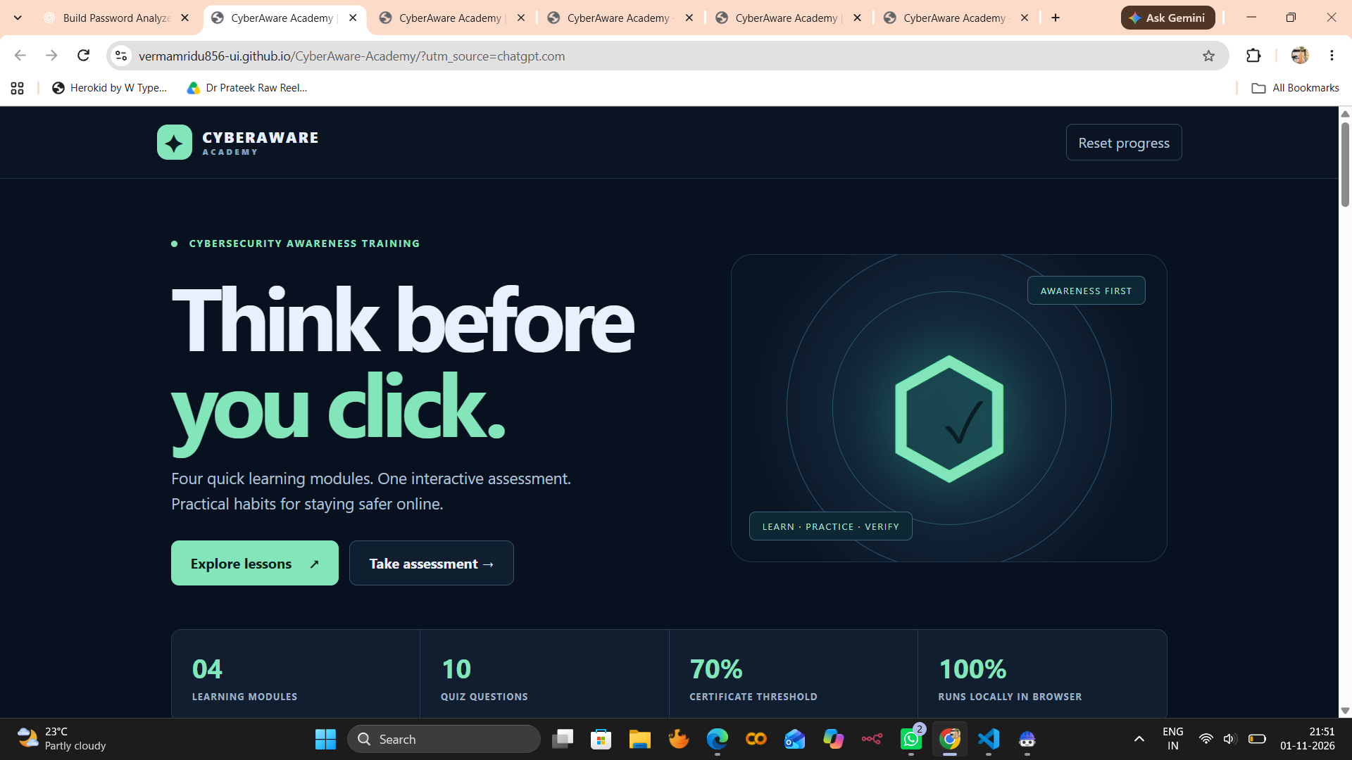
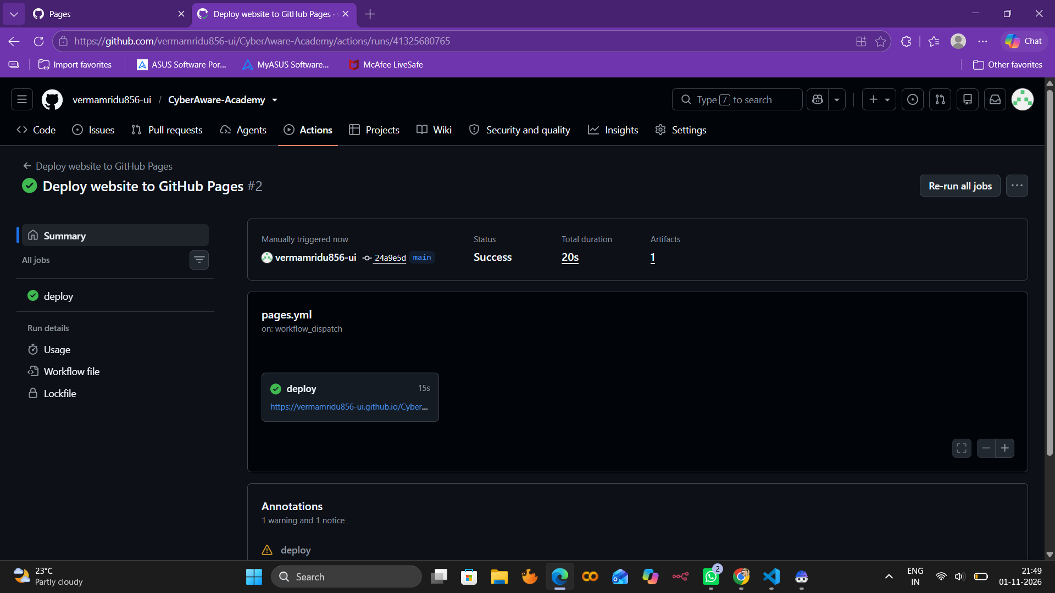
06 / DEMONSTRATION
Live application and deployment
The project is hosted publicly and can be demonstrated end-to-end.
Live website
GitHub Pages hosts the complete training platform for public access and testing.
Website: vermamridu856-ui.github.io/CyberAware-Academy/
CyberAware Academy • Cybersecurity Awareness Training Program
07

Slide 8
07 / TESTING & LIMITATIONS
Validation, tracking, and next steps
The project was checked using both manual testing and GitHub-based automation.
What was verified
Known limitations
Lesson access and progress update
Incomplete quiz warning
Final score and explanations
Certificate generation
Google Form score prefilling
Google Sheets result recording
GitHub Pages deployment
Progress is device-specific because localStorage is browser-based. Students must still submit the Google Form manually, and prefilled scores can be edited before submission.
Automated JavaScript tests also run through GitHub Actions. The repository contains the detailed README and testing report for reference.
CyberAware Academy • Cybersecurity Awareness Training Program
08

Slide 9
08 / CONCLUSION
CyberAware Academy
A student-built, practical cybersecurity awareness training project.
Project outcome
CyberAware Academy now includes structured learning modules, an assessment system, validation improvements, certificates, Google Forms result recording, Google Sheets tracking, GitHub deployment, and project documentation.
GitHub Repository
github.com/vermamridu856-ui/CyberAware-Academy
Presented by
Mridu Verma • 231303060 • MBS College of Engineering and Technology
CyberAware Academy • Cybersecurity Awareness Training Program
09

