Slide 1
Machine Learning for Engineering and Science Applications
Basic Operations

Slide 2
Tensor operations covered in this video
Addition, Broadcasting
Multiplication
Matrix Product, Dot Product, Hadamard Product (Elementwise multiply)
Transpose
Inverse
Skip this video if you know this basic material

Slide 3
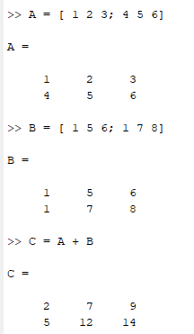
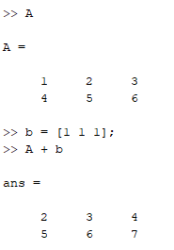

Addition
Normal Matrix addition: $A_{ij}+B_{ij}=C_{ij}$
Broadcasting: $A_{ij}+b_{j}=C_{ij}$
Adding a vector to a matrix by repeating the vector
Done automatically in MATLAB and Numpy

Slide 4
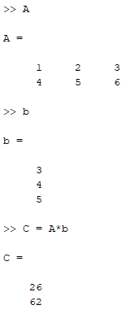
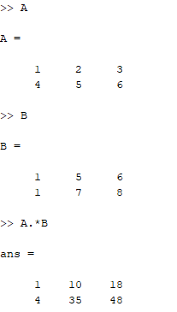

Multiplication
Matrix Product : $C=AB$
$C_{ij}=\sum_{k}{A_{ik}B_{kj}}$
Sizes must match
Hadamard Product: $C=A⨀B$
Elementwise multiplication
A, B and C must be of the same size

Slide 5
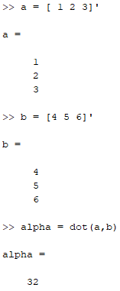
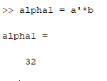

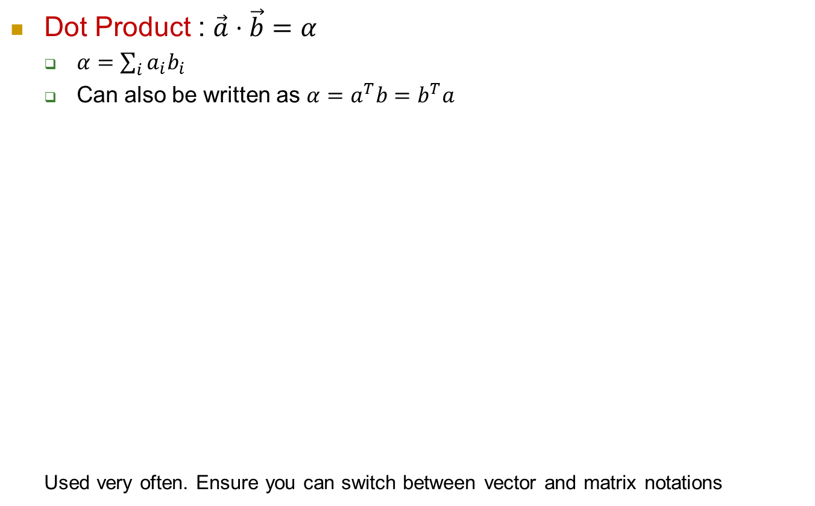
Multiplication (contd)
Dot Product : $\vec{a}⋅\vec{b}=α$
$α=\sum_{i}{a_{i}b_{i}}$
Can also be written as $α=a^{T}b=b^{T}a$
Used very often. Ensure you can switch between vector and matrix notations

Slide 6
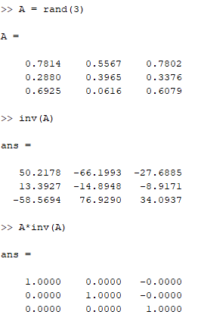
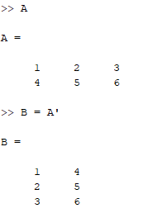
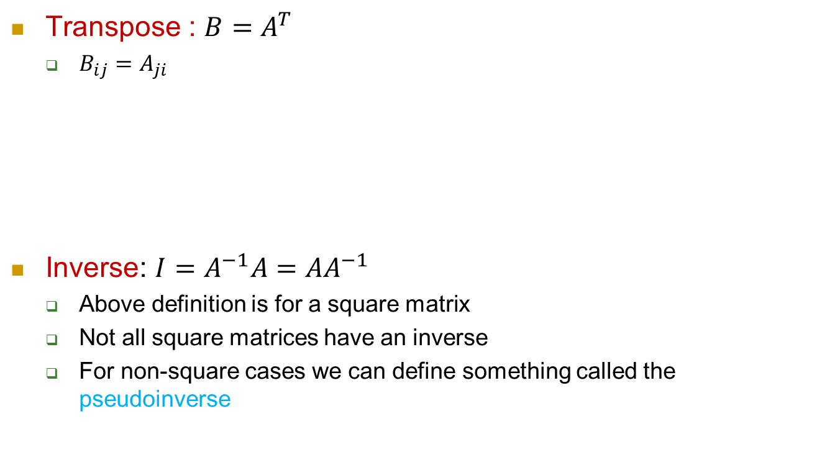
Transpose and Inverse
Transpose : $B=A^{T}$
$B_{ij}=A_{ji}$
Inverse: $I=A^{−1}A={AA}^{−1}$
Above definition is for a square matrix
Not all square matrices have an inverse
For non-square cases we can define something called the pseudoinverse

