Slide 1


National Institute of Technology, Warangal (Department of Computer Science Engineering)
Introduction to Security
Lecture By:-
Dr R Padmavathy
Dept of CSE, NIT Warangal

Slide 2

Secure Aggregation Protocol using Homomorphic Encryption to solve privacy problems in federated learning
Secure Exchange of ML models using Blockchain technology

Slide 3
Content
What is Security?
Kerckhoffs’ Principles
OSI Security Architecture
Threats and Attacks
Cryptographic Security
8. Security Services
9. Security Mechanism
Flow of Secure System
Layers in Secure System
Protocol Stack.

Slide 4
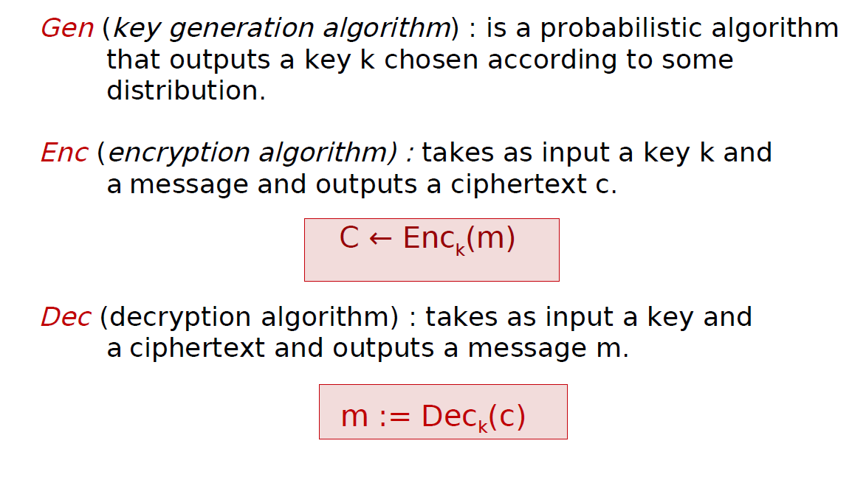
Cryptographic Algorithm
Any encrpytion scheme(Gen, Enc, Dec) is defined by three algorithms:

Slide 5
What is Security ?
Definition 1: An encryption scheme is secure if no adversary can find the secret key when given a cipher text.
Definition 2: An encryption scheme is secure if no adversary can find the plaintext that corresponds to the cipher text.
Definition 3: An encryption scheme i s secure if no adversary can determine any character of the plaintext that corresponds to the cipher text.
Definition 4: An encryption scheme is secure if no adversary can derive any meaningful information about the plaintext from the cipher text.

Slide 6
What is Security ?
Definition 5: An encryption scheme is secure if no adversary can compute any function of the plaintext from the cipher text.

Slide 7
Kerckhoffs’ Principles
Principle 1: The cipher method must not be required to be secret.
Principle 2: The adversary knows the algorithm.
Principle 3: The only secret is the key.

Slide 8
OSI Security Architecture
The OSI security architecture focuses on security attacks, mechanisms, and services. These can be defined briefly as follows:
● Security attack: Any action that compromises the security of information owned by an organization.
● Security mechanism: A process (or a device incorporating such a process) that is designed to detect, prevent, or recover from a security attack.
● Security service: A processing or communication service that enhances the security of the data processing systems and the information transfers of an organization.

Slide 9
Threats and Attacks
Threats:
A threat is a possible danger that might exploit a vulnerability.
Attacks:
An assault on system security that derives from an intelligent threat.
Types of Attacks:
Passive Attacks,
Active Attacks.

Slide 10
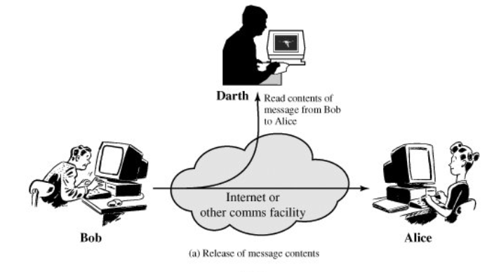
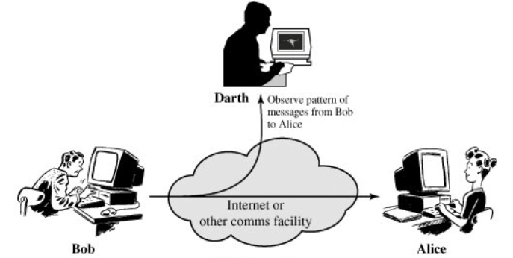
Security Attacks
Passive Attacks:
A passive attack attempts to learn or make use of information from the system but does not affect system resources.
Alice
(a) Release of message contents
(b) Traffic Analysis

Slide 11
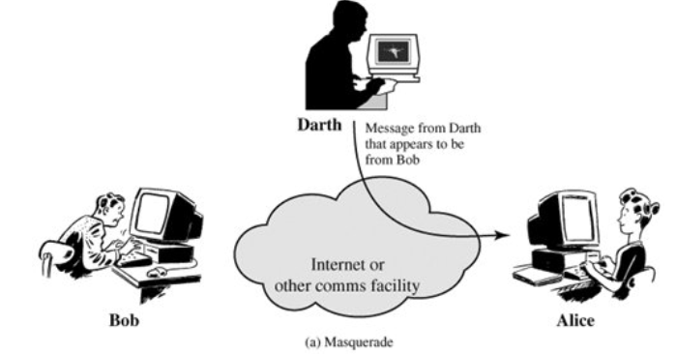
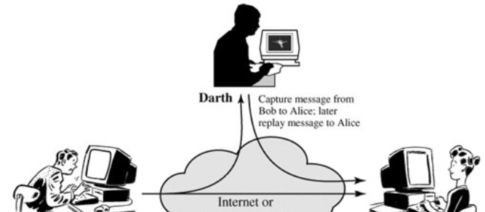
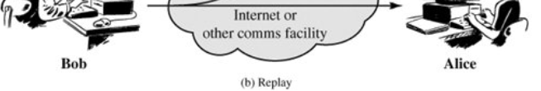
Security Attacks
Active Attacks:
An active attack attempts to alter system resources or affect their operation.
(a) Masquerade
(b) Reply

Slide 12
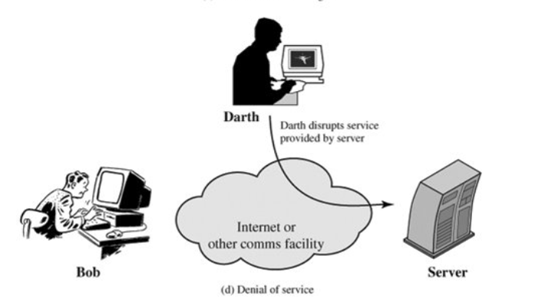
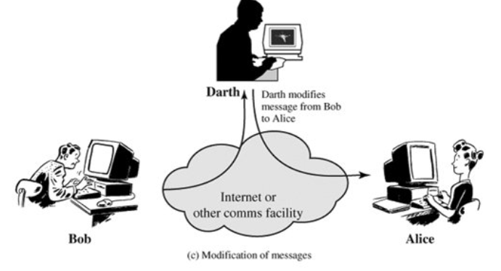
Security Attacks
Active Attacks:
An active attack attempts to alter system resources or affect their operation.
(c) Modification of Message
(d) Denial of Service

Slide 13
Cryptographic Security
How can we develop strong cryptosystems that can be practically used? • Should be based on strong mathematical primitives. • Should be able to resist known attacks.

Slide 14
Cryptographic Security (Attacks)
Mathematical attacks Exploiting flaws in mathematical construction, solving system as set of mathematical equations, extracting information regarding key.
2. Statistical attacks Extracting information from cipher text, exploiting randomness properties for distinguishing attacks.

Slide 15
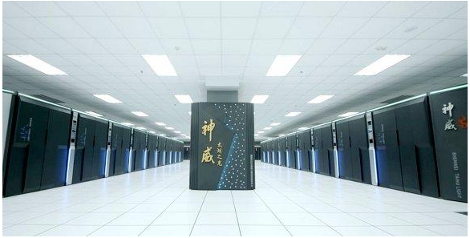
Cryptographic Security (Attacks)
China’s Sunway Taihulight Supercomputer 124.5 petaflops peak performance (10.65 million compute cores)

Slide 16
Cryptographic Security (Attacks)
3. Computational attacks
Using high-performance systems for attacks, solving system using a different model of computation.
4. Implementation & side-channel attacks Extracting information about key from physical processes (power, magnetic field, time consumption), from equipment or memory, using fault injection, hardware tampering.

Slide 17
Cryptographic Security (Attacks)
The block cipher DES with 56-bit keys, allows attacks via exhaustive search and is not currently secure.
The Wired Equivalent Privacy (WEP) algorithm (40&128 bit) is used to protect wireless communication & prevent unauthorized access to a wireless network. WEP uses RC4 stream cipher & is subject to attacks due to flaws in its design

Slide 18
Cryptographic Security (Attacks)
Example – Skipjack
Block cipher developed by the US NSA.
Uses a 80-bit key to encrypt and decrypt 64-bit data blocks.
Based on unbalanced Feistel network with 32 rounds.

Slide 19
Cryptographic Security (Attacks)
Attacks on Skipjack
Impossible differential cryptanalysis (31 rounds) : slightly faster than exhaustive search.
Saturation attack (27 rounds): User key can be recovered with 250 chosen plaintexts & 3.275 encryption times.
Truncated differential attack, related-key miss-in-themiddle attack, related-key rectangle attack.
FSE-2016: Statistical integral distinguisher – key recovery attack on Skipjack variant. Not recommended for current use (NIST, ECRYPT II).

Slide 20
Security Services
Definition:
Security Services implement security policies and are implemented by security mechanisms.
These services are divided into five categories:
Authentication,
Access Control,
Data Confidentiality,
Data Integrity,
Non Repudation.
A processing or communication service that is provided by a system to give a specific kind of protection to system resources.

Slide 21
Security Services
1. Authentication:
The authentication service is concerned with assuring that a communication is authentic.
2. Access Control:
Access control is the ability to limit and control the access to host systems and applications via communications links. To achieve this, each entity trying to gain access must first be identified, or authenticated, so that access rights can be tailored to the individual.
3. Data Confidentiality:
The protection of data from unauthorized disclosure.

Slide 22
Security Services
4. Data Integrity:
The assurance that data received are exactly as sent by an authorized entity (i.e., contain no modification, insertion, deletion, or replay). 5. Non-Repudiation:
Provides protection against denial by one of the entities involved in a communication of having participated in all or part of the communication.

Slide 23
Security services in detail
Authentication
1. Peer Entity Authentication:
2. Data Origin Authentication
Access Control
Data Confidentiality
1.Connection Confidentiality
2.Connectionless Confidentiality
3.Selective field Confidentiality
4.Traffic flow Confidentiality

Slide 24
Security services in detail
Data Integrity
Connection Integrity with recovery
Connection Integrity without recovery
Selective field connection Integrity
Connectionless Integrity
Selective field connectionless integrity
Non repudiation
1.Origin
2.Destination
Availability

Slide 25
Security Mechanism
Encipherment
Digital Signature
Access Control mechanisms
Data Integrity MAC HMAC
Authentication Exchange X and Z X wants to authenticate Z
Traffic Padding
7. Routing Control
8. Notarization

Slide 26
SERVICE | Encryption | Digital Signature | Access control | Data Integrity | Authentication exchange | Traffic padding | Routing control | notarization
Peer entity authentication | Y | Y |  |  | Y
Data origin authentication | Y | Y
Access Control |  |  | Y
Confidentiality | Y |  |  |  |  |  | Y
Traffic flow confidentiality | Y |  |  |  |  | Y | Y
Data Integrity | Y |  |  | Y
Non repudiation |  | Y |  |  |  |  |  | Y

Slide 27
Network security model

Slide 28
Steps in Network Security Model
Design an algorithm for security related transformation – Adversary should not succeed his goal
Generate secret information
Distribution and sharing of secret information
Specify a protocol to be used by two principles make use of security algorithm and secret information to achieve specific security services

Slide 29
Network Access Control model

Slide 30
Flow of Secure System
Mathematical
Foundation
Cryptographic
Algorithm
Security
Algorithm
Security
Protocol
1.PGP
2. Kerberos
3.SSL / TSL
4.IPSec
5.Wireless Security Protocol (WEP)
1.Number Theory
2. Abstract Algebra
3.Computational Number Theory
1.Stream Cipher (e.g. RC4, AS5/1)
2. Block Cipher (e.g. DES, AES)
3.Public key Cryptography (e.g. RSA, ElGammal)
1.RSA-Digital Signature
2. ElGamal- Digital Signature
3.DSS / DSA
4. Certificate

Slide 31
Layers in Secure System
One-Time Pad (Perfect Secrecy)
Security Protocol
Security Algorithm
Cryptographic
Number
Theory
Computational
Secrecy
Algorithm

Slide 32
Protocol Stack
SSL
Handshake
Protocol
SSL Change
Cipher Spec
Protocol
SSL
Alert
Protocol
HTTP
SSL Record Protocol
TCP
IPSec
IP

Slide 33

Any Queries ?

Slide 34
Thank You…

