Slide 1
OPENING A
NEW HOTEL IN CANADA
NITIN VERMA
JUNE 2019

Slide 2
INTRODUCTION
Hotels play a great role in attracting the tourists and generating revenue. Hotels can also result in increase in employment rate. Various shops are also set near the hotels to attract the tourists. . However if a great number of hotels exist in an area, this results in competition, which can result in increasing the fare for a room in the hotels. Due to which the number of tourists visiting that place decreases.

Slide 3
BUSINESS PROBLEM
Studying the distribution and determining which places have high number of hotels already present in that area and determining which areas would result in greater revenue if a new hotel is setup in that area using machine learning and data science methodology.

Slide 4
DATA ACQUISATION
The dataset can be acquired from https://simplemaps.com/data/world-cities .
The attributes present are- name of the city, country, latitudes, longitudes, iso2, iso3, city_ascii, admin_name. capital, population, id.
Required attributes- country, city, latitudes and longitudes.

Slide 5
METHODOLOGY
Acquiring dataset.
Cleaning the dataset.
Accessing the coordinates
Visualizing the dataset.
Using Foursquare API to access the VenueCategory.
Selecting hotels from the VenueCategory.
Use K-means cluster algorithms to cluster the result
Visualize the results
Analyze the results.

Slide 6
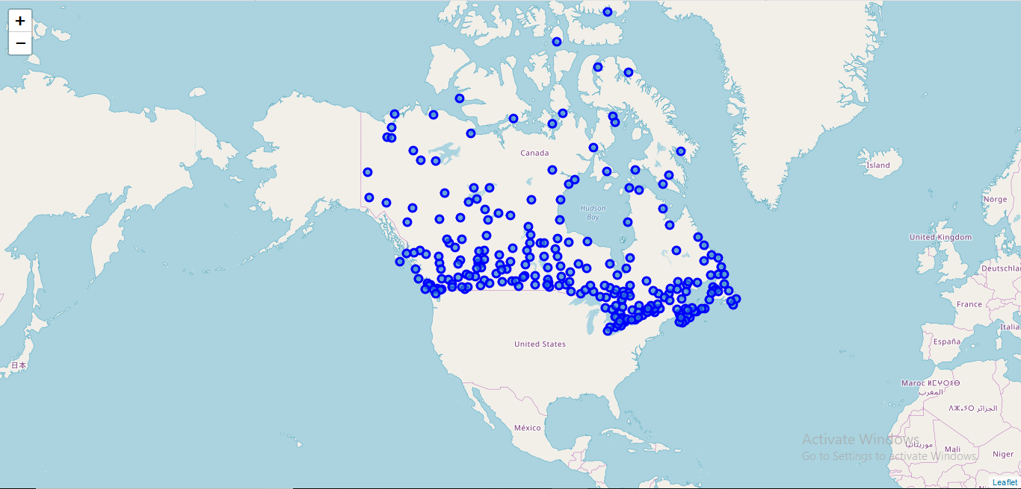
RESULTS
Visualizing the cities:

Slide 7
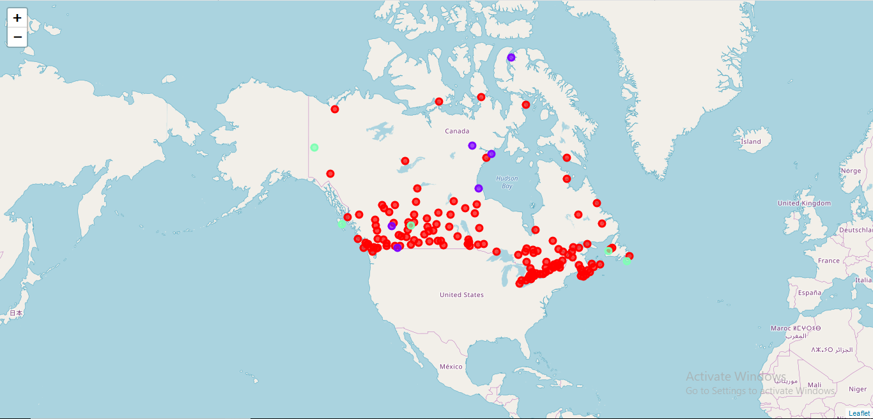
Visualizing the clusters:

Slide 8
OBSERVATIONS
On the basis of clusters the following observations were made:
High number of hotels exists in cluster 2.
Moderate number of hotels exists in cluster 1.
Low number of hotels exists in cluster 0.

Slide 9
INFERENCE
Based upon the results that were obtained it is safe to say that setting up a new hotel at the location defined in cluster 2 will be very risky as very high concentration of hotels are already present. Setting up a new hotel there will result in competition. It is highly recommended that new hotel should be setup at either location mentioned in cluster 1 or cluster 0, but preferably cluster 1.

