Slide 1
Project_967wk

Slide 2
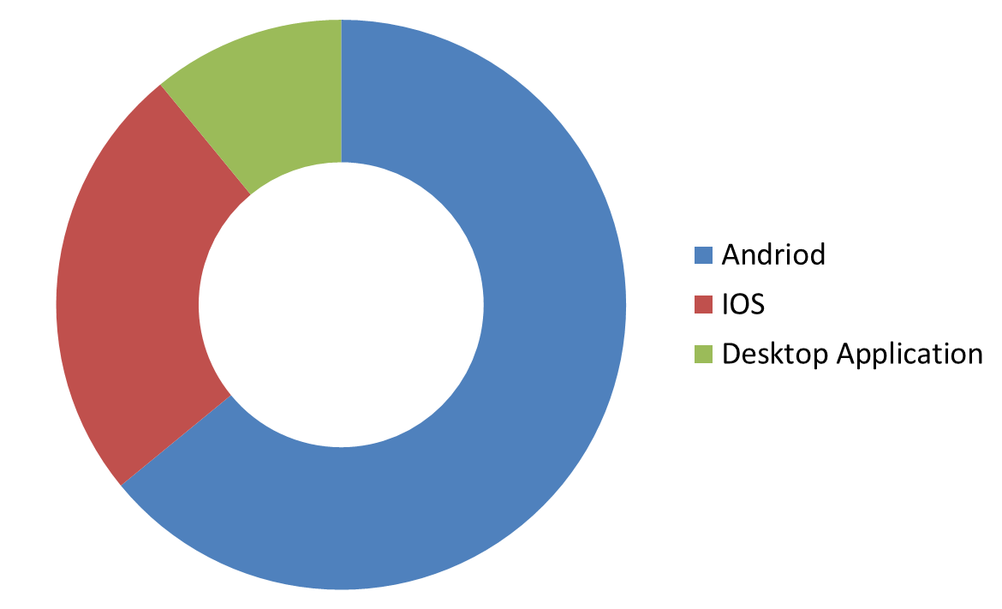


PWA
Desktop App
Android App
IOS App

Slide 3
PWA
What is PWA ?
Progressive web applications (PWAs) are a type of application software delivered through the web, built using common web technologies including HTML, CSS and JavaScript. They are intended to work on any platform that uses a standards-compliant browser. App Store or Google Play.
Functionality includes working offline, push notifications, and device hardware access, enabling creating user experiences similar to native applications on desktop and mobile devices. Since they are a type of webpage or website known as a web application, there is no requirement for developers or users to install the web apps via digital distribution systems like Apple

Slide 4

Meet The Solution
THE SHRUB

