Slide 1
ANDROID AUDIO ARCHITECTURE
Presented by:
Shobhit Verma

Slide 2
Today’s Agends
Audio Basics.
Audio Record and Play Procedure.
Audio Architecture (Practical Implementation)
Types of Sound Drivers.

Slide 3
AUDIO Basics
Types : Analog and Digital.
Analog : It is copy of original sound signal.
Digital : It is sampling of original sound at specified rate.
Conversion From Analog to Digital : PCM(Pulse Code Modulation) See Fig1.

Slide 4
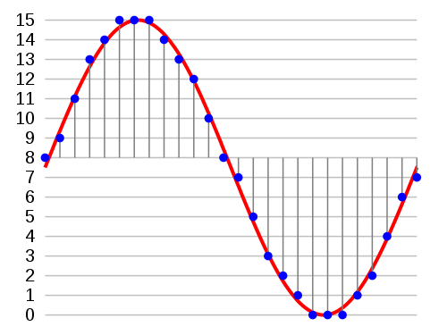
Sampling in Audio
Fig 1

Slide 5
PCM Terms Used
Samples : Amplitude at certain time .
Channels : MONO or STEREO.
Frame : One sample . For mono -> 1
For Stereo -> 2
Frame size : size of each frame (in bytes) and depend on no of channels. Mono -> 8 bits
Sample Rate: Number of samples per second.
Data Rate : Number of bytes recorded/played per sec at given frame size and rate.
Period : Time interval between processing each frame to hardware.
Period Size: Size of each Period in Hz.

Slide 6
Terms related to sound
Loudness : Volume of sound and depend on amplitude.
Pitch : Degree of high or low of tone.Greater the frequency greater is pitch.

Slide 7
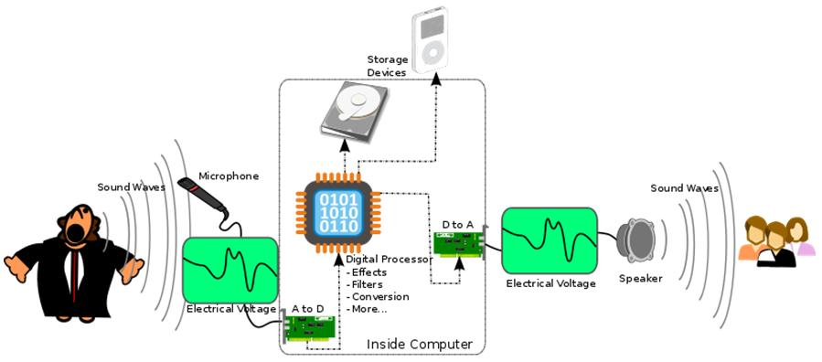
Audio Record and Play

Slide 8
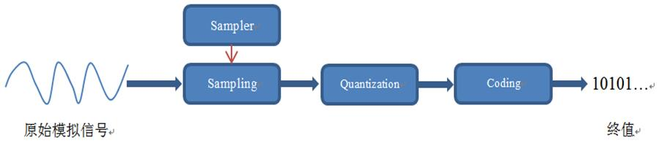
Analog to Digital Audio Conversion Steps

Slide 9
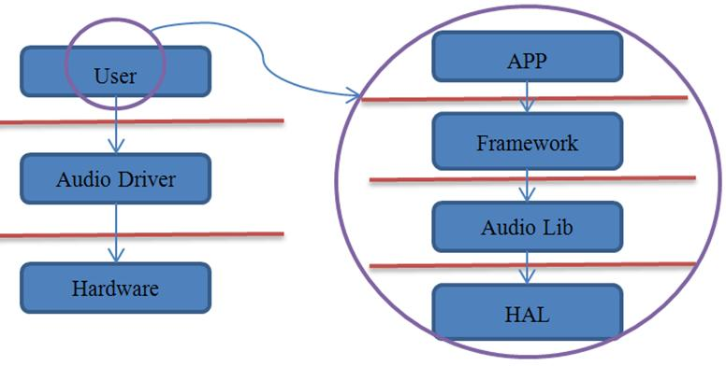
Audio Architecture Simplified

Slide 10
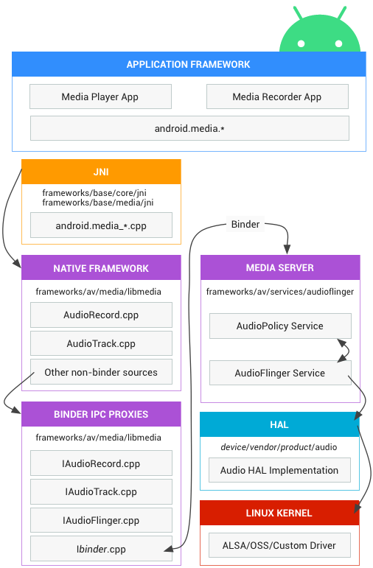
Original Audio Architecture

Slide 11
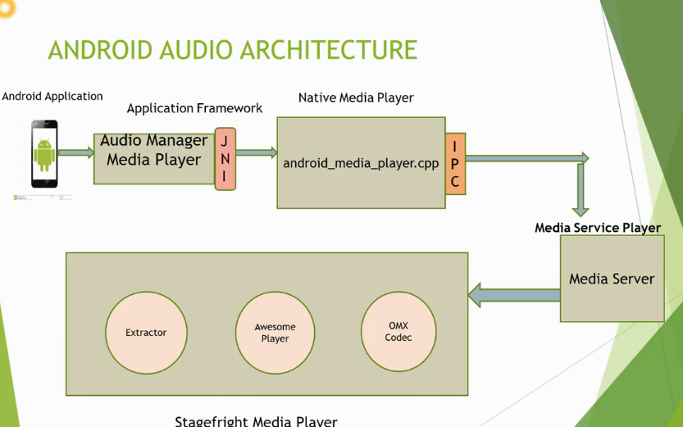
OMX Codec Interface

Slide 12
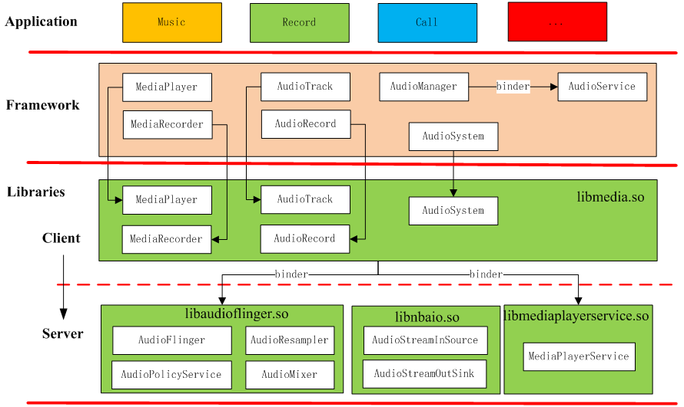
Detailed Android Audio Architecture

Slide 13
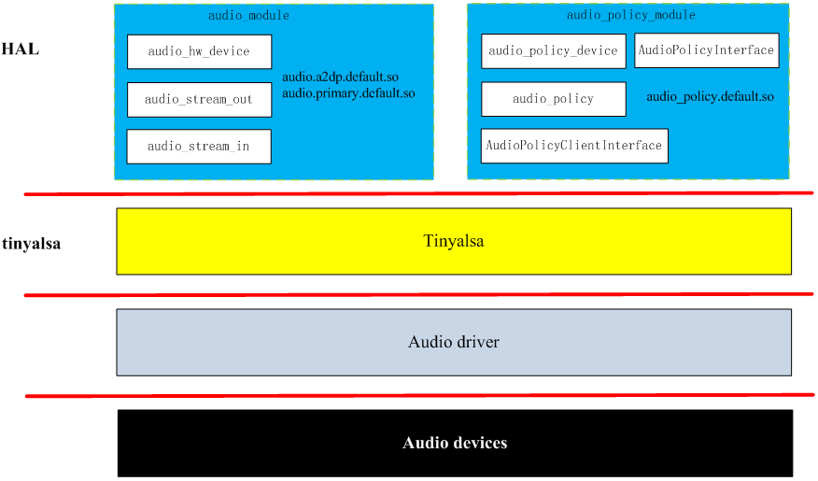
Detailed Audio Architecture Contd...

Slide 14
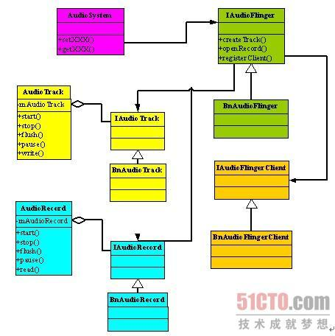
Interaction between Native , Bind and Media Layer

Slide 15
Sound Driver Architecture Types
cat/proc/asound/cards -> check the sound card.
Open Sound System (OSS)
  Created by Hannu Savolainen.
  Used in UNIX system.
  Use the device system call (read,write,open,ioctl etc) by special devices i.e /dev/dsp, /dev/mixer.
  Writing driver Independent of sound hardware.
  Problems : 1. Insufficient support for new audio
  features.
2. Lack of support for latest kernel features.

Slide 16
Sound Driver Architecture Types contd....
ALSA(Advance Linux Sound Architecture)
  Provide api’s for sound card drivers.
  Automatic Configure the sound card hardware.
  Handling of multiple sound devices.
  Larger and more complex API’s.
  Provide user space library for developer and is at higher level api than provided by kernel.
Some OSS touch...
  Hardware mixing of multiple channels.
  Full Duplex Communication
  Multiprocessor compatible.

Slide 17
Sound Driver Architecture Types contd....
Tiny ALSA
  Small library to interface with ALSA.
  Provide a PCM(Pulse Code Modulation) and mixer API.
  Provide detailed documentation.
  Avoid complex and unnecessary operations.
  Check at : external/tinyalsa/

Slide 18
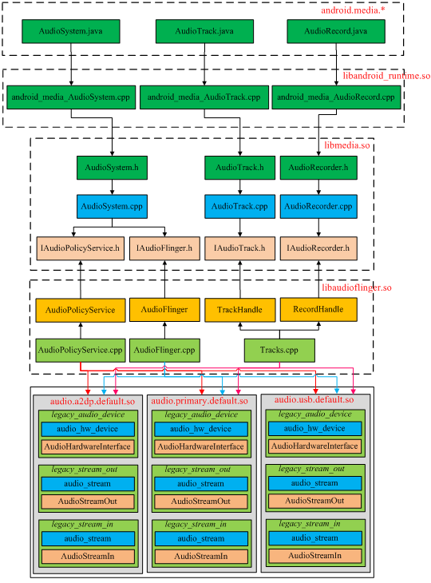
Flow of Libraries

Slide 19
Imp Points related to Audio Architecture
Not have CODEC in audio and implemented separately by Opencore or stragefreight and is called after decoding of PCM(pulse code modulation) signal.
AudioManager.java : provide volume and ring mode control.
AudioTrack.java : play and manage audio PCM stream.
AudioRecord.java : record .
mediaplayer and mediarecorder: Provides easy programming interface than AudioTrack and AudioRecord.
AudioTrack and AudioRecord: Use streaming audio buffer and provide more control on Audio.

Slide 20
Thank You

Slide 21
Any Queries???

Slide 22
Your Valuable Feedback!!

