Slide 1
SIGNALS

Slide 2
Today’s Agenda
What are signals
Types of Signals
Default signal handler
Ignore signal and write user defined signal handler.
Masking of a signal
Limitation of signal system call

Slide 3
What is signal
Why do we need a signal:
  It is a form of IPC(Inter Process Communication).
  Used to notify in case of synchronous and asynchronous event happens.
It is a software interrupt delivered to process by OS to notify for some event without the need of polling by process .
To send a signal to process use kill command.

Slide 4
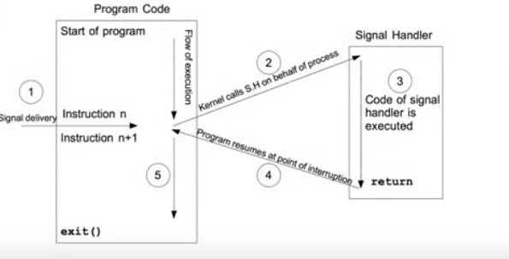
How signal handling is done

Slide 5
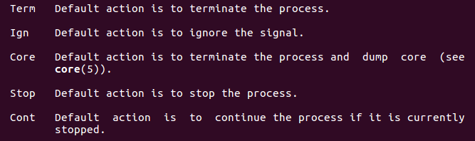
Disposition of the signal
It means what action can be taken if a signal is encountered.
The following are the various actions:

Slide 6
Types of signals
Maskable and Non-Maskable

Slide 7
Default Signal handler
It can be done by:
  trap() - command mode
  Kill() - system call mode
Syntax for kill() :
int kill(pid_t pid, int sig);
trap
  trap -l : for listing out various signals.

Slide 8
Ignore Signal
It can be implemented by:
  signal system call
  trap command
Syntax for signal:
sighandler_t signal(int signum, sighandler_t handler);
First argument specify the signal number.
SIG_IGN in 2nd argument to ignore it.
trap :
  trap -p : list out the ignored signals
  trap ‘ ’ signal no: to ignore the signal

Slide 9
User Defined Signal Handler
For handling signal() system call is used.
Syntax:
void (*sh) (int);
SIGSTOP(19) and SIGKILL(9) can’t be caught.
Note: for getting the default behaviour we can specify SIG_DFL.

Slide 10
Masking of the signals
Race around condition

Slide 11
THANK YOU

Slide 12
ANY QUERIES????

Slide 13
References
https://www.youtube.com/channel/UCMqUl4U_8LwHiXT09_ouzxQ/videos
http://www.firmcodes.com/signals-in-linux/
https://www.linuxjournal.com/article/10815

Slide 14
Practice Questions
What is the difference between SIGSTOP and SIGTSTP?
Why trap -p or trap shows the SIGTSTP , SIGTTIN and SIGTTOU as ignored signal?
Difference between kill and signal system call?

