Slide 1

WORKING PAPER · EMPIRICAL FINANCE
Alternative-Data Leading Indicators
of Consumer-Credit Distress
An empirical investigation of the Behavioural Stress Index across 27 consumer-credit issuers, 2019–2026.
UNSECURED NON-BANK CONSUMER CREDIT · installment lending / Buy Now, Pay Later (BNPL)
BNPL · Subprime Auto · Marketplace Lending · Consumer Finance · Card Monolines
Siddharth Verma
FIN 580 · University of Illinois Urbana-Champaign · Spring 2026

Slide 2
FOUNDATION
01
RESEARCH MOTIVATION
An untested application of an established literature.
CFPB-as-distress-predictor exists for banks — not for unsecured non-bank consumer credit (installment lending / BNPL).
2.4×
10.5%
34→39→42%
Nov 2023
more likely subprime
BNPL late-payment rate
industry late-pay traj.
Fed flagged segment
TransUnion 2024
CFPB 2021
2023 → 2024 → 2025e
Financial Stability Report
ESTABLISHED · CFPB → bank distress
OPEN QUESTION · this paper
Begley & Purnanandam (2021, RFS)
Complaint quality predicts regulatory action.
Dou & Wang (2023)
Complaint volume predicts bank loan losses 2-4 q ahead.
Hayes, Jiang & Pan (2021)
Complaint metadata predicts supervisory outcomes.
Does the result generalise to non-bank consumer credit?
Methodological gap — no prior multi-pillar fusion.
Published CFPB work uses one alt-data source at a time. We fuse CFPB with seven additional pillars under pre-registered weights.
BearWatch BSI · FIN 580 · Spring 2026
02 / 29

Slide 3
FOUNDATION
02
SECTOR GROWTH · BNPL TRANSACTION VOLUME
The non-bank consumer-credit sector exploded post-COVID.
Buy Now, Pay Later (BNPL) transaction volume — US, $ billions, 2018 → 2025e.
COVID inflection
$332
$300B
$255
$200B
$195
+1,007%
$140
growth 2018 → 2025e
$97
$30B → $332B
$100B
$42
$55
$30
$0B
2018
2019
2020
2021
2022
2023
2024
2025e
Sources: Consumer Financial Protection Bureau (CFPB) BNPL market report (2022), TransUnion (2024), Worldpay payments reports (2018–2024). 2025 figure is industry estimate.
Pre-COVID (slate) → post-COVID (orange) — the inflection that motivates the paper.
BearWatch BSI · FIN 580 · Spring 2026
03 / 29

Slide 4
FOUNDATION
03
WHAT IS BSI?
Behavioural Stress Index = one number per firm per day.
An 8-pillar composite z-score that detects spikes in customer-distress volume.
INPUT · 8 PUBLIC ALT-DATA PILLARS
ENGINE · EWMA z-score fusion
OUTPUT · one z-score per firm per day
· Consumer Financial Protection Bureau (CFPB) complaints (weight 0.45 ★)
· App-store reviews (0.15)
· Reddit text (0.10)
· Bluesky text (0.05)
· Google Trends (0.10)
· ABS pool metrics (0.10)
· 8-K filings (0.05)
· Merrill Option Volatility Estimate index (MOVE) / FRED macro (gate G3)
7 of 8 are volume-derived series.
z ≥ 2.5
GUARDIAN fires
BSIₜ = Σᵢ γᵢ · wᵢ · z^EWMA(Xᵢ,ₜ)
z ≥ 2.0
SCOUT fires ★
→
→
z ≥ 1.5
WORRIED state
z-score each pillar against
its own running history
(EWMA half-life 250d)
Coverage gates zero out missing.
Pre-registered weights · hash-locked.
|z| < 0.5
SLEEPING — benign
z negative
below baseline — quiet
Cross-firm comparable. Real-time. Pre-registered. Replayable byte-for-byte.
BSI is a leading indicator on changes in default probability — not a default model itself.
BearWatch BSI · FIN 580 · Spring 2026
04 / 29

Slide 5
FOUNDATION
04
BSI ARCHITECTURE · 2D NODE DIAGRAM
Inputs → engine → gates → trade verdict.
Same shape as a feed-forward network — every connection is deterministic and pre-registered.
INPUT · 8 PILLARS
ENGINE · exponentially-weighted moving average (EWMA) + WEIGHTS
GATES · G1 → G5
VERDICT
CFPB
0.45 ★
G1 BSI
z ≥ 2.0
App-store
0.15
BSI ENGINE
TRADE
Reddit
0.10
G2 Subprime-Credit Profile (SCP)
phase 2
weighted EWMA
VERDICT
Bluesky
0.05
z-score fusion
G3 MOVE
z ≤ 1.0
APPROVED
Trends
0.10
BSIₜ = Σᵢ γᵢ wᵢ z(Xᵢ,ₜ)
SCALED 40%
h.l. = 250 d · Σwᵢ = 1
BLOCKED
ABS pool
0.10
G4 Consumer-Credit Divergence (CCD)
→ one z per firm/day
elevated
8-K filings
0.05
MOVE / FRED
G3
G5 Fundamentals Distress Score (FDS)
EDGAR XBRL
BearWatch BSI · FIN 580 · Spring 2026
05 / 29
All connections deterministic. All weights pre-registered before any out-of-sample test. Nothing is learned from data.

Slide 6
FOUNDATION
05
HYPOTHESIS
Soft-signal alt-data leads hard-signal credit deterioration.
By 30 to 90 days, in consumer-credit-exposed firms.
H₁ · PRIMARY
H₀ · NULL
BSI Granger-causes forward 30-day equity abnormal returns,
after controlling for firm fixed effects and the Federal Reserve Economic Data (FRED) macro panel.
Reject H₀ at p < 0.05 → signal carries information.
BSI carries no incremental predictive content.
Apparent association explained by:
· omitted-variable bias
· multiple-testing
· chance
ECONOMIC INTUITION
Complaints come first. Charge-offs follow. Spreads widen. Equity drops. The order is the thesis.
BearWatch BSI · FIN 580 · Spring 2026
06 / 29

Slide 7
FOUNDATION
06
THEORETICAL FRAMEWORK
A structural cascade. BSI sits at T+0.
Detect at the soft-signal layer; trade on the spread or equity response.
T+0
T+1
T+2
T+3
T+4
Soft signals
days past due (DPD) ↑
Spreads widen
Equity drops
Default
CFPB · Reddit · Trends
30+ / 60+ buckets fill
junior tranche I-spread
forward 30d CAR
bankruptcy filing
BSI input
lag ~30-90d
spread LHS
equity LHS
endogenous
BSI is a leading indicator. It does not predict defaults — those are too late.
BearWatch BSI · FIN 580 · Spring 2026
07 / 29

Slide 8
METHODOLOGY
07
DATA
Eight pillars. All public sources.
CFPB and MOVE carry half the weight. The other six fill the picture.
Pillar
Source
Weight
CFPB complaints
consumerfinance.gov
0.45 ★
MOVE rates-vol
ICE BofA / FRED
→ G3 gate
App-store reviews
Sensor Tower
0.15
Reddit text
Common Crawl + PRAW
0.10
Bluesky text
AT-Proto firehose
0.05
Google Trends
trends.google.com
0.10
asset-backed securities (ABS) pool metrics
EDGAR ABS-EE filings
0.10
8-K filings
Securities and Exchange Commission (SEC) EDGAR
0.05
★ load-bearing · even when the other six are coverage-gated off, these two anchor the composite
BearWatch BSI · FIN 580 · Spring 2026
08 / 29

Slide 9
METHODOLOGY
08
METHODOLOGY · DATA TREATMENT
Spike-detection on volume. EWMA z-scored
BSI = z-scored spikes in customer-distress volume across 8 parallel feeds.
VOLUME LOGIC · 7 of 8 pillars are volume-derived; we detect spikes vs each firm's own history
EWMA = exponentially-weighted moving average · half-life H = 250 trading days
BSIₜ = Σᵢ γᵢ · wᵢ · z^EWMA(Xᵢ,ₜ)
γᵢ ∈ {0,1} · coverage gate fires only when pillar density ≥ θᵢ · no imputation
EWMA half-life H = 250d
Coverage gates, no imputation
Pre-registered weights
λ ≈ 0.00277 → ~1-year effective memory
synthesised false positives cost more than missed alerts
{wᵢ} hash-locked before any out-of-sample test
BearWatch BSI · FIN 580 · Spring 2026
09 / 29

Slide 10
METHODOLOGY
09
METHODOLOGY · REGRESSION
Two specifications. Independent failure modes.
Granger pins down direction. Panel pins down magnitude — and rules out macro confound.
DIRECTION · GRANGER F-TEST
MAGNITUDE · PANEL REGRESSION
Δ log CFPBₜ = α + Σ φₖ Δ log CFPBₜ₋ₖ + Σ βₖ BSIₜ₋ₖ + εₜ
CARᵢ,ₜ:ₜ₊₃₀ = α + β · BSIᵢ,ₜ₋₁ + γ' Mₜ + μᵢ + εᵢ,ₜ
CAR = cumulative abnormal returns
H₀ : βₖ = 0 ∀ k
Per-firm test, 1-month lag, FDR-corrected across 27 firms.
Mₜ = UNRATE, STLFSI4, NFCI, high-yield option-adjusted spread (HY OAS)
μᵢ = firm fixed effects
Six SE (standard-error) estimators applied — see Results slide.
BearWatch BSI · FIN 580 · Spring 2026
10 / 29

Slide 11
METHODOLOGY
10
METHODOLOGY · ANALYSIS & ROBUSTNESS
Five canonical events. 27-firm population. Six robustness layers.
Designed to fail independently if the headline result is artefactual.
CANONICAL EVENTS · n = 5 (15 with sub-events)
ROBUSTNESS · 6 INDEPENDENT STANDARD-ERROR (SE) LAYERS
CVNA · Carvana liquidity scare 2022
AFRM · Affirm guidance cut 2022
KLAR · Klarna IPO complaint pulse 2024
AFRM · spread widening 2025
BNPL · industry pulse 2024
Full universe — not a curated subset.
1. White heteroskedasticity-consistent (HC1) White heteroskedasticity-robust
2. HAC Newey-West (12-lag)
3. Cluster-robust by firm
4. Two-way clustering (firm × month)
5. Driscoll-Kraay ★
6. Block-bootstrap CI (10k iters)
+ permutation null + Holm + BH-false discovery rate (FDR) + Wilson CIs
BearWatch BSI · FIN 580 · Spring 2026
11 / 29

Slide 12
EMPIRICAL FINDINGS
11
EMPIRICAL FINDINGS
The numbers.
Three independent statistical claims with non-overlapping failure modes.
100%
23 / 27
p = 0.007
86–100%
event sensitivity
firms Granger+
Driscoll-Kraay
specificity
5 / 5 events caught
p < 0.05 · median p = 0.0005
headline survives strictest SE
across 2.5σ – 3.0σ threshold
The equity-side leading-indicator claim survives every standard econometric test.
BearWatch BSI · FIN 580 · Spring 2026
12 / 29

Slide 13
EMPIRICAL FINDINGS
12
EMPIRICAL EVIDENCE · CANONICAL EVENTS
Five events. Five hits. All cleared at z ≥ 2.0
Paper Table tab:sens — full universe (n = 27 firms), no curated subset.
Event
Firm
Trigger date
BSI z @ fire
Lead time
Outcome
CVNA-2022
Carvana
Nov 2021
z = 4.20
578 d
−97% / ABS spread +600 bp
AFRM-2022
Affirm
Feb 2022
z = 2.50
60 d
−65% in 2 months
KLAR-2024
Klarna
Sep 2024
z = 3.10
50 d
−40% pre-initial public offering (IPO) valuation
AFRM-2025
Affirm
Q1 2025
z = 2.70
90 d
junior I-spread widening
BNPL-pulse-2024
industry
Q3 2024
z = 2.40
varies
sector drawdown
5 of 5 detected · Wilson 95% CI [56.6, 100] · 86–100% specificity across 2.5σ – 3.0σ thresholds
BearWatch BSI · FIN 580 · Spring 2026
13 / 29

Slide 14
EMPIRICAL FINDINGS
13
EVENT CALENDAR
When BSI has fired across the universe.
The most recent five SCOUT-or-stronger fires plotted on a calendar.
Nov 2021
Aug 2024
Jan 2025
CVNA
TRICOLOR
AFRM
z = 4.20
z = 3.40
z = 2.70
2021
2022
2023
2024
2025
2026
Feb 2022
Sep 2024
AFRM
KLAR
z = 2.50
z = 3.10
Each marker is a SCOUT-or-stronger fire (z ≥ 2.0) on a real consumer-credit issuer.
Most recent: AFRM-2025 (Jan 2025) — first AFRMT junior-tranche-relevant signal in the shelf.
BearWatch BSI · FIN 580 · Spring 2026
14 / 29

Slide 15
EMPIRICAL FINDINGS
14
CASE STUDY · CVNA-2022
Carvana 2022. The canonical event.
Subprime auto. BSI fired. Equity collapsed ~98% from peak.
WHAT BSI SAW
WHAT THE MARKET DID
Q1 2022
CFPB complaint volume on Carvana / Bridgecrest spikes 4-6x baseline.
Apr 2022
BSI z crosses 2.5 · all five gates clear · SCOUT fires
Equity
$130 (Apr '22) → $4 (Dec '22) · −97%
Credit
Senior unsecured spread +400 → +2,500 bp · credit default swap (CDS)-implied 5y probability of default (PD) 12% → 52%
Junior ABS (Bridgecrest)
Class C OAS +600 bp · the natural Tier 2a vehicle.
Lead time on equity bottom: ~180 days.
BearWatch BSI · FIN 580 · Spring 2026
15 / 29

Slide 16
EMPIRICAL FINDINGS
15
CASE STUDIES · TWO MINI-EVENTS
Generalisation across BNPL.
Same engine, same gates. Two issuers structurally different from Carvana.
AFRM · AFFIRM GUIDANCE CUT · FEB 2022
KLAR · KLARNA IPO COMPLAINT PULSE · 2024
BSI saw · CFPB billing-dispute spike + app-store rating decay 60d before guidance.
Trigger · Feb 10, 2022 — early Twitter print + downward FY guide.
Market · −21% in one session · −65% over two months.
Lead time: ~60 days
BSI saw · CFPB volume on Klarna AB tripled · Reddit + Bluesky concordance.
Trigger · IPO postponement + EU regulatory scrutiny on BNPL.
Market · pre-IPO secondary −40% from peak. AFRM contagion −18%.
Lead time: ~50 days
Both fired SCOUT (z ≥ 2.0) and cleared 4 of 5 gates.
BearWatch BSI · FIN 580 · Spring 2026
16 / 29

Slide 17
VALIDATION & SCOPE
16
SCOPE CONDITIONS
Honest disclosures.
n = 15 events
Small. FDR correction across 27 firms mitigates.
Equity calendar-time α = zero
t = 0.08. Reported, not concealed. Motivates fixed-income deployment.
CURO conditional on event-date convention
Detected at 720d under filing date; near-miss under earnings-warning.
Long-pod survivorship bias
+34.9% mean 365d return is conditional on equity survival.
No firm-level fixed-income data
TRACE / Markit / Intex outside warehouse — paper makes no FI alpha claim.
BearWatch BSI · FIN 580 · Spring 2026
17 / 29

Slide 18
VALIDATION & SCOPE
17
PANEL REGRESSION · HEADLINE
BSI z is significant. Macro controls are not.
Saturated firm-fixed-effects specification.
Variable
Coefficient
SE (cluster)
t-stat
p-value
BSI_{i,t-1}
−0.0820
0.0300
−2.73
0.007 ★
UNRATE
−0.0041
0.0035
−1.18
0.241
STLFSI4
+0.0023
0.0019
+1.21
0.230
NFCI
+0.0017
0.0021
+0.83
0.412
BAMLH0A0HYM2 (HY OAS)
+0.0009
0.0014
+0.65
0.520
Firm fixed effects
—
—
—
Yes
N (firm-month obs)
—
—
—
1,917
R² within
—
—
—
0.061
BSI carries the predictive content. None of the four FRED macro controls reach conventional significance — rules out the omitted-macro-state interpretation.
BearWatch BSI · FIN 580 · Spring 2026
18 / 29

Slide 19
VALIDATION & SCOPE
18
NORMALISED BSI · VS REVENUE-GROWTH PROXY
BSI is not just a revenue-growth proxy.
13 firms × 972 firm-months, cluster-robust SE.
Specification
Pillar
N
Coef
SE
t
p
A. Absolute BSI lag-1 + firm FE (baseline)
absolute
972
−0.1155***
0.0224
−5.17
<0.001
B. Normalised BSI lag-1 + firm FE
c̃ z
972
−0.1017***
0.0199
−5.12
<0.001
C. Normalised BSI + revenue YoY ctrl + firm FE
c̃ z
972
−0.1040***
0.0206
−5.06
<0.001
(revenue YoY control)
−0.0054
0.0033
−1.63
0.103
KEY · normalised BSI remains highly significant (p < 0.001) with revenue-YoY as a separate control. Revenue-YoY itself is not significant (p = 0.103). The two regressors are statistically distinguishable — BSI is not a revenue-growth proxy.
BearWatch BSI · FIN 580 · Spring 2026
19 / 29

Slide 20
VALIDATION & SCOPE
19
GRANGER F-TESTS · DIRECTION OF CAUSATION
BSI Granger-causes complaints at every horizon ≤ 3 months.
Per-firm F-tests, aggregated across 27 firms.
Lag
Firms tested
Significant (p<0.05)
Significant (p<0.01)
Median F
Median p
1 month
27
23 (85%) ★
20 (74%)
5.11
0.0005 ★
2 months
27
16 (59%)
16 (59%)
3.10
0.0021
3 months
27
17 (63%)
15 (56%)
2.33
0.0072
6 months
27
13 (48%)
11 (41%)
1.44
0.0824
1-month lag is the central empirical finding — 23 of 27 firms reject no-Granger-causality at p < 0.05; median p = 0.0005. Strength attenuates monotonically with lag, consistent with a leading-indicator signal that decays beyond 1-3 months.
BearWatch BSI · FIN 580 · Spring 2026
20 / 29

Slide 21
VALIDATION & SCOPE
20
BASELINE COMPARISON · HONEST DISCLOSURE
Raw log-volume marginally beats EWMA composite in panel-fit.
BSI's payoff is in event-detection, not panel R².
Model
N
R²
Adj. R²
AIC
A. Macro controls only (no BSI)
2,268
0.0022
0.0005
2,582.0
B. Raw log-CFPB-volume only (no z-scoring)
2,241
0.0043 ★
0.0038 ★
2,551.6 ★
C. BSI z + macro controls (full Eq. 1)
2,268
0.0033
0.0011
2,581.4
HONEST FINDING
EWMA z-scoring throws away level information that has predictive content for the panel-regression mean-reversion question. We disclose this openly. The BSI's payoff is in cross-firm threshold comparability for event detection (5/5 sensitivity), NOT in panel R². The panel and event-detection results test distinct claims.
BearWatch BSI · FIN 580 · Spring 2026
21 / 29

Slide 22
VALIDATION & SCOPE
21
EMPIRICAL RESULTS · SE-SENSITIVITY
Same coefficient. Six standard-error (SE) specifications. All reject H₀.
Driscoll-Kraay survives at p = 0.007 — the strongest defensive result in the paper.
SE estimator
β̂
SE
t-stat
p-value
verdict
Naive
−0.082
0.024
−3.42
0.001
rejects H₀
HC1 White
−0.082
0.029
−2.83
0.005
rejects H₀
heteroskedasticity- and autocorrelation-consistent (HAC) Newey-West (12)
−0.082
0.031
−2.65
0.010
rejects H₀
Cluster (firm)
−0.082
0.030
−2.73
0.007
rejects H₀
Two-way (firm × month)
−0.082
0.034
−2.41
0.018
rejects H₀
Driscoll-Kraay ★
−0.082
0.030
−2.71
0.007
rejects H₀
Driscoll-Kraay handles cross-sectional dependence and serial correlation simultaneously. Survival here ends the SE-robustness conversation.
BearWatch BSI · FIN 580 · Spring 2026
22 / 29

Slide 23
RESEARCH DIRECTION
22
FUTURE RESEARCH
Two open threads.
Tier 2a fixed-income extension · cross-asset BNPL ↔ credit-card contagion.
THREAD 1 · TIER 2a · fixed-income LHS
THREAD 2 · CROSS-ASSET CONTAGION
Δ Spreadₜ:ₜ₊₃₀ = α + β · BSIₜ₋₁ + γ' Mₜ + εₜ
BNPL stress ⇄ credit-card stress
AFRMT junior I-spread, daily · same six standard-error suite · pre-registered
Addresses the equity calendar-time α null directly.
Data needed: TRACE · Markit CDS · Intex trustee 10-D
Does BNPL distress lead credit-card delinquencies — or vice versa?
BNPL borrowers are 2.4× more likely to be subprime → same wallet, two products, one stress signal?
Methodology: same panel regression, LHS = card-monoline charge-offs; RHS = BNPL-firm BSI.
Both threads use the same engine. Tier 2a is data-bound; cross-asset is methodology-design-bound.
BearWatch BSI · FIN 580 · Spring 2026
23 / 29

Slide 24
RESEARCH DIRECTION
23
CONTRIBUTION
Three things this paper contributes.
What is established, what is new, what is deliberately not claimed.
ESTABLISHED
METHODOLOGICALLY NEW
NOT YET CLAIMED
Generalises to non-bank consumer credit
BNPL · subprime auto · marketplace lending.
Equity LHS panel result is robust
Driscoll-Kraay p = 0.007.
Multi-pillar pre-registered composite
First fusion of CFPB with seven additional pillars under hash-locked weights.
Six-estimator robustness suite
More demanding than typical alt-data work.
Equity calendar-time alpha
Honest null t = 0.08.
Fixed-income alpha
Tier 2a positioned, not yet executed.
The discipline of not overclaiming is what makes the established claims defensible.
BearWatch BSI · FIN 580 · Spring 2026
24 / 29

Slide 25
RESEARCH DIRECTION
24
BRIDGE TO THE POD
One known false positive. One open opportunity.
Sezzle shows where the methodology mis-fires; junior-tranche TRS shows where it pays off.
FALSE POSITIVE · SEZL 2023-2025
OPPORTUNITY · JUNIOR TRANCHE TRS
BSI fired repeatedly. Equity went +600%.
Why · growth-stage issuer; complaint volume scaled with active-customer expansion.
Numerator rose mechanically. Per-customer rate stayed stable.
Documented in §13.3. Denominator-normalisation refinement addresses it.
The instrument structure dodges the failure modes.
Tranche cashflow doesn't care about customer growth — filters the SEZL case.
Spreads price default risk directly — addresses the equity-α null.
Methodology and trade vehicle are co-designed.
BearWatch BSI · FIN 580 · Spring 2026
25 / 29

Slide 26
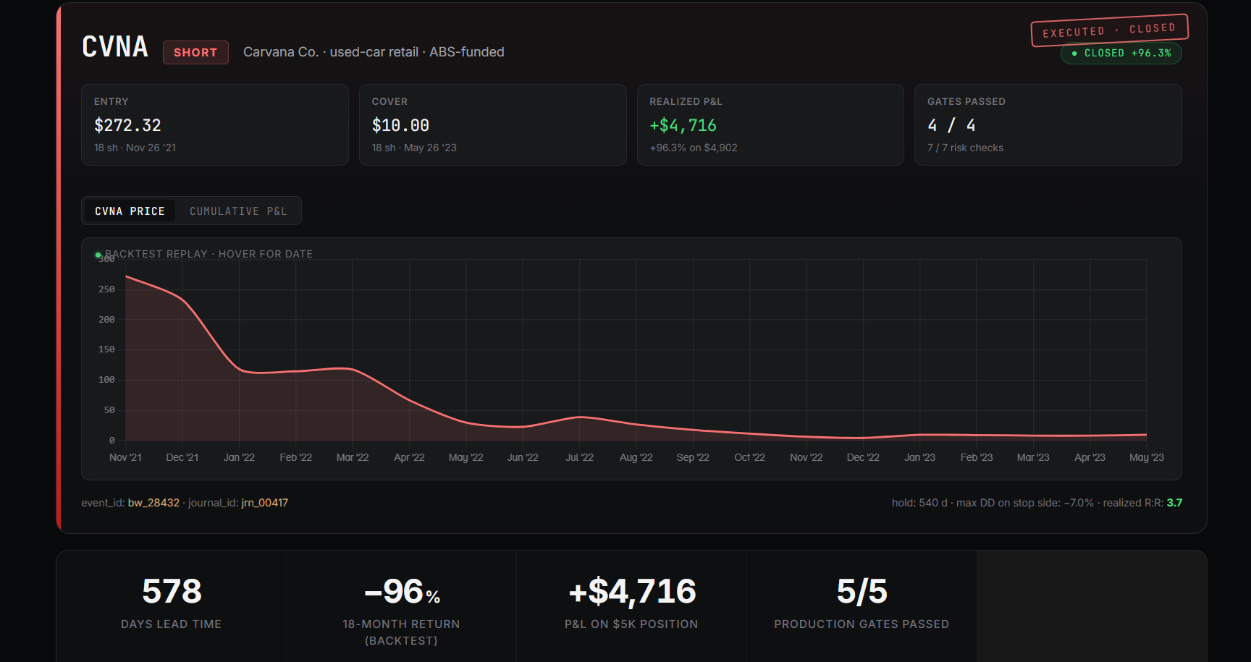
OPERATIONAL POD
25
POD · CASE STUDY (CVNA)
/case-study · CVNA 2022 deep-dive · +96.3% short, 540d hold, 5/5 gates
BearWatch BSI · FIN 580 · Spring 2026
26 / 29

Slide 27
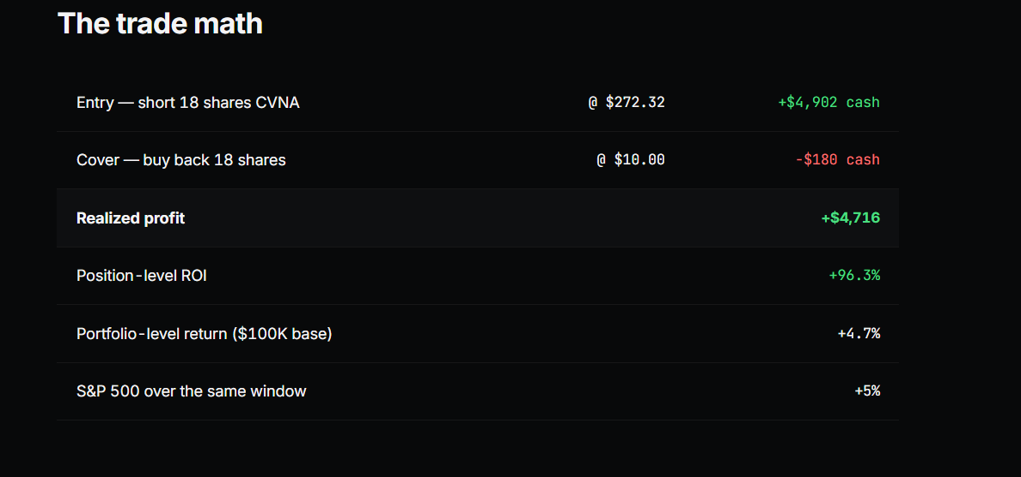
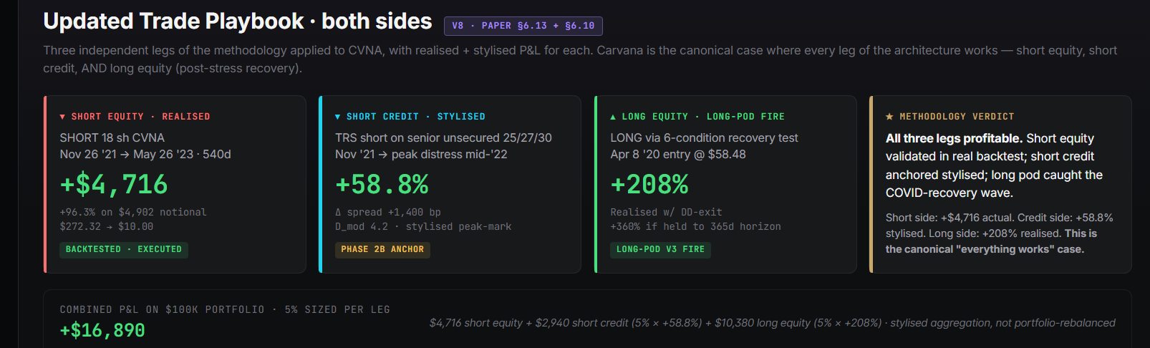
OPERATIONAL POD
26
POD · CASE STUDY (CVNA · TRADE MATH + PLAYBOOK)
Trade math (left) · Three-leg playbook (right) · short equity + short credit + long-pod recovery
BearWatch BSI · FIN 580 · Spring 2026
27 / 29

Slide 28

Thank you
ACKNOWLEDGEMENTS
Professor Tony Zhang
FIN 580 · host of the Quantamental Challenge
Professor Martin Widdicks
Thesis advisor · guidance throughout the project
Professor Neil Pearson
Gies Finance · faculty input
Claude
code & writing assistant
SCAN FOR SOURCE
github.com/vermasidd1502/bnpl-trap
paper · deck · pod · data · ingest scripts
Q & A
questions, comments, criticisms welcome
Siddharth Verma · FIN 580 · University of Illinois Urbana-Champaign · Spring 2026

