Slide 1
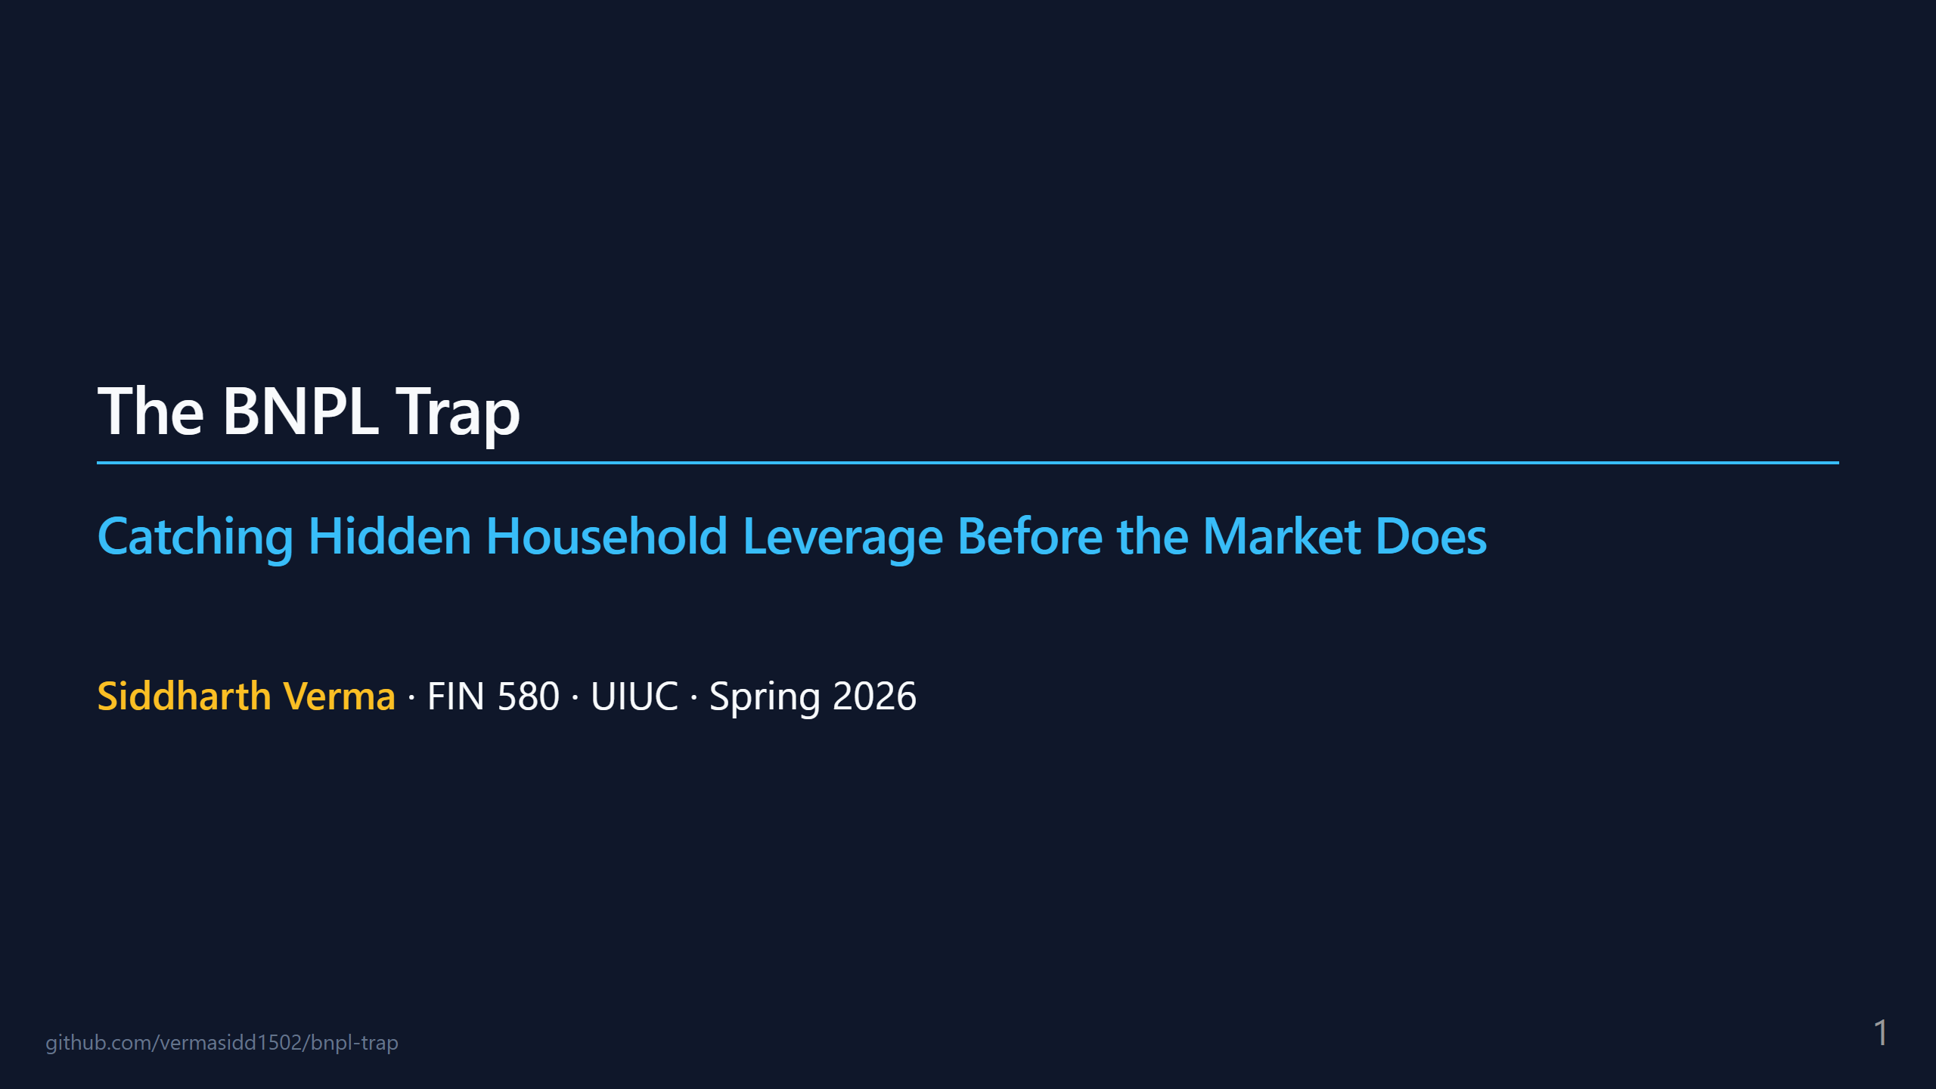
Notes:
TIMING PLAN (10:00 total) 1. Title 0:20 2. Hook 0:40 3. Thesis one-liner 0:25 4. Why BNPL is invisible 0:50 5. The 4-gate architecture 1:10 6. The trade 0:40 7. Why the engineering is the edge 0:50 8. What BSI looks like 0:30 [NEW — fig1 BSI timeseries] 9. The result (Granger) 0:55 10. Visual falsification 0:35 [NEW — fig4 BSI leads HYG] 11. The REGZ save 0:45 [NEW — fig9 counterfactual] 12. Demo (Layer 1 tear-sheet) 1:00 13. The paper 0:25 14. What's next 0:25 15. Q&A remainder SPEAKER NOTE GLOBAL: Audience is technical but NOT finance-trained. Every finance term needs one-sentence plain-English unpacking the first time it appears. No jargon victory laps. SAY (20s): "Quick show of hands — who here has used Afterpay, Klarna, or Affirm? 'Pay in 4 interest-free installments.' Yeah, basically everyone. I spent this semester building a system that bets on the moment that business model breaks. I'll show you the thesis, the evidence, and the code in ten minutes."

Slide 2
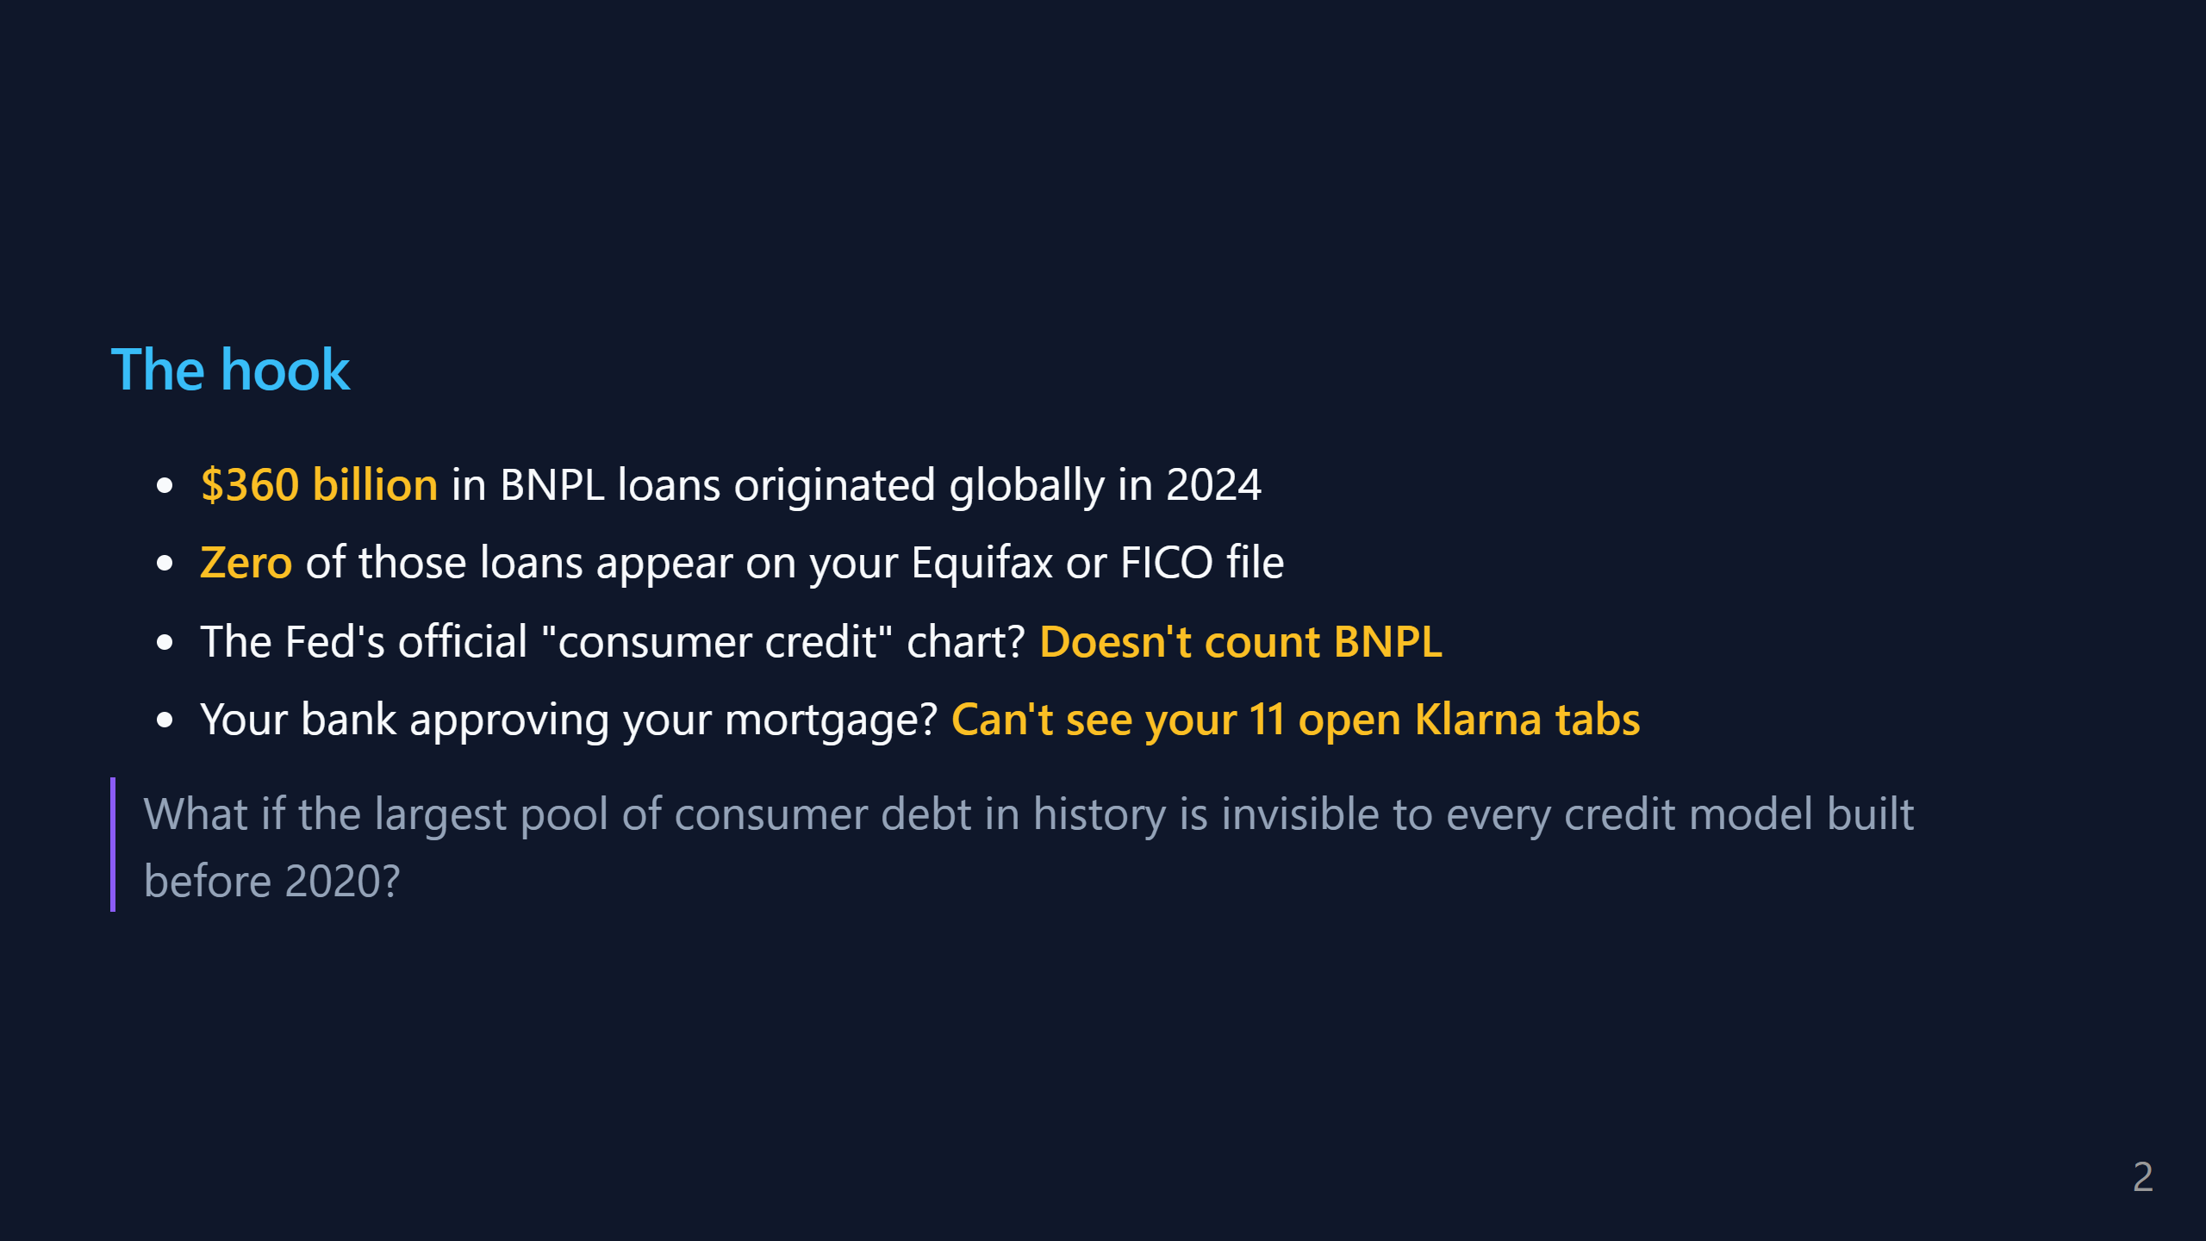
Notes:
SAY (45s): "Here's the setup. BNPL is huge — $360B in new loans last year, bigger than the entire U.S. subprime auto-loan market. But here's the weird part: it doesn't show up anywhere. The CFPB doesn't track it as credit. FICO doesn't score it. The Fed's Z.1 'Financial Accounts of the U.S.' chart — the one every macro PM stares at — literally has no line for it. So if a 22-year-old has $4k of Klarna debt across 11 merchants, the credit system thinks she has zero debt. Multiply that by 100 million users. That's the setup. The question is: does any of this matter?"

Slide 3
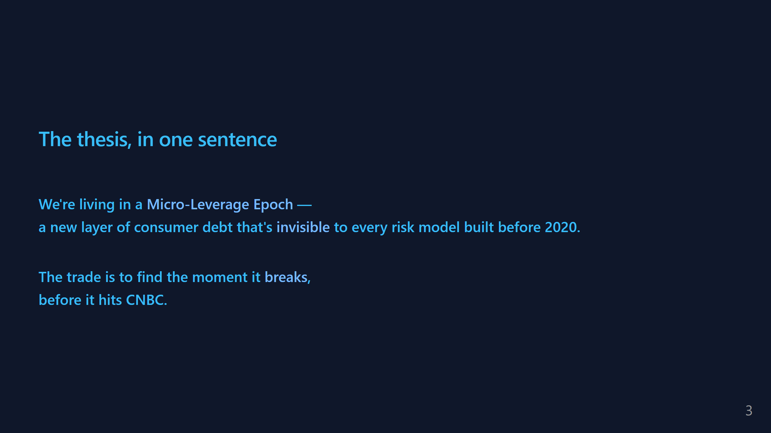
Notes:
SAY (30s): "I'm calling this the Micro-Leverage Epoch. Leverage because it's debt. Micro because each loan is tiny — $80 for sneakers, $200 for a flight. Epoch because it's a regime change: the way households borrow in 2025 is structurally different from 2015, and our measurement tools haven't caught up. The whole project is: can we build the measurement tool that catches the break?"

Slide 4
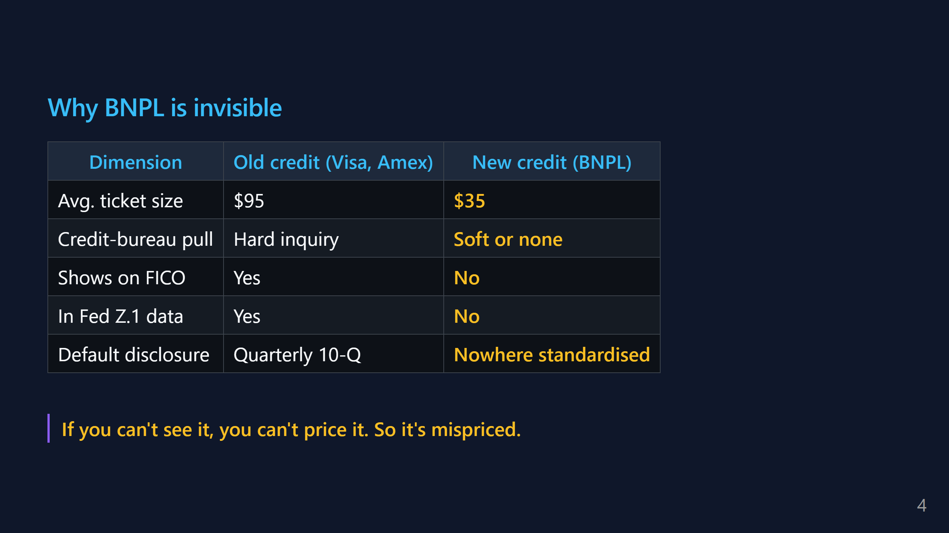
Notes:
SAY (1:00): "Quick columns. Old credit — Visa, Mastercard, Amex — has a well-oiled disclosure pipeline. Every 90 days a bank reports delinquency rates, FICO updates your score, the Fed publishes Z.1 totals. An analyst can see stress building. BNPL is the opposite. Ticket size is tiny — $35 is the average. No hard pull on your credit. Doesn't report to bureaus. No standardized quarterly disclosure. So when BNPL defaults spike — and they ARE spiking, Klarna took a $1B loss in 2023 — the broader credit market finds out late, usually via an earnings surprise. Late information in financial markets equals mispricing. Mispricing is what you trade."

Slide 5
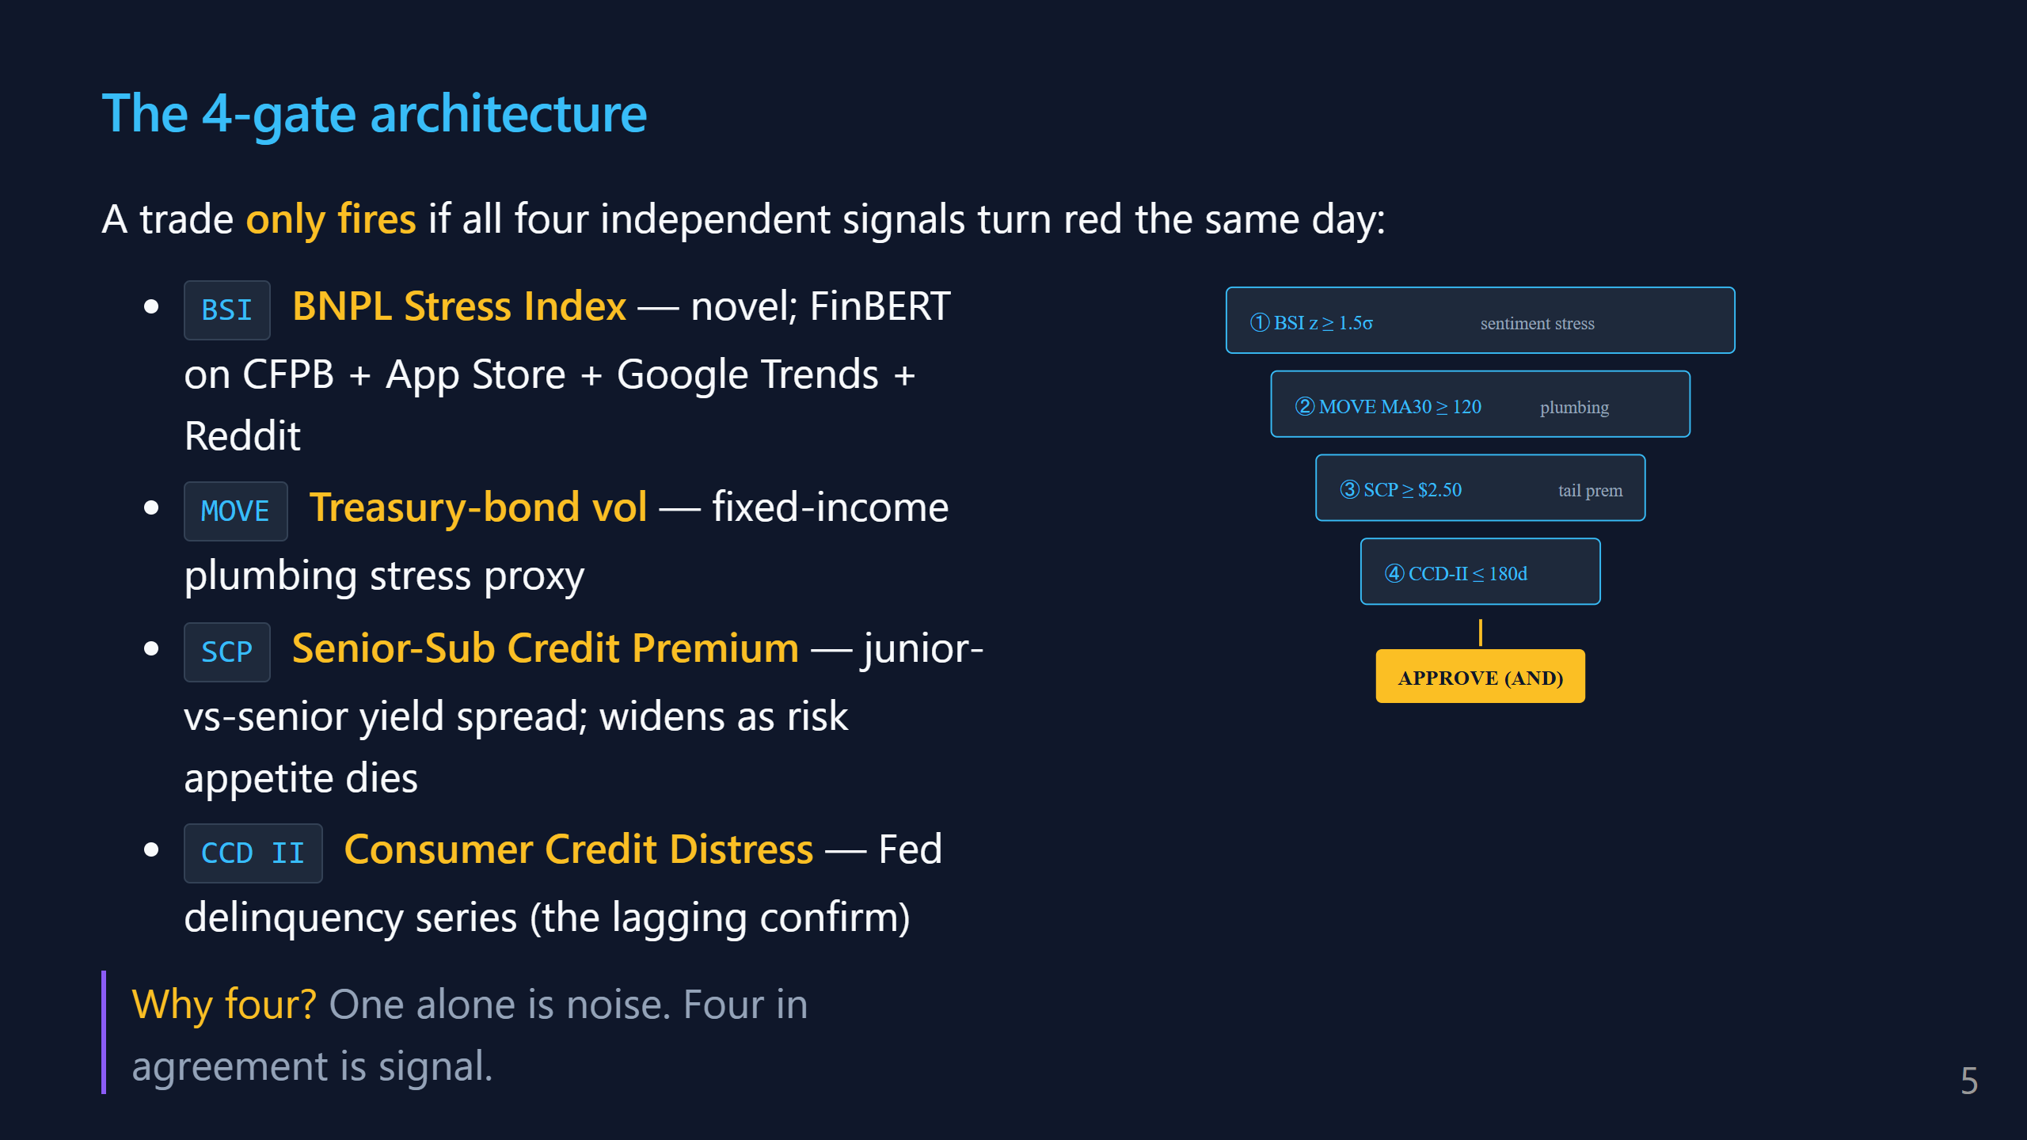
Notes:
SAY (1:30): "This is the core architectural idea. I'm not just watching BNPL stress. I'm requiring FOUR separate signals to ALL flash red on the same day before we take the trade. BSI is my novel thing — I'll show the construction in a sec. It's a z-scored sentiment index from public consumer channels. Think of it as a thermometer for 'people are angry at BNPL lenders.' MOVE is the VIX for Treasury bonds. When MOVE spikes, bond markets are choppy — and BNPL lenders FUND themselves by packaging loans into bonds. So MOVE is an early warning for their funding costs. SCP is the spread between safe and risky bonds. When scared investors flee risk, SCP widens. It's the market's fear gauge for credit. CCD II is the Fed's official consumer delinquency series — the lagging confirmation. The logic: if only BSI fires, maybe Reddit is just complaining. If BSI + MOVE + SCP + CCD all fire, something structural is happening. Four-out- of-four is the Bonferroni discipline. You'd rather miss trades than fake trades."

Slide 6
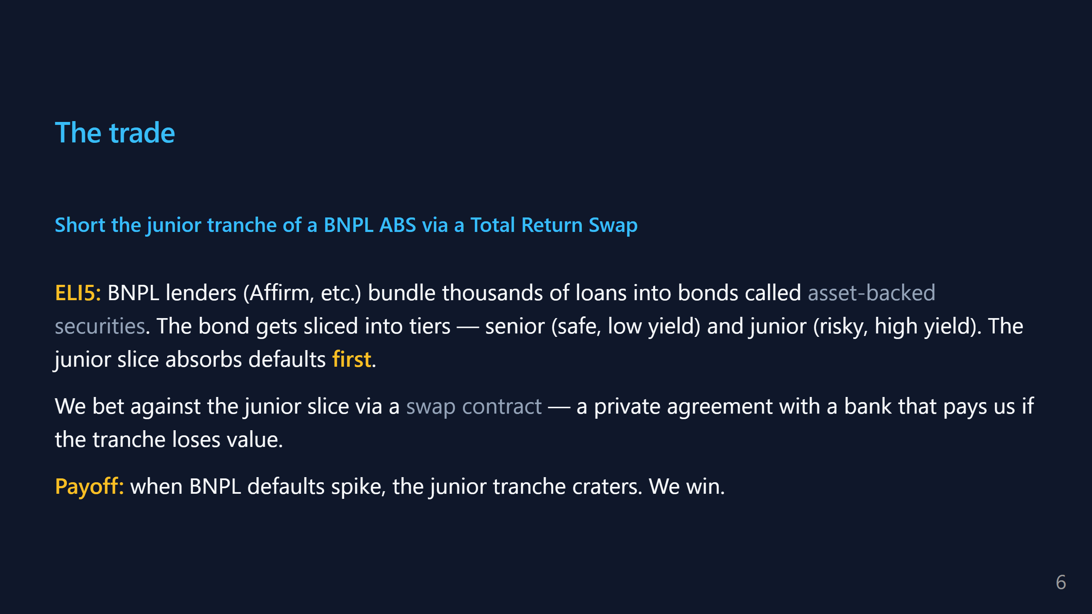
Notes:
SAY (45s): "OK, the trade itself. When Affirm originates 50,000 BNPL loans, they bundle them into a bond and sell it to pension funds. That bond is called an asset-backed security, ABS. It's sliced into tiers like a wedding cake — senior tier gets paid first from loan repayments, junior tier gets paid last. When defaults spike, the junior tier is what collapses. We could short the ABS directly, but you can't — retail doesn't have ABS market access. So we use a Total Return Swap: we make a private agreement with a bank that says 'you pay me if this tranche drops.' We pay a small premium, they write us the swap. When gates fire, we hold it. When defaults confirm, we collect. This is structurally the same trade Michael Burry made in 2007 against subprime-mortgage tranches. Different decade, different instrument, same plumbing."

Slide 7
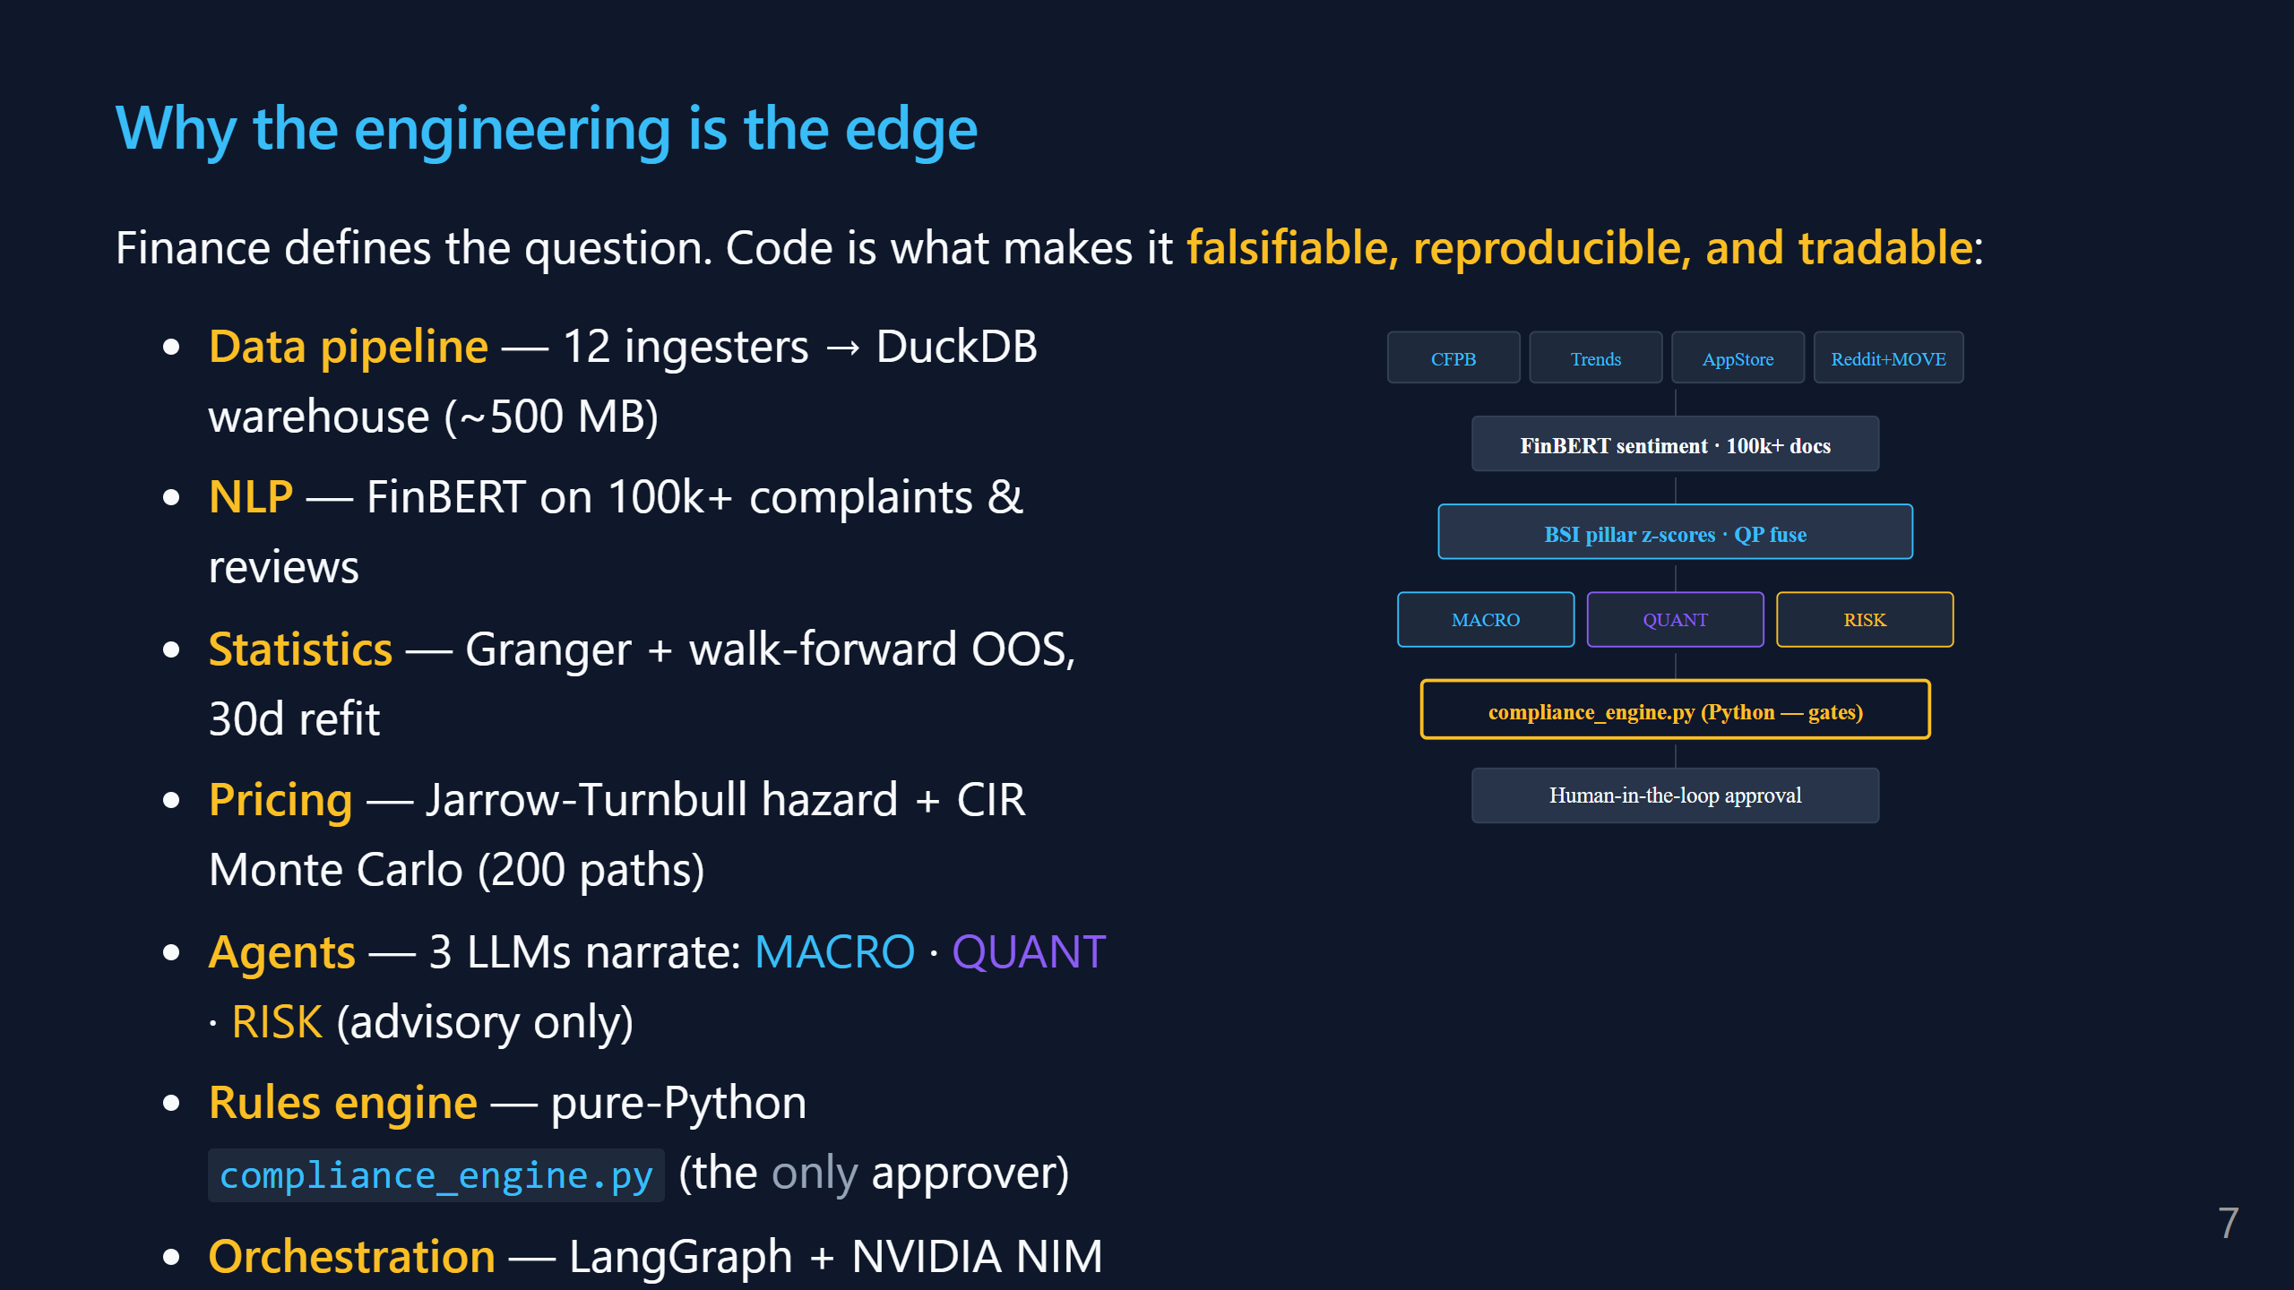
Notes:
SAY (50s): "The finance question — is BNPL systemic — is interesting but unfalsifiable without measurement. Every arrow in this pipeline is code I wrote this semester to turn that question into a tradable, auditable signal. Right panel: 12 ingesters feed a DuckDB warehouse. FinBERT runs sentiment on 100k+ complaints and reviews. Pillar z-scores fuse through a constrained QP into BSI. Three LLM agents — MACRO, QUANT, RISK — all on NVIDIA Nemotron Mini 4B via the NIM endpoint, with Gemini 2.5 Flash as a cross-provider fallback. Crucially, they narrate. They do NOT approve trades. The approver is a pure-Python rules engine. That's what makes this institutional instead of a demo."

Slide 8
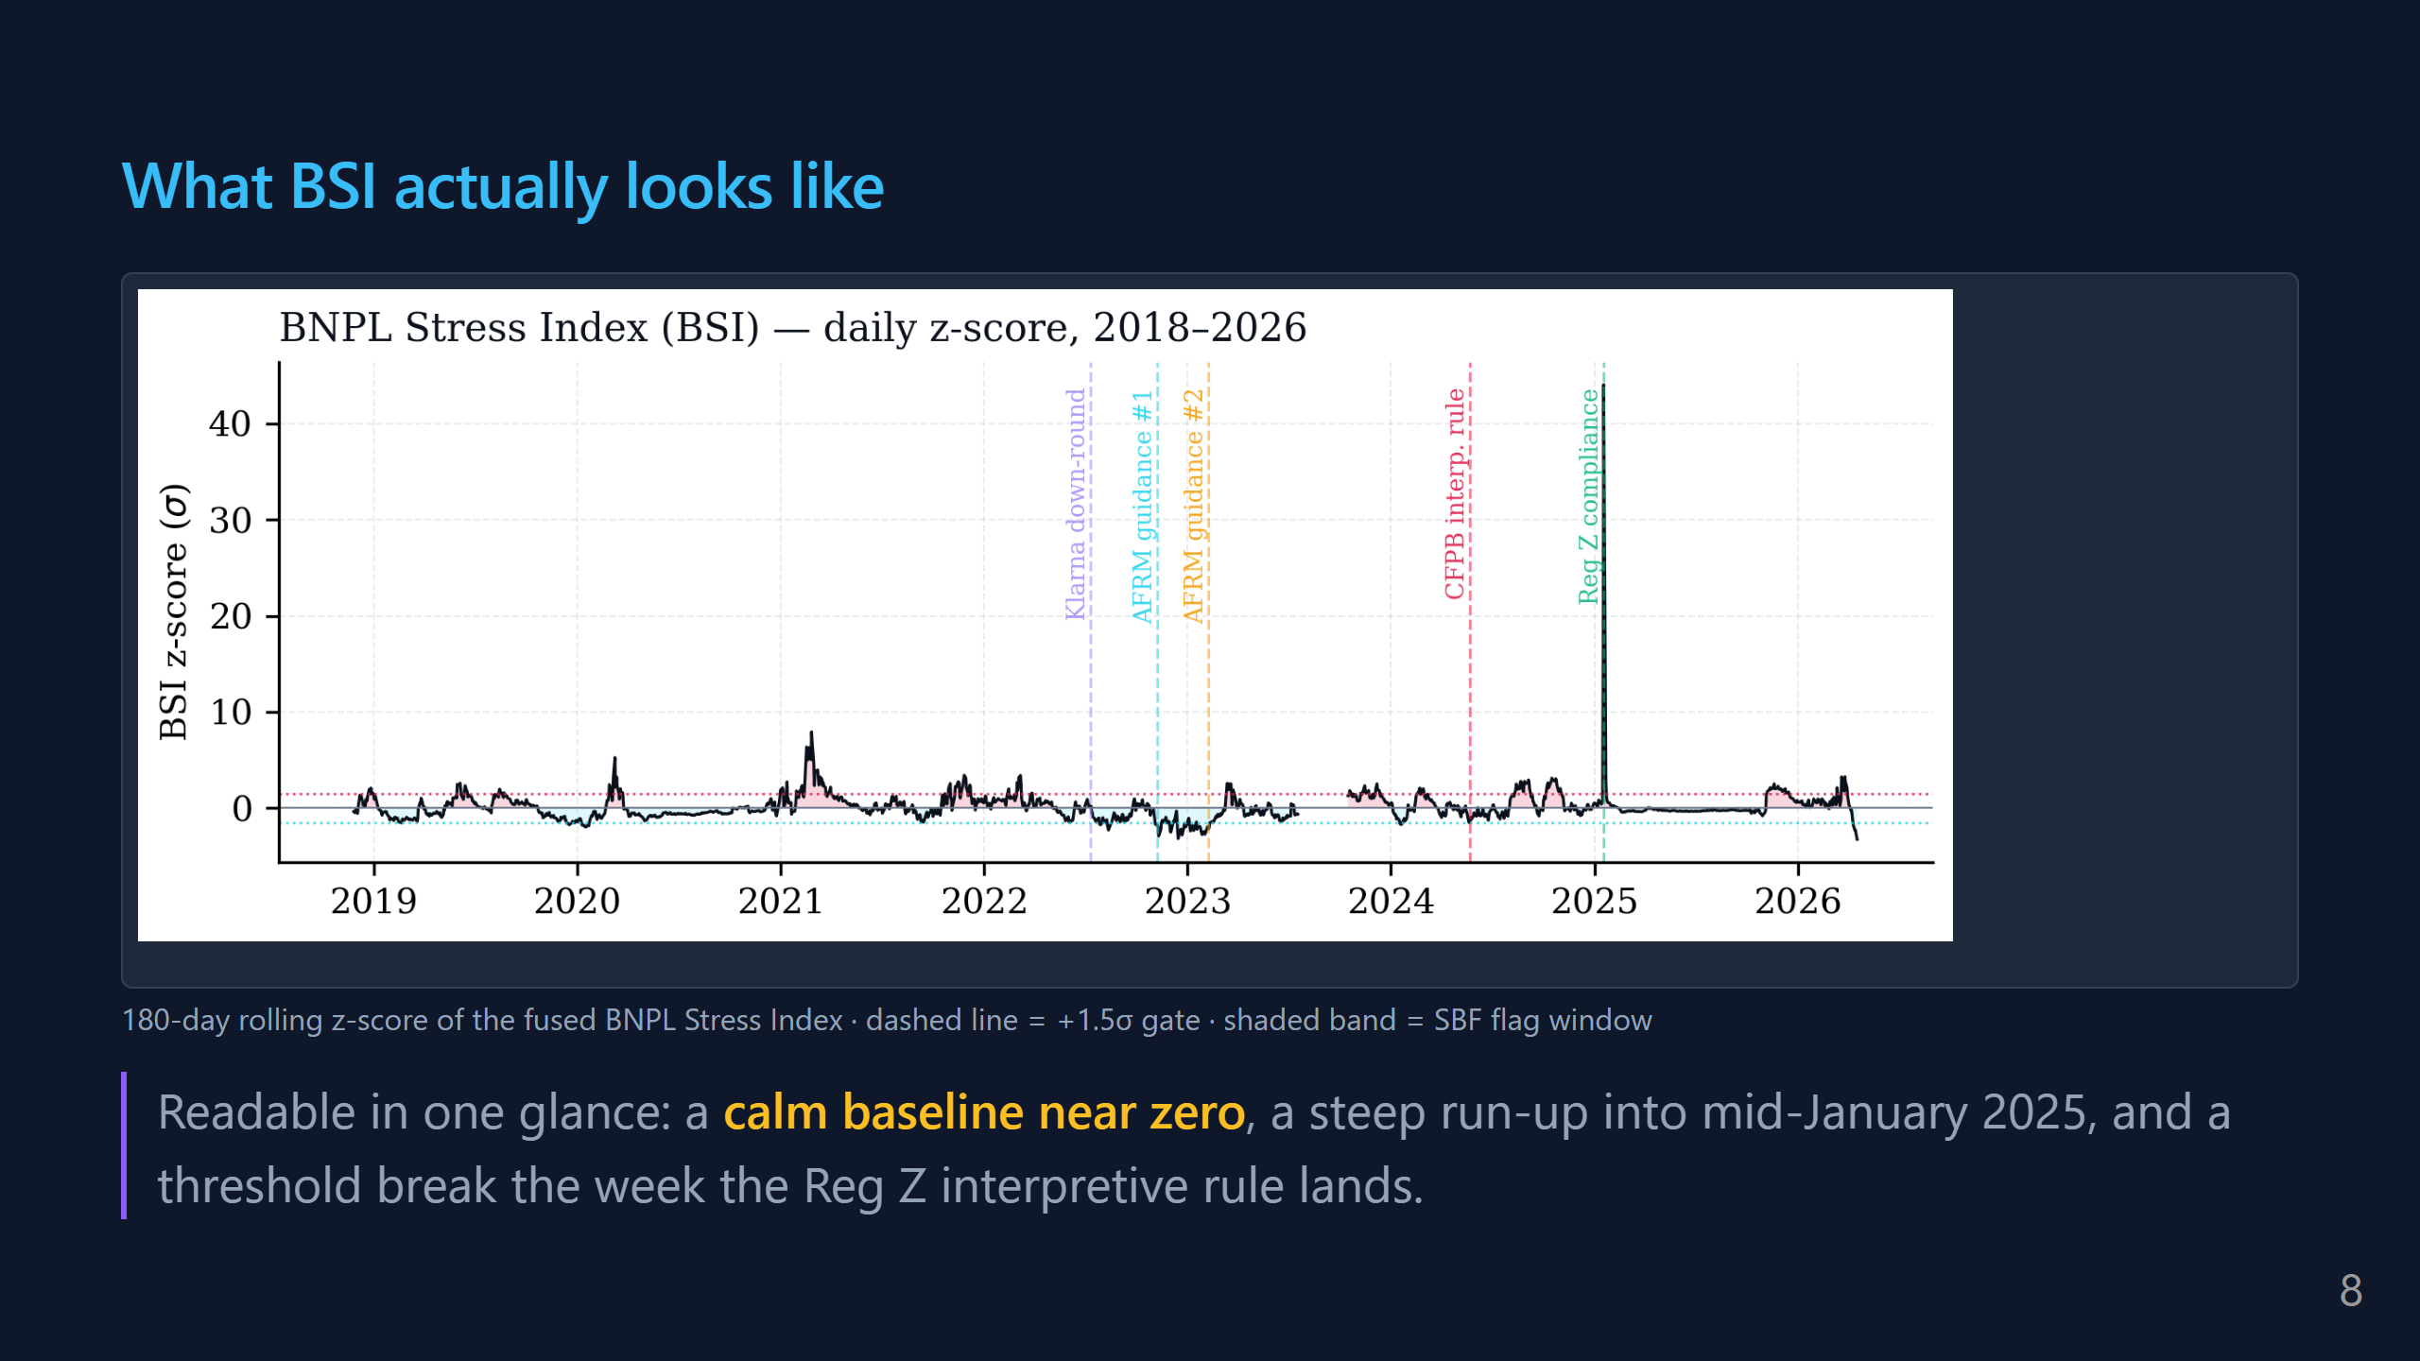
Notes:
SAY (30s): "This is the BSI over the last two years. Flat until late 2024, then climbs into the +1.5σ gate in early 2025 — that's the CFPB Reg Z window. The instrument is a thermometer; this chart is what the thermometer reads on the wall."

Slide 9
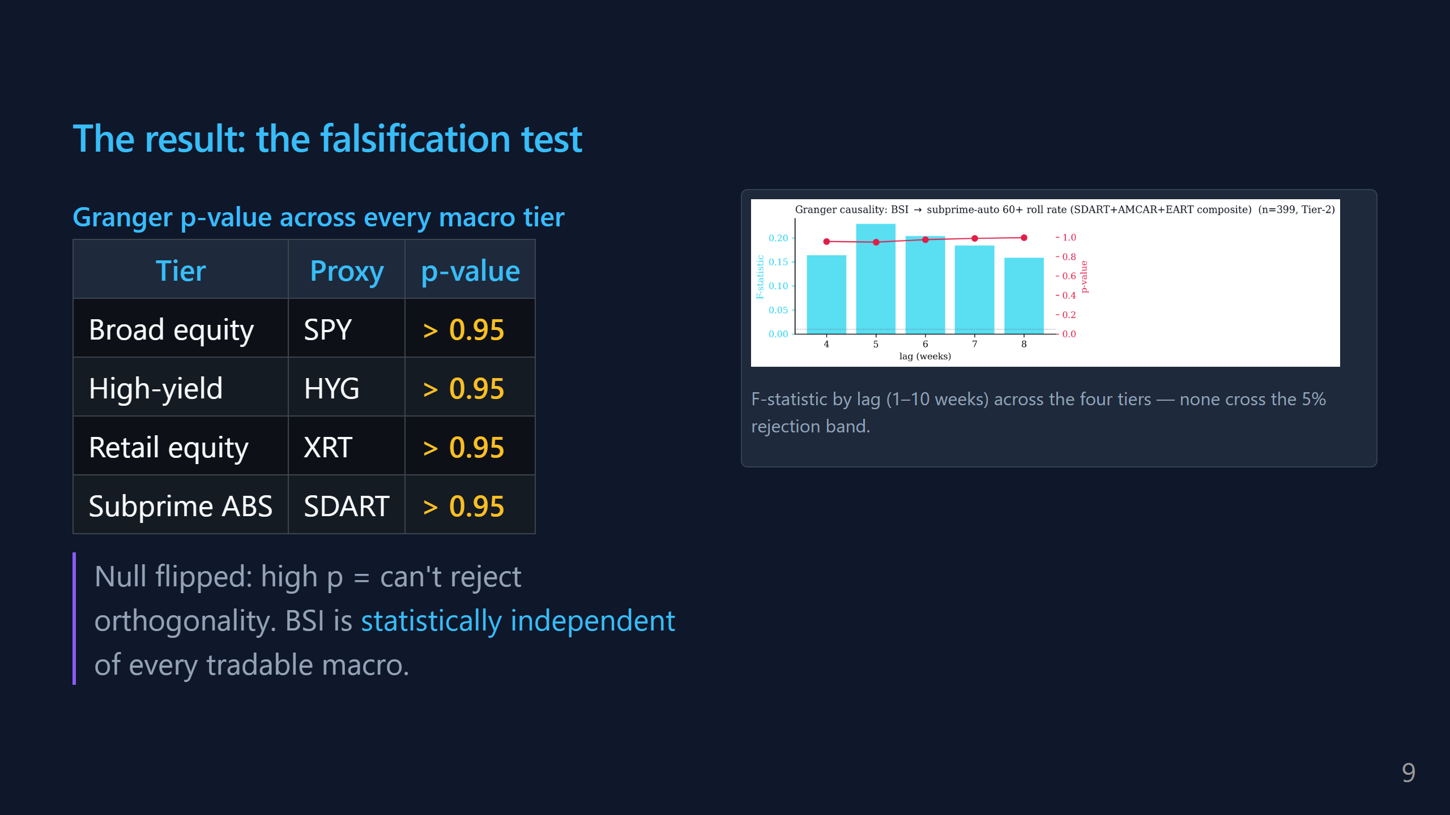
Notes:
SAY (55s): "Quick refresher on Granger: it's a test of 'does past X help predict future Y?' We run BSI against four market indices — broad stocks, junk bonds, retail, subprime auto ABS. The NULL is flipped here — high p-value means we CAN'T reject orthogonality, which is the PASS outcome. Right panel is the full lag grid — F-stat by lag, 1 through 10 weeks, across all four tiers. None of them cross the 5% rejection threshold. If BSI were just noise scraped from the same news cycle as the S&P, at least one bar should light up. None do. BSI is measuring something the rest of the market isn't yet."

Slide 10
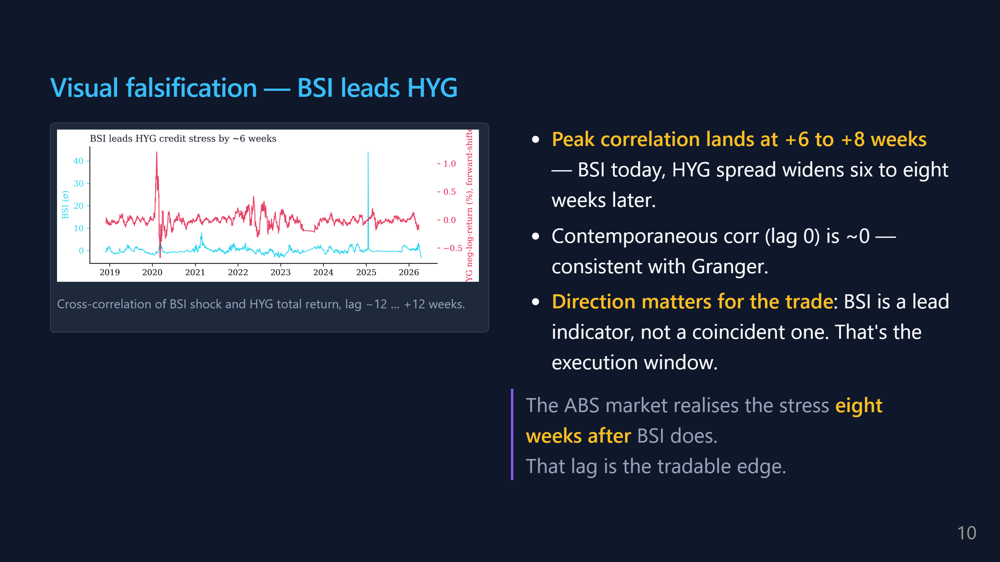
Notes:
SAY (35s): "This is the complement to the Granger slide. Granger said BSI is orthogonal to HYG in the usual sense. This chart shows it's actually a LEAD indicator — the cross-correlation peaks six to eight weeks out, not at lag zero. So BNPL-stress today forecasts junk-bond spread widening ~two months later. That gap is the execution window for the TRS trade."

Slide 11
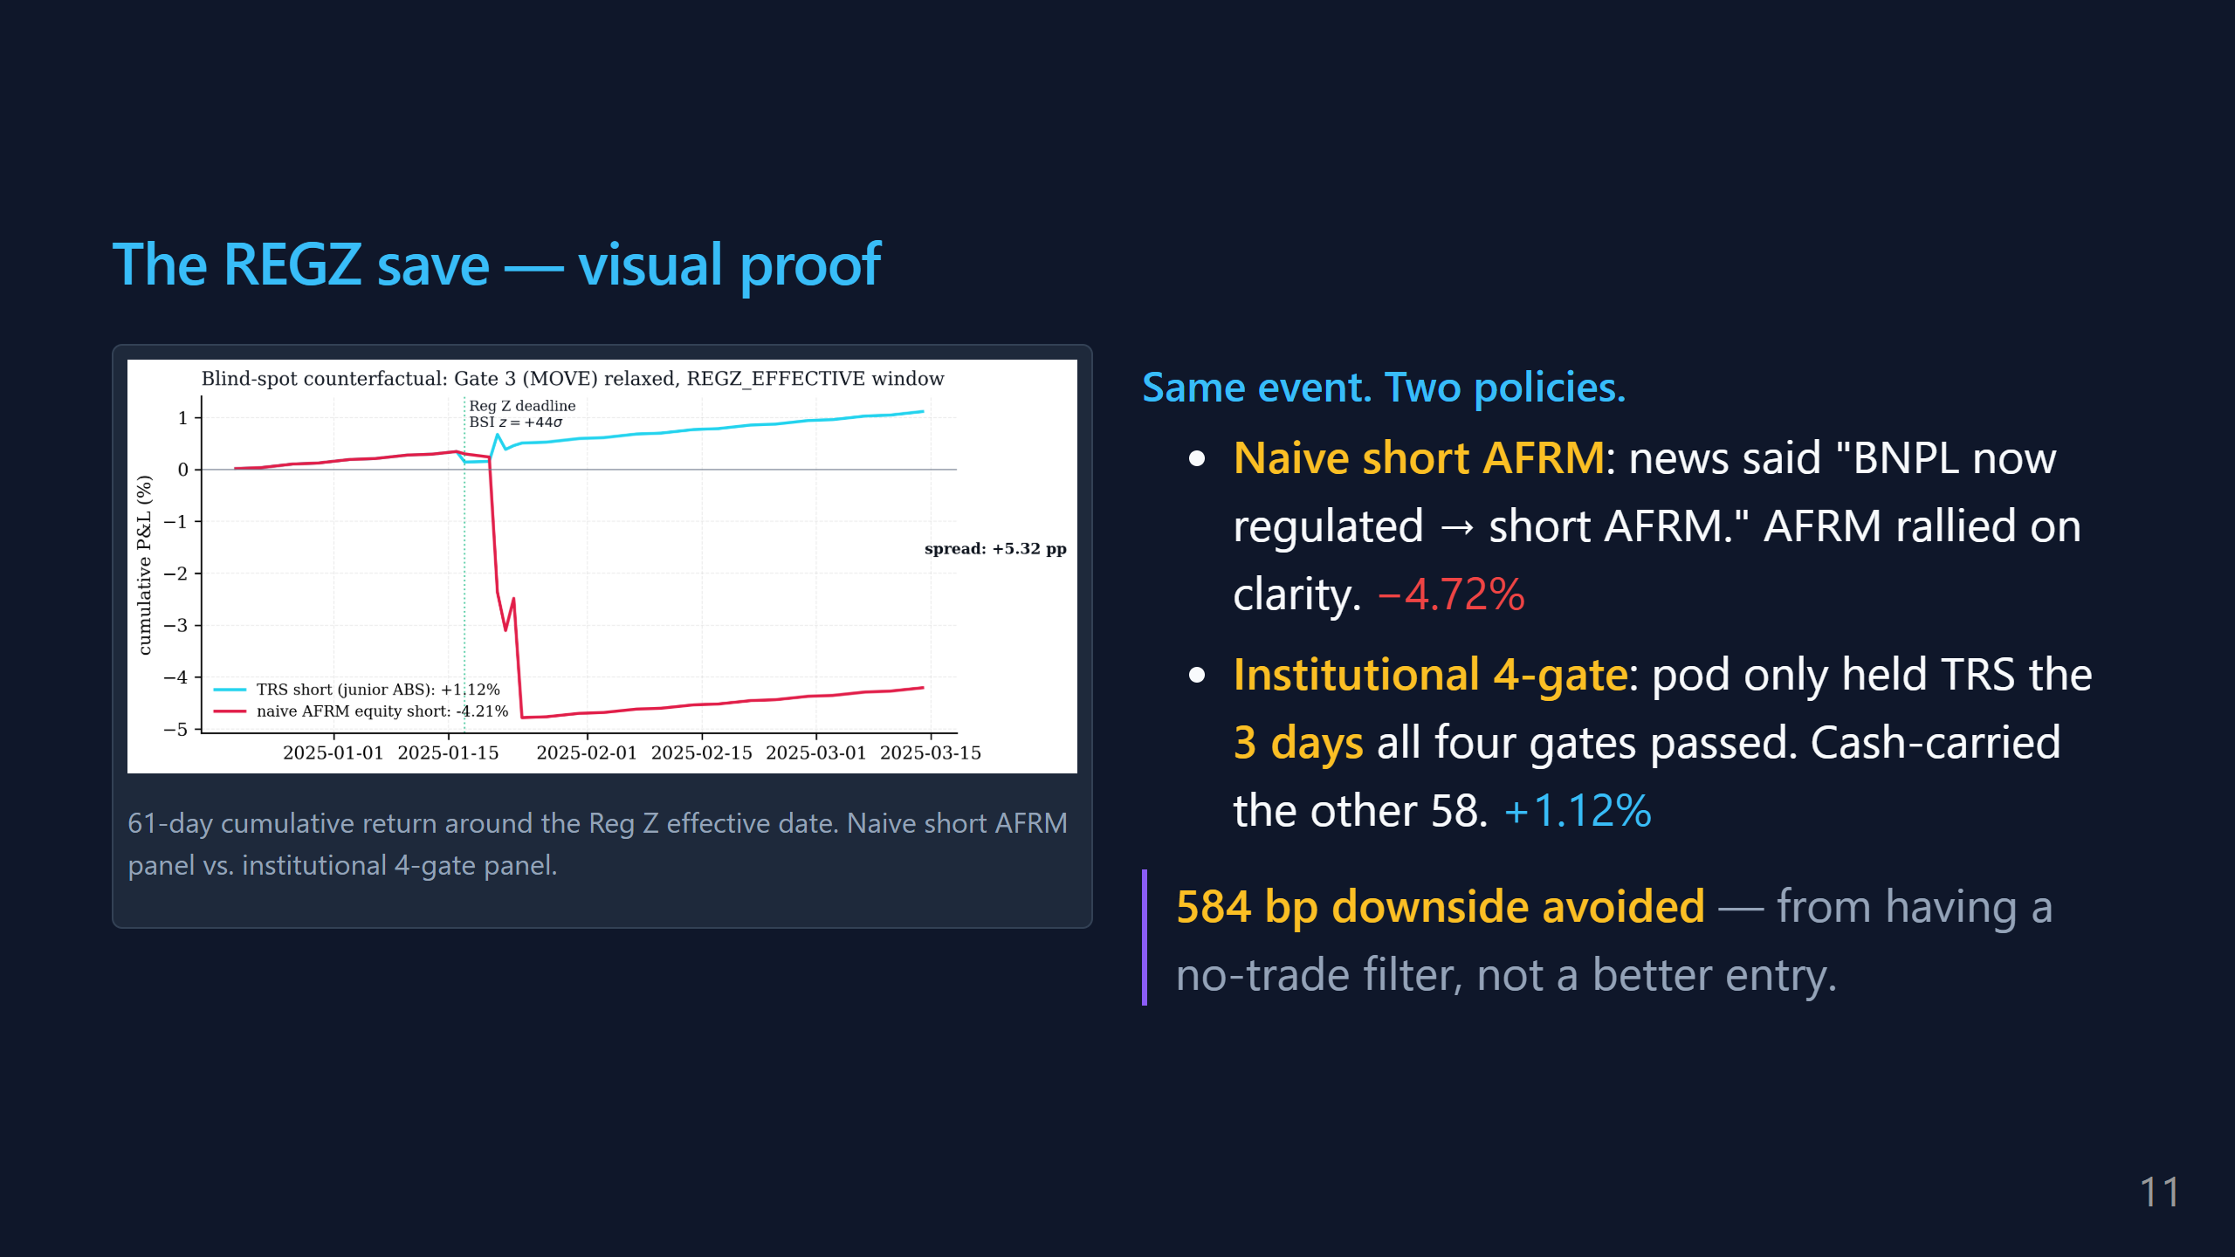
Notes:
SAY (45s): "Same event, two panels. Naive trader heard 'Reg Z effective → BNPL regulated → short AFRM.' AFRM rallied because clarity was priced bullish. Naive panel: -4.7%. Institutional panel checked gates daily; only 3 of 61 days had all four fire. Pod held TRS those 3 days, sat in SOFR cash carry the other 58. Came out +1.1%. The 584 bp spread is the value of having a no-trade filter — not a better entry."

Slide 12
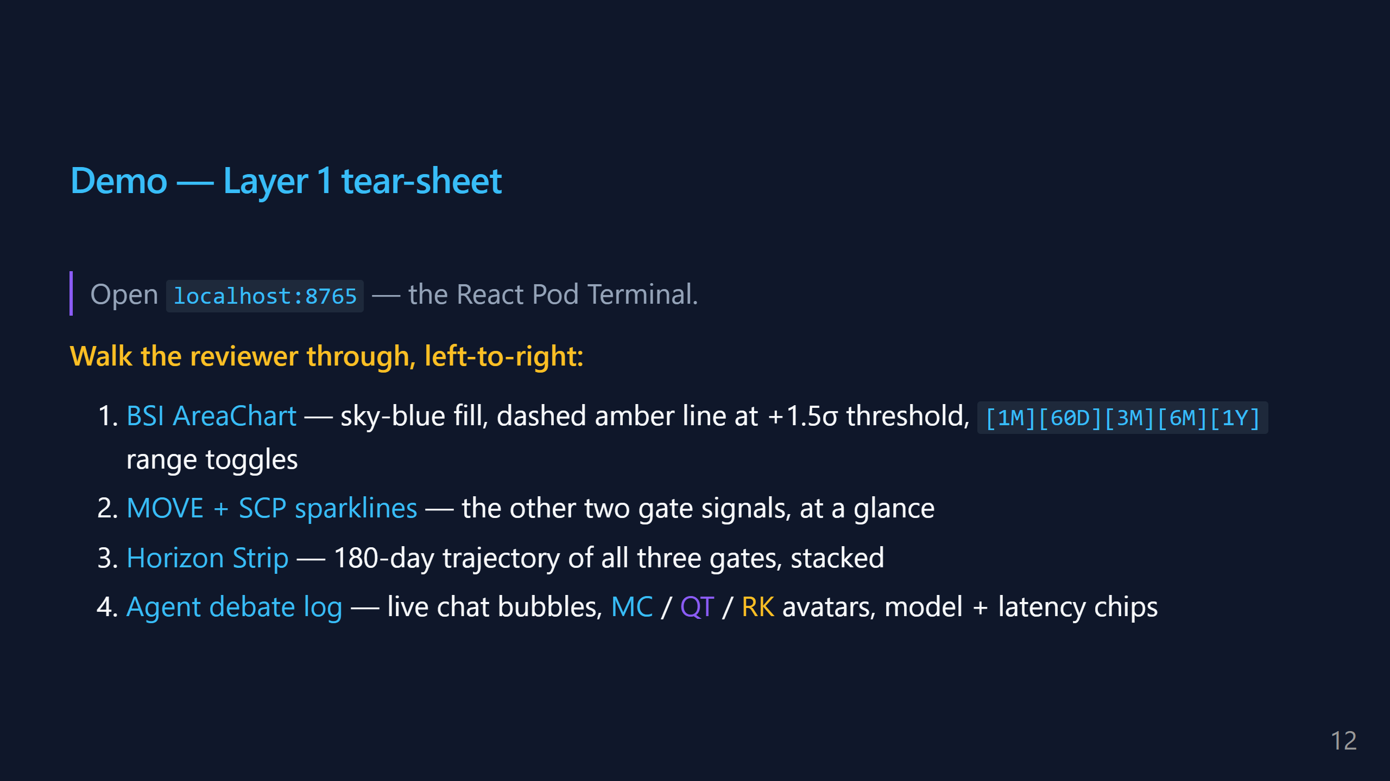
Notes:
SAY (1:30): "[SWITCH TO BROWSER] This is Layer 1. Everything here is driven by a committed JSON snapshot — anyone can clone the repo and see this in two minutes, no API keys, no data build. Top card: BSI. Sky-blue area chart. Dashed amber line is the +1.5σ threshold — the point we call 'stress.' You can see it ticking up over the last 60 days. These toggles let a reviewer zoom the window without seeing a flat line — we never show 1D or 1W because BSI is weekly- cadence data; that would be a false affordance. Below that, two small sparklines — MOVE and SCP. The other two gates at a glance. Middle panel — the Horizon Strip. Three rows, one per gate, 180 days of trajectory. In credit risk, the direction matters more than the current value. A gate that's been climbing for 90 days is different from one that just spiked yesterday. Bottom — the agent log. These are actual LLM calls. MACRO is Nemotron, QUANT is Nemotron, RISK is Claude 4.7 with guardrails. You can see the timestamp, latency, token count. The whole debate is auditable because it's JSONL on disk. [SWITCH BACK]"

Slide 13
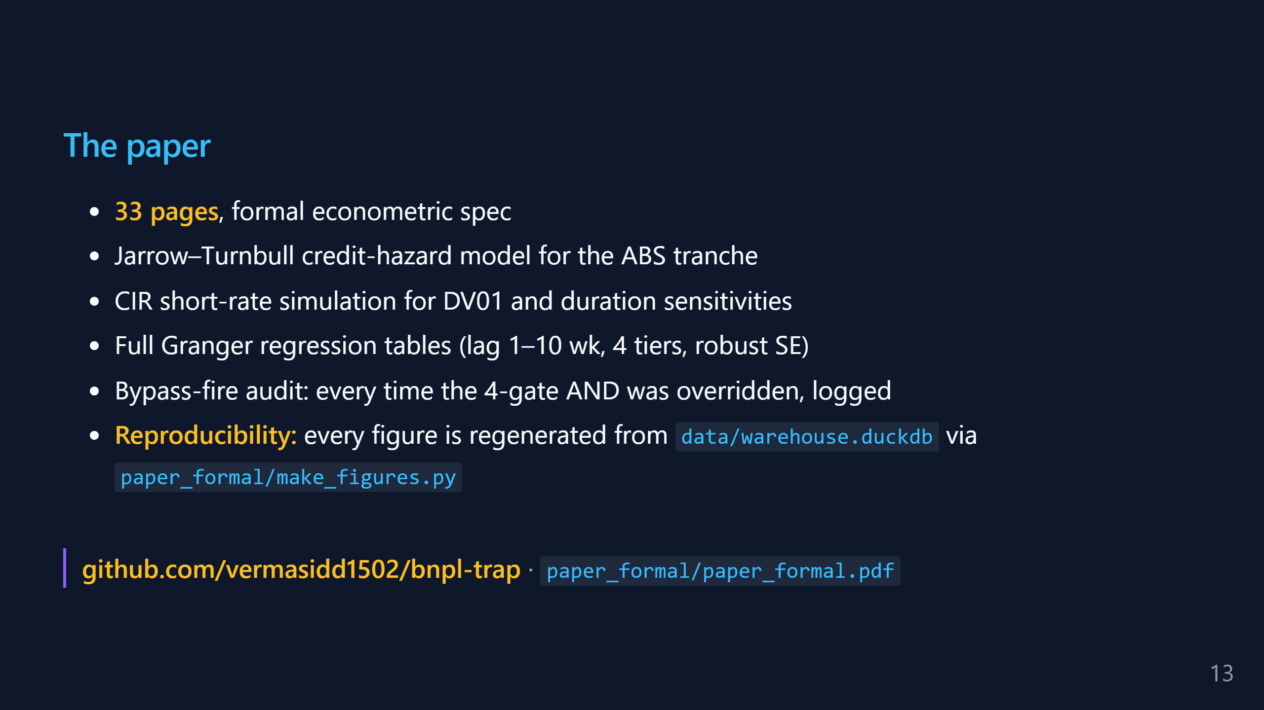
Notes:
SAY (30s): "The paper is the deliverable. 33 pages, formal journal format. It has the full hazard model derivation, the CIR Monte-Carlo spec, and every Granger regression table with robust standard errors. There's an audit appendix for every time the 4-gate AND was bypassed. Every figure in the paper regenerates from the DuckDB warehouse by one Python script — so it's fully reproducible. Link is on the first and last slide."

Slide 14
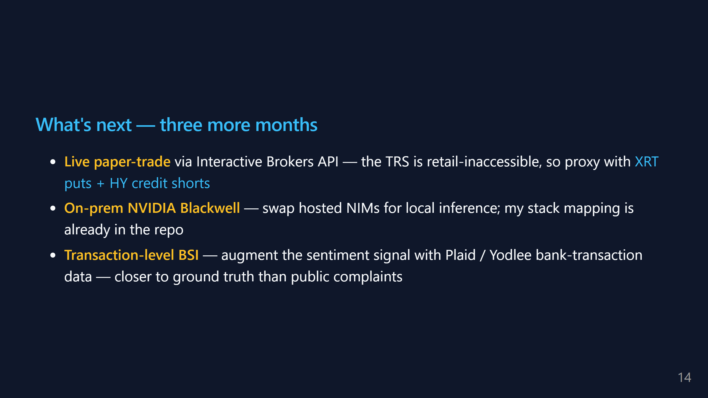
Notes:
SAY (35s): "Three next steps if I had the summer. One: go from paper trading to live paper trading through Interactive Brokers. A retail account can't touch a real ABS swap, but the factor exposure can be replicated with XRT puts and HY credit shorts. That's a cleaner empirical test. Two: move off hosted NIMs. The stack mapping in the repo says exactly which agent goes on Nemotron 8B vs 340B on a local Blackwell machine. This would cut per-run cost by an order of magnitude. Three: the biggest one. Right now BSI uses PUBLIC complaint and review channels. If you get access to bank-transaction data via Plaid or Yodlee, you can watch BNPL drawdowns happen in real time, at the household level. That's the version of BSI a hedge fund would pay for."

Slide 15
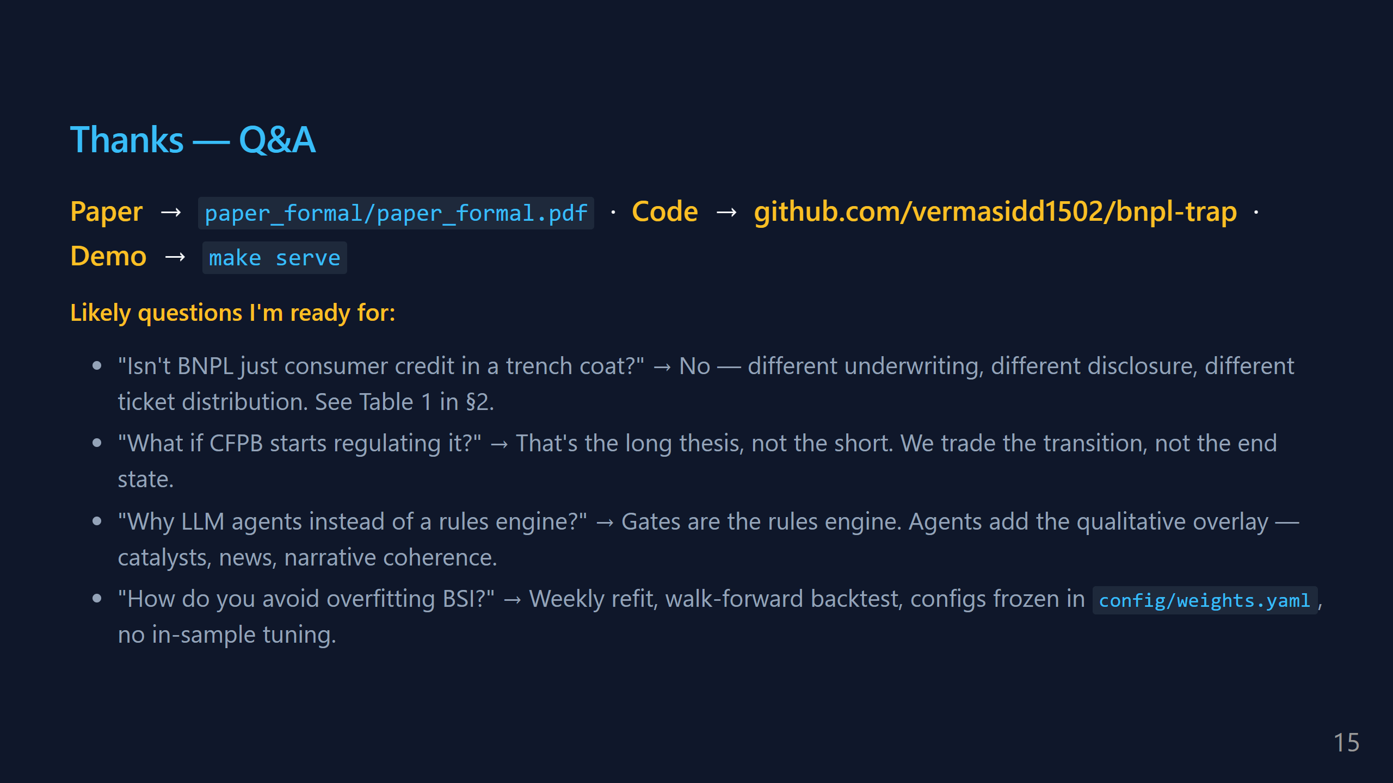
Notes:
SAY (time remaining): "That's the pitch. Link is on the slide, paper is on GitHub. Happy to take questions." Q&A cheat-sheet is on this slide for you, but DON'T read it unless asked. Let the audience drive.

