Slide 1
SpendLens
Intelligent Expense Categorizer with OCR
Total spend
₹1,475.79
A Django monolith that turns receipt images into structured expenses, auto-categories, and dashboard insights.
Top category
Travel
Django
Tesseract OCR
Chart.js
SQLite
Receipts
4 processed
Hackathon Demo Deck

Slide 2
PROBLEM
01
Manual expense tracking breaks down at receipt scale
Users collect receipts across food, travel, shopping, medical, groceries, and bills. Manually reading every receipt and tagging expenses is slow, inconsistent, and easy to abandon.
User story
“I want my daily receipts auto-categorized so I don’t manually track expenses.”
Unstructured inputs
Photos, screenshots, and PDFs arrive in different layouts.
Human categorization
Merchant names and keywords need consistent mapping.
No instant visibility
Users need summary totals, not another spreadsheet.

Slide 3
SOLUTION
02
Upload once. OCR, parse, categorize, and visualize instantly.
1
2
3
4
5
Upload
OCR
Parse
Categorize
Dashboard
Receipt image/PDF
Extract raw text
Merchant, amount, date
Merchant + keyword rules
Charts and insights
Built as a Django monolith to keep setup simple for a 2–3 hour hackathon: templates for frontend, views/models for backend, SQLite for persistence, and Chart.js for interactive visuals.

Slide 4
ARCHITECTURE
03
A compact monolith with clean backend responsibilities
Django Templates
Views
OCR Module
Categorizer
Upload + review + dashboard UI
Upload flow, pending review, save/delete
Tesseract + PDF text extraction fallback
Indian merchant mapping + keyword rules
SQLite
Expense records and uploaded receipt paths
Single repo. Minimal moving parts. Easy to explain to judges.

Slide 5
OCR + PARSING
04
OCR converts messy receipt layouts into usable fields
Raw OCR text
Parsed output
Uber March 10, 2025
Thanks for tipping, Nisha
Total %311.93
Trip Charge 261.93
Subtotal 261.93
Tip 50.00
Merchant
Amount
Date
Uber
₹311.93
10 Mar
Parser handles OCR noise like `%311.93` when Tesseract misreads the rupee symbol, then normalizes the amount before categorization.

Slide 6
CATEGORIZATION
05
Specific merchant rules win before broad keyword rules
Food
Swiggy, Zomato, Domino’s
Travel
Uber, Ola, IRCTC, IndiGo
Shopping
Amazon, Flipkart, Myntra
Bills
Airtel, Jio, electricity
Medical
Apollo Pharmacy, 1mg, MedPlus
Groceries
D Mart, Blinkit, Zepto
Entertainment
BookMyShow, PVR, Netflix
Example fix: APOLLO PHARMACY contains “Lifestyle”, but Medical is prioritized before Shopping, so it resolves correctly.

Slide 7
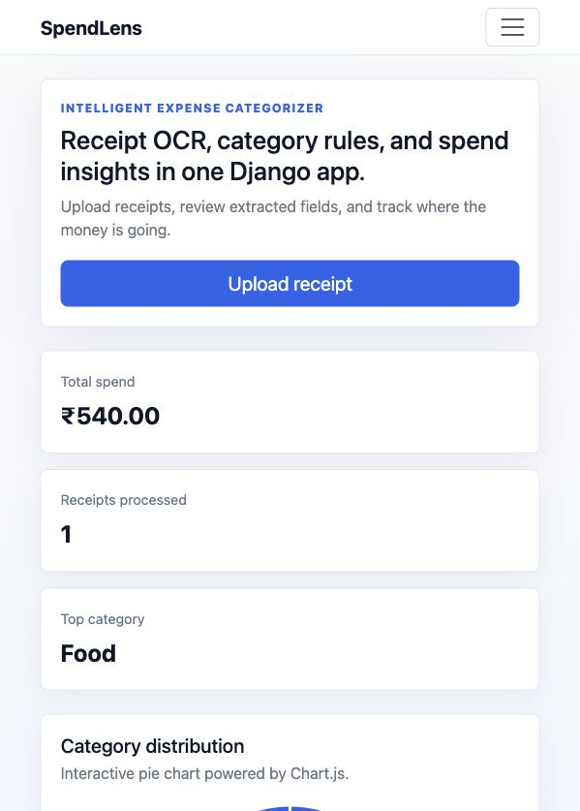
PRODUCT DEMO
06
Dashboard gives immediate spend visibility
Clean upload/review flow plus category totals, filters, receipt table, and interactive chart.
Demo path
Upload receipt → Review fields → Save → Dashboard updates category totals and chart
OCR
Rules
UI
Tesseract
Merchant-first
Chart.js
Save behavior was refined: processing creates a pending review; the expense is stored only after the user confirms.

Slide 8
IMPLEMENTATION QUALITY
07
Small codebase, clear modules, demo-safe fallbacks
Pending review flow
OCR diagnostics
Upload processing no longer saves accidental rows.
`python manage.py check_ocr` tells teammates what is missing.
CLI fallback
Regression tests
Uses Tesseract command even if Python OCR wrapper is unavailable.
Uber OCR noise, Apollo category priority, and save flow are covered.

Slide 9
What we built
SpendLens makes receipts useful the moment they are uploaded.
Learning from manual re-categorization
More receipt layouts and languages
OCR extraction, resilient parsing, India-focused merchant categorization, and an interactive spend dashboard in a Django monolith.
Monthly budgets and alerts
Ready for demo

