Slide 1

Satellite Orbit Predictor
Presented by:
Sonika S Lokhande
Arash Hamzehlou
Matthew Debacker

Slide 2
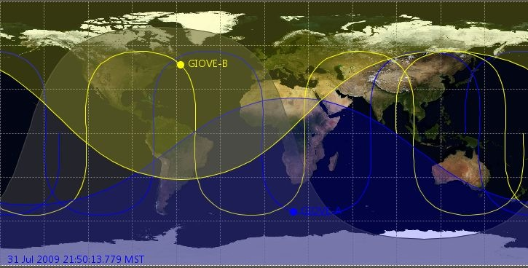
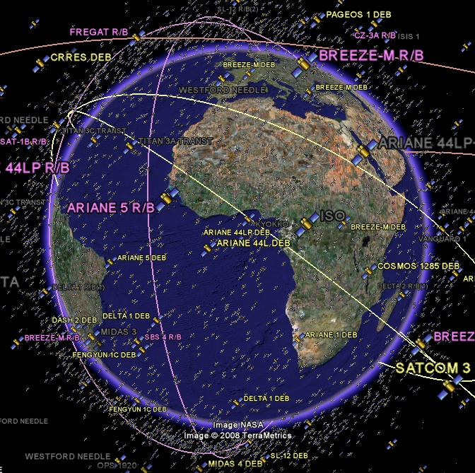
Objective
The main goal of this project is to predict the position of any given satellite in each given timespan and propagate its orbit using multiple different libraries and display on either a 2D map or a 3D globe.

Slide 3
Framework of the Package
Using SGP4 library we will create different modules:
Module for Angles
Module for Coordinate system
Module for Constants
Module for Locations
We will create another Module (Pandas dataframe) to import the data from the above modules.
Using the information from above modules we will create arrays and with the help of Plotly we will do plotting.(2D/3D plotting).
Additional Modules might be needed for 3D globe interactions.
Note: This framework is temporary and can be changed.(such as no. of modules)

Slide 4
Libraries
We will be using New Packages which includes the following:
SGP4: Simplified perturbations model library to predict the position of satellite given orbital elements. This package will get the position data for plotting.
Plotly: Plot the orbits on an interactive graph (can view details of orbit by hovering mouse over). Possibly plot the orbits in 3D around earth.
Among the Previously used Packages, we will be using:
Pandas: To create dataframes to hold and process the large quantity of satellite data
NumPy: To perform scientific Calculations.

Slide 5
Group Member Contributions
Arash:-Handle SGP4 and obtain satellite data for orbits of interest
Sonika :-Post process the SGP4 data and create arrays for plotting
Matthew:-Plot orbits of interest in Plotly, make plots interactive

