Slide 1
Interactive Music and MIDI in Games
(and why you should care)

Slide 2

Movember!
Notes:
This sweet ‘stache isn’t just to look cool!
It’s to raise awareness (and funds) for prostate cancer research!

Slide 3
What is MIDI?
MIDI = Musical Instrument Digital Interface
(Just in case you’ve been living under a rock…)
Yeah, but what IS it?
First…
Notes:
Stands for Musical Instrument Digital Interface.
Okay, so you want to know some more?

Slide 4
What MIDI is NOT:
Just “bleeps” and “bloops”
A storage format for sound
Tied to hardware
Outdated!
Well, it is a bit, but we won’t worry about that now…

Slide 5
What MIDI IS
A message format that describes events
Bwah? That doesn’t sound like music!
Events can represent notes or metadata
Notes:
How does a message format relate to music?
Simple:

Slide 6
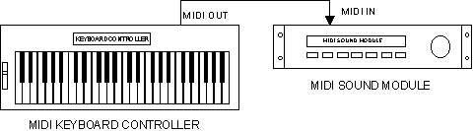
MIDI as inter-device communication
Figure 1: Simple MIDI setup
Notes:
Quick review of CMPT 365 – Who’s taken it?
Alright, you should know, then, that MIDI devices get hooked up in a chain from output port to input port.
The most basic setup is a single controller (usually a keyboard) hooked up to a synthesizer.

Slide 7
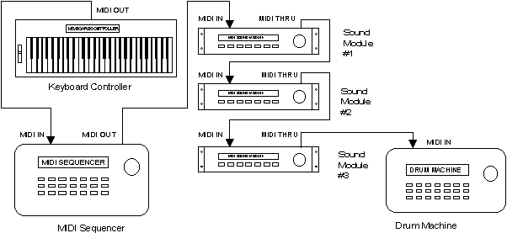
MIDI as inter-device communication
Figure 2: More complicated setup
Notes:
You eventually get stuff like this…
MIDI messages are only processed by the device (channel) they are marked for.
You can have up to 16 channels.
In this type of configuration, the device will act on a message if it is on the same channel, and will pass it along through the “thru” port regardless.
The “out” port is pretty much the same, but provides an opportunity for the device to generate its own messages or modify incoming ones.
Don’t concern yourself too much with this.

Slide 8
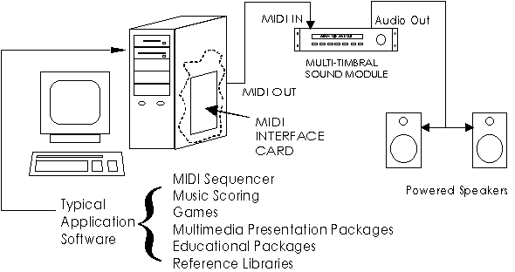
MIDI as inter-device communication
Figure 3: What we’re interested in: Using software as a sequencer.
Notes:
So, what we want to do is use our “game” as a MIDI master device to drive our synthesizers.

Slide 9
Whoa, back up there sparky!
A) What does a sequencer actually DO?
and
B) Where are we gonna get synthesizers from?
Notes:
And to that I say, Hold your horses! First let’s go over how sound synthesis works.

Slide 10
Synthesis
Traditionally done in hardware
SNES used FM (Frequency Modulation)
PC’s used Wavetable
MIDI hardware exists to do all kinds of stuff
We will create a software synthesizer to do wavetable lookup
Notes:
Old game hardware used to do synthesis on a dedicated FM synthesis chip. This is how we got sweet chip music! PC’s later put wavetables on their sound cards to do a sample lookup (not too bad). And there is a lot of hardware for musicians for all kinds of different sounds.
Some of you may know that the current generation of game hardware doesn’t have any dedicated sound hardware. That means we need to do something clever if we want MIDI to work.

Slide 11
The Sequencer (duh-duh!)
Is a general term for a device that sends messages to everything else
Reads a MIDI file and sends events to devices
at the right time…
This is also implemented in software
lots of software packages exist
Notes:
The sequencer is the “brain” of the MIDI system.
You feed it a MIDI file, and it sends messages to the devices in the MIDI chain at the appropriate time.
There are a lot of fiddly little things in the MIDI file format, like setting the appropriate timing method. Implementing one of these isn’t very much fun.

Slide 12
MIDI Messages
So that’s the basic MIDI architecture overview
How does a message do it’s dirty work?
Notes:
We’ll now take a look at what a MIDI message looks like, to understand how it’s working.

Slide 13
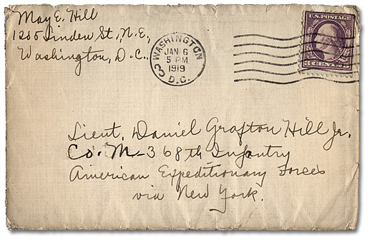
MIDI Messages

Slide 14

MIDI Messages
Notes:
This is not a MIDI message

Slide 15
MIDI Messages
Delta Time | Event Type | MIDI Channel | Parameter 1 | Parameter 2
Variable-length | 4-bits | 4-bits | 1-byte | 1-byte
Notes:
THIS is a MIDI message!
3 bytes, plus a little bit

Slide 16
MIDI Messages
Delta Time
How long to wait after previous event
0 means simultaneous
Event Type
Three Types: Control, Meta and System Exclusive
Channel
0-15
Parameter 1 &2
Stuff specific to the message
Notes:
Control events are the main events. They are the ones that get sent around through the MIDI channels that we hooked up.
Meta events tell the system as a whole what to do, and don’t get passed around.
SysEx events get passed around, but we can safely ignore them, since they are just manufacturer specific stuff.

Slide 17
Control Messages
Name | Event Type | MIDI Channel | Parameter 1 | Parameter 2
Note Off | 0x8 | 0-15 | Note Number | Velocity
Note On | 0x9 | 0-15 | Note Number | Velocity
Note Aftertouch | 0xA | 0-15 | Note Number | Aftertouch Value
Controller | 0xB | 0-15 | Controller Number | Controller Value
Program Change | 0xC | 0-15 | Program Number
Channel Aftertouch | 0xD | 0-15 | Aftertouch Value
Pitch Bend | 0xE | 0-15 | Pitch Value (LSB) | Pitch Value (MSB)

Slide 18
Control Messages
Name | Event Type | MIDI Channel | Parameter 1 | Parameter 2
Note Off | 0x8 | 0-15 | Note Number | Velocity
Note On | 0x9 | 0-15 | Note Number | Velocity
Note Aftertouch | 0xA | 0-15 | Note Number | Aftertouch Value
Controller | 0xB | 0-15 | Controller Number | Controller Value
Program Change | 0xC | 0-15 | Program Number
Channel Aftertouch | 0xD | 0-15 | Aftertouch Value
Pitch Bend | 0xE | 0-15 | Pitch Value (LSB) | Pitch Value (MSB)
Notes:
These are the ones we care about

Slide 19
Meta Events
Meta Event | Type (Params 1&2) | Length | Data
0xFF | 0-255 | Variable-length | Type-specific
Examples:
Set Tempo
Time Signature
Key Signature
Track Name
End of Track
Etc

Slide 20
So What?
Because MIDI music is stored as a series of events, we can do some powerful stuff:
Change the tempo (independent of pitch)
Change the pitch (independent of tempo)
Transpose to another key
Seamlessly transition to another song, literally without missing a beat
In real time. Basically for free.
Notes:
So now you kinda have an idea of what MIDI is and how it works, but how is it useful?

Slide 21
Sold! I want one!
Now what?
Notes:
I thought you might. Let’s go over some ways we can use MIDI to get it into our game.

Slide 22
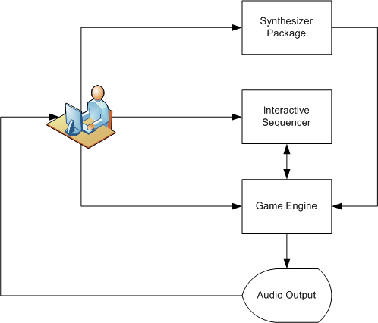
Workflow
Notes:
First, the user creates a “Soundfont” either by hand, or by using an existing synthesizer package (like Reason)
Next, the user composes a MIDI file in a sequencer program (like PureData or Max/MSP), and previews it through a link to the running game engine.

Slide 23
Now the exciting stuff!
What happened in practice?
Synthesizer soundfonts “borrowed” from Reason patches
Linear sequencing used via importing basic MIDI files
Game engine imports soundfont and MIDI file for playback

Slide 24
Reason Demo
Notes:
Show off Reason hardware rack

Slide 25
A little about XNA
XNA’s Not Acronymed
It’s the cross-platform library for Windows and Xbox 360 for hobbyist developers
It does a LOT of stuff for you already
Making it do advanced stuff requires some hacks…
Notes:
What does XNA stand for?

Slide 26
XNA Sound / XACT
XNA WaveBank
Stores (compressed) wave files
XNA SoundBank
Stores “Cues” for accessing wavebank entries programmatically
Cues are access by a call to GetCue(cuename);
… This Sucks!

Slide 27
Reasons Why XACT Sucks
You can’t access cues with an index
Have to translate MIDI note number to a string
Only a few built-in effects
Volume, Pitch, Reverb
No Chorus, Portamento, Vibrato, Pan(!), etc
No option to add custom effects
Can’t access sound buffers
Can’t do things like visualization

Slide 28
XNA 3.0 is WAY better!
Uses XAudio 2.0
Allows custom effects to be inserted
Can access any buffer
Can write custom buffers
Allows for creating procedural synthesizers!
E.g. FM or graintable synthesis
… But it’ll have to wait

Slide 29
XACT Demo
Notes:
Show the XACT tool here

Slide 30
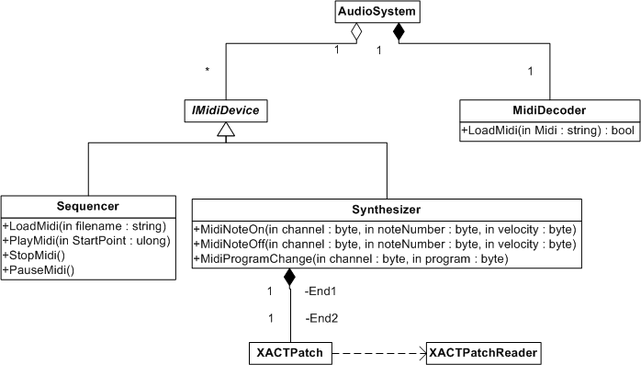
System Architecture
Notes:
The basic architecture of the Duet sound system.
The AudioSystem object takes care of basic, common tasks, like time keeping.
MidiDecoder is used to deserialize MIDI files (it’s a library file).
IMidiDevice provides the interface for handling MIDI control events.
Sequencer is an implementation that reads from the deserialized MIDI file loaded into AudioSystem, and raises events
Synthesizer handles MIDI control events by mapping the note number to a string (via the xml specified patch) and executing commands on the resulting “cue”
The XACTPatchReader is the runtime interface for loading xml patch files from the custom pipeline.

Slide 31
Demo
Notes:
To the MidiDemo program!

Slide 32
Future Work
Support for more MIDI messages
Interface to PD for far greater interactivity

Slide 33
References
Dettlaff, Victor. For the MidiDecoder class.
http://www.sonicspot.com/guide/midifiles.html
http://www.midi.org/about-midi/tutorial/tutor.shtml
http://en.wikipedia.org/wiki/Musical_Instrument_Digital_Interface

Slide 34
Contact
Slides / Source code available from GDC website:
http://www.sfu.ca/~gdcexec/talks.html
Or email me:
jsipko@gmail.com

Slide 35
Questions?
Answers!

