Slide 1
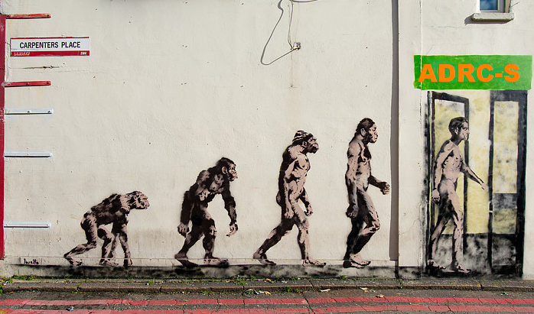

Slide 2




Stata Codefest©
Vernon Gayle
Professor of Sociology & Social Statistics
University of Edinburgh
vernon.gayle@ed.ac.uk
@profbigvern
9th October 2015
© Vernon Gayle

Slide 3

Administrative Data Research Centre - Scotland
Allows researchers to
gain carefully supervised access to data
undertake studies that are ethical and feasible

Slide 4
Administrative Data Research Centre - Scotland
Allows researchers to
gain carefully supervised access to data
undertake studies that are ethical and feasible
A critical feature of administrative social science data is that people cannot be identified and data cannot be linked back to individuals (this ensures that nobody’s privacy is infringed)

Slide 5

The outcome will be unparalleled new sources of social science data suitable for research

Slide 6
ADRC – Scotland Stata Codefest (Friday 9th October)
9:30 The workflow and administrative data revisited
10:00 Introduction to Github (Alasdair Grey)
10:30 Coffee Break
10:45 Syntax Show and Tell (Vernon Gayle, Roxanne Connelly, Chris Playford)
11:45 Chalk and Talk Identification of Potential Problems
12:30 Lunch
13:00 Flexible Programming in Small Teams (based on Pair Programming)
16:00 Syntax Showcasing and Sharing
16:30 End of Codefest

Slide 7
Thoughts for today…
What can we learn from computer science?
What can we learn from each other?
What can we do to improve the workflow within ADRC-S?
What can we do to help share code?
Are there any coding tasks that we can ‘hack’ today / and then share?

Slide 8
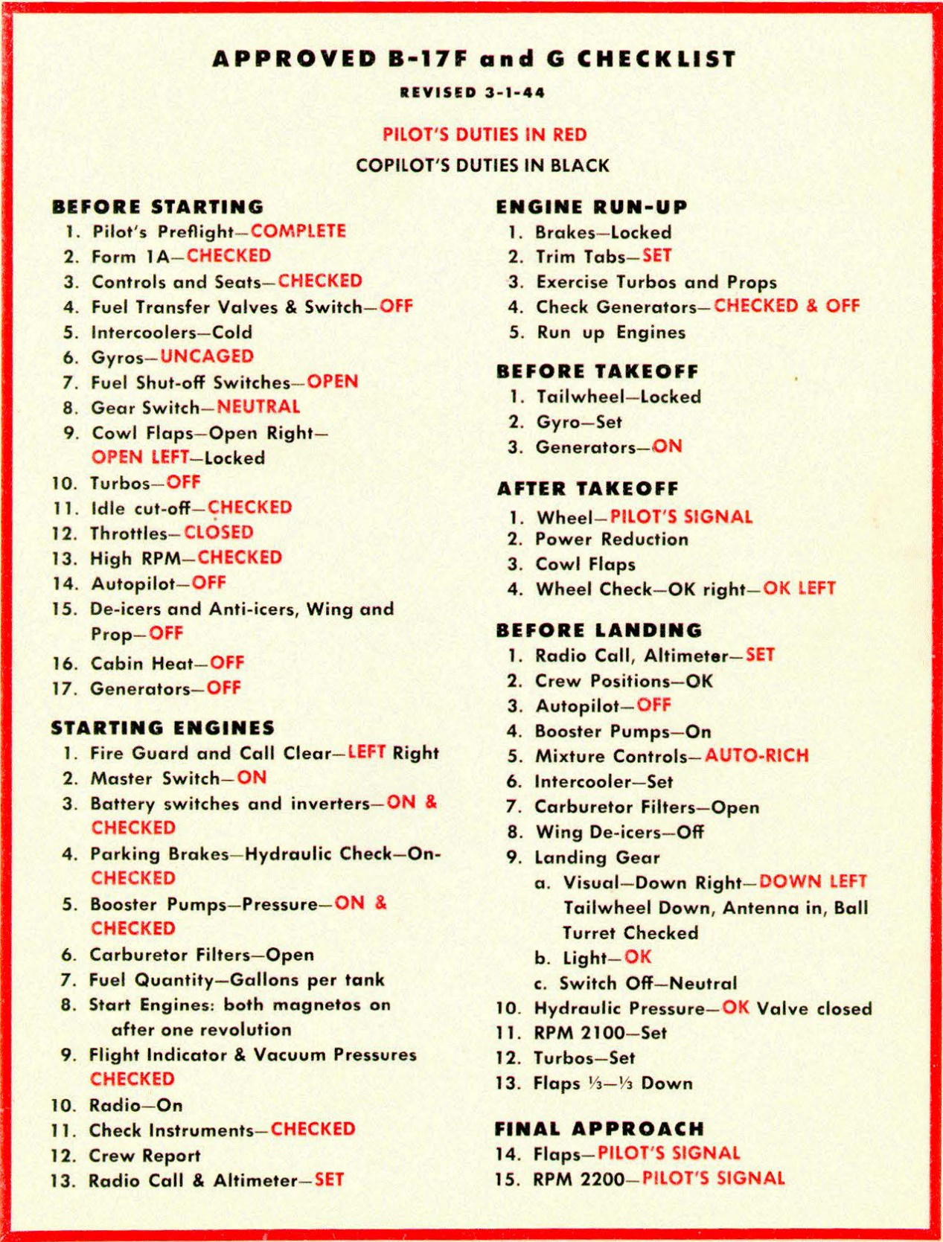
In the late 1930s, military aviators in the American Army and Navy began using aviation checklists. Checklist became part of a new paradigm for how to fly, which consisted of
• Elaborate standardized procedures for many activities
• Checklists to ensure all critical steps had been done
• Quantitative tables and formulas that specified the best settings, under different conditions, for speed, engine RPM, gasoline/air mixture, engine cooling, and many other parameters.
This new paradigm (Standard Procedure Flying) had a major influence on reducing aviation accidents and increasing military effectiveness during World War II, particularly because of the rapidly increasing complexity of military aircraft, and the huge number of new pilots.
Despite the benefits of Standard Procedure Flying for both safety and efficiency, by the end of WWII only a few air forces had fully embraced it
Roger Bohn http://www.vs29.org/Links/NATOPS/SOP-bohn-2013-1.pdf

Slide 9
The Workflow
The workflow is critical in survey data analysis
Even more critical in administrative data analysis
No desk top access to dataset
Other staff running data analysis jobs (e.g. Centre staff)
Remote job data analysis
Time limitations in safe setting etc.

Slide 10
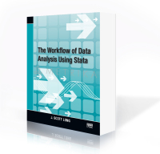

Slide 11
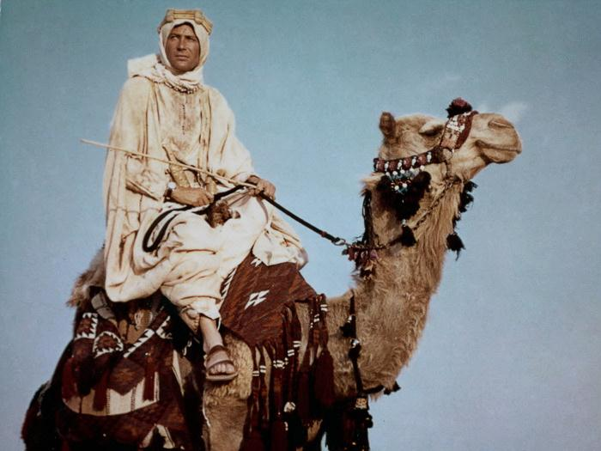
The Four Pillars
of Wisdom

Slide 12

Efficiency
Transparency
Effectiveness
Replication

Slide 13
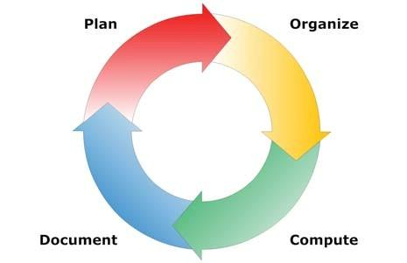

Slide 14
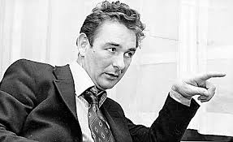
The best habit that you can get into
is to get into good habits!

Slide 15
The Workflow
ADRC(N) Challenges…
Improving the workflow for both ADRC and other researchers?
Encouraging (enforcing) good practices
Sharing good syntax

Slide 16
The Audit Trail
Effectiveness
minimising information loss and errors in analyses and output
Efficiency
automation, maximising features in software
Transparency
tracing what you did, why, when, how
Replication
same results every time whoever or wherever
editing, rewriting thesis or re-submission of papers

Slide 17
The Audit Trail
What might this mean in practice…
Standardisation
consistency of practices and procedures?
repetition of practices leading to efficiency
Usability
the workflow should reflect how the team prefer to work
(up to a point)

Slide 18
A Planned Workflow Has Benefits
Efficiency
Transparency
Effectiveness
Replication

Slide 19
The Workflow
Drukker’s dictum:
Never type anything that you can obtain from a saved result

Slide 20
The Workflow / Work Life Balance
Gayle’s dictum:
You can’t be too fit or have too many publications….

Slide 21
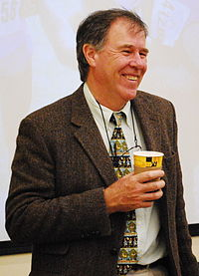
500+ scientific publications in peer reviewed journals (15,000+ citations and an H-index of 66)
Has run more than 70 marathon and ultra-marathon races, including seven 90km Comrades Marathons and fifteen 56km Two Oceans Marathons
http://www.essm.uct.ac.za/ESSM/Tim_Noakes

Slide 22
Long’s Law
It is always easier to document today than it is tomorrow!
Corollary 1:
Nobody likes to write documentation
Corollary 2:
Nobody every regrets having written documentation

Slide 23

Long’s Law
Has anyone in the history of administrative data analysis ever said
“These data is too well documented”

Slide 24
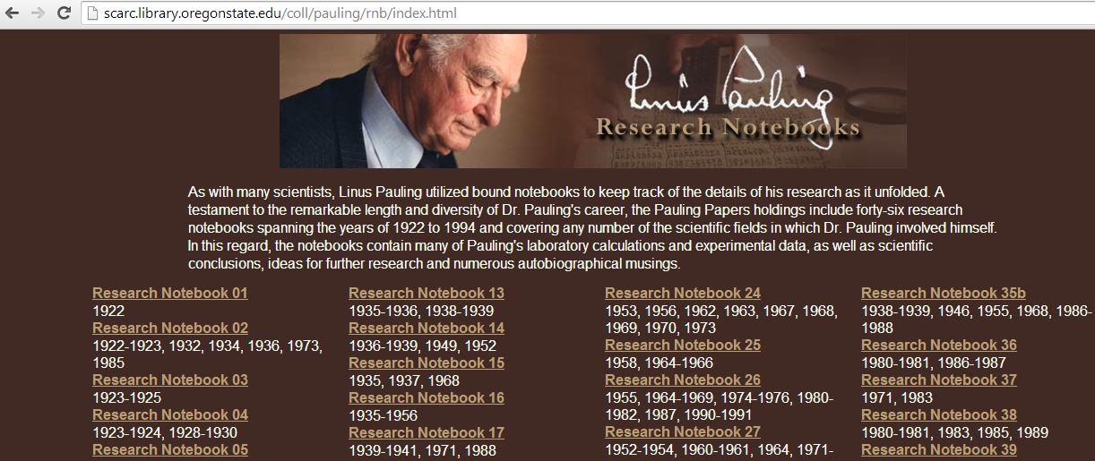

Slide 25
Vernon Gayle
Professor of Sociology & Social Statistics
University of Edinburgh
vernon.gayle@ed.ac.uk
@profbigvern
Sept 2015
© Vernon Gayle

