Slide 1
E-Commerce Operations Platform
Multi-Platform Data Synchronization · Intelligent Analytics · Automated Operations
Community Edition — Built with FastAPI + SQLAlchemy + PostgreSQL + Redis + Celery
Live Demo
Open Source
Production Ready
Presentation · Platform Demonstration · Technical Overview

Slide 2
Platform Demo Walkthrough
Follow the steps below to explore every feature of the platform
01
→
02
→
03
→
04
→
05
→
06
Login
Dashboard
Stores & Orders
Inventory
Automation
Smart Features
Access the platform with demo credentials
Real-time KPIs & sales analytics
Manage multi-platform store connections
Stock tracking & low-stock alerts
Create condition- triggered rules
Product selection, AI suggestions & auto-reply
⚡ Quick Start
Open http://localhost:8100 → Login with demo@example.com / Demo1234! → Explore all features from the navigation sidebar
STEP 0 OF 6

Slide 3
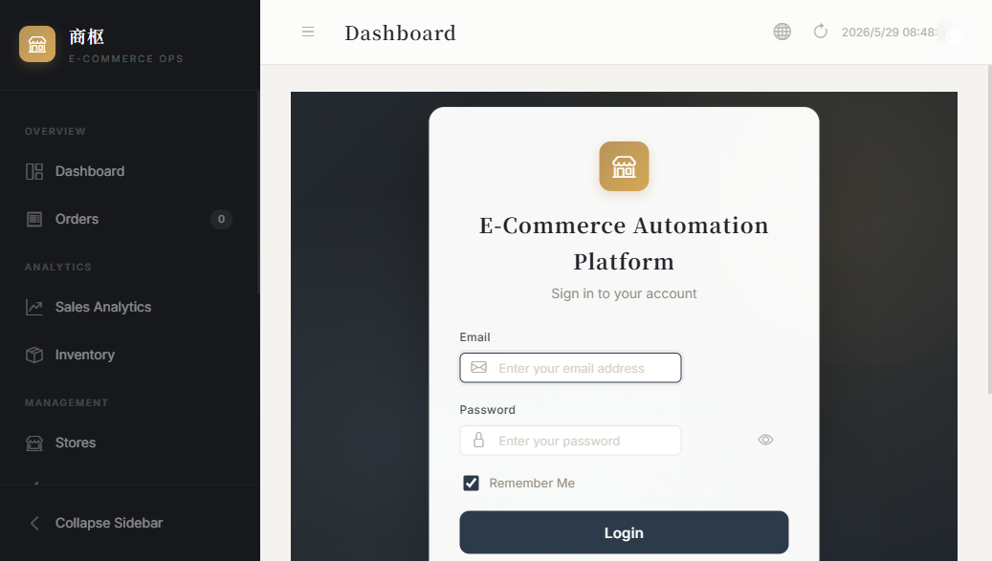
1
Login & Authentication
Authentication Flow:
1. User enters email + password
2. Server validates against bcrypt hash
3. JWT token issued (1-hour expiry)
4. Token stored in HTTP-only cookie
5. All API requests authenticated
via cookie or Authorization header
Security Features:
• Password strength validation
• Token bucket rate limiting
(5 req/min for login)
• HSTS + X-Frame-Options headers
• CORS whitelist enforcement
• Operation audit logging
Login Page — JWT-based authentication
Demo credentials pre-configured. Email: demo@example.com Password: Demo1234!
STEP 1 OF 6

Slide 4
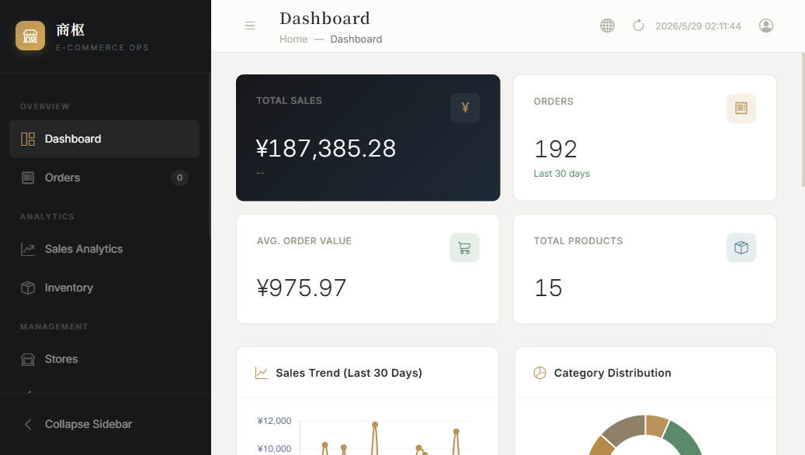
2
Dashboard — Real-Time Business Overview
📊 KPI Cards
Total sales, order count, avg. order value, active stores
📈 Sales Trends
7 / 30 / 90 day trends with daily breakdown
🥧 Category Dist.
Product category distribution visualization
🏆 Top 10 Products
Best-selling products ranked by revenue & volume
⚠️ Inventory Alerts
Main Dashboard — centralized business command center
Low-stock warnings for immediate action
All KPIs update in real-time with data synced across connected stores.
STEP 2 OF 6

Slide 5
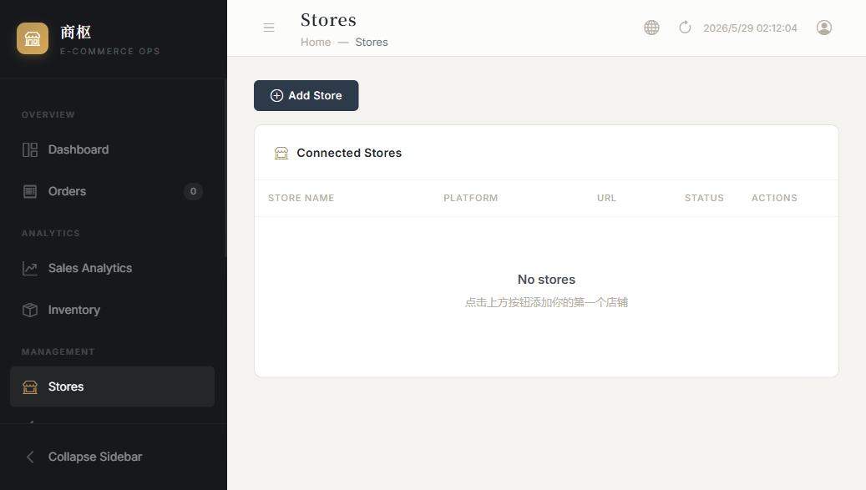
3
Store Management — Multi-Platform Integration
Taobao
OAuth 2.0
App Key + Secret
Shopify
Lazada
API Token
OAuth 2.0
API Key + Token
App Key + Region
WooCommerce
Shopee
OAuth 1.0a
Signed Req.
Consumer Key
Partner + Shop ID
Store Management Interface — add & manage store connections
Connect stores from 5 platforms. Each platform has its own auth flow.
Platform Adapter Pattern: Adding a new platform requires only 5 method implementations + factory registration. All platforms expose a unified interface.
STEP 3 OF 6

Slide 6
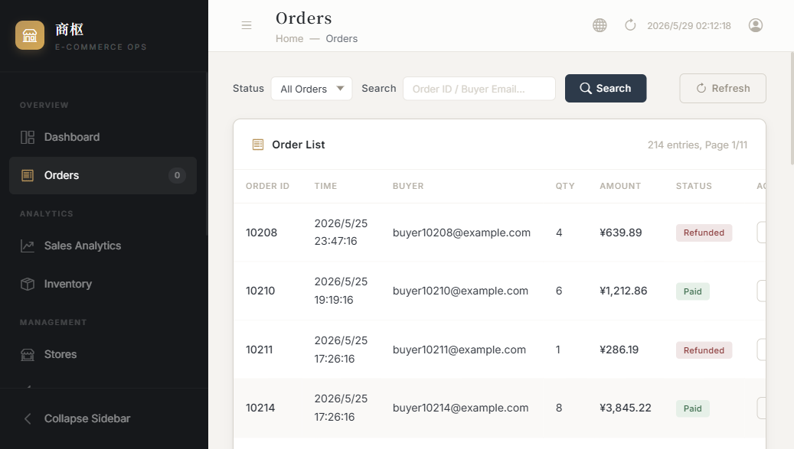
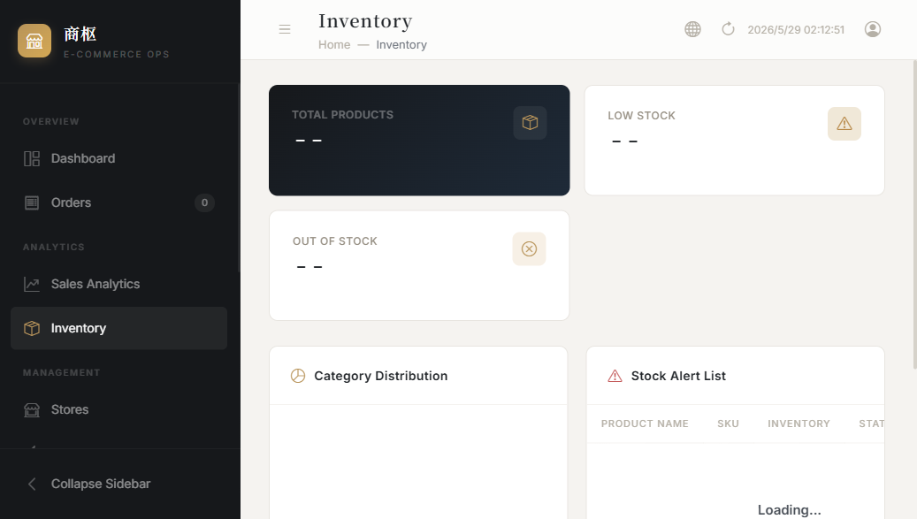
4
Orders & Inventory Management
Orders — cross-platform order tracking
Inventory — stock classification & alerts
View orders from all connected stores in one unified list.
Inventory is automatically categorized: Normal / Low / Out-of-Stock.
✓ Unified order view across all platforms
✓ Real-time inventory sync from connected stores
✓ Automatic stock-level classification (Normal / Low / Out-of-Stock)
✓ Category distribution visualization
✓ Low-stock alert lists for proactive restocking
✓ Order status tracking & history
STEP 4 OF 6

Slide 7
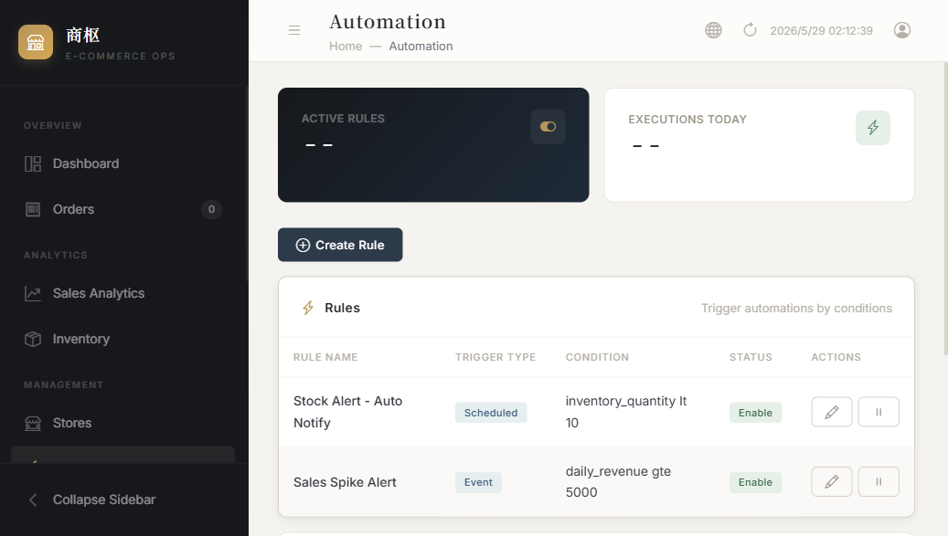
5
Automation Rules Engine
⚙️ How Automation Works
1. Define a trigger condition:
• Inventory drops below threshold
• Sales spike detected
• Time-scheduled action
2. Set the action:
• Send alert notification
• Generate report
• Trigger sync
3. Toggle ON / OFF:
• Rules only fire when enabled
• Each rule runs independently
Example:
"If inventory < 10 units →
send restock alert"
Automation Rules — create & manage condition-triggered workflows
Rules evaluate continuously and trigger actions automatically.
STEP 5 OF 6

Slide 8
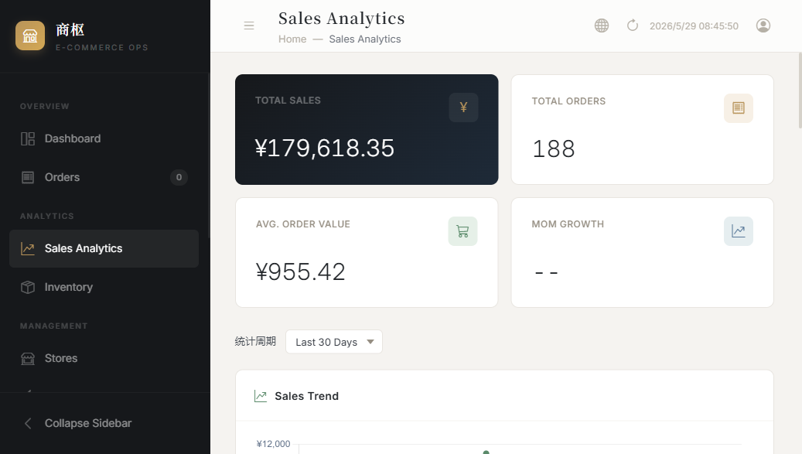
6
Smart Features — Product Selection
🎯 Scoring Algorithm
Composite Score = weighted blend of:
📈 Sales Velocity (30%)
How fast the product sells
💰 Profit Margin (25%)
Unit profitability analysis
📊 Market Trend (20%)
Category growth trajectory
⭐ Review Score (15%)
Customer feedback rating
🔄 Inventory Health (10%)
Stock turnover efficiency
Review Workflow:
Pending → Approved / Rejected
Sales Analytics — multi-dimensional trend analysis
7/30/90 day views with MoM growth and category aggregation.
STEP 6 OF 6

Slide 9
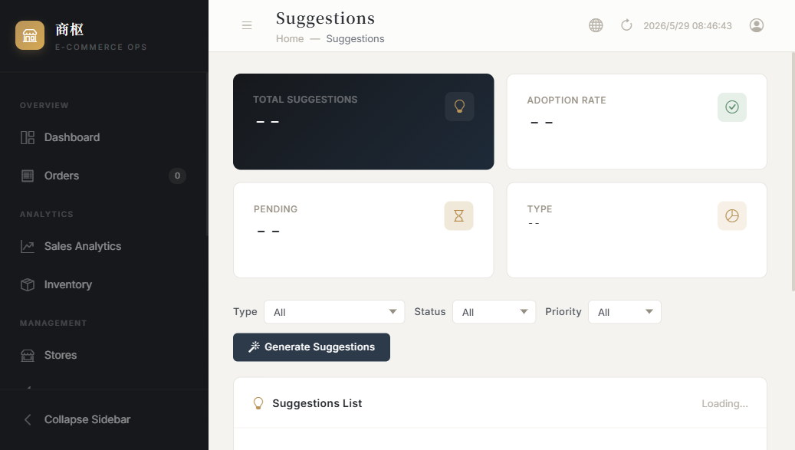
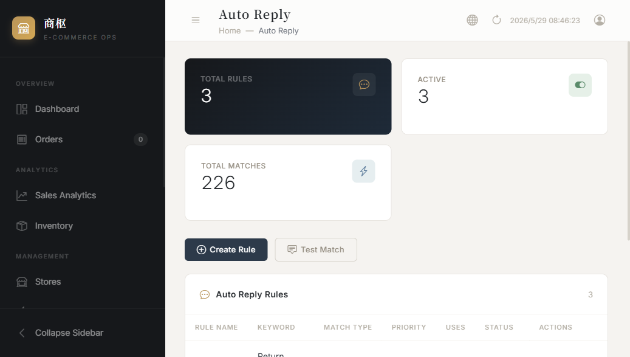
AI Operations Suggestions & Auto Reply
Pro module features — intelligent automation powered by data
Operations Suggestions — AI-generated optimization insights
Auto Reply — keyword-based automated customer service
Each suggestion includes reasoning, expected impact, and adopt/ignore workflow.
Support for contains / exact / regex matching modes.
🤖 AI Suggestions:
• Restock alerts based on velocity
• Pricing optimization recommendations
• Marketing campaign suggestions
• Inventory tuning guidance
• Adopt / Ignore workflow
💬 Auto Reply:
• Keyword matching: contains / exact / regex
• Test matching before activation
• Usage statistics & response rates
• Multi-language support
• Easy enable/disable toggle

Slide 10
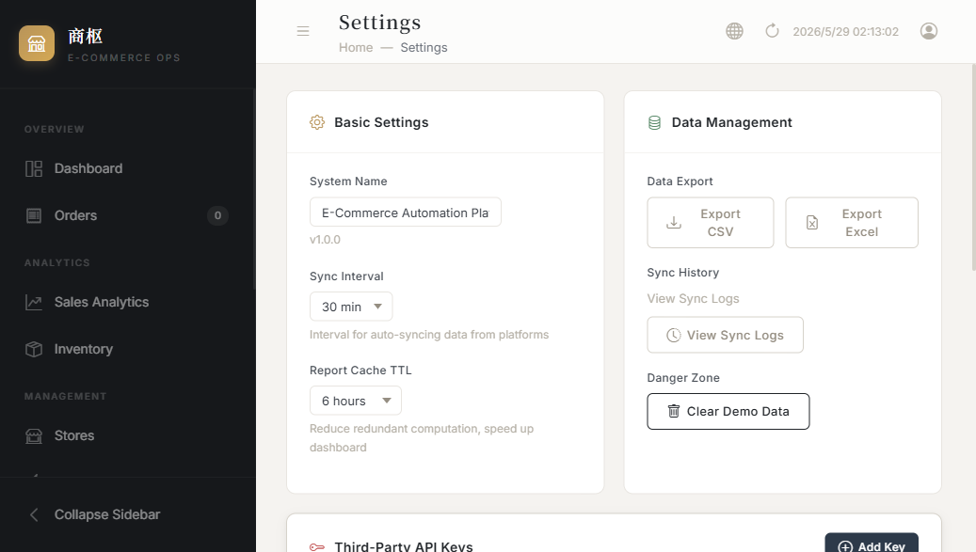
Settings, Security & API Key Management
🔒 Security Architecture
Authentication:
• JWT with 1-hour token expiry
• bcrypt password hashing (12 rounds)
• Password strength validation
Encryption:
• Fernet (AES-128-CBC + HMAC-SHA256)
• PBKDF2 key derivation
• Rotatable encryption keys
• Zero-downtime key migration
API Protection:
• Token bucket rate limiter
• CORS whitelist enforcement
• Request body size limits
• Full audit operation logs
Third-Party Keys:
• Encrypted at rest (AES)
• Provider: OpenAI / Claude / DeepSeek
• Enable/disable per key
Settings — third-party API key management
AES-encrypted storage for OpenAI, Claude, DeepSeek & other AI provider keys.

Slide 11
Technical Architecture
Built for scalability, maintainability, and production use
🔄 Platform Adapter Pattern
Unified PlatformAdapter interface. Each platform (Taobao, Shopify, etc.) implements: get_orders(), get_products(), get_inventory(), sync_data(), get_analytics(). Factory registration enables zero-code platform addition.
🗄️ Dual-Layer Caching
L1: In-memory cache (30s TTL, LRU eviction). L2: Redis cache. Automatic management via @cached decorator. Reduces database load by 80%+ for frequent queries.
🔒 Data Isolation
Three-tier permission model: User → Store → Entity. Every query filters through this hierarchy. Integration-tested for security compliance.
🌐 i18n Architecture
Translation JSON files for Chinese & English. Global _(text) function in Jinja2 templates. Auto-detection via Cookie + Accept-Language header.
⚡ Async-First Design
SQLAlchemy 2.0 async session, FastAPI async endpoints, Celery for background tasks. Non-blocking I/O throughout the stack.

Slide 12
Pro Module System
Community Edition + Commercial Add-ons — extensible by design
🧩 Community Edition (Free)
⭐ Pro Modules (Commercial)
✓ Dashboard & KPIs
✓ Order management
✓ Inventory tracking
✓ Store management (5 platforms)
✓ Automation rules engine
✓ Operation audit logs
✓ Settings & key management
✓ i18n: Chinese / English
✓ JWT auth + rate limiting
✓ Docker one-click deploy
📊 Advanced Sales Analytics
📦 Data-driven Product Selection
🤖 Intelligent Auto Reply
💡 AI Operations Suggestions
📋 Automated Retrospectives
🔗 Taobao OAuth Integration
Loaded via: try/except ImportError
No code changes needed to upgrade
Graceful degradation when absent
→
💡 The Community Edition runs fully standalone. Pro modules activate automatically when the pro/ package is detected — zero configuration required.

Slide 13
Technology Stack & Deployment
Backend
Python 3.14, FastAPI, SQLAlchemy 2.0 (async), Alembic
Database
PostgreSQL 16 (production) / SQLite (development), Redis 7
Frontend
Jinja2 templates, Élan CSS design system, Chart.js, Vanilla JS (no frameworks)
Auth
JWT (python-jose), bcrypt, Fernet encryption (AES-128-CBC + HMAC-SHA256)
Async Tasks
Celery + Redis broker for data sync & report generation
DevOps
Docker Compose: Nginx + API + Celery Worker + PostgreSQL + Redis
🐳 One-Click Production Deploy
Testing
pytest + httpx (ASGI async) with comprehensive integration tests
cp backend/.env.example backend/.env → docker compose -f docker/docker-compose.yml up -d → open http://localhost:8000

Slide 14
Testing & Quality Assurance
Comprehensive test suite covering all layers of the application
✓ Authentication
✓ Store API
✓ Orders
✓ Product Selection
✓ Automation
Registration, login, logout, token refresh, rate limiting
CRUD operations, authorization, sync triggers
Order listing, filtering, status management
Scoring, review workflow, approve/reject
Rule creation, evaluation, enable/disable
✓ Auto Reply
✓ AI Suggestions
✓ Retrospectives
✓ Security
✓ Platform Adapters
Keyword matching, rule evaluation, stats
Generation pipeline, adopt/ignore flow
Create, publish, archive, insight generation
Crypto, key rotation, encryption/decryption
Shopify, WooCommerce adapter implementations
Framework: pytest + httpx (ASGI async) | Coverage: API, core logic, adapters, security, and utilities

Slide 15
Thank You
E-Commerce Operations Platform · Community Edition
GitHub Repository
https://github.com/veron-spec/E-commerce-Operations-Platform
Tech Stack
FastAPI · SQLAlchemy · PostgreSQL · Redis · Celery · Docker
License
Community Edition — Open Source
Contact
E-Commerce Operations Platform Team
Built with Python, FastAPI, and modern web technologies

