Slide 1
E-Commerce Operations Platform
📊 Dashboard
Unified multi-platform data sync · Intelligent analytics · Automated operations
📈 Sales Analytics
📦 Inventory Mgmt
A production-ready backend platform that aggregates e-commerce data across Taobao, Shopify, Shopee, Lazada, and WooCommerce — providing real-time dashboards, sales analytics, inventory alerts, and AI-powered automation. Tech Stack: FastAPI + SQLAlchemy (async) · PostgreSQL / SQLite · Redis · Celery Deployment: Docker Compose · Jinja2 server-side rendering Design: Élan Design System — sand-tone palette with gold accents
🏪 Stores
🤖 Automation Rules
🎯 Product Selection
💬 Auto Reply
💡 Suggestions
📋 Retrospectives
Community Edition v1.0 | Élan Design System | 2026

Slide 2
The Challenge & Our Solution
Why this platform? — Real problems faced by every cross-platform e-commerce seller
🔴 Fragmented Management
✨ Platform Value Proposition
Each platform has its own admin panel — no unified view of orders, products, or customers across Taobao, Shopify, Shopee, and Lazada.
▸ Unified Data Hub
Adapter pattern connects 5 platforms into one dashboard. All metrics, one screen.
🔴 Manual Data Aggregation
Export → Excel merge → manual reports. Takes hours, error-prone, stale by the time it's done.
▸ Auto Sync (30min)
Celery-powered incremental sync every 30 minutes with automatic retry.
🔴 No Real-Time Alerts
▸ Smart Analytics Engine
Stock shortages, refund spikes, sales drops discovered too late — after damage has been done.
Sales trends, inventory alerts, category distribution — real-time.
▸ 4 Automation Pillars
🔴 High AI Integration Barrier
Product selection · Auto reply · Suggestions · Retrospectives — AI-driven.
Smart suggestions, auto-reply, analytics require complex multi-API integrations beyond most sellers.
▸ Enterprise-Grade Security
JWT · bcrypt · Fernet encryption · Rate limiting · CSRF · Audit logs.

Slide 3
Technology Stack & System Architecture
Production-grade foundations · Adapter pattern · Dual-layer cache · Data isolation
🔌 Adapter Layer Taobao/Shopify/Shopee Lazada/WooCommerce
🔄 Sync Orchestrator Celery periodic sync Incremental + retry
💾 Storage Layer PostgreSQL / SQLite Redis · Celery queue
📊 Analytics Engine Sales · Inventory · Trends Aggregation + reports
🤖 Automation Selection · Reply · Suggest · Retrospect
🖥️ Presentation Élan · Chart.js Jinja2 SSR
→
→
→
→
→
Backend
Database
Frontend
DevOps
Python 3.14 · FastAPI · SQLAlchemy 2.0 (async) · Alembic · Celery
PostgreSQL 16 (prod) / SQLite (dev) · Redis 7 (cache + MQ)
Jinja2 SSR · Chart.js 4.4 · Bootstrap Icons · i18n CN/EN
Docker Compose · Nginx · Cloudflare Tunnel · Fernet encryption
Architecture Highlights
🔹 Adapter Pattern — PlatformAdapter abstract base + AdapterFactory. Add a new platform with 5 method implementations, zero core code changes. Unified models (UnifiedOrder / UnifiedProduct / UnifiedCustomer) shield platform differences.
🔹 Dual-Layer Cache — L1 in-memory (30s TTL / LRU) + L2 Redis, managed via @cached decorator. Dashboard data cached for 6 hours to reduce recomputation.
🔹 Data Isolation — Three-tier model: User → Store → Entity. APIs inject identity via Depends(get_current_user), users only see their own stores.
🔹 Rotatable Encryption — Fernet (AES-128-CBC + HMAC-SHA256) for API key storage, zero-downtime key rotation support.

Slide 4
Multi-Platform Integration
Adapter pattern — one interface, five e-commerce platforms unified
Taobao (淘宝)
Shopify
Shopee
Lazada
WooCommerce
OAuth 2.0 authorization HMAC-SHA256 API signing Products / Orders / Customers
REST Admin API Full CRUD operations Real-time inventory sync
Partner API SE Asia localization Per-store data isolation
Open Platform Multi-country support Category mapping
WordPress REST API Self-hosted data source Flexible extensions
How the Adapter Pattern Works
All platforms inherit the same PlatformAdapter abstract base class implementing five core methods: get_orders(), get_products(), get_inventory(), sync_data(), get_analytics(). The AdapterFactory dynamically creates the correct adapter based on store.platform_type.
▸ Adding a new platform: ① Subclass PlatformAdapter ② Implement 5 methods ③ Register — zero changes to core code.
▸ SyncOrchestrator manages order/product/customer sync with incremental (updated_since), automatic pagination, and 3x retry on failure. Sync tracked in sync_jobs table.
▸ Unified data models — UnifiedOrder (amount/status/line items), UnifiedProduct (SKU/stock/price), UnifiedCustomer (email/address/order history) — abstract away platform differences.

Slide 5
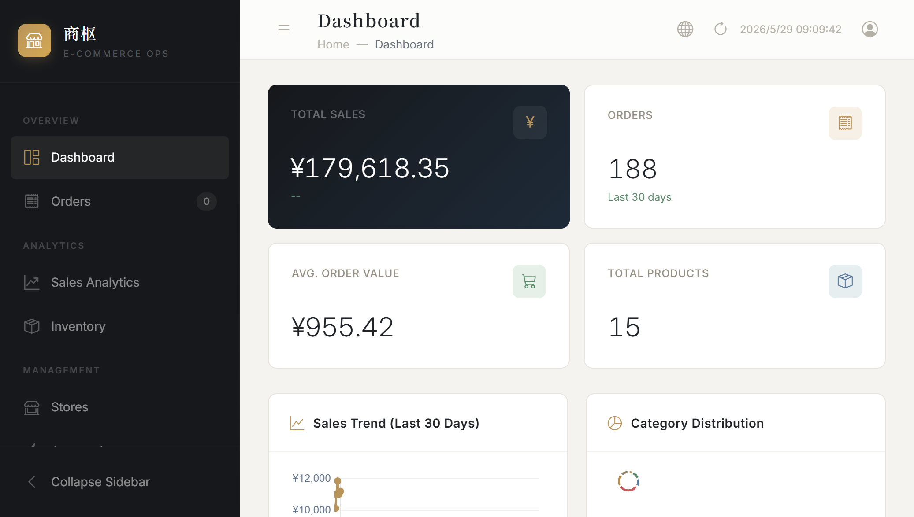
Dashboard — Business Command Center
Home page: all critical KPIs at a glance
Dashboard Features
📊 KPI Cards
Total Sales, Orders, Avg. Order Value, Total Products — updated in real time with MoM change indicators.
📈 Sales Trend Chart
30-day sales curve rendered with Chart.js. Hover for daily breakdown.
🥧 Category Distribution
Pie chart showing revenue share by product category.
🏆 Top 10 Products
Ranked by revenue with sales volume and amount. Pinpoint star performers.
⚠️ Stock Alerts
Auto-detected low-stock products highlighted in red. Click through to inventory.
🔄 Data Sync Status
Last sync time displayed in header. One-click refresh button.
🔗 Cross-Page Navigation
Dashboard cards link to Orders, Inventory, Sales pages for deep-dive analysis.
📱 Desktop Optimized
Layout adapts gracefully from 1366px to 1920px — no horizontal scrolling.

Slide 6
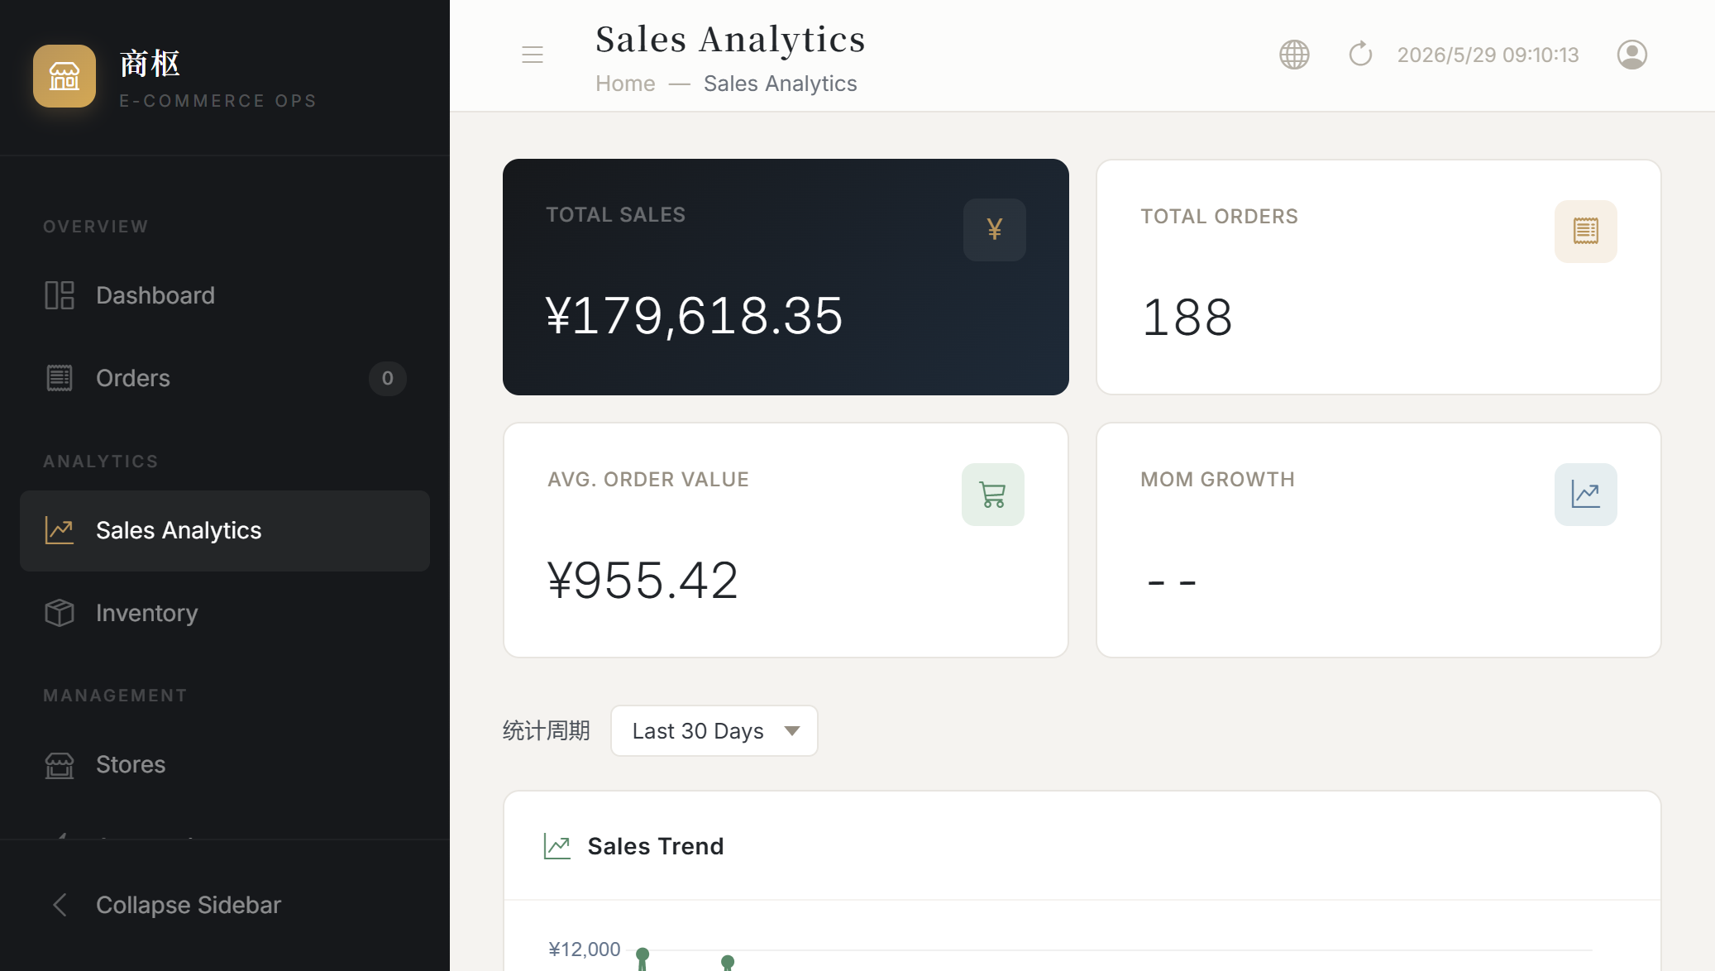
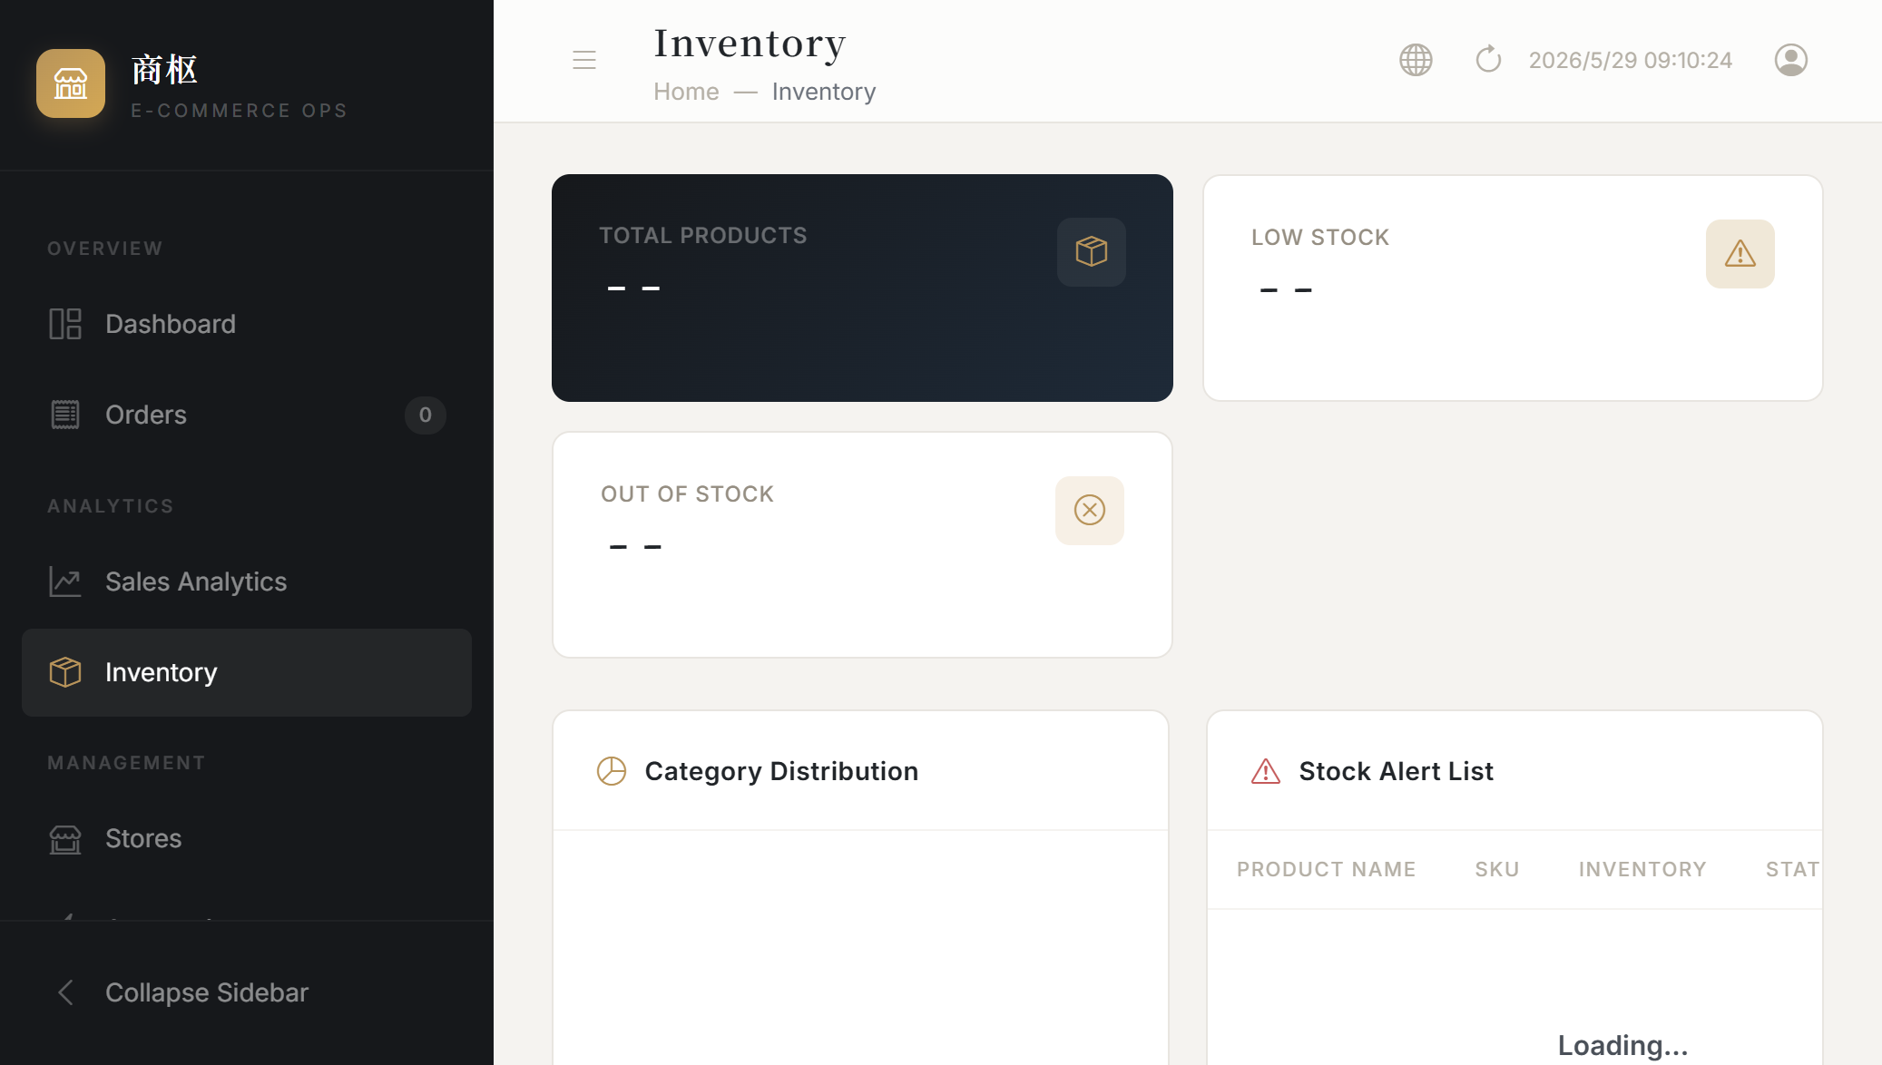
Sales Analytics & Inventory Management
Multi-dimensional trends + intelligent stock monitoring
Core Capabilities
▸ Sales Analytics: Three time windows (7/30/90 days) — Total Revenue, Order Count, Avg. Order Value, MoM Growth. Trend chart backed by daily detail table (date/revenue/orders/discount). Filter by platform.
▸ Inventory Management: Total/Low/Out-of-stock stat cards. Category pie chart for visual distribution. Alert list auto-filters products below configurable threshold.
💡 Close the Ops Loop: Dashboard daily check → spot sales decline → adjust marketing → inventory restock → measure impact next day.

Slide 7
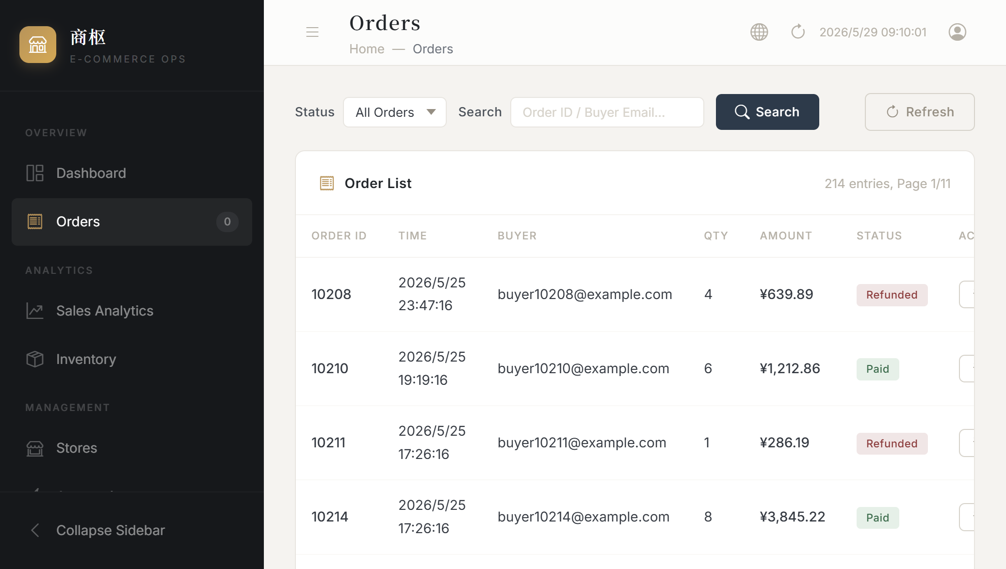
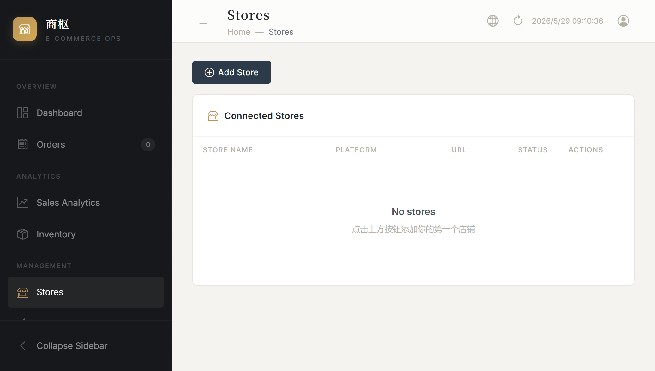
Order Management & Store Management
Cross-platform order tracking · One-click store connection
Core Capabilities
▸ Orders: Cross-platform unified order list — status filter (All/Paid/Refunded/Pending), keyword search by order ID or buyer email, paginated (20/page). No more logging into each platform separately.
▸ Stores: Add Taobao/Shopify/Shopee/Lazada stores with App Key, App Secret, and URL. Status indicators show connection health. Taobao OAuth 2.0 flow pre-built.
💡 Getting started: Register → Add store → Auto-sync → Dashboard populates → Explore automation. Takes just 5 minutes.

Slide 8
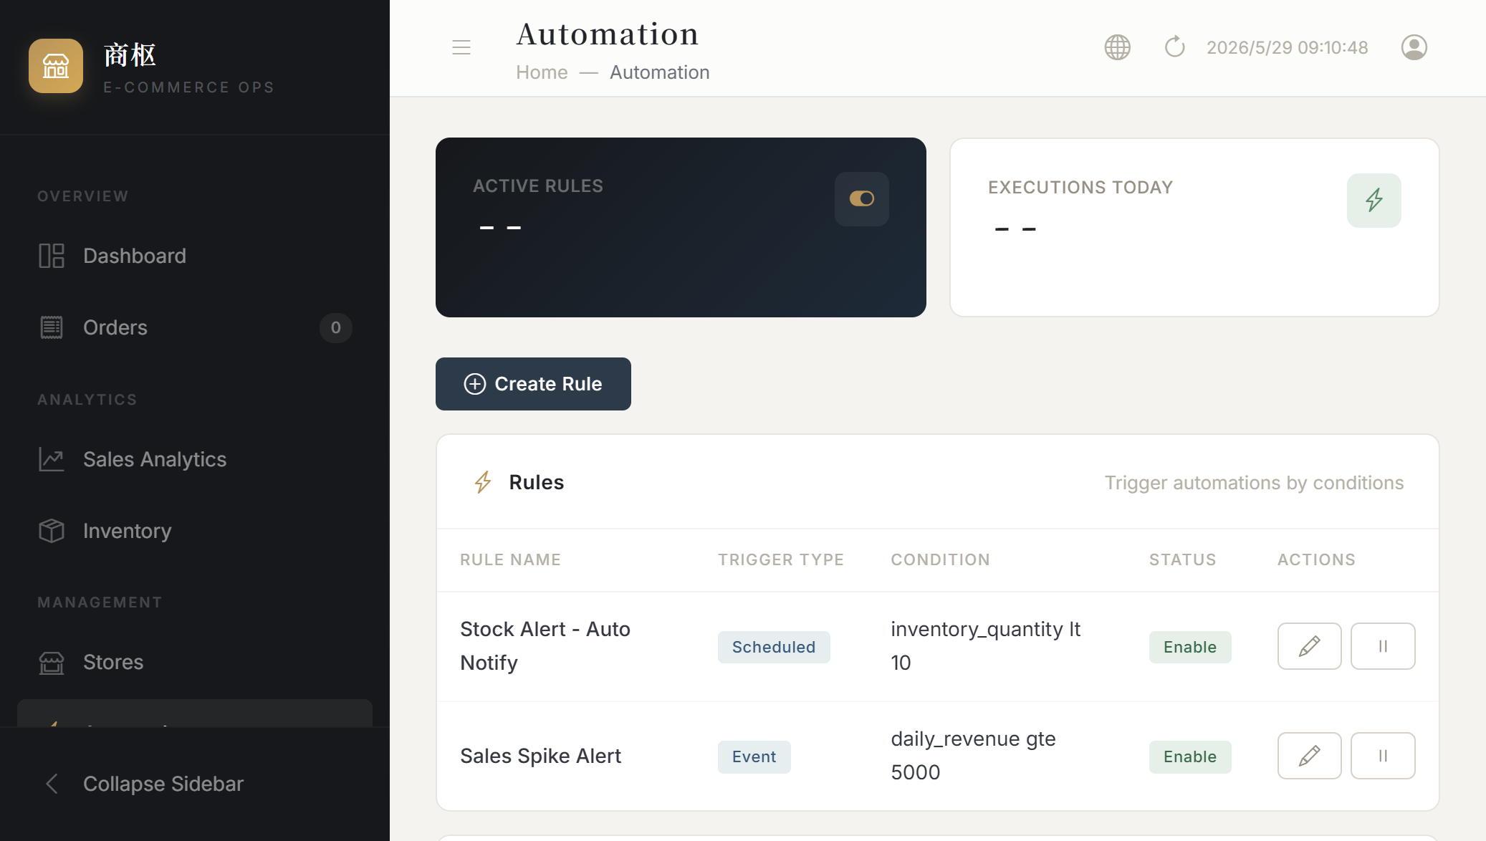
Automation Rules Engine
Condition-triggered workflows — your business, automated 24/7
Engine Details
▸ Trigger Modes
Scheduled (cron expression) and event-driven (real-time evaluation on data changes).
▸ Condition Evaluation
8 operators including between/in. Supports inventory, daily revenue, order count.
▸ Rule Templates
Built-in: Low Stock Alert (qty < 10), Sales Spike (> ¥10,000/day). One-click create.
▸ Action System
Notify (toast) + Log (audit trail). Extensible to auto-list/unlist, auto-price, coupon dispatch.
▸ Status Monitoring
Active rules + today's executions shown on stat cards. Each rule independently toggled.
▸ Audit & Compliance
Every rule creation/activation/modification logged to audit trail with timestamp and user ID.

Slide 9
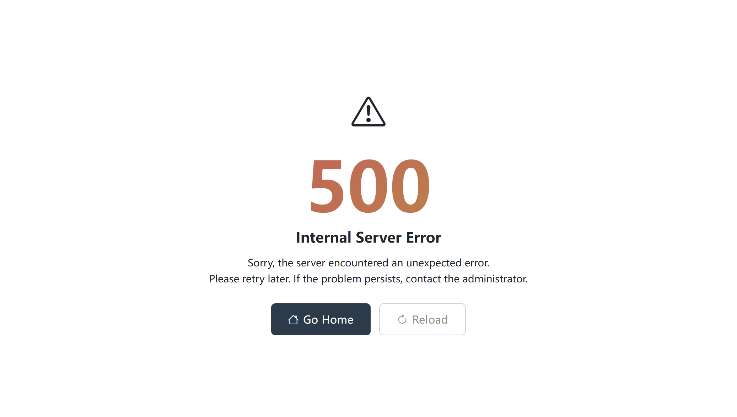
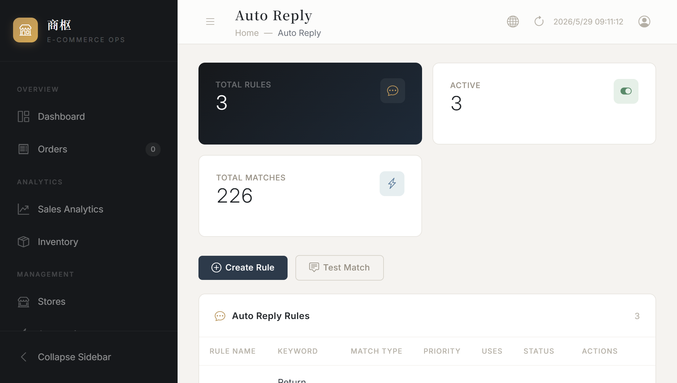
Product Selection & Auto Reply
AI-powered product discovery + intelligent customer service automation
Product Selection
Composite scoring (0-100) from sales data, margin analysis, and market trends. Auto-scan identifies trending products from 30-day sales. Review workflow: pending → approved/rejected. Stats: total, pending, approved, avg score.
Auto Reply
Three matching modes: contains/exact/regex. Priority ordering — higher priority fires first. Built-in test tool: type a mock message, see which rule matches. Stats: total rules, enabled, total matches.

Slide 10
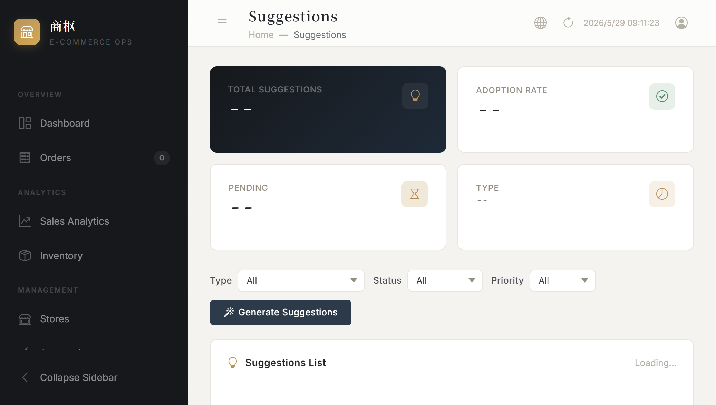
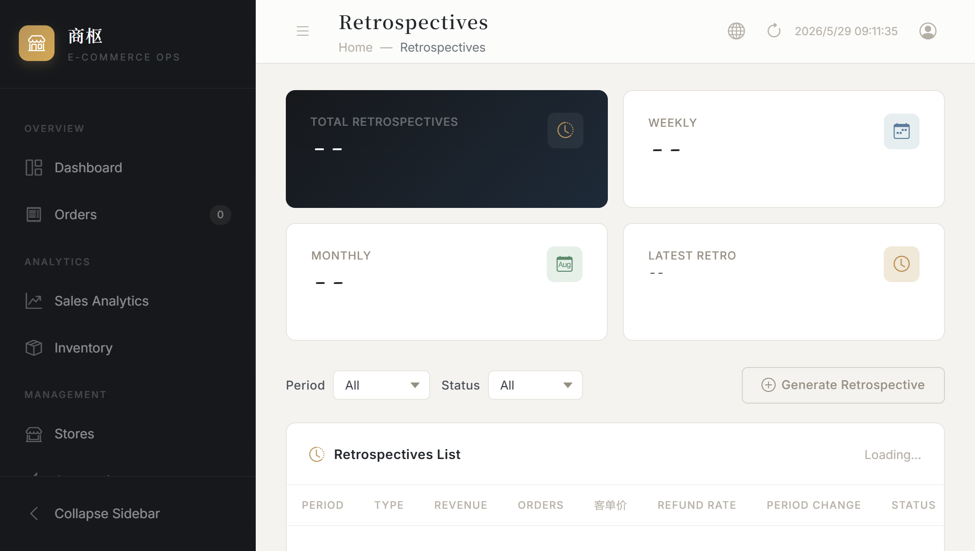
Operations Suggestions & Retrospectives
AI-driven decision support + periodic business reviews
Operations Suggestions
Four types: Restock alerts / Price adjustments / Marketing campaigns / Inventory optimization. AI analyzes recent data, generates priority-tagged (High/Med/Low) suggestions. Apply or Dismiss with adoption rate tracking.
Retrospectives
Weekly/Monthly/Quarterly cycles. Auto-generates standardized reports with KPIs (revenue, orders, AOV, refund rate) and MoM comparisons. AI insights + action items. Lifecycle: Draft → Published → Archived.

Slide 11
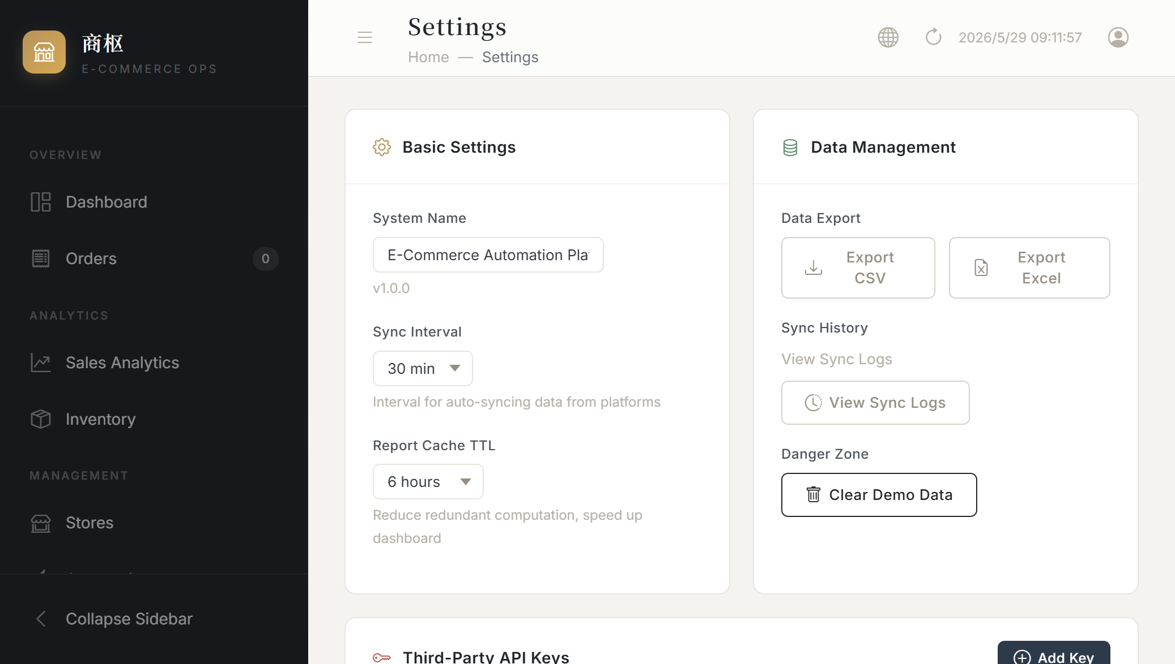
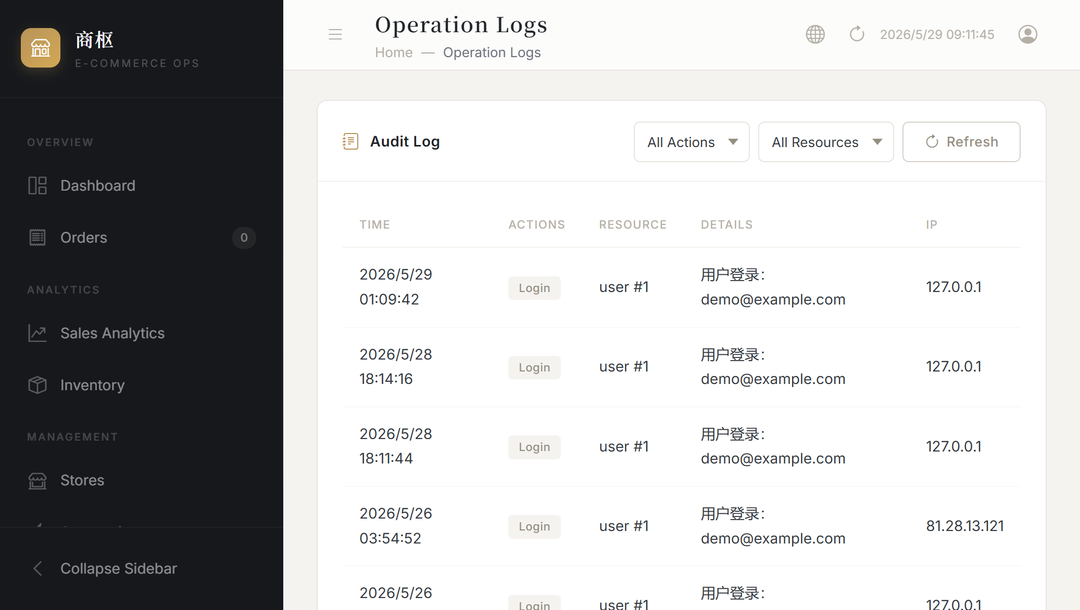
Settings · Audit Logs · Security
Configuration, compliance, and defense in depth
System Settings
System name, sync interval (15/30/60 min), report cache TTL (1/3/6/12 h). API key management — OpenAI, Claude, DeepSeek, Qwen, ERNIE — all encrypted at rest with Fernet.
Audit Logs
Every action (create/update/delete/login/register) logged with timestamp, resource ID, detail, IP. Filter by action/resource type. Paginated for compliance audits.
Security Protections
✓ JWT stateless auth
HttpOnly + SameSite=Lax cookies, configurable expiry
✓ bcrypt password hashing
Built-in strength validation, no plaintext storage
✓ Comprehensive rate limiting
Login 5/min, register 10/min, API 60/min per user
✓ Fernet encryption
AES-128-CBC + HMAC-SHA256 for API keys, key rotation support
✓ Security headers
X-Content-Type-Options=nosniff, X-Frame-Options=DENY, HSTS
✓ CSRF protection
Double-submit cookie pattern, all POST/PUT/DELETE routes enforced
✓ Session management
Token expiry configurable (1h / 24h / 7d), refresh on activity
✓ Full audit trail
All sensitive operations logged for forensics and compliance

Slide 12
Pro Module System
Community Edition free + pluggable Pro modules — extensible by design
🧩 Community Edition (Free)
⭐ Pro Modules (Commercial)
Open-source, ready to use out of the box
Advanced features on top of Community Edition
✓ Real-time Dashboard (KPI + trends + categories)
📊 Sales Analytics Pro
✓ Order Management (cross-platform + filter + page)
7/30/90 day multi-dim trends + MoM growth + daily detail
✓ Inventory Management (distribution + alerts)
🎯 Product Selection
✓ Store Management (5 platforms + status)
→
Composite score 0-100 + auto-scan + review workflow
✓ Automation Rules Engine (templates + toggle)
💬 Auto Reply
✓ Operation Audit Logs + System Settings
3 match modes + priority + test tool + usage stats
✓ Encrypted API Key Management
💡 Operations Suggestions
4 suggestion types + AI generation + adoption tracking
✓ i18n (CN/EN) + Élan Design System
📋 Retrospectives
✓ JWT Auth + Rate Limiting + Security Headers
Weekly/monthly/quarterly + MoM + AI insights + action items
🔗 Taobao OAuth
Browser-based authorization, self-service store binding

Slide 13
Quick Start — 5 Steps to Go Live
From registration to full operation in 5 minutes
01
02
03
04
05
Sign Up / Login
Add a Store
Sync Data
Configure Automation
Daily Operations
Register or use demo login (demo@example.com / Demo1234!). Auto-redirect to dashboard.
Stores → Add Store → Select platform. Enter App Key / Secret / URL. Auto-sync begins on first connection.
Wait 1-2 min for initial sync. Dashboard auto-populates. Adjust sync interval in Settings (15/30/60 min).
Create stock alert / sales spike rules. Set auto-reply keywords. Generate suggestions & retrospectives.
Monitor dashboard → analyze sales → manage inventory. Run retrospectives to guide strategy. Refine automations.
Tips for Best Experience
💡 Use Chrome / Edge for optimal Chart.js rendering and responsive layout.
💡 Data sync runs every 30 min by default. Adjust to 15 or 60 min in Settings. Celery auto-retries on failure.
💡 On first use, click "Generate Suggestions" and "Generate Retrospective" to establish baseline analysis data.
💡 Configure AI provider keys (OpenAI, Claude, DeepSeek, Qwen, ERNIE) to power suggestion/analysis features.
💡 Use the built-in demo account for evaluation — it comes pre-loaded with sample sales data and configured stores.

Slide 14
Roadmap
Delivered + Planned — continuous evolution
✅ Phase 1: MVP Foundation
FastAPI + 7 tables + 5 platform adapters + analytics engine + Celery sync
✅ Phase 2: 4 Automation Pillars
Product Selection + Auto Reply + Suggestions + Retrospectives — full automation loop
———— PLANNED ————
🔜 Phase 3: Operations Deepening
P0: Product editing (price/listing/title) → P0: Taobao OAuth flow → P1: Auto-action expansion (price/listing/coupon) → P1: Refund/return processing
🔜 Phase 4: Intelligence Enhancement
P2: Profit analytics (commissions/insurance/fees for true net profit) → P2: Inventory prediction (consumption-rate-based forecasting) → P2: Notification channels (DingTalk/WeCom/SMS)
🔜 Phase 5: Enterprise Scale
P2: HSM integration → P3: Core module test coverage → P3: Kubernetes deployment → P3: Multi-tenant SaaS architecture

Slide 15
Thank You
E-Commerce Operations Platform · Community Edition
Resources
GitHub https://github.com/veron-spec/E-commerce-Operations-Plugins
Tech FastAPI · SQLAlchemy 2.0 · PostgreSQL 16 · Redis 7 · Celery · Chart.js
Design Élan Design System — Elegance in every pixel
License Community Edition — Open Source
Star / Fork / Issues welcome — let's make e-commerce operations smarter together!

