Slide 1
DATA ANALYSIS PROJECT
Olist E-Commerce
Seller Performance Analysis
Revenue • Order volume • Delivery efficiency • Freight costs
Tools: MySQL Workbench, SQL and Microsoft Excel

Slide 2
BUSINESS QUESTION
How does seller performance vary across sales, order fulfillment, delivery reliability, and freight costs?
• Identify sellers with the highest revenue and order volume.
• Compare average delivery time and delivery delay rates.
• Review cancellation rates and freight cost differences.
• Translate the findings into practical operational recommendations.
Approach: use SQL to calculate seller-level indicators, then visualize the results in Excel.
Olist Seller Performance Analysis • 2

Slide 3
Data and Methodology
1
2
3
4
Query
Calculate
Export
Visualize
Use SQL in MySQL Workbench to aggregate orders by seller.
Measure revenue, order volume, delivery time, delays, cancellations and freight cost.
Export query results to CSV and open them in Excel.
Create five charts to compare seller performance.
Important: seller-level results depend on the query definitions and the number of orders available for each seller.
Olist Seller Performance Analysis • 3

Slide 4
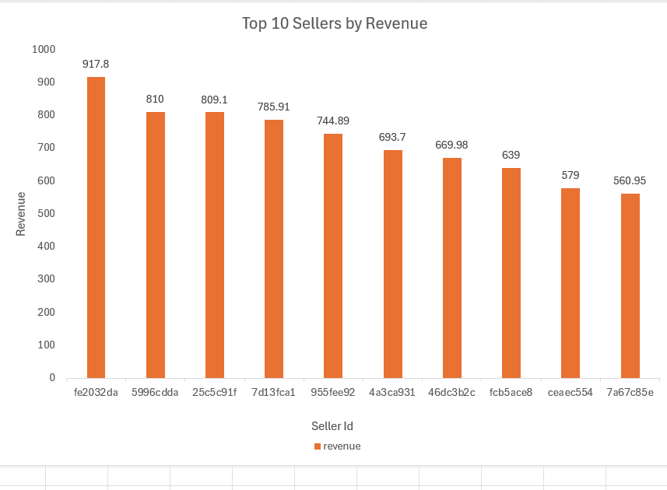
Revenue: Top 10 Sellers
KEY TAKEAWAY
The leading seller generated 917.80 in revenue; the tenth seller generated 560.95.
Revenue indicates sales contribution, not profitability or delivery quality.
Olist Seller Performance Analysis • 4

Slide 5
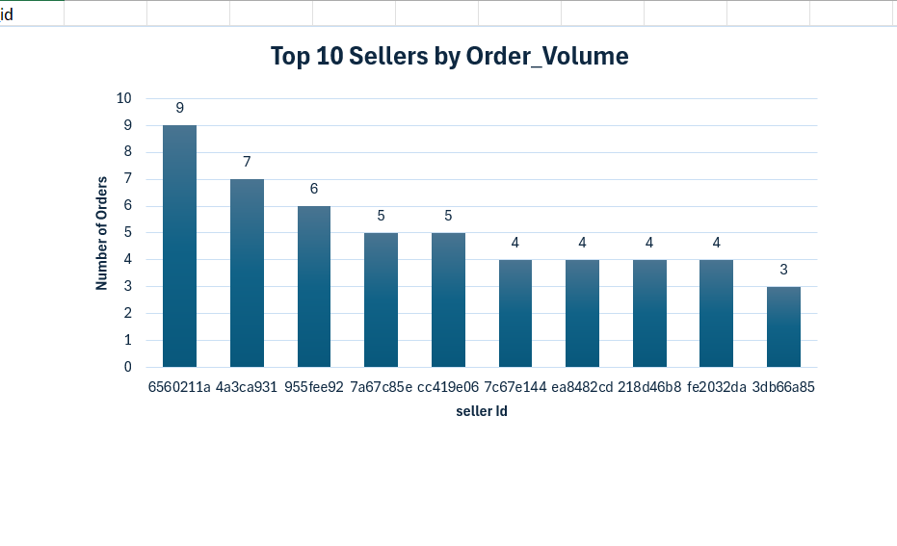
Order Volume: Top 10 Sellers
KEY TAKEAWAY
The highest-volume seller handled 9 orders; the chart's top 10 range from 3 to 9 orders.
These are small counts, so avoid treating them as a complete picture of each seller's business.
Olist Seller Performance Analysis • 5

Slide 6
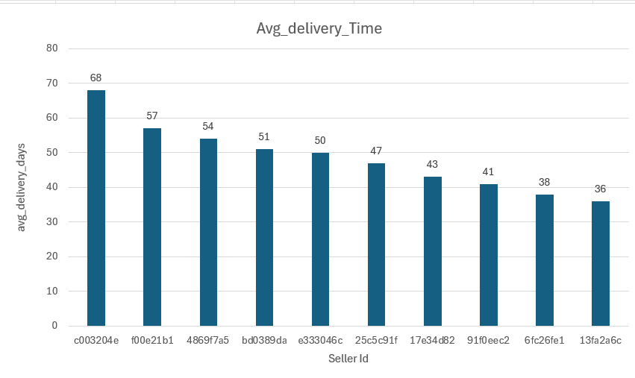
Average Delivery Time
KEY TAKEAWAY
The ten sellers shown average between 36 and 68 delivery days.
Longer delivery time warrants investigation, but does not alone prove a delivery was late; compare against estimated dates.
Olist Seller Performance Analysis • 6

Slide 7
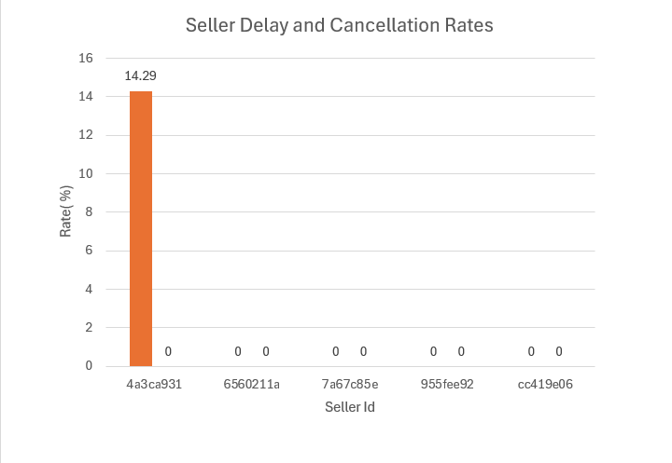
Delay and Cancellation Rates
KEY TAKEAWAY
One of the five sellers shown has a 14.29% delay rate; the other four show 0%.
All five show 0% cancellation in this result set. Each seller has only 5–9 orders, so interpret cautiously.
Olist Seller Performance Analysis • 7

Slide 8
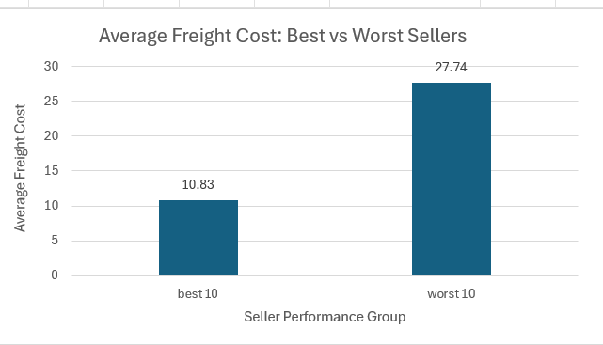
Freight Cost: Best vs. Worst Sellers
KEY TAKEAWAY
Average freight cost is 10.83 for the best 10 and 27.74 for the worst 10 sellers.
The worst-performing group is about 2.56× higher. This is an association, not proof that freight cost causes weaker performance.
Olist Seller Performance Analysis • 8

Slide 9
Business Recommendations
01
Build a seller scorecard
Review revenue, order volume, delivery time, delay rate, cancellation rate and freight cost together.
02
Investigate long delivery times
Check processing, dispatch, routes, carriers and estimated delivery dates.
03
Review freight-cost differences
Compare shipping distance, package characteristics, product mix and carrier arrangements.
Use sufficient data
Monitor performance over a consistent period and avoid overinterpreting small samples.
04
Olist Seller Performance Analysis • 9

Slide 10
Conclusion and Limitations
WHAT THE ANALYSIS SHOWS
WHAT TO KEEP IN MIND
• Seller revenue and order volume differ.
• The selected delivery-time group ranges from 36 to 68 days.
• Freight costs differ between the selected performance groups.
• The delay/cancellation chart contains only five sellers.
• Small order counts can make rates unstable.
• Observed associations do not prove cause and effect.
Evaluate sellers with a balanced scorecard and investigate operational causes before taking action.
Olist Seller Performance Analysis • 10

