Slide 1


Algorithmic Fairness, Accountability and Ethics
Investigating Representation Gaps in Medical Imaging Datasets
Group random
Constantin-Bogdan Craciun (cocr@itu.dk)
Gino Franco Fazzi (gifa@itu.dk)
Veron Hoxha (veho@itu.dk)
Notes:
Hi, this is the mandatory assignment 3 for Algorithmic Fairness, Accountability and Ethics
Investigating Representation Gaps in Medical Imaging Datasets

Slide 2


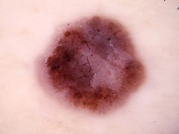
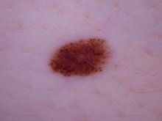
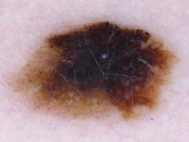
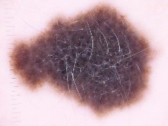

Dataset
Image recognition image dataset “HAM10000”, a large collection of multi-source dermatoscopic images of pigmented lesions (10015 entries); and “PAD-UFES-20”, a skin lesion dataset composed of patient data and clinical images collected from smartphones (1496 entries).
Aspects of bias and fairness
Sample bias, fairness in predictions for gender and skin color. Analysis of performance metrics for the different subgroups.
Notes:
We focus on two main datasets, the “HAM10000”, a large collection of multi-source dermatoscopic images of pigmented lesions; and “PAD-UFES-20”, a skin lesion dataset composed of patient data and clinical images collected from smartphones.
These data will be used to investigate for sample bias and fairness in predictions for gender and skin color.

Slide 3
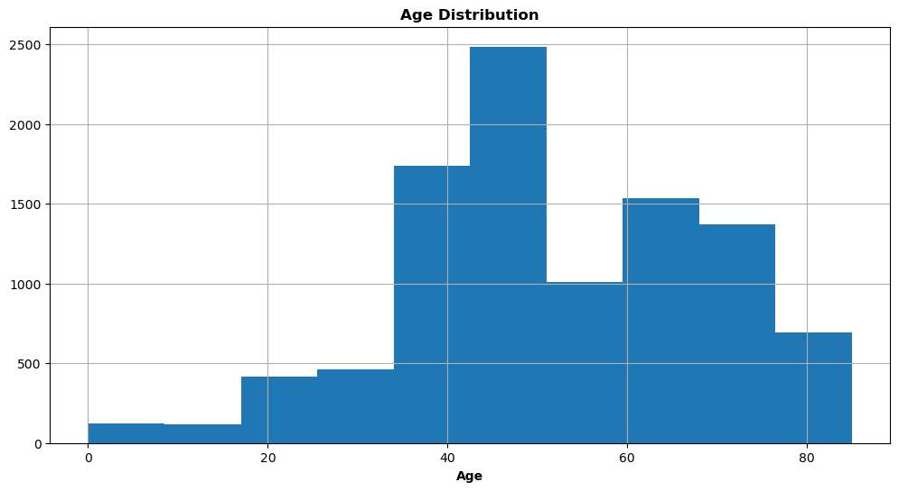
EDA
Gender distribution
Males: 4552 (~45%)
Females: 5406 (~54%)
Unknown: 57 (~1%)
Notes:
Our Exploratory Data Analysis shows a gender distribution of 45 percent males, 54 percent females and around 1 percent unknown. With respect to age, most images come from middle age people, ranging from 38 to 85 years old.

Slide 4
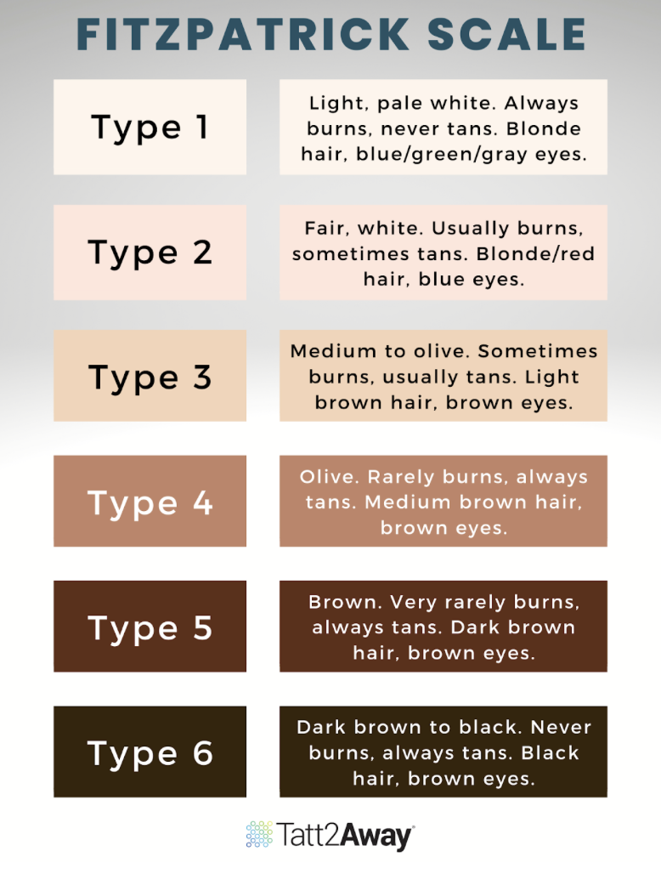
Fitzpatrick Skin Scale
HAM10000 Dataset (sample size: 100; Visual inspection):
96% Light skin color
4% Dark skin color
PAD-UFES-20 Dataset:
95% Light skin color
5% Dark skin color
Light skin
Dark skin
Notes:
To analyse for skin color variations, we use as a guide the Fitzpatrick scale, a 6-point scale commonly used by dermatologists to assign a skin color level. For simplicity, we bin the types into "Light skin" and "Dark skin", following previous research.
Our training dataset does not contain a skin color label, but our test dataset contains gold labels. These labels will be used to test for disparities across subgroups.

Slide 5


Methods
Ethical questions
Application of fairness metrics, such as, statistical parity, equalized odds, equalized outcomes and other performance metrics by group.
- Are AI-based Medical solutions being built upon a fair representation of the world?
- Are these tools aiming to help everybody equally?
- How does the use of Fitzpatrick scale impact the fairness and bias in dermatological or facial recognition technologies across different skin types?
Notes:
The methods we are going to use are statistical parity, equalized odds equalized outcomes and other performance metrics by group.
When it comes to ethical investigation, potential questions to be addressed are:
- Are AI-based Medical solutions being built upon a fair representation of the world?

Slide 6
Notes:
The methods we are going to use are statistical parity, equalized odds equalized outcomes and other performance metrics by group.
When it comes to ethical investigation, potential questions to be addressed are:
- Are AI-based Medical solutions being built upon a fair representation of the world?

