Slide 1
The Happiness Index
Jayvis Hanna, Jeremy Hartnett, Ralph Baroud, Sean Jokhai, Veronica Valencia

Slide 2
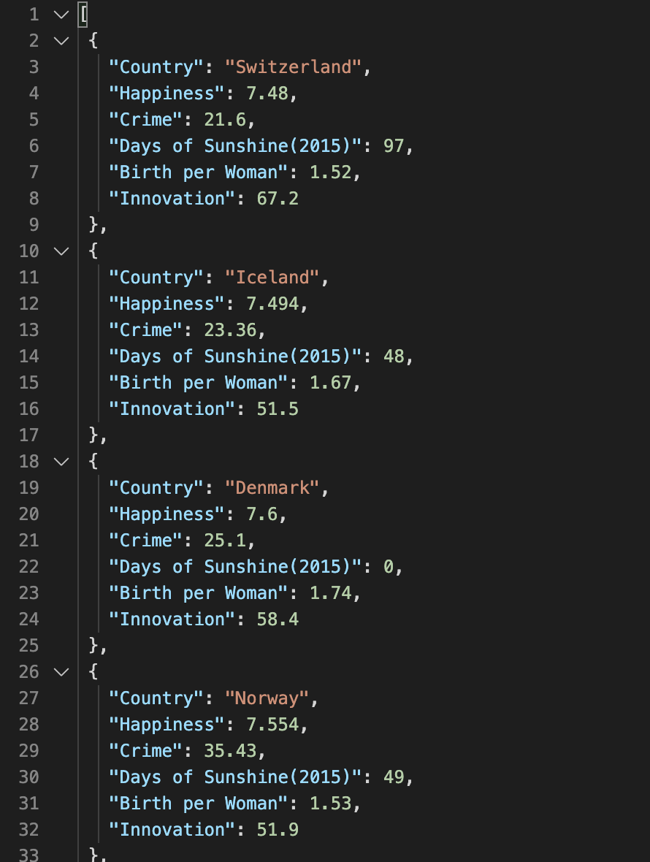
Data
2019 Happiness Index Data
Country
Happiness
Crime
Days of Sunshine
Birth of Woman
Innovation

Slide 3
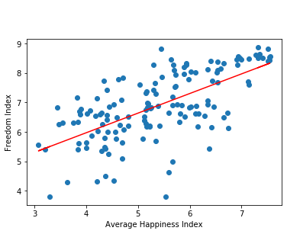
Regression Analysis: Freedom Index vs. Average Happiness Index
The r-squared is: 0.6511029465923641
Happiness and Freedom are Related

