Slide 1
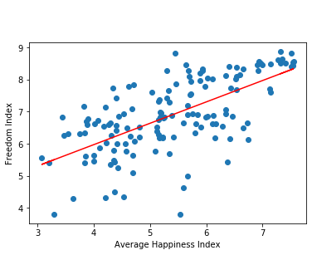
Regression Analysis: Freedom Index vs. Average Happiness Index
The r-squared is: 0.6511029465923641
Happiness and Freedom are Related

