Slide 1
The Happiness Index
Jayvis Hanna, Jeremy Hartnett, Ralph Baroud, Sean Jokhai, Veronica Valencia

Slide 2
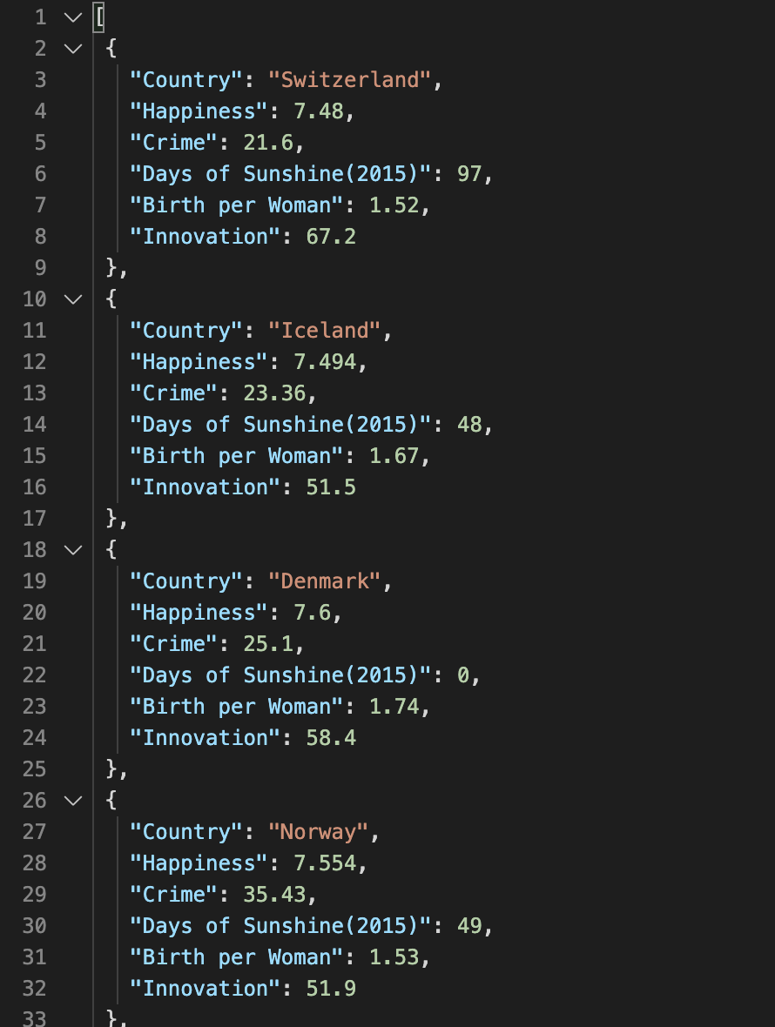
Data
2019 Happiness Index Data
Country
Happiness
Crime
Days of Sunshine
Birth of Woman
Innovation

Slide 3


World Happiness Index: Top 10 Low & High Avg Scores 2015-2019
Lowest
Highest
Country | Avg
Burundi | 3.08
Cent. Afr. Republic | 3.21
Syria | 3.29
Rwanda | 3.44
Tanzania | 3.47
Afghanistan | 3.51
Togo | 3.54
Yemen | 3.63
Madagascar | 3.75
Botswana | 3.83
Country | Avg
Denmark | 7.55
Norway | 7.54
Finland | 7.54
Switzerland | 7.51
Iceland | 7.51
Netherlands | 7.40
Canada | 7.35
Sweden | 7.32
New Zealand | 7.31
Australia | 7.28

Slide 4
Top 5 Countries by 2019 Happiness Index vs. Key Metrics
All but Finland rank below the 50th percentile
All 5 countries rank above the 75th percentile
All but Finland rank below the 50th percentile
The 5 Countries are widely spread above/below the 50th Percentile

Slide 5
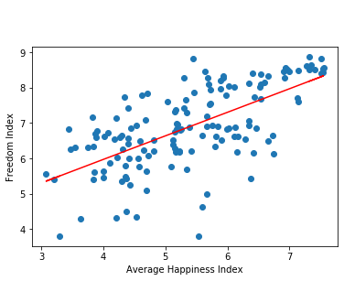
Regression Analysis: Freedom Index vs. Average Happiness Index
The r-squared is: 0.6511029465923641
Happiness and Freedom are Related

