Slide 1

Cirrhosis patient survival prediction data analysis
Verónica Gamo, Andrea Pradas and Jaime Martín

Slide 2
INDEX
Introduction
Data preparation
Model training + evaluation in Altair and Python
Comparison Altair Studio vs Python
Combination of Models
Statistical Analysis and Final Conclusions
Notes:
We will talk about the following topics: Introduction, Data preparation, Model training and evaluating with Altair Studio and Python, Comparison and Combination of Models and finally, Statistical Analysis and Conclusions.

Slide 3
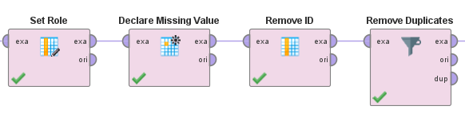
Introduction
ID → integer (id)
N_Days → integer
Status → polynominal
Drug → nominal
Age → integer
Sex → binominal
Ascites → nominal
Hepatomegaly → nominal
Spiders → nominal
Edema → polynominal
Bilirubin → real
Cholesterol → integer
Albumin → real
Copper → integer
Alk_Phos → real
SGOT → real
Triglycerides → integer
Platelets → integer
Prothrombin → real
Stage → polynominal (label)
418 patients
20 clinical features
Handling the missing values: NA
"Declare Missing Values"
Remove ID attribute
Notes:
The dataset used in this study originates from a Mayo Clinic research and includes data from 418 patients with 20 clinical features. It contains the following attributes: ID (unique), Status (polynominal – target label; values: D [death], C [censored], CL [liver transplant and many other physiological parameters. Missing values are represented as "NA" and then transformed into interrogation question marks. Also, the ID attribute was excluded from further analysis as it provides no predictive value.

Slide 4
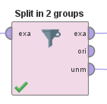
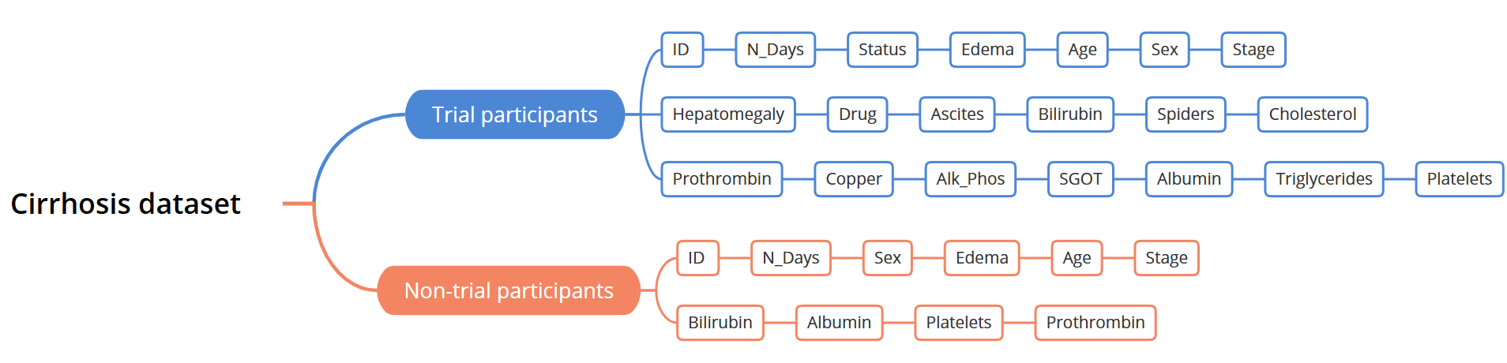
Data preparation
DATA QUALITY:
Notes:
The dataset has moderate/poor quality, with 418 unique instances but significantly missing data affecting 142 rows (~34%, a significant proportion). Six instances with extensive missing data were excluded. As you may see the data is divided into two groups due to the difference in data related to the Drug attribute:
Trial participants (312 patients): These patients were part of a randomized controlled clinical trial, and their clinical data was collected in more detail, having 10 more features than non-trial group.
Non-trial participants (100 patients): Limited data availability, with many clinical attributes missing due to the lack of trial protocols.

Slide 5
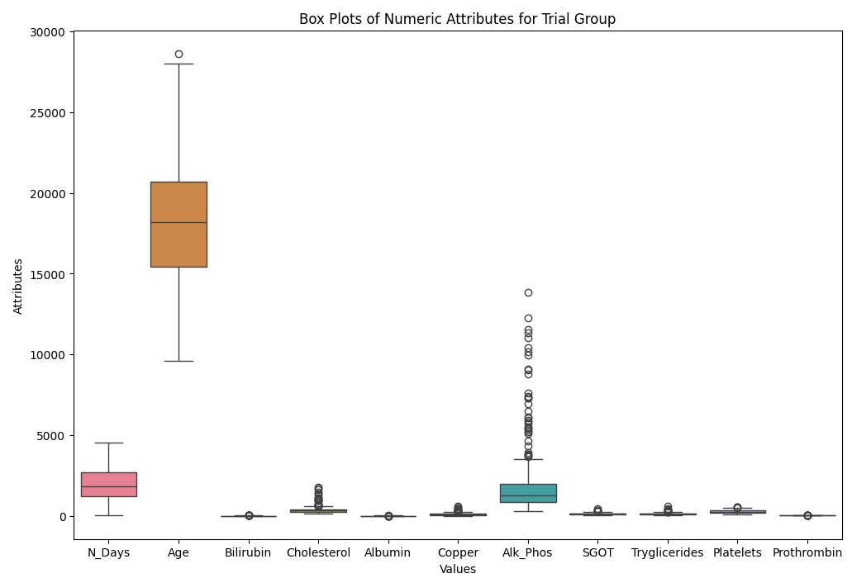
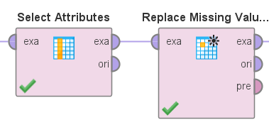
DATA QUALITY:
Handling missing values:
Outliers:
Replace by the mean value
Remove them from the dataset
Notes:
This separation allows for more appropriate handling of missing values.
For the trial group, missing values were imputed using the mean value for each attribute, ensuring consistency without introducing bias.
For the non-trial group, attributes with no observed values such as the ones in the trial-group were removed and the rest imputed using the mean value.
Regarding OUTLIERS: No obvious outliers were detected only some extreme values like high cholesterol (1775 mg/dL) and alkaline phosphatase (13862.4 IU/L) but there are not considered errors just severe state of the disease.

Slide 6
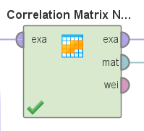
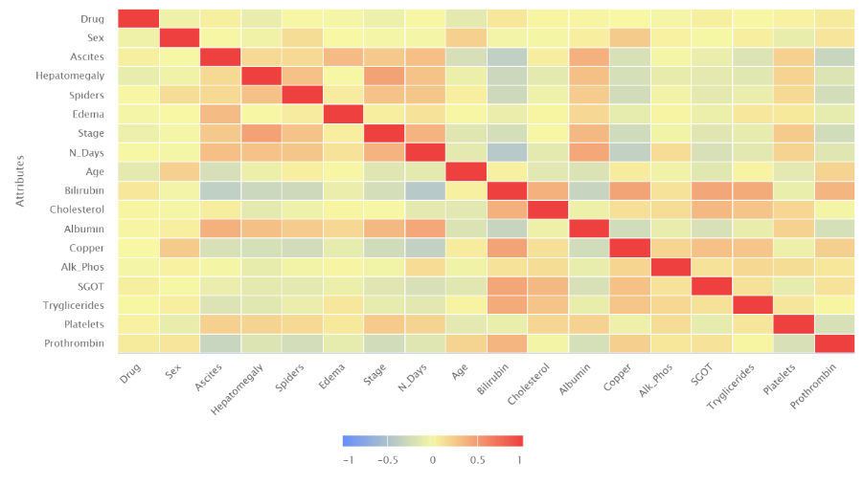
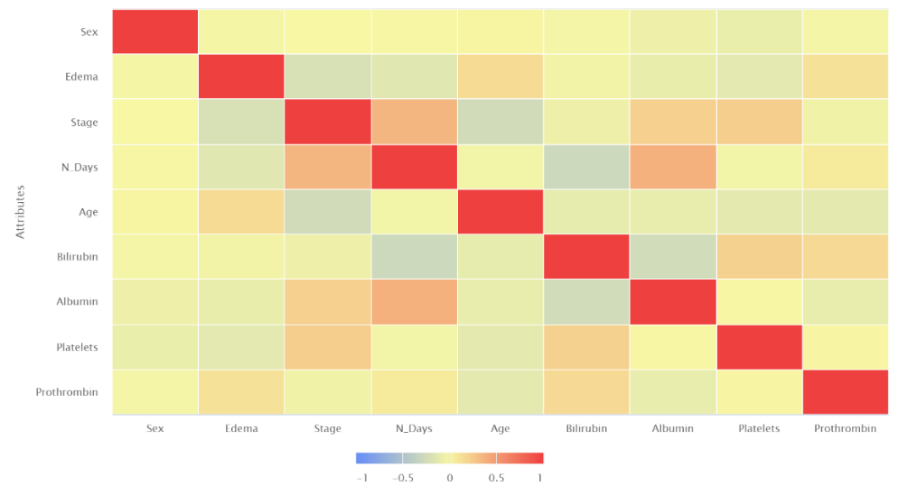
DATA EXPLORATION:
Correlation:
Trial group
Non-trial group
Notes:
In both the trial and non-trial groups, moderate correlations were found around 0.5 (represented with colors near to red) between various attributes such as Hepatomegaly-Stage for the trial group and Albumin-N_day for the non-trial. Additionally, scatterplots indicate non-linear relationships.

Slide 7
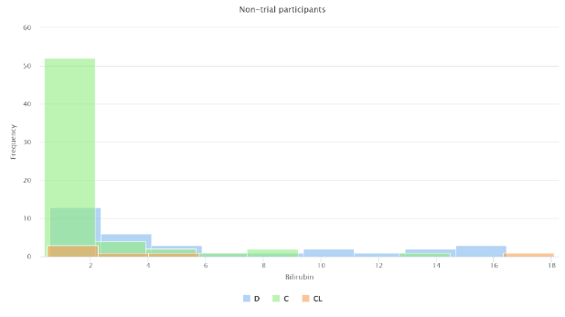
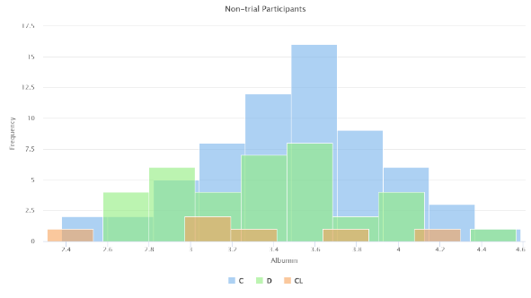
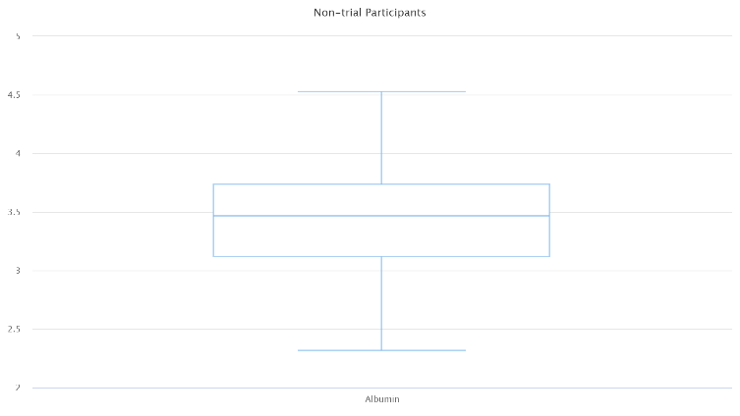
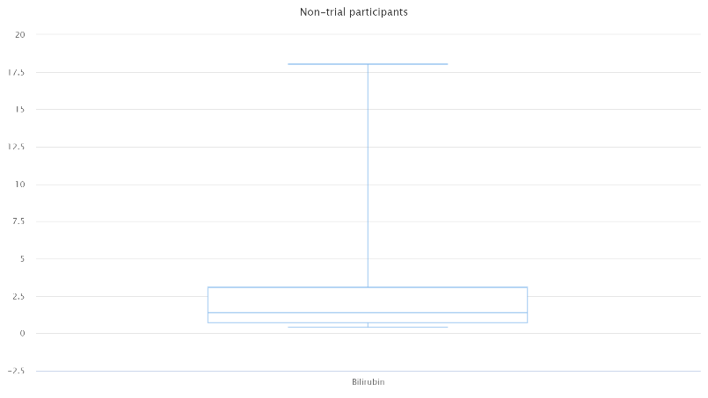
Prob. distribution:
Notes:
The dataset exhibits varying normality distribution across groups. In the trial group, attributes like Age and Albumin are approximately normal, while others, like Bilirubin and Prothrombin, show right-skewness, indicating abnormal distributions. The non-trial group has more deviations from normality, and class imbalances in attributes like Status and Sex may impact analysis. That is the reason why afterwards we will apply a logarithm transformation

Slide 8
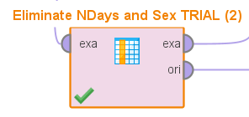

FEATURE SELECTION:
$m≫n^{2}$
 | Trial | Non-trial
Weight by information gain | N_days | N_days
Weight by information gain ratio | Triglycerides | Bilirubin
Weight by chi squared statistics | N_days | N_days
Weight by relief | Hepatomegaly | Bilirubin
Forward selection | Sex | N_days
Exclude N_days (non-trial), N_days + Sex (trial)
Notes:
For both the non-trial and trial groups, the condition m≫n^2 is not satisfied, indicating the need for feature selection (dimensionality reduction). Reducing the number of attributes will improve computational efficiency and model interpretability. Finally, after applying all these weights operator and forward selection, we conclude to exclude N_Days (survival): in both groups because it is directly correlated with Status, making predictions redundant. And also, Sex: in the trial group due to low predictive relevance and class imbalance. Excluding these less relevant features ensures both groups satisfy now the condition, reducing the risk of overfitting and improving model reliability.

Slide 9
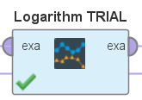
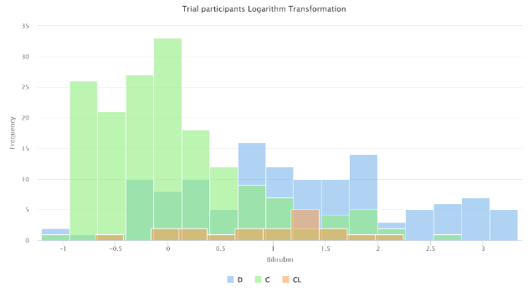
FEATURE TRANSFORMATION:
After logarithm transformation:
Notes:
As mentioned earlier, a logarithmic transformation was applied to long-tailed histograms to reduce skewness and compress extreme values.

Slide 10
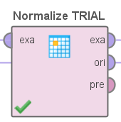
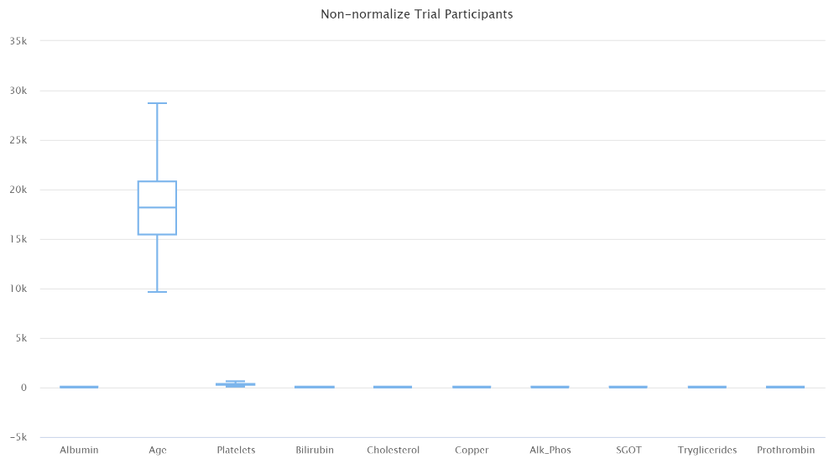
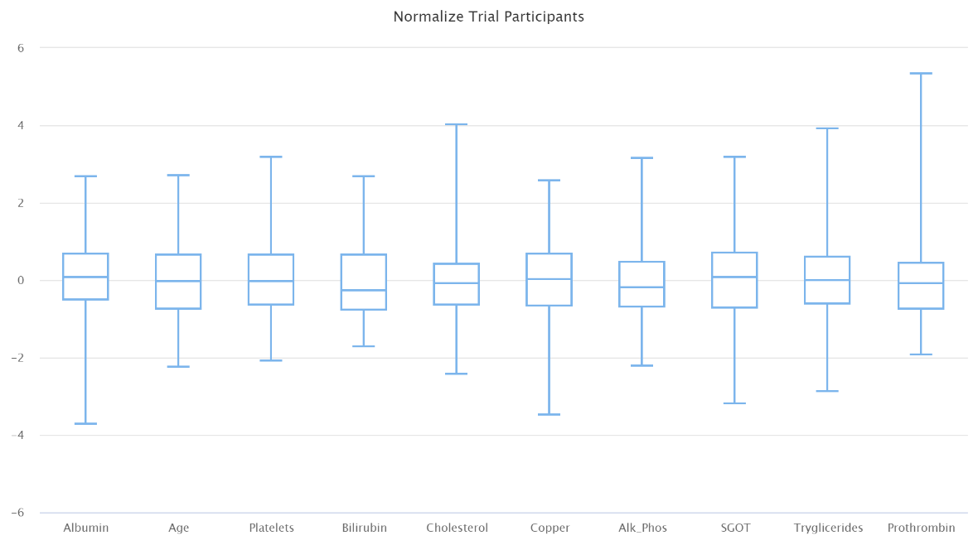
FEATURE TRANSFORMATION:
Non-normalized:
Normalized:
Notes:
Additionally, numeric attributes were normalized to standardize their ranges, as the boxplots already have revealed, ensuring consistency.

Slide 11
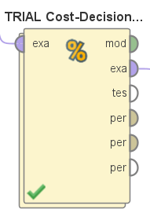
Model training and evaluation
Decision tree
Rule-based model
Naive Bayes
Bayesian network
Neural networks
Deep learning
Predicted \ Actual | D (Death) | C (Censored) | CL (Liver Transplant)
D (Death) | 0 | 5 | 10
C (Censored) | 10 | 0 | 8
CL (Liver Transplant) | 15 | 5 | 0

Slide 12
CONCLUSIONS:
Trained based on ACCURACY:
Model | Accuracy | Cost
Decision tree (non-trial) | 60.00% ± 10.54% | 3.450 ± 0.669
Decision tree (trial) | 68.62% ± 6.32% | 2.682 ± 0.704
Rule-based (non-trial) | 67.00% ± 8.23% | 2.77 ± 0.713
Rule-based (trial) | 67.65% ± 9.39% | 2.655 ± 0.766
Naive Bayes (non-trial) | 67.00% ± 9.49% | 2.770 ± 0.759
Naive Bayes (trial) | 73.38% ± 8.80% | 2.269 ± 0.807
Bayesian network (non- trial) | 63.00% ± 14.18% | 2.990 ± 1.129
Bayesian network (trial) | 74.03% ± 3.58% | 2.203 ± 0.461
Neural network (non- trial) | 66.00% ± 11.74% | 2.670 ± 1.012
Neural network (trial) | 72.40% ± 7.28% | 2.224 ± 0.630
2-layer neural network (non-trial) | 64.00% ± 5.16% | 3.430 ± 0.600
2-layer neural network (trial) | 74.71% ± 8.53% | 1.974 ± 0.654
Deep learning (non-trial) | 66.00% ± 12.65% | 2.670 ± 0.996
Deep learning (trial) | 69.86% ± 11.06% | 2.315 ± 0.999

Slide 13
CONCLUSIONS:
Trained based on COST:
Model | Accuracy | Cost
Decision tree (non-trial) | 60.00% ± 16.33% | 2.870 ± 1.127
Decision tree (trial) | 71.45% ± 6.06% | 2.044 ± 0.506
Rule-based (non-trial) | 67.00% ± 14.94% | 2.440 ± 1.069
Rule-based (trial) | 72.72% ± 6.70% | 1.999 ± 0.476
Naive Bayes (non-trial) | 67.00% ± 15.67% | 2.440 ± 1.178
Naive Bayes (trial) | 75.01% ± 9.55% | 1.948 ± 0.635
Bayesian network (non-trial) | 70.00% ± 14.14% | 2.190 ± 1.141
Bayesian network (trial) | 73.34% ± 8.19% | 1.198 ± 0.576
Neural network (non-trial) | 70.00% ± 13.33% | 2.220 ± 0.993
Neural network (trial) | 74.02% ± 5.82% | 1.892 ± 0.450
2-layer neural network (non-trial) | 72.00% ± 10.33% | 2.140 ± 0.871
2-layer neural network (trial) | 74.31% ± 7.25% | 1.932 ± 0.418
Deep learning (non-trial) | 70.00% ± 18.86% | 2.120 ± 1.346
Deep learning (trial) | 74.68% ± 8.10% | 1.814 ± 0.591

Slide 14
Model training and evaluating with Python
TRIAL: 10-fold cross-validation
max_depth: 5
min_samples_leaf: 2
min_samples_split: 5
NON-TRIAL: 6-fold cross-validation
max_depth: 5
min_samples_leaf: 2
min_samples_split: 2

Slide 15
CONCLUSIONS:
Trained based on ACCURACY:
Model | Accuracy | Cost per instance
Decision tree (non-trial) | 68.99% ± 7.512% | 2.59 ± 0.75
Decision tree (trial) | 73.33% ± 7.154% | 2.26 ± 0.57
Naive Bayes (non-trial) | 67.95% ± 7.707% | 2.75 ± 0.88
Naive Bayes (trial) | 71.47% ± 5.438% | 2.68 ± 0.44
Neural network (non-trial) | 69.05% ± 10.685% | 2.55 ± 1.03
Neural network (trial) | 68.27% ± 6.452% | 2.53 ± 0.47
2-layer neural network (non-trial) | 69.05% ± 10.685% | 2.5 ± 0.94
2-layer neural network (trial) | 69.54% ± 7.487% | 2.43 ± 0.60
Deep learning (non-trial) | 48.89% ± 9.98% | 3.29 ± 0.80
Deep learning (trial) | 73.08% ± 8.87% | 1.945 ± 0.768

Slide 16
CONCLUSIONS:
Trained based on COST:
Model | Accuracy | Cost per instance
Decision tree (non-trial) | 55.75% ± 15.66% | 3.16 ± 1.15
Decision tree (trial) | 70.50% ± 6.44% | 2.33 ± 0.59
Naive Bayes (non-trial) | 65.99% ± 4.37% | 2.80± 0.58
Naive Bayes (trial) | 70.82 % ± 7.06% | 2.58 ± 0.53
Neural network (non-trial) | 66.17 % ± 8.98% | 2.70 ± 0.80
Neural network (trial) | 69.24% ± 7.67% | 2.42 ± 0.53
2-layer neural network (non-trial) | 65.01% ± 11.30% | 2.83 ± 1.04
2-layer neural network (trial) | 71.81 % ± 8.84% | 2.23 ± 0.62

Slide 17
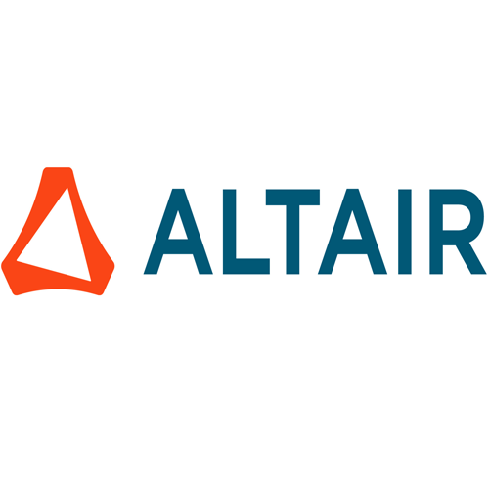

Comparison Altair Studio vs Python

Slide 18
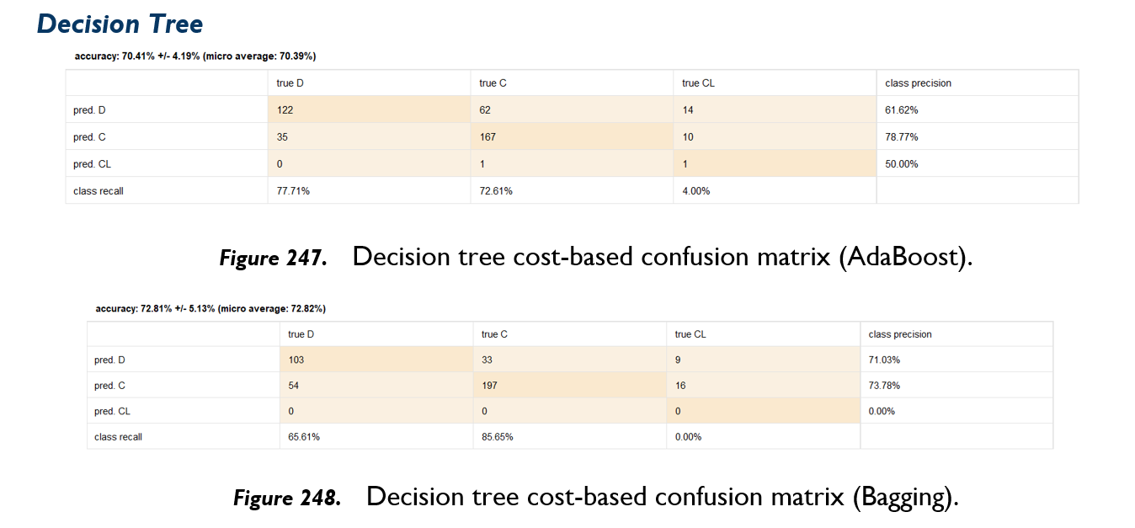
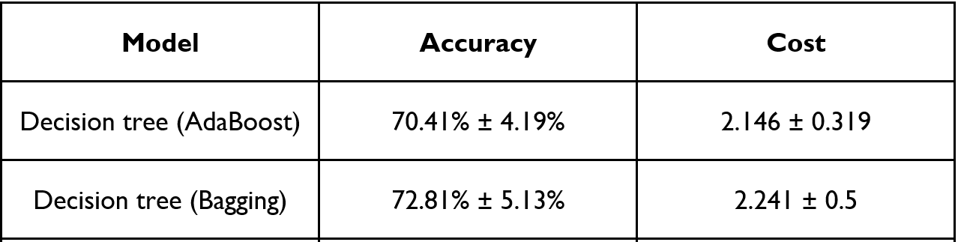
Combination of Models

Slide 19
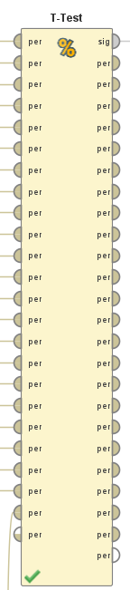
Statistical Analysis and Final Conclusions
P-values for trial models are statistically significant (p < 0.05)
Combined models offer a balance of cost and accuracy

