Slide 1
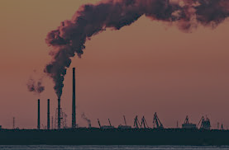
`1qw
Pollution remover

Slide 2
`1qw
The content of factories smoke
carbon monoxide
lead
nitrogen dioxide
ozone
Particles
sulfur dioxide
The pressure needed will be calculated by Hanry’s law

Slide 3
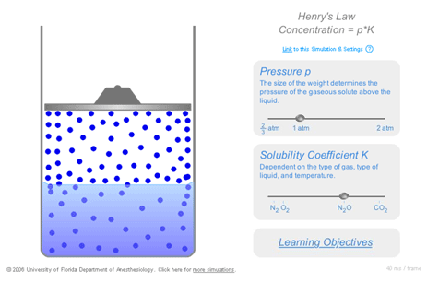
`1qw
The idea of stands on making pressure of the smoke and the water
When we make pressure on smoke and water the smoke dissolve in water

Slide 4
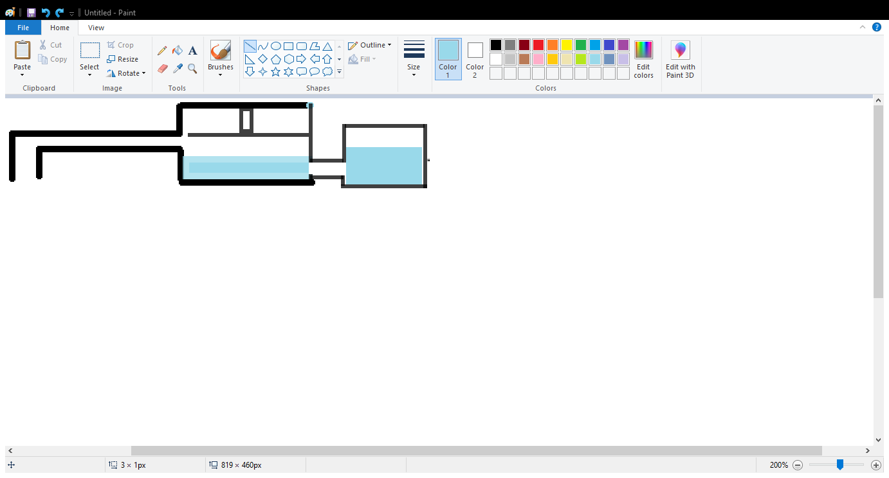
`1qw
First, the smoke enter the device .
Then, the compressor makes pressure on the smoke and water
Compressor
Polluted water
smoke
smoke

Slide 5
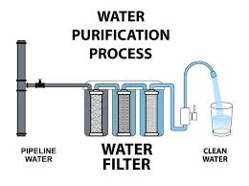
`1qw
Finally, we filter the dirty water

