Slide 1
Travel by bus
Veronika valentinova, 62073
12.02.2020

Slide 2
Idea
Online system for browsing routes and buying bus tickets
It supports different roles – Traveler, Bus Company and Admin
The system is developed using Spring 5 and Angular 8. The backend is implemented as a REST/JSON API using JSON data serialization. Routing is done client-side. JWT is used for authorization.

Slide 3
Roles
Bus Company
Create new bus lines with information for start point, end point, price, distance, duration, departure time, number of seats and working days
Edit/Delete bus line
View list of bus line details
Traveler
Search route by start point, end point and travel date
Sort results by different criteria – duration, price, distance
Buy ticket
View list of all bought tickets
Administrator
Manages users, bus lines and tickets
All users
Edit personal profile data – password, first name, last name

Slide 4
Functional summary
Manage bus lines | Bus company, Administrator
Search route | Traveler
Buy ticket | Traveler
View tickets | Traveler
Manage tickets | Administrator
Login | Traveler, Bus company, Administrator
Register | Anonymous User, Administrator
Update profile | Traveler, Bus company, Administrator

Slide 5
Entities
Stops
Bus lines
Users
Tickets

Slide 6
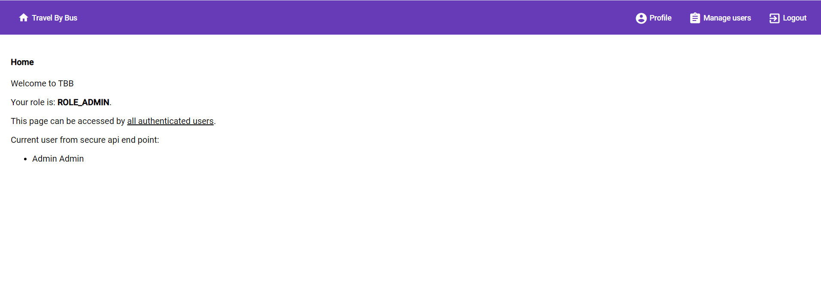
Admin

Slide 7
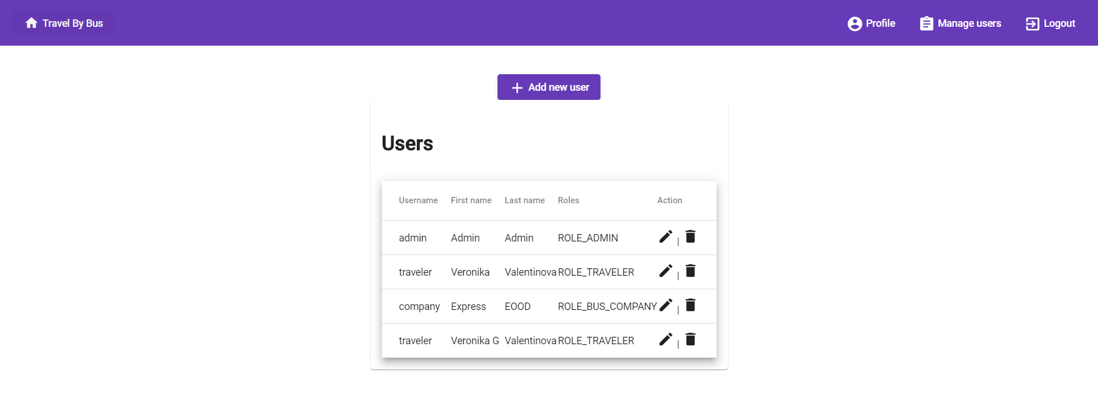
Admin

Slide 8
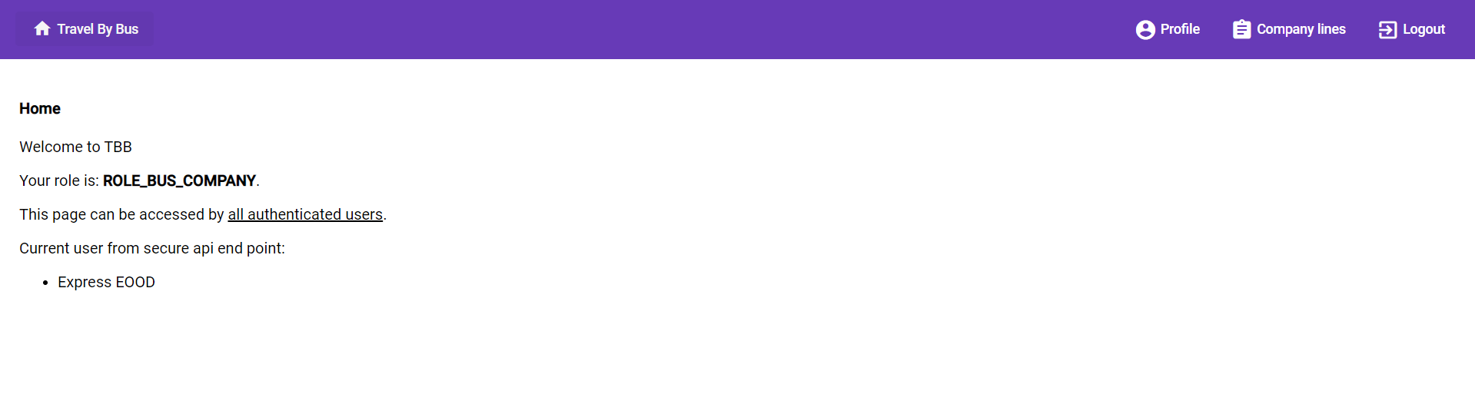
Bus company

Slide 9
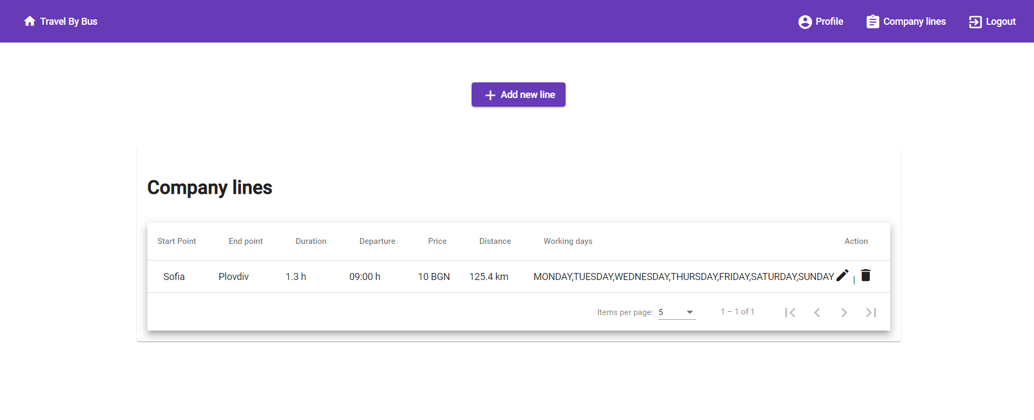
Bus company

Slide 10
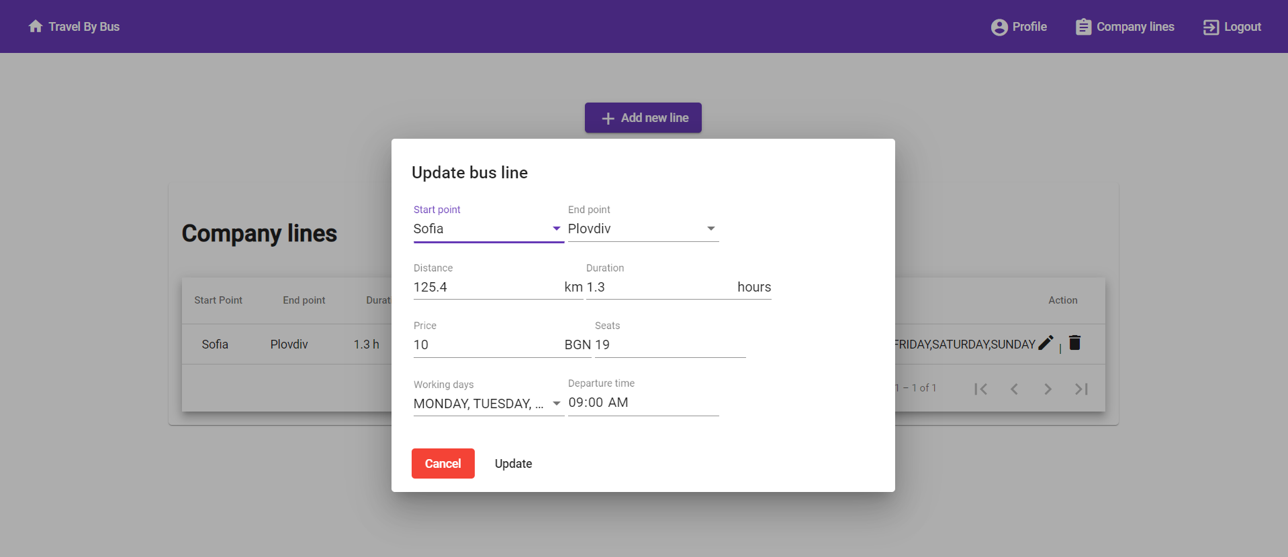
Bus company

Slide 11
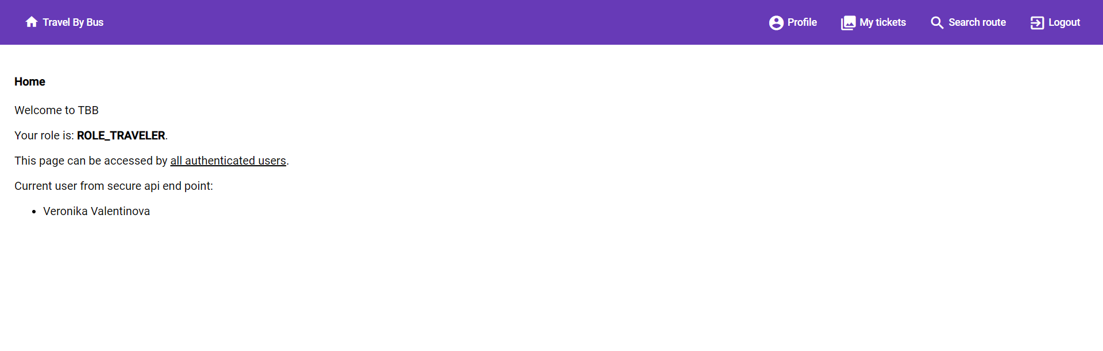
Traveler

Slide 12
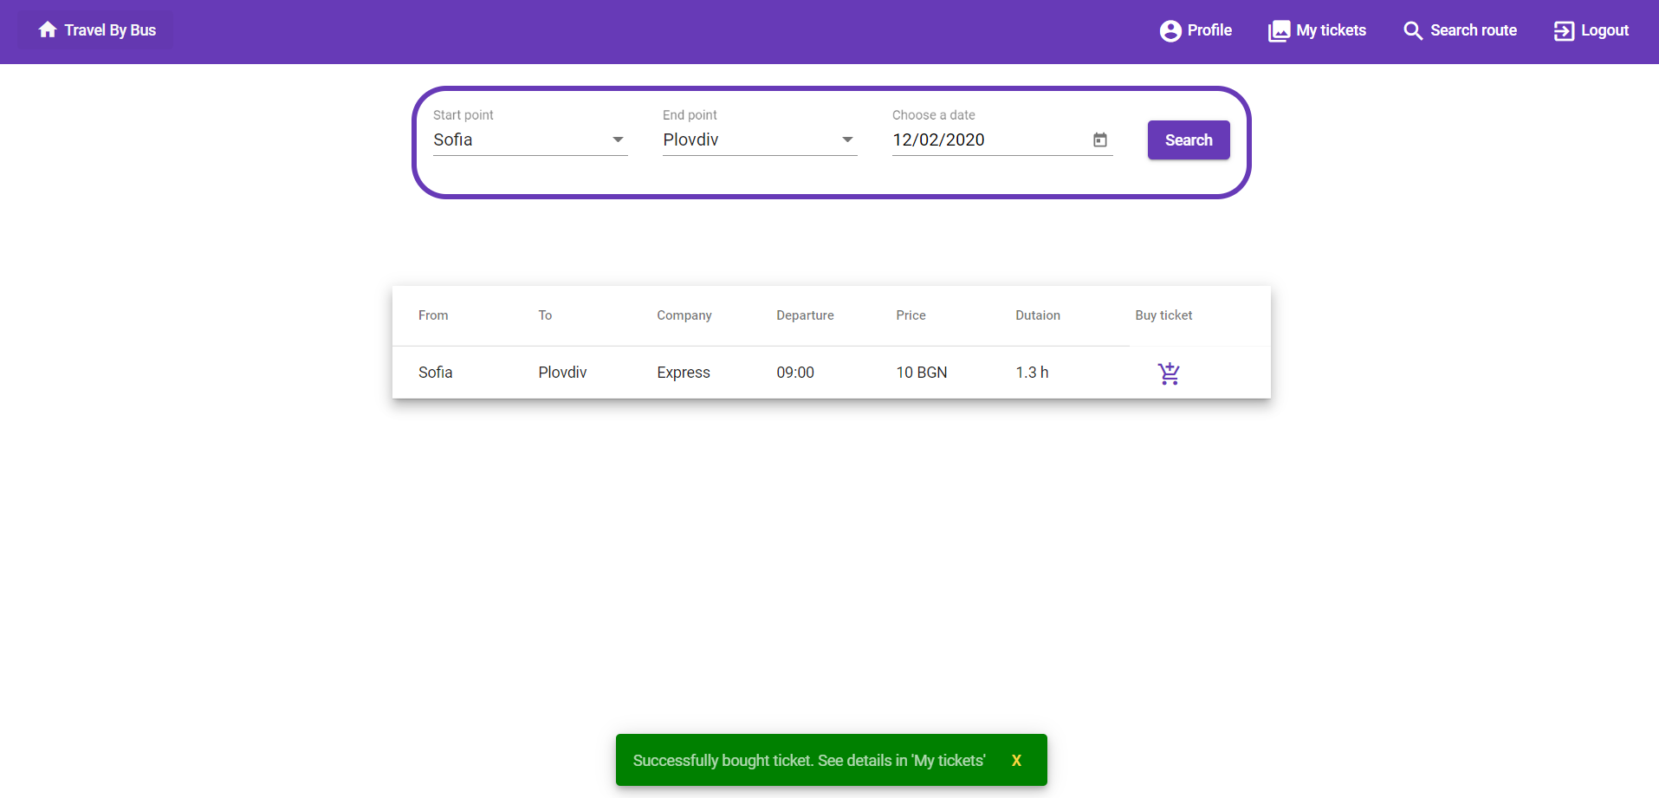
Traveler

Slide 13
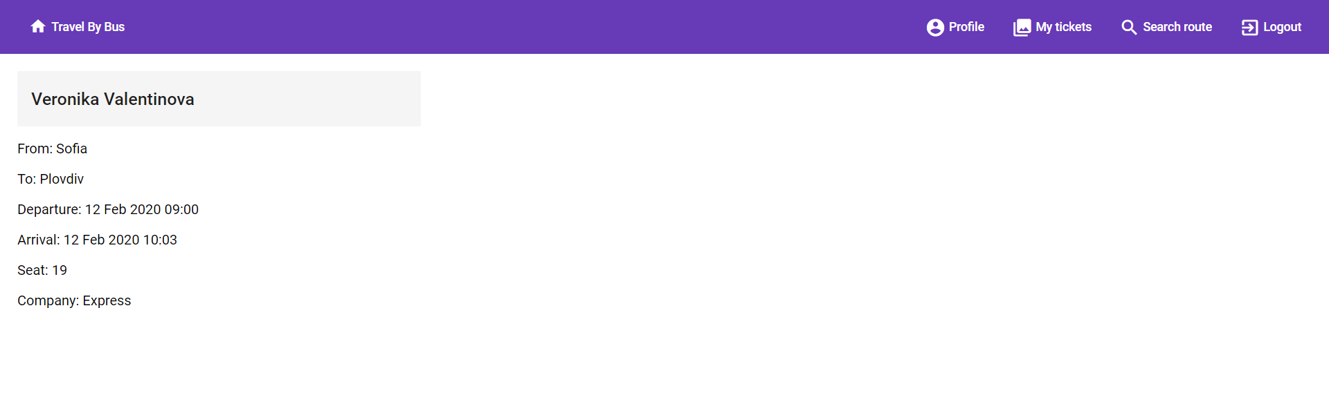
Traveler

Slide 14
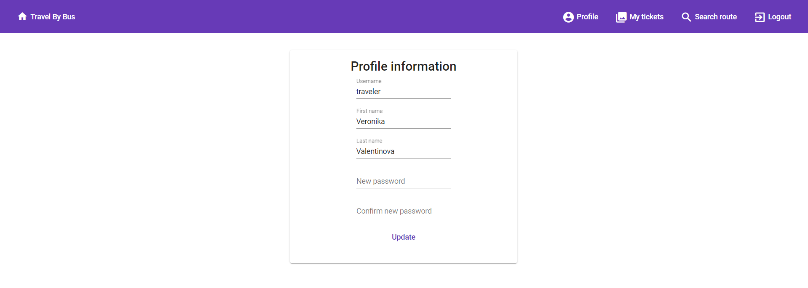
Profile

Slide 15
Future development
More flexibility for route search
Integration of map to visualize the route
Ability for user to choose seat.
With more time it can be further extended to offer different kind of transport.

