Slide 1
Machine Learning Classification
Presenter: Veronica Moreno
Mentor: Aymen Chentouf

Slide 2
agenda
INTRODUCTION
PROJECT
RESULTS
CONCLUSION

Slide 3
Introduction
This project is based on the two data sets of wines related to red and white vinho verde wine samples, from the north of Portugal. The main objective is to test different Classification models to differentiate the wines based on their type: Red or White.
Then 5 different classification methods with the standard parameters are tested:
KNeighborsClassifier
DecisionTreeClassifier
RandomForestClassifier
Support Vector Machines
GaussianNB
The Kfold technique is applied to the same Classification Models and compare the results.
To understand better each Classification model, the GridSearchCV and RandomizedSearchCV Hyperparameter Tunning are applied to each model to find best estimator.

Slide 4
Project
Load Data
Visualize the Data – Data Exploration
2.1. General Information / Statistical Information / Verify NULLS
2.2. Data Distribution
2.3. Create Boxplots
2.4. Pairplot Data with column ['type']:
2.5. Correlation Matrix
Splitting the Data for Training and Testing

Slide 5
Project
Testing Multiple Models
4.1 KNeighborsClassifier
4.2 DecisionTreeClassifier
4.3 RandomForestClassifier
4.4 Support Vector Machines
4.5 GaussianNB
Testing The Models using Kfold
Hyperparameter Tuning using GridSearchCV and RandomizedSearchCV on each Model

Slide 6
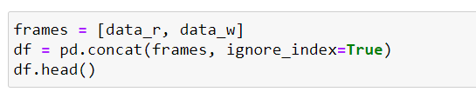
1. Load Data
This project is based on the data set Wine Quality provided by the UC Irvine. There are two data sets, one for white wine and one for red wine in csv format. I on each file, I added a Type column, with the values of 0 for red wine and 1 for white wine.
Each csv file is loaded, and then a new data frame is created with the concatenate command.
Once the data is in one data frame, to avoid bias, the shuffle method from the sklearn.utils library is applied.

Slide 7
2. Visualize the Data – Data Exploration
The following visualization methods are applied to the data to understand better how it is configured:
General Information / Statistical Information / Verify NULLS
Data Distribution
Create Boxplots
Pariplot Data with column ['type']:
Correlation Matrix

Slide 8
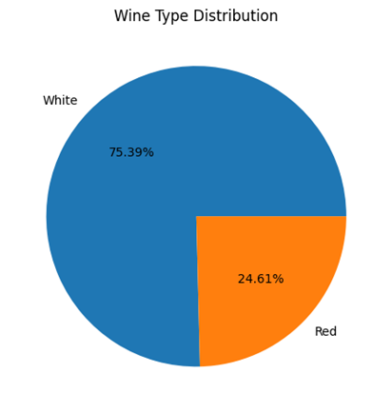
2. Visualize the Data – Data Exploration
Since this dataset is for education purposes, the information was very clear in a csv format. There were no nulls.
The dataset distribution show that there is 75% of white wine and 25% of red whine. It is important to take into account that this feature can create bias in the results.

Slide 9
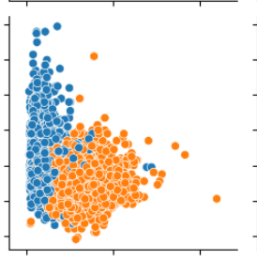
2. Visualize the Data – Data Exploration
The Boxplots show that flex acidity, volatile acidity, chlorides and sulphates have significant outliers.
The pairplot with the type of wine as a hue, shows how some of the features have a tendency either to the red or the white wine.
Like: Fixed Acidity and Total Sulfur Dioxide

Slide 10
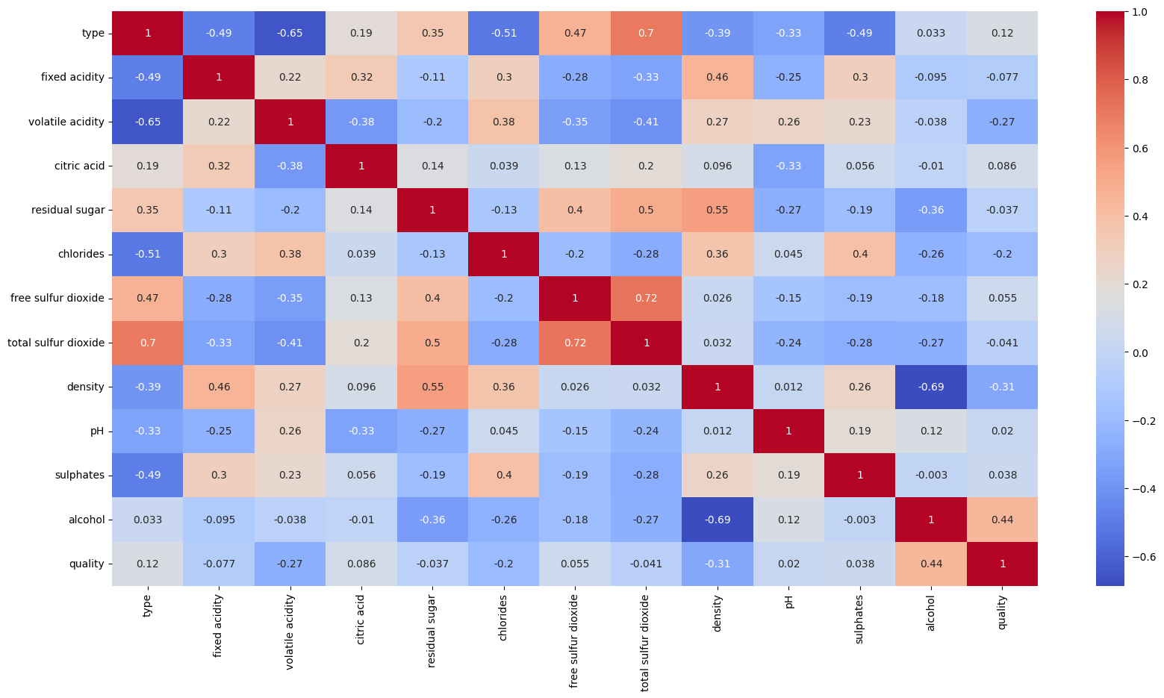
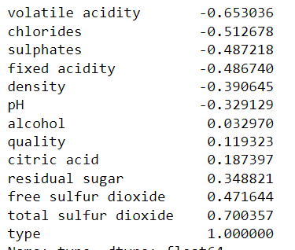
2. Visualize the Data – Data Exploration
I also created a correlation matrix, that shows total sulfur dioxide, volatile acidity and chlorides as the columns with more correlation with the type.

Slide 11
3. Splitting the data for Training and Testing
These are the parameters used to split the dataset:
Parameter | Definition
test_size = 0.2 | The data is split with 80% for training and 20% for testing.
random_state = 10 | Whenever randomization is part of a Scikit-learn algorithm, a random_state parameter may be provided to control the random number generator used. Note that the mere presence of random_state doesn’t mean that randomization is always used, as it may be dependent on another parameter, e.g. shuffle, being set. (Reference)
stratify = y | Some classification problems do not have a balanced number of examples for each class label. As such, it is desirable to split the dataset into train and test sets in a way that preserves the same proportions of examples in each class as observed in the original dataset. (Reference)

Slide 12
4. Testing Models
For testing purposes, 5 models with default parameters were applied:
KNeighborsClassifier
DecisionTreeClassifier
RandomForestClassifier
Support Vector Machines
GaussianNB

Slide 13
Results
For each Classifier, I gathered the information for:
Accuracy Score
Confusion Matrix
Classification Report
Mean Accuracy
Standard Deviation

Slide 14
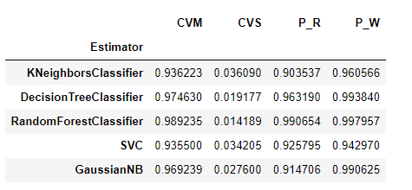
Results
After running each model, collected the information for the Mean Accuracy(CVM), Standard Deviation (CVS), Precision for Red Wine (P_R) and Precision for White Wine (P_W). Then plotted the information to review the results.

Slide 15
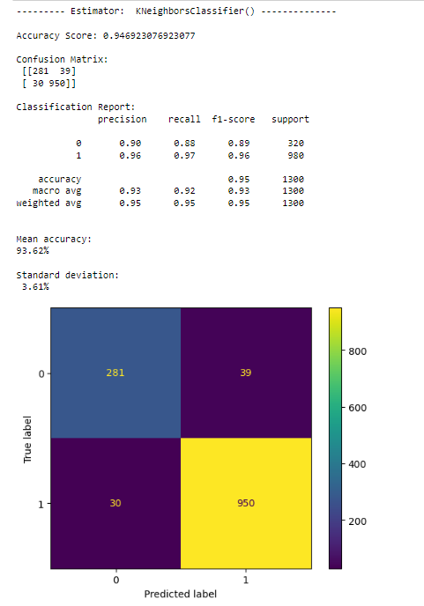
Example of the Results of the KNeigborusClassifier

Slide 16
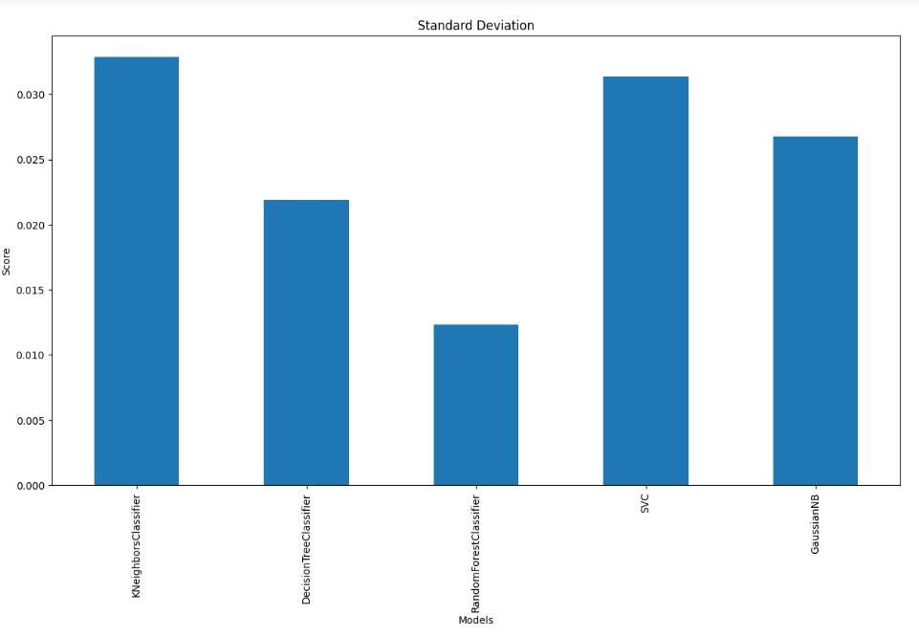
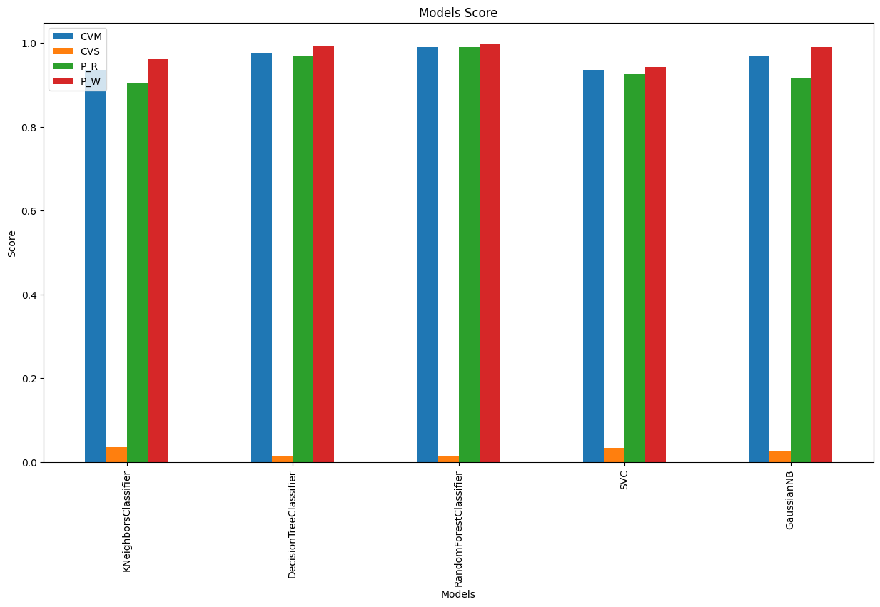
Results
Looking at the results in a bar chart, we can determine that the Model with highest accuracy and lowest standard deviation is the RandomForestClassifier.

Slide 17
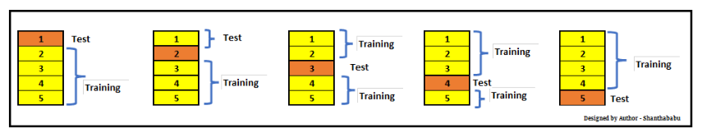
5. Testing The Models using KFold
Kfold is a method to use all the dataset and divide the data in different sets.
I tested the technique with each Classification Method.
(Reference)

Slide 18
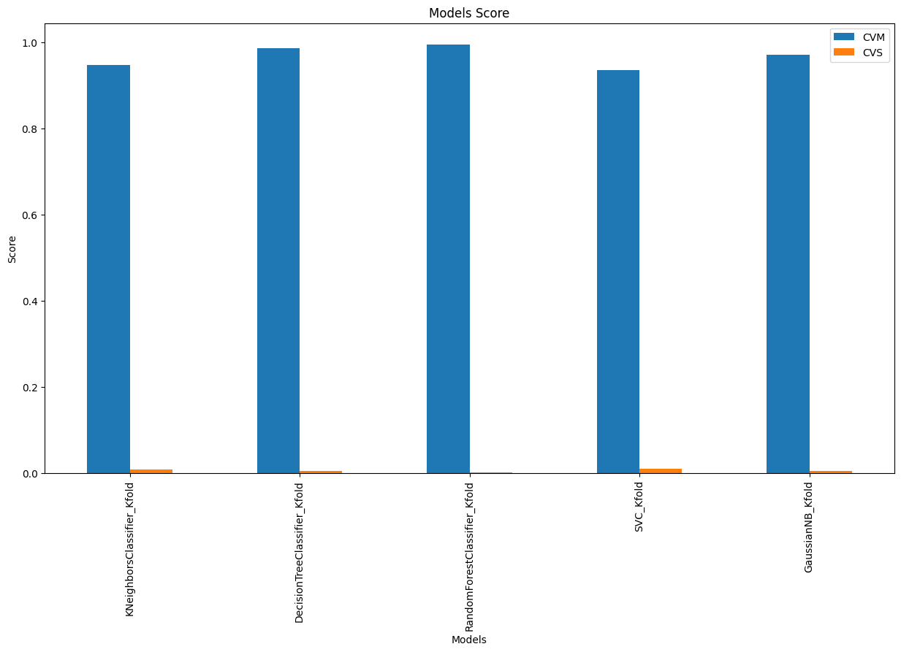
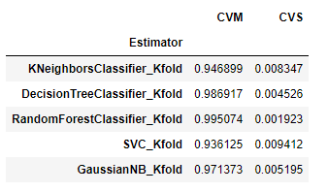
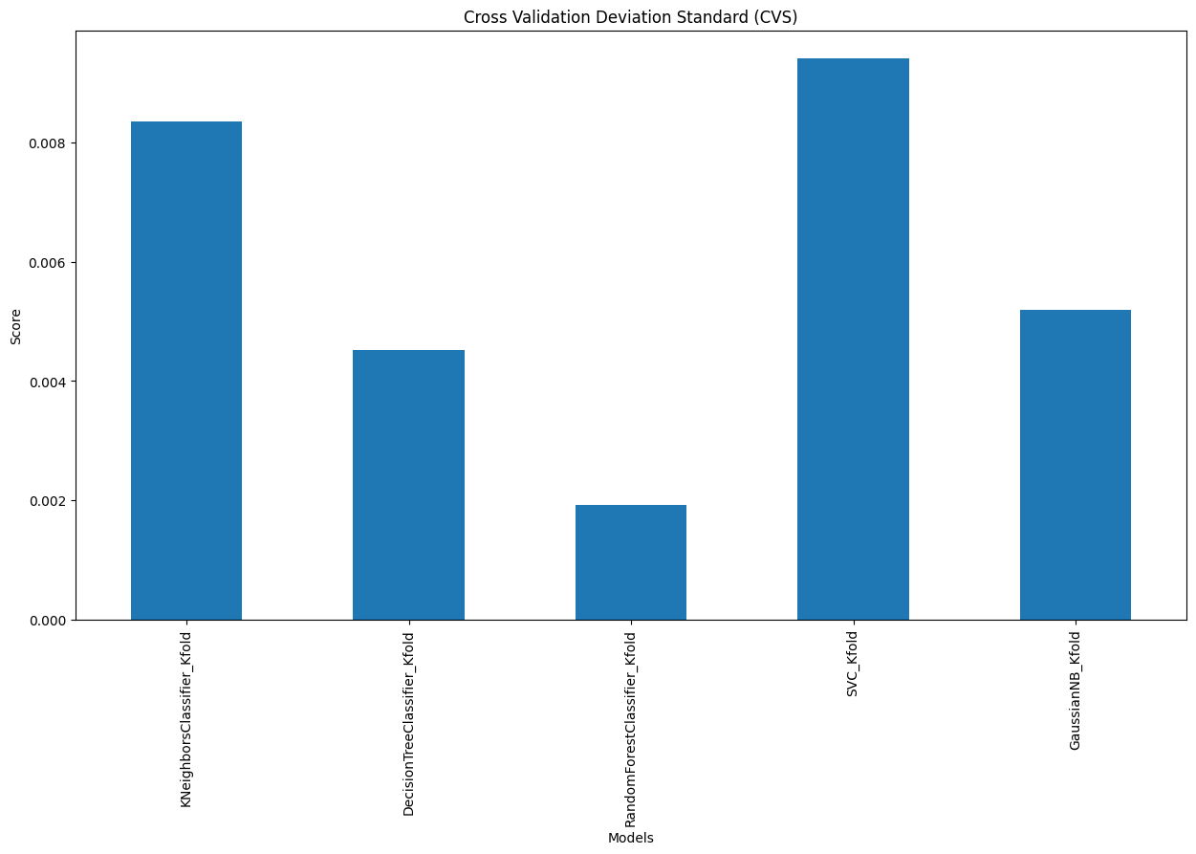
5. Testing The Models using Kfold - Results
Kfold is a method to use all the dataset and divide the data in different sets.
I tested the technique with each Classification Method.
Observing the information from the Mean Accuracy(CVM) and Standard Deviation (CVS) parameters. We can identify that the Random Forest Classifier, gives the best result.

Slide 19
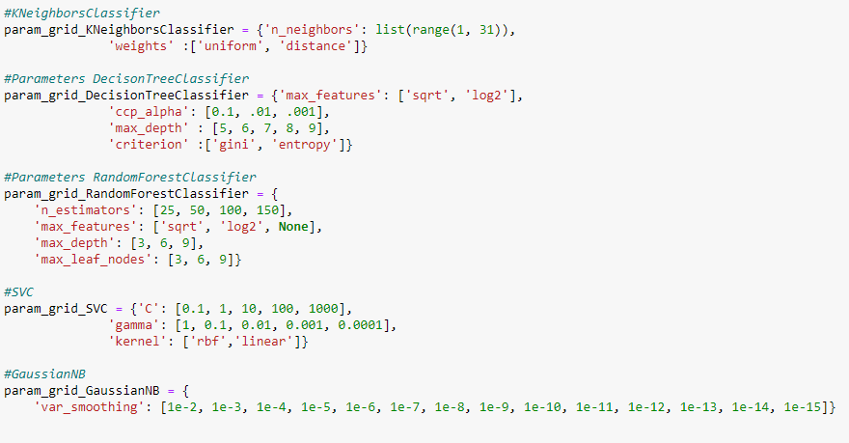
6. Hyperparameters Tuning using GridSearchCV and RandomizedSearchCV on each Model
The next step on the project, was to identify the best set of hyperparameters for each model using the methods : GridSearch CV and RandomizedSearchCV.
For each Model, I created a dictionary with a potential set of hyperparameters:

Slide 20
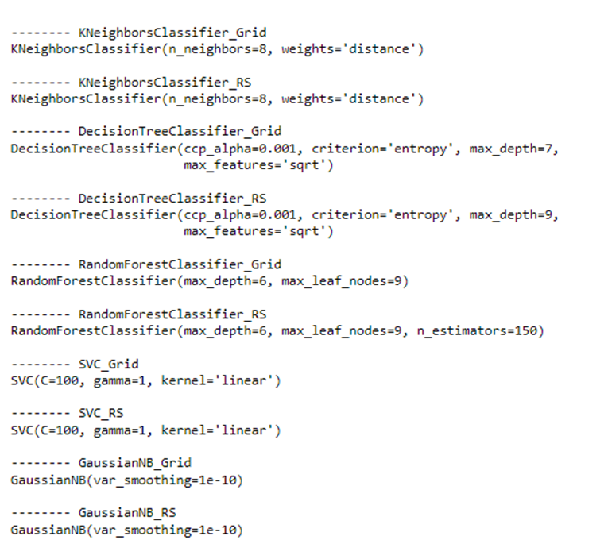
6. Hyperparameters Tuning using GridSearchCV and RandomizedSearchCV on each Model
I gathered the parameters identified as the best hyperparameters:

Slide 21
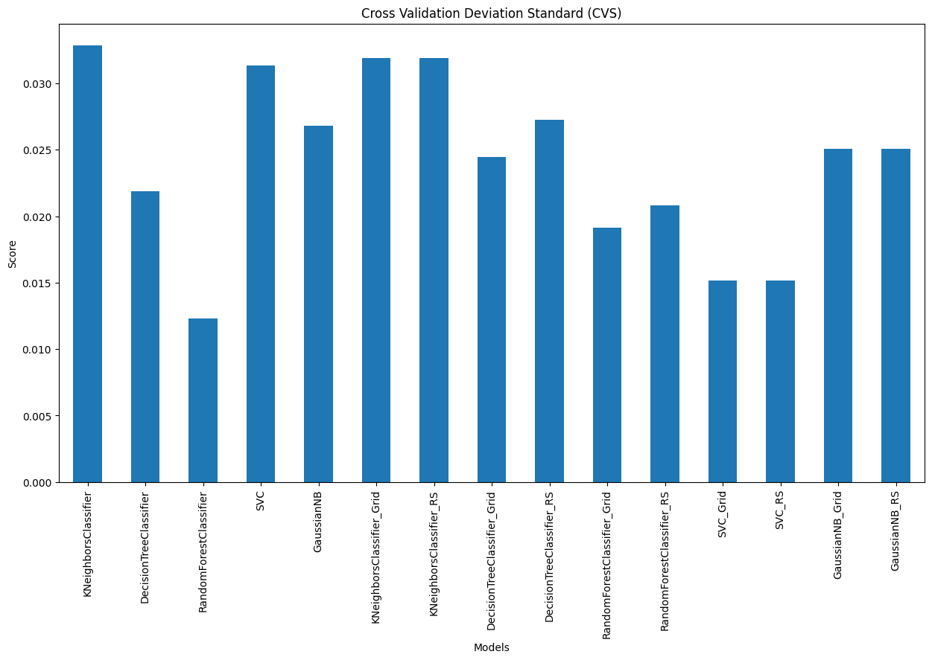
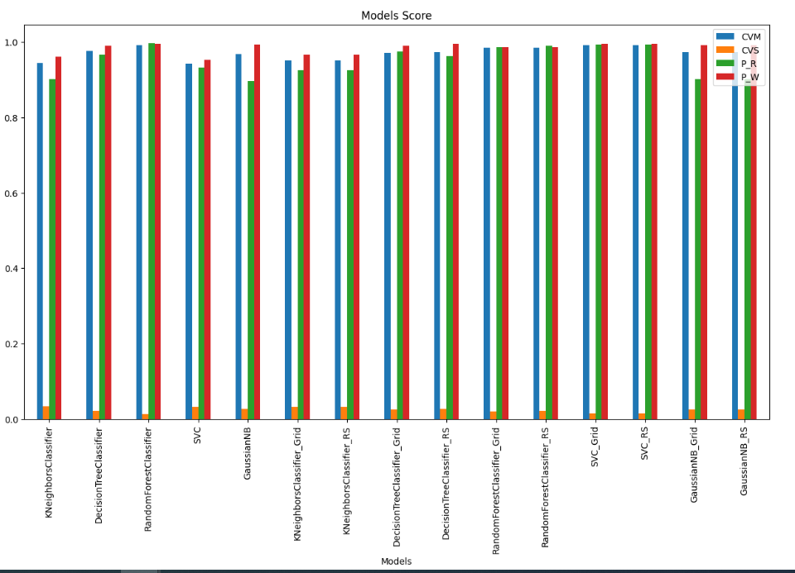
6. Hyperparameters Tuning using GridSearchCV and RandomizedSearchCV on each Model
After identifying which Hyperparameters have the best results, I applied them to the models. The comparison shows RandomForestClassifier has the best results:

Slide 22
Conclusion
The experience of working on this project helped me to understand how to approach very basic concepts of Data Science.
The more I learn, the more I want to implement new methods and visuals in my project. As well as try other platforms.
This is my first python project, and I really enjoyed the versatility of the language.
I am motivated to continue learning to start building my Data Science skills. I am planning to find an organization where I can volunteer to help with Data Science projects as an apprentice.
The source code for this project is available in my github account:
https://github.com/veronmoren/DSDP_Project/blob/main/Wine_Type_Classification_VMA.ipynb

Slide 23
Sources of information and support:
Intro to Python for Computer Science and Data Science: Learning to Program with AI, Big Data and The Cloud, Global Edition 1st Edition - Paul Deitel
Statistics in a Nutshell: A Desktop Quick Reference Second Edition -Sarah Boslaugh
Data Science from Scratch: First Principles with Python 2nd Edition - Joel Grus
The Manga Guide to Regression Analysis - Part of: Manga Guides
https://realpython.com/
Sklearn- Model Linear Regression: https://scikit-learn.org/stable/modules/generated/sklearn.linear_model.LinearRegression.html
Sklearn – Support Vector Regression: https://scikit-learn.org/stable/auto_examples/svm/plot_svm_regression.html
Wine Quality Prediction Using Machine Learning: https://www.analyticsvidhya.com/blog/2021/04/wine-quality-prediction-using-machine-learning/
Guide to Hyperparameters: https://analyticsindiamag.com/guide-to-hyperparameters-tuning-using-gridsearchcv-and-randomizedsearchcv/
https://www.ncei.noaa.gov/access/monitoring/climate-at-a-glance/global/time-series/globe/ocean/ytd/12/1880-2018
Wine Datasets: https://archive.ics.uci.edu/dataset/186/wine+quality
https://www.youtube.com/watch?v=BqDae4GPnu0
https://www.youtube.com/watch?v=jLtaqJe5fNM&t=290s
https://www.youtube.com/watch?v=W25TEa93T_I

Slide 24
thank you
Veronica Moreno

