Slide 1


Daniel Rozin
Veronica Raga

Slide 2
Daniel Rozin
Born in Jerusalem, lives in New York
Trained as an industrial designer
An artist, educator, and computer developer
Arts Professor at ITP, Tisch School Of The Arts, NYU
Working in the area of interactive digital art
Installations and sculptures
Change and respond to the presence and point of view of the viewer
Exhibited widely with solo exhibitions in the US and internationally
Featured in publications such as The New York Times, Wired, ID, Spectrum and Leonardo
Awards including Prix Ars Electronica, ID Design Review and the Chrysler Design Award.

Slide 3
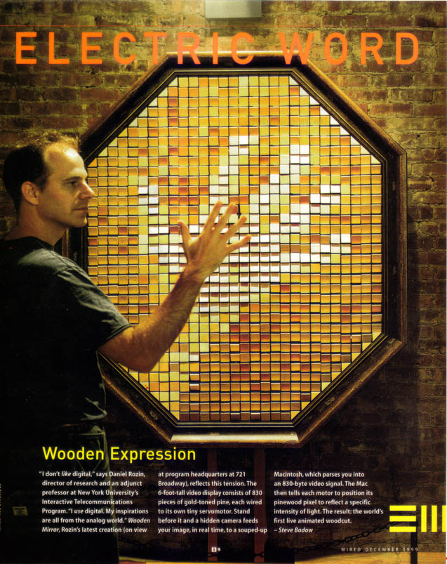
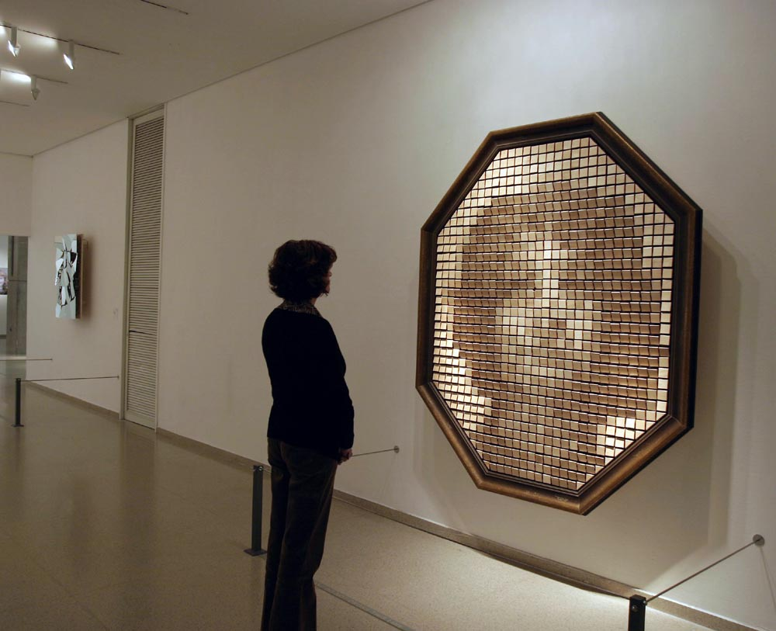
Wooden Mirror
Built in 1999
830 square pieces of wood, 830 servo motors, control electronics, video camera, computer, wood frame.
Size - W 67” x H 80” x D 10” (170cm , 203cm, 25cm).

Slide 4
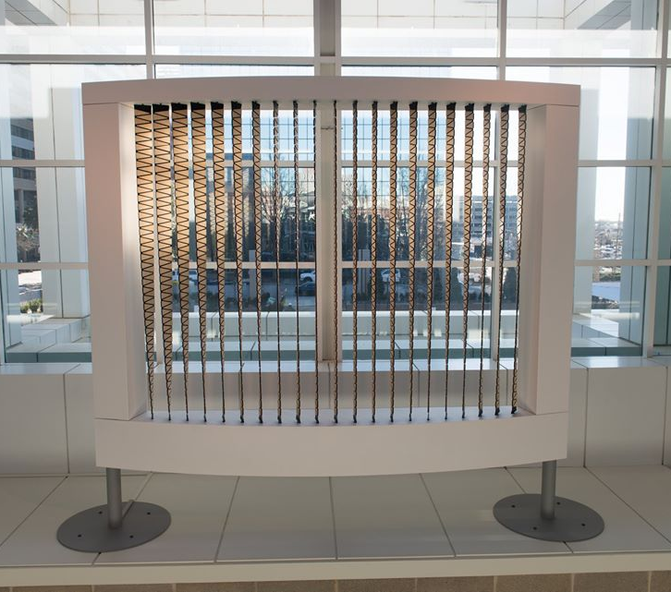
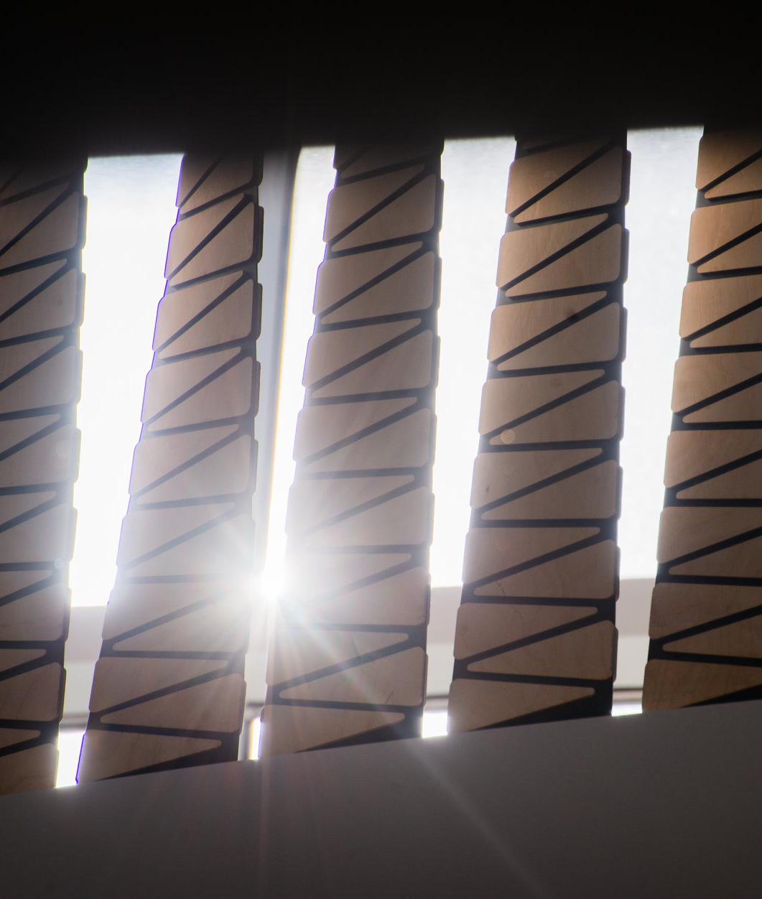
Phase
Built in 2019
Steel frame, 21 rubber and wood ribbons, 2 motors, control electronics, speakers
Height: 14 feet
21 twisting ribbons is generatively governed by the independent motion of two motors, yielding a continuously changing gradation of transparency and materiality
Sun from museum windows filters in, always shifting with the whims of weather, and sends patterns of light through the artwork into the Upper and Lower Atriums.

Slide 5
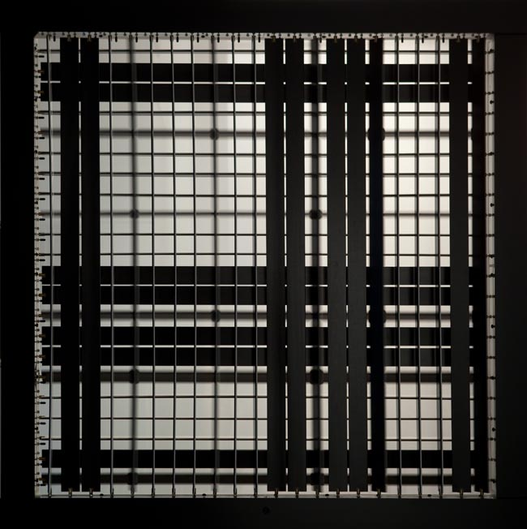
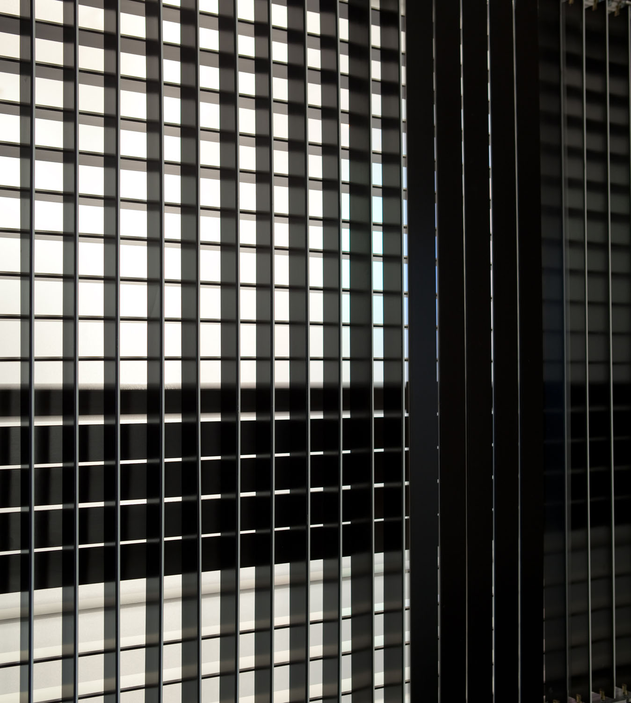
X by Y
Built in 2010
44 wooden slats,44 motors, video camera, control electronics.
Size: 54 inches H, 54 inches W, 3 Inches D
X by Y is an investigation into the idea of the grid. With this meager amount of visual information the piece is still able to create rich imagery, interaction and kinetic motion. The piece hangs in the middle of a space and can be viewed from both sides each the negative of the other.

Slide 6
