Slide 1
bENESHFinal Project
Cari Benesh
Data Structures
May 2, 2018

Slide 2
The Problem:
Every quarter I get a sales report for my district outlining product sales by vendor for every store in the chain. In its current format, I have to pull up each vendor one by one and search out my store rankings compared to the chain. I wanted a way to pull that information from the report and use a sort method to put the stores in descending order by profit.

Slide 3
The solution
I used ArrayLists, which are flexible in size, to store the data read from the files. Collection.sort() and Comparable() methods were used to sort the data by gross profit.

Slide 4
Remaining Challenges
As of now, I have a Link class set up, as well as VendorData and StoreData classes, that aren’t being used.
These are how, if I had been able to implement a GUI, I would have created filters for the full RankData ArrayList. For now all the data is in one large array list, but in its final form I would want results to be filtered by Vendor and by Store.

Slide 5
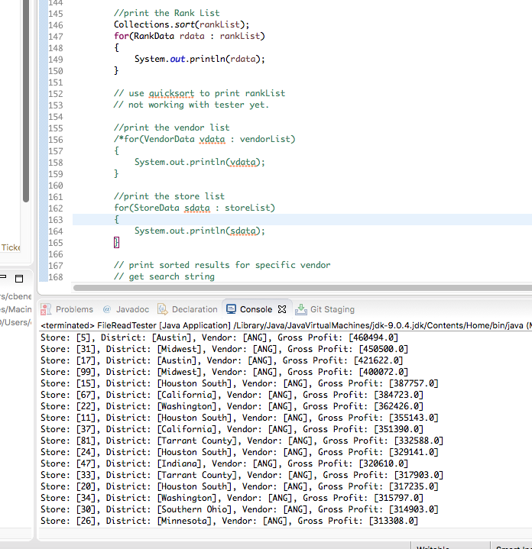
Program DEMO #1
Screen shot #1: open rankList print block and run program

Slide 6
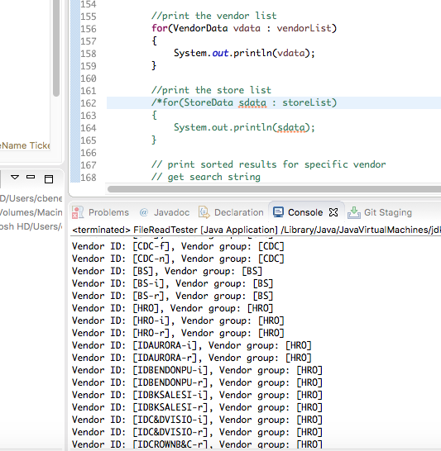
Program Demo #2
Screen Shot #2 Run vendorList print block

Slide 7
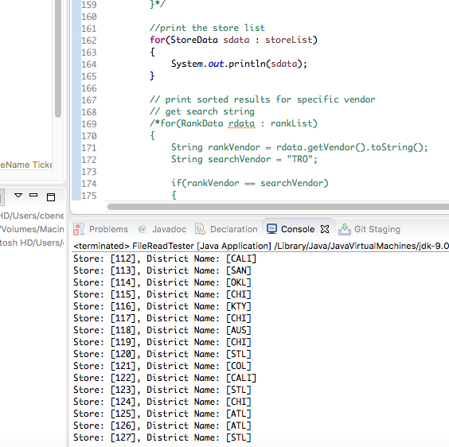
Program Demo #3
Screen Shot #3: run storeLIst print block

Slide 8
Github
https://github.com/verplow/NewRepoCariBenesh/

