Slide 1
Chapter 5 – JavaScript
#25 – Section 1
Node JS Installation

Slide 2
Windows Installation
Open your Web browser
Type http://nodejs.org in the address bar
Click on the button to down the latest version of Node JS Installer executable
After download, run the Node JS Installer executable
Accept terms, and defaults

Slide 3
Mac OS X/Linux Installation
Open your Web browser
Type http://nodejs.org in the address bar
Click on the button to down the latest version of Node JS Installer executable
How you run an executable may be different, but you know how to do that already

Slide 4
Verify Node JS Installation
Open a command line prompt
Windows users usually type ‘cmd’
Type “node” and press the enter key
If you get a prompt that loos like this “>”, then node is installed successfully
Type “1 + 2” and press enter key to get “3”
Type ctrl+c twice to exit Node JS

Slide 5
Chapter 5 – JavaScript
#26 – Section 2
Birth of a Program

Slide 6
Human to Computer
Before the computer can do anything, it has to be presented with instructions
Told what to do
Source Code or just Code
Programmer writes the Code
Optionally converts “code” to another format
Makes it easier for the computer to “understand”
understand => execute
This process is call “compiling”
Now the computer run the code

Slide 7
The Process
Idea
Code
write
what you wan the computer to do
instructions that is human readable
compile (convert)
Computer
Machine Language
execute
Give encoded instruction to computer to perform (execute/run)
Create a program by writing instructions that is human readable

Slide 8



The Process (cont.)
Human readable
code in a file
Compiler
Computer/machine
instructions in a file
execute

Slide 9
Example – Hello World in C++
Code
#include <iostream>
int main(int argc, char* argv[]){
cout << “Hello, world!” << endl;
}
Compile
g++ hello.cpp -o hello.exe
Execute
hello.exe

Slide 10
Example – Hello World in JavaScript
Code
console.log(“Hello, World!\n”)
Compile & Execute
node hello.js

Slide 11
Chapter 5 – JavaScript
#27 – Section 3
Getting The Code

Slide 12
How To Access The Code
Location: http://github.com/verrol/learn-computer-programming
Two Ways To Access The Code
Online with web browser
Point web browser to:
http://github.com/verrol/learn-computer-programming
Clone a copy to your computer using ‘git’
Command line, type the following:
git clone https://github.com/verrol/learn-computer-programming.git
Brackets

Slide 13
Chapter 5 – JavaScript
#28 – Section 4
Hello World

Slide 14
JavaScript
Core Features
High Level : easier to read and write code, gets rid of fluff/boilerplate, forgiving, …
Dynamic : allows extension and changes at runtime
Untyped : flexible in operations used on different types of data
Interpreted : No step for producing a binary executable or any other intermediate artifact
Reference:
https://en.wikipedia.org/wiki/JavaScript

Slide 15
“Hello World” Program
Purpose
One of the simplest complete program in a programming language
Feature
Demonstrates a number of features of the language
Structure
History
Traces back to languages in the C pedigree (B, BCPL)
Reference: https://en.wikipedia.org/wiki/%22Hello,_World!%22_program

Slide 16
hello.js
// My ‘hello world’ program in JavaScript
console.log(“Hello, World”)

Slide 17
A Breakdown Of ‘hello world’
Statement
Function call
Function argument(s)
Calling the ‘log’ function with arguments
Object
Eg: ‘console’
Membership Resolution
Using the ‘.’ or ‘dot’ operator
Eg: console.log()
Comments
Single line using //
Multi-line using /* … */

Slide 18
Basic Data Types
Bit
Representing a binary value or 2-value system
Byte : 8-bits
Character can be one or two bytes
Number
20
495.97
10e-8
String
“Hello, World\n”
‘Hi’

Slide 19
Chapter 5 – JavaScript
#29 – Section 5
Two Flavors Of JavaScript

Slide 20
Native Home Of JavaScript
Created for the Web browser
Works along side HTML and CSS
1 of the cornerstone technologies for Web programming, along with HTML and CSS

Slide 21
JavaScript In The Web Browser
<!DOCTYPE html>
<html>
<head>
<title></title>
</head>
<body>
<script>
console.log("hello world")
console.log("3 + 5 = ", 3 + 5)
</script>
</body>
</html>

Slide 22
JavaScript In The Web Browser (cont.)
<!DOCTYPE html>
<html>
<head>
<title></title>
</head>
<body>
<script>
alert("hello world")
alert("3 + 5 = ", 3 + 5)
</script>
</body>
</html>

Slide 23
Web Browser: JavaScript Console
Use for debugging and seeing code errors
<!DOCTYPE html>
<html>
<head>
<title></title>
</head>
<body>
<script>
console.log("hello world")
console.log("3 + 5 = ", 3 + 5)
</script>
</body>
</html>

Slide 24
Web Browser: JavaScript Console (cont.)
Open JavaScript Console
Chrome: View -> Developer -> JavaScript Console
Firefox: Tools -> Web Developer -> Web Console
Safari: http://bfy.tw/3pD2
Internet Explorer: Right-click, select “Inspect Element”, click “Console” tab.
In the console, type:
console.log("hello world")
console.log("3 + 5 = ", 3 + 5)

Slide 25
Interactive Web Pages
To simple examples of dynamic web pages:
Simple calculator using +, -, *, and /
Simple calculator with history

Slide 26
Browser Abstraction
Web Browser
JS
Engine

Slide 27
JS Engine Liberation
Web Browser
NodeJS Application
JS
Engine
JS
Engine

Slide 28
Chapter 5 – JavaScript
#30 – Section 6
Values & Variables

Slide 29
Definition: Value
What is a ‘value’?
Verrol’s definition:
A value is an abstraction to represent a computed result
Examples:
6
3.141592
‘verrol’
2016/01/26
new Date(2016, 1, 26)

Slide 30
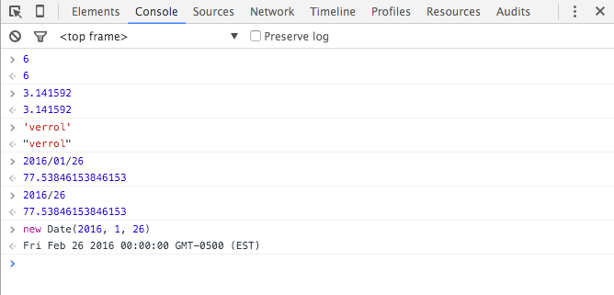
Demo: Values
Using the Brower JavaScript console:

Slide 31
Definition: Variable
What is a ‘variable’?
Verrol’s definition:
A variable is a named abstraction to recall or reference a value
Examples:
6
3.141592
‘verrol’
2016/01/26
new Date(2016, 1, 26)

Slide 32
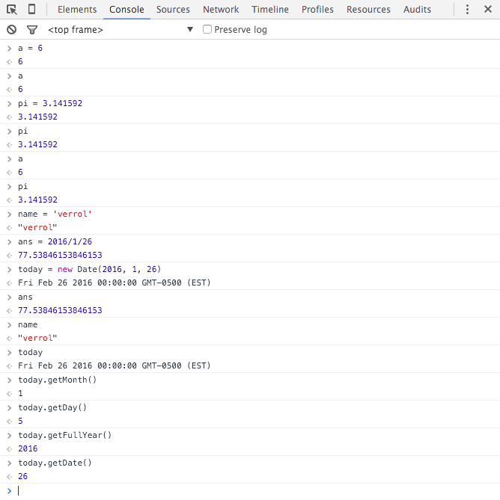
Demo: Variables
Using the Brower JavaScript console:

Slide 33
Chapter 5 – JavaScript
#31 – Section 7
Values, Variables, Data Types

Slide 34
Definition: Data & Data Type
What is ‘data’?
‘data’ is another name for ‘value’
The words ‘data’ and ‘value’ can be used interchangeably
What is ‘data type’?
Verrol’s definition:
A ‘data type’ is the format or representation of the data/value
In other words, it is the grouping of similar values
Examples:
Number
String
Date
Boolean

Slide 35
My Data Type Tree
Data Type
Number
Whole
Float
String
Boolean
Date
Container
Array
Function
Hash
Object

Slide 36




Example Data Types
Number
String
Boolean
Date

Slide 37


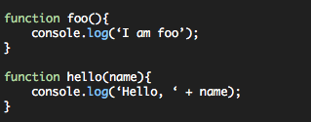
Example Data Types
Array
Hash
Function

Slide 38
Chapter 5 – JavaScript
#32 – Section 8
Functions

Slide 39
Definition: Functions
What is a ‘function’?
Verrol’s definition:
A ‘function’ ’ is a name given to a collection/set of statements
What are the benefits of functions?
Reuse
Organization
Abstraction

Slide 40
Function Syntax
Named Function
Compact Syntax
function name([argument list]){
body
}
Argument List
Optional comma separated list of variable names
Body
One or more statements

Slide 41
Function Syntax
Named Function
Expanded
function name([arg0, arg1, …, argN]){
statement0;
statement1;
...
statementN;
}

Slide 42
Function Syntax
Anonymous Function
Compact Syntax
var name = function([argument list]){
body
}
Expanded
var name = function([arg0, arg1, …, argN]){
statement0;
statement1;
...
statementN;
}

Slide 43
My Data Type Tree
Data Type
Number
Whole
Float
String
Boolean
Object
Date
Container
Array
Hash
Function

Slide 44
Using Functions
Function Name followed by ‘(‘ and ‘)’
If functions doesn’t require arguments/parameters, leave the parameter list empty
Definition:
function name ([argument list]){
body
}
Usage:
name([…])

Slide 45
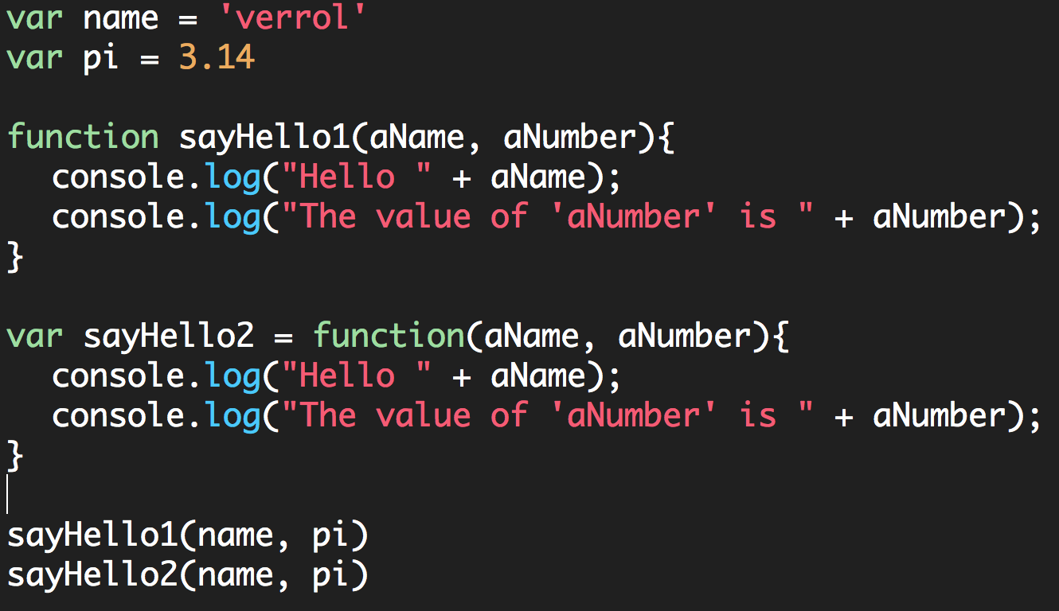
Example-01

Slide 46
Chapter 5 – JavaScript
#33 – Section 9
Functions : More On Usage

Slide 47
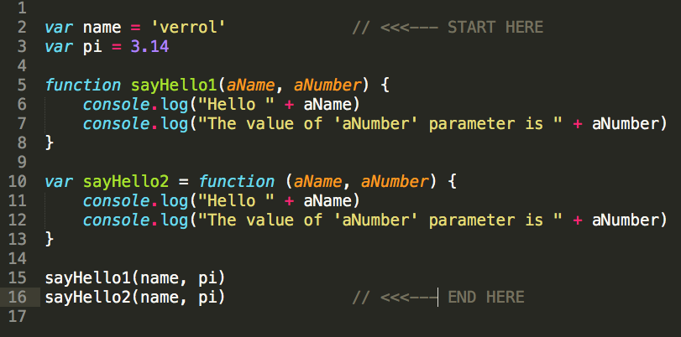
C05S08 : Example-01.js

Slide 48
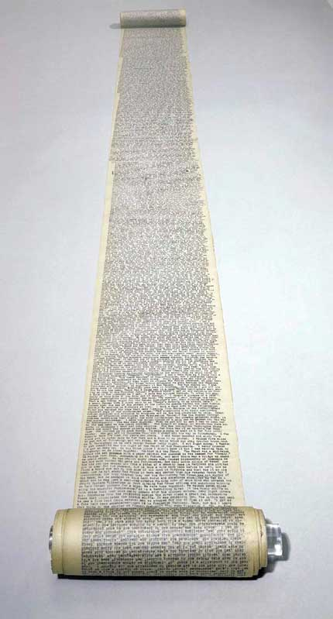
Your Awesome Program
START
END

Slide 49
Your Awesome Program
START
Repetition
END

Slide 50
Introduce Function(s)
START
foo()
Repetition
END

Slide 51
Introduce Function(s)
START
foo()
Repetition
END

Slide 52
Chapter 5 – JavaScript
#34 – Section 10
Containers: Arrays

Slide 53
Problem
Record Temperature reading at 8am, 12pm, and 6pm for a week
Day 1: 80°, 83°, and 76°
Day 2: 79°, 83°, and 79°
Day 3: 80°, 85°, and 80°
Day 4: 81°, 87°, and 79°
Day 5: 72°, 79°, and 75°
Day 6: 75°, 79°, and 72°
Day 7: 81°, 88°, and 77°

Slide 54
Definition: Array
What is a ‘array’?
Verrol’s definition:
An ‘array’ is a name given to a collection/set of values
What are the benefits of arrays?
Grouping of related values

Slide 55
Why Arrays?
Record Temperature reading at 8am, 12pm, and 6pm for a week
Day 1: 80°, 83°, and 76°
Day 2: 79°, 83°, and 79°
Day 3: 80°, 85°, and 80°
Day 4: 81°, 87°, and 79°
Day 5: 72°, 79°, and 75°
Day 6: 75°, 79°, and 72°
Day 7: 81°, 88°, and 77°

Slide 56
Why Arrays?
Day 1: 76°, 81°, 79°
Day 2: 79°, 83°, 80°
Day 3: 80°, 85°, 80°
Day 4: 81°, 87°, 79°
Daily Grouping
Day 5: 72°, 79°, 75°
Day 6: 75°, 79°, 72°
Day 7: 81°, 88°, 77°

Slide 57
Why Arrays?
Day 1: 76°, 81°, 79°
Day 2: 79°, 83°, 80°
Day 3: 80°, 85°, 80°
Day 4: 81°, 87°, 79°
Weekly Grouping
Day 5: 72°, 79°, 75°
Day 6: 75°, 79°, 72°
Day 7: 81°, 88°, 77°

Slide 58
Array Syntax
Simple/Compact Syntax
[element0, element1, element2, …, elementN]
Formal Syntax
new Array(element0, element1, element2, …, elementN)

Slide 59
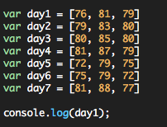

Basic Array Usage

Slide 60
Conclusion
What have we learned?
Arrays are useful for group related values
Creating an array is fairly simple
JavaScript’s console.log() function knows how to print an array

Slide 61
Chapter 5 – JavaScript
#35 – Section 11
Arrays: More On Usage

Slide 62
Topics
How to access elements of an array?
How to count the elements in an array?
How to modify an array, add/remove elements?

Slide 63
Why Arrays?
Record Temperature reading at 8am, 12pm, and 6pm for a week
Day 1: 80°, 83°, and 76°
Day 2: 79°, 83°, and 79°
Day 3: 80°, 85°, and 80°
Day 4: 81°, 87°, and 79°
Day 5: 72°, 79°, and 75°
Day 6: 75°, 79°, and 72°
Day 7: 81°, 88°, and 77°

Slide 64
Why Arrays?
Day 1: 76°, 81°, 79°
Day 2: 79°, 83°, 80°
Day 3: 80°, 85°, 80°
Day 4: 81°, 87°, 79°
Daily Grouping
Day 5: 72°, 79°, 75°
Day 6: 75°, 79°, 72°
Day 7: 81°, 88°, 77°

Slide 65
Basic Array Usage
Day 1: 76°, 81°, 79°
Day 2: 79°, 83°, 80°
Day 3: 80°, 85°, 80°
Day 4: 81°, 87°, 79°
Day 5: 72°, 79°, 75°
Day 6: 75°, 79°, 72°
Day 7: 81°, 88°, 77°

Slide 66
An Array Illustrated
Individual values
Array: named grouping
Elements
0
1
2
3
4
5
Index: element address
6
length
0
1
2
3
4
5

Slide 67
Access Elements of An array
Use the ‘[]’, the array ‘index operator’
Access an element:
array[index]
* Index: an integer value
Length or count of array elements:
array.length
* Return an integer value

Slide 68
Conclusion
How to access elements of an array using ‘[]’, the array index operator
How to get the length of an array using the ‘length’ property
Resources:
Mozilla Developer Network – Array Documentation
https://developer.mozilla.org/en-US/docs/Web/JavaScript/Reference/Global_Objects/Array

Slide 69
Chapter 5 – JavaScript
#36 – Section 12
Arrays: Add/Remove Elements

Slide 70
Topics
How to modify an array’s?
Grow or shrink an array

Slide 71
An Array Illustrated
Front
End
0
1
2
3
4
5

Slide 72
Grow : Add Element(s)
Front
2
3
4
5
6
7
End
0
1
2
3
4
5
Add to
front
1
2
3
4
5
6
7
0
1
2
3
4
5
6
2
3
4
5
6
7
8
Add to
end
0
1
2
3
4
5
6
0
1
2
3
4
5
6
Add at index-X

Slide 73
Shrink: Remove Element(s)
Front
1
2
3
4
5
6
End
0
1
2
3
4
5
Remove
From front
1
2
3
4
5
6
0
0
1
2
3
4
1
2
3
4
5
6
Remove
From end
0
1
2
3
4
5
1
2
4
5
6
0
1
2
3
4
Remove at index-X

Slide 74
Array ‘end’ Operations
Add elements to the end of an array:
Array.push(<value>)
Add to
end
0
1
2
3
4
5
6
Add elements to the end of an array:
Array.pop()
1
2
3
4
5
6
Remove
From end
0
1
2
3
4
5

Slide 75
Array ‘front’ Operations
Add elements to the end of an array:
Array.unshift(<value>)
Add to
front
1
2
3
4
5
6
7
0
1
2
3
4
5
6
Add elements to the end of an array:
Array.shift()
Remove
From front
1
2
3
4
5
6
7
0
0
1
2
3
4
6

Slide 76
Chapter 5 – JavaScript
#37 – Section 13
Arrays: Advance Usage

Slide 77
Topics
What are some of the other Array operations available?
forEach()
every()
map()
filter()
And more

Slide 78
forEach()
0
1
2
3
()
()
()
()

Slide 79
Print Temperature Taken per Day
76
81
79
0
1
2
(…)
(…)
(…)
It was 79 deg at 6pm
It was 81 deg at 12pm
It was 76 deg at 8am

Slide 80
reduce()
0
1
2
3
4
5
Reduce()

Slide 81
Average Daily Temperature
(76 + 81 + 79)/3 => 236/3 => 78.67
76
81
79
0
1
2
sum()
236

Slide 82
Conclusion
Array are very cool
Fairly easy to use
Flexible
Provides a number of useful methods out of the box
Resources:
Mozilla Developer Network – Array Documentation
https://developer.mozilla.org/en-US/docs/Web/JavaScript/Reference/Global_Objects/Array

Slide 83
Chapter 5 – JavaScript
#38 – Section 14
Objects: Introduction

Slide 84
Topics
What is an Object?
What kind of data/values can be stored in Objects?
Where can Objects be used?
And more…

Slide 85
Problem
Record the name, age, date-of-birth, and favorite foods for some family and friends:
Name | Age | DoB | Favorite Foods
Bob | 13 | 2003/01/23 | Pizza and Hamburgers
Clint | 43 | 1972/10/01 | Chinese, Italian, and Mexican
Uri | 57 | 1958/08/12 | Pizza, Hot dogs, and Steaks
Frank | 23 | 1992/05/09

Slide 86
Observation About The Data
We could create a variable name, age, etc each holding an array of the set of data.
Pro: Seems straight forward
Con: Not easy to get all the values for one person
We could create an array for each person
Pro: groups related data
Con: would still have to remember which index holds which type of data
Name | Age | DoB | Favorite Foods
Bob | 13 | 2003/01/23 | Pizza and Hamburgers
Clint | 43 | 1972/10/01 | Chinese, Italian, and Mexican
Uri | 57 | 1958/08/12 | Pizza, Hot dogs, and Steaks
Frank | 23 | 1992/05/09

Slide 87
As An Array
index
value
0
“Bob”
1
13
2
new Date(2013, 0, 23)
3
[“Pizza”, “Hamburger”]

Slide 88
Key and Value
key
value
name
“Bob”
age
13
dob
new Date(2013, 0, 23)
ffood
[“Pizza”, “Hamburger”]

Slide 89
Object
Object
name
“Bob”
age
13
dob
new Date(2013, 0, 23)
ffood
[“Pizza”, “Hamburger”]

Slide 90
Definition: Object
What is a ‘object’?
Verrol’s definition:
An ‘object’ is a name given to a collection/set of properties. Where each property is a {key, value} pair.
What are the benefits of objects?
Grouping of related values accessible by user defined keys.

Slide 91
Object
Object
name
“Bob”
Property
age
13
dob
new Date(2013, 0, 23)
ffood
[“Pizza”, “Hamburger”]

Slide 92
Object Syntax
Simple/Compact Syntax
{keyA: valueA, keyB: valueB, keyC: valueC, …, propertyN}
Formal Syntax
var obj = new Object()
obj.keyA = valueA
obj.keyB = valueB
...

Slide 93
Access Elements of An object
Use the ‘[]’, the ‘index operator’
If the key is not a simple string:
object[key]
* key: any computed value
Use the ‘.’, the ‘dot operator’:
object.key
* key: property name

Slide 94
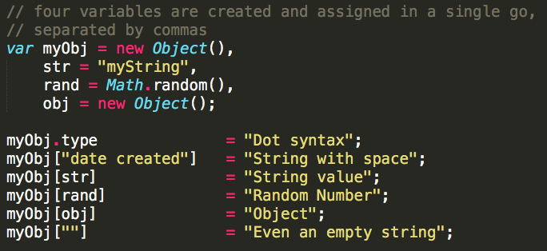
Property Name or Key
Can be anything, but must be specified in a way to avoid ambiguity.
Examples:

Slide 95
Conclusion
Objects are very cool
Fairly easy to use
Flexible
Resources:
Mozilla Developer Network – Object Documentation
https://developer.mozilla.org/en-US/docs/Web/JavaScript/Reference/Global_Objects/Object

Slide 96
Chapter 5 – JavaScript
#39 – Section 15
Objects: “Everything” Is An Object

Slide 97
Topics
Is everything really an ‘objet’?
Playing with Objects

Slide 98
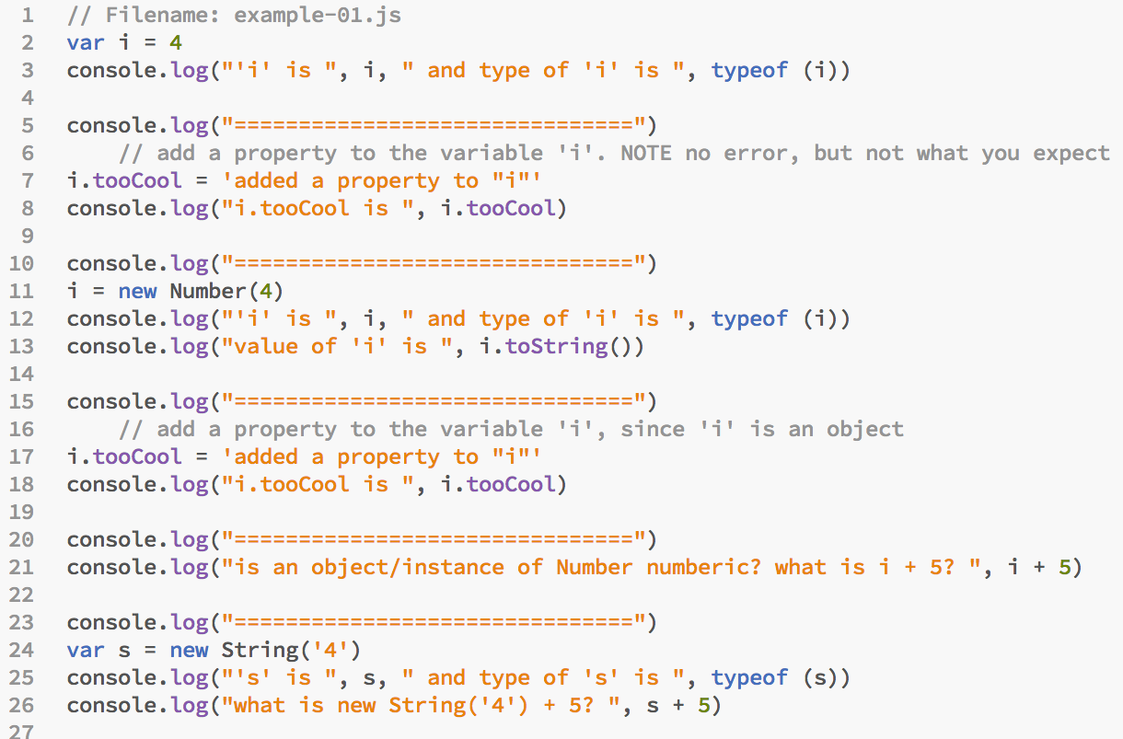
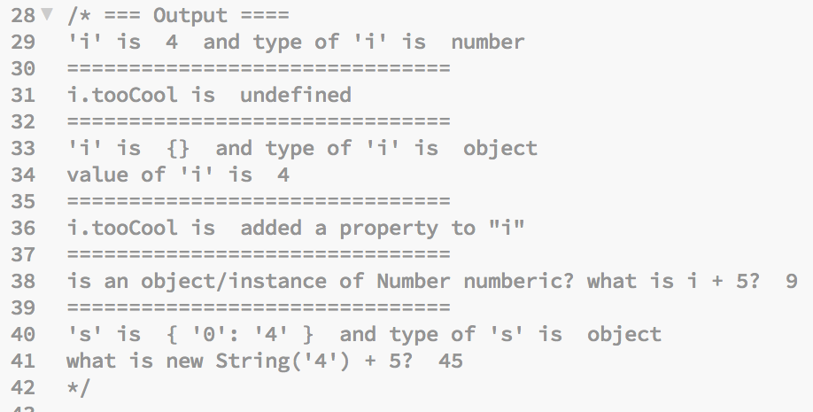

Slide 99
Classification
Animal
Dog
Cat
Human

Slide 100
JavaScript Value Type Class Hierarchy
Object
Number
Array
Function
Date
String

Slide 101
Class vs. Instance/Object
Class | Instance/Object | Notes
Dog | Rex | A dog name ‘Rex’
Number | 5, a | To examples or instances of the Number type. ‘a’ is a variable containing a numeric value, and ‘5’ is itself a number
String | “all men are created”

Slide 102

Recipe vs. Product
Cake recipe
Preparation & Baking
Product = Cake
Class
Create instance using ‘new’
Instance

Slide 103
Creating Instances in JavaScript
Class | Instance/Object | Notes
Object | {} | An instance of the generate Object class
Array | [] | An instance of the specific class ‘Array’
Number | new Number(5) | An instance of the Number class to represent a numeric value
Function | new foo() | An instance of the ‘foo’ function

Slide 104
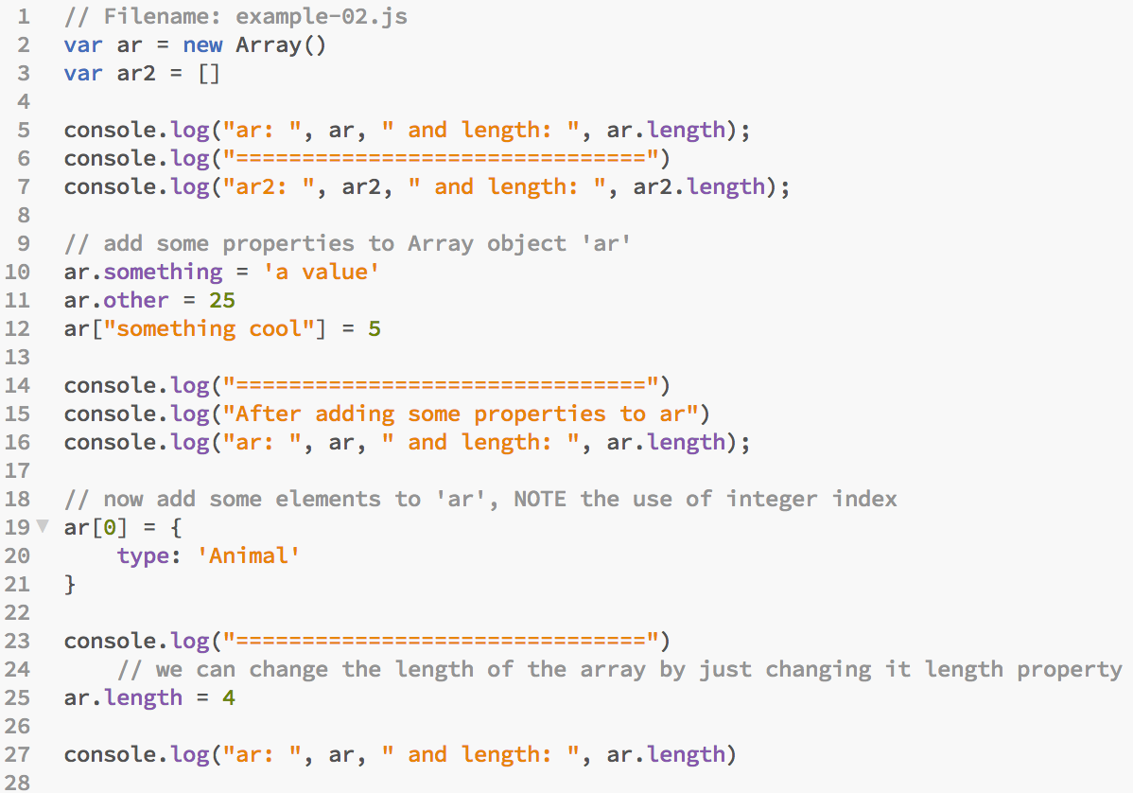
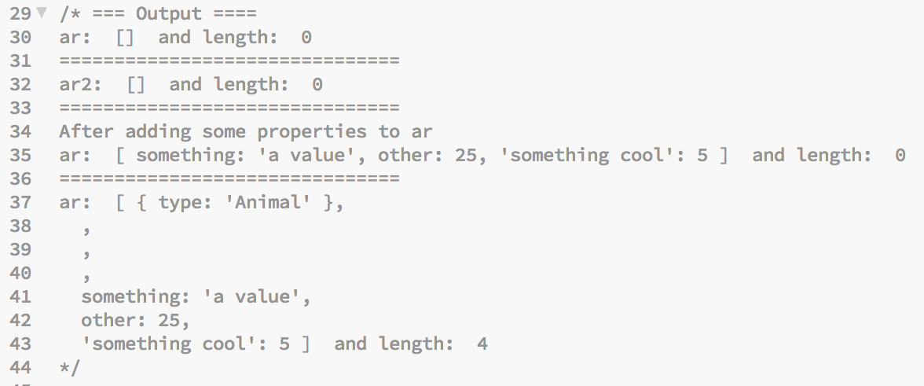

Slide 105
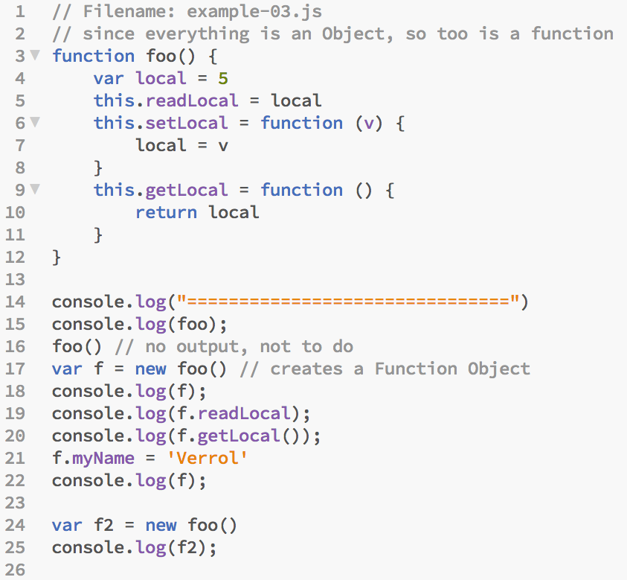
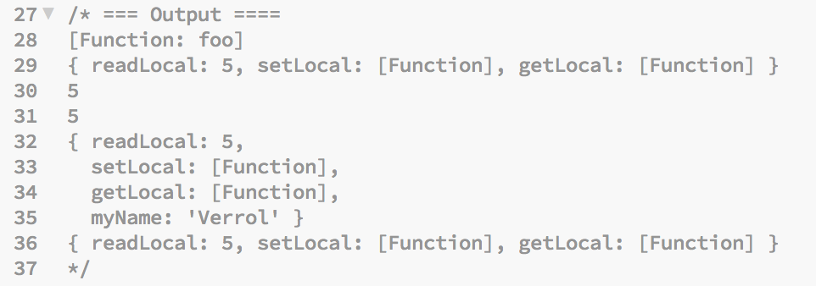

Slide 106
Conclusion
Objects are awesome
A bit confusing
But still flexible
Resources:
Mozilla Developer Network – Object Documentation
https://developer.mozilla.org/en-US/docs/Web/JavaScript/Reference/Global_Objects/Object

Slide 107
Chapter 5 – JavaScript
#40 – Section 16
Control Flow – If Statement

Slide 108
Topics
What is ‘Control Flow’?
The ‘if’ Statement

Slide 109
c05s39 – Example-03.js

Slide 110
Our Programs So Far
Start
Statement 1
Statement 2
Statement 3
Statement …
Statement N
End

Slide 111
What “if”?
Instead of this
You want this
true
false

Slide 112
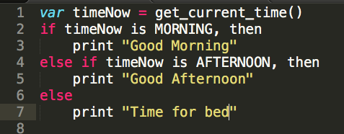
Changing the Flow
What if we wanted a program that prints an appropriate greeting based on the time of day?
A program like that might look this in pseudo code (not quite code):

Slide 113
Definition: Control Flow
What is ‘Control Flow’?
Verrol’s definition:
A mechanism/way to alter/change the order in which statements are executed
Control Flow allows some of the following to occur for one statement or a statement block:
Skipped
Execute only once
Execute multiple times

Slide 114
Skip
Start
Statement 1
Statement 2
Statement 3
Statement …
Statement N
End

Slide 115
Choosing One of Two Paths
Start
Statement 1
Statement 2
Statement 3
Statement …
Statement N
End

Slide 116
Choosing One Of Many Paths
Start
Statement 1
Statement A
Statement …
Statement Z
Statement …
Statement N
End

Slide 117
The ‘if’ Statement
Formal syntax:
if (condition) block
else if (condition) block
…
else block
Where:
‘condition’ is an expression that evaluates to the boolean type true or false

Slide 118
Conclusion
Control Flow gives the programmer the ability to write more sophisticated and elegant programs
The ‘if’ statement is one of the most often used control-flow statement
The ‘if’ statement allows for the execution of different branches in the program

Slide 119
Chapter 5 – JavaScript
#41 – Section 17
Control Flow – Switch Statement

Slide 120
Topics
The ‘switch’ Statement
Understanding Fall-through

Slide 121
Choosing One Of Many Paths
Start
Statement 1
Statement A
Statement …
Statement Z
Statement …
Statement N
End

Slide 122
The ‘switch’ Statement
Formal syntax:
switch(expressionA) {
case expression1:
Statement(s)
break
case expression2:
Statement(s)
break
…
default:
Statement(s)
break
}

Slide 123
‘if’ vs. ‘switch’ Statement
if (condition){
Statement(s)
}
else if (condition) {
Statement(s)
}
…
else {
Statement(s)
}
switch(expressionA) {
case expression1:
Statement(s)
break
case expression2:
Statement(s)
break
…
default:
Statement(s)
break
}

Slide 124
Case ‘fall-through’
Start
Statement 1
Case A
Statement …
Case B
Statement …
Case C
Statement …
Statement N
End

Slide 125
Conclusion
A ‘switch’ statement can be used in place of a multi-condition ‘if’ statement
The ‘switch’ statement provides ‘fall through’, but it must be used with care

Slide 126
Chapter 5 – JavaScript
#42 – Section 18
Control Flow: For and While Loops

Slide 127
Repeat/Loop
Start
Statement 1
Statement …
Statement …
Statement N
End

Slide 128
Topics
The ‘while’ Loop Statement
The ‘for’ Loop Statement

Slide 129
The ‘while’ Statement
Formal syntax:
while(condition){
Statement 1
..
Statement N
}
Where:
Condition is an expression that evaluates to the boolean type true or false
NOTE: If the ‘condition’ for the ‘while’ loop is not updated within the loop, it will be an infinite loop

Slide 130
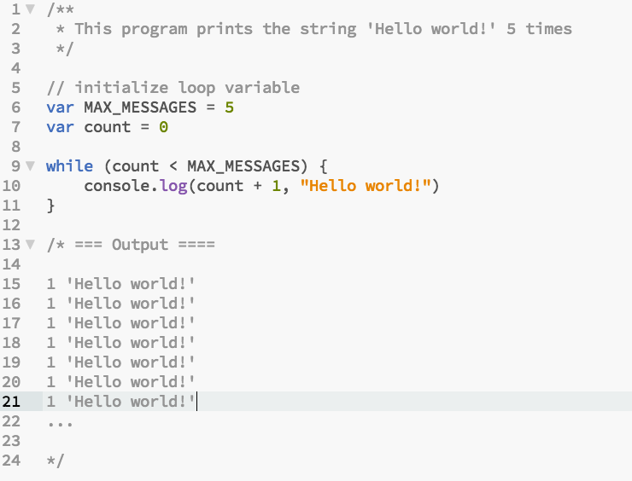
Example-01.js

Slide 131
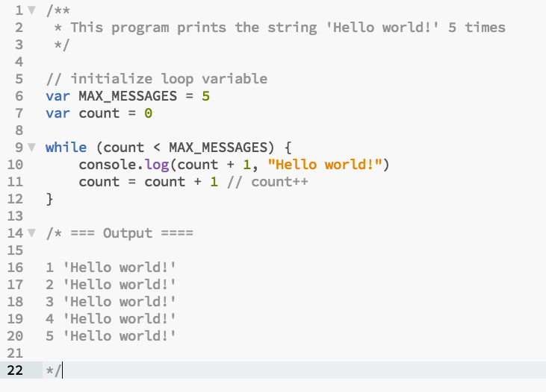
Example-02.js

Slide 132
Loop Breakdown

Slide 133
The ‘for’ Statement
Formal syntax:
for(initialization; condition; update){
Statement 1
..
Statement N
}
Where:
‘initialization’ gets executed ONLY once at the beginning of the ‘for’ loop
‘condition’ gets tested to determine if the block of statement is executed
‘update’ gets executed after block of statement

Slide 134
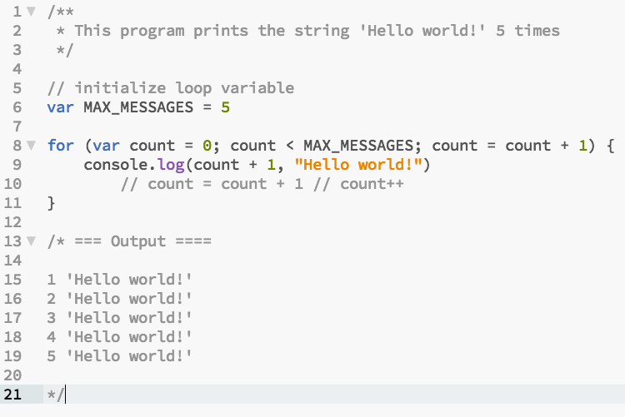
Example-03.js

Slide 135
‘for’ Loop Pitfall
Don’t update ‘for’ loop condition variable(s) multiple times in loop iteration

Slide 136
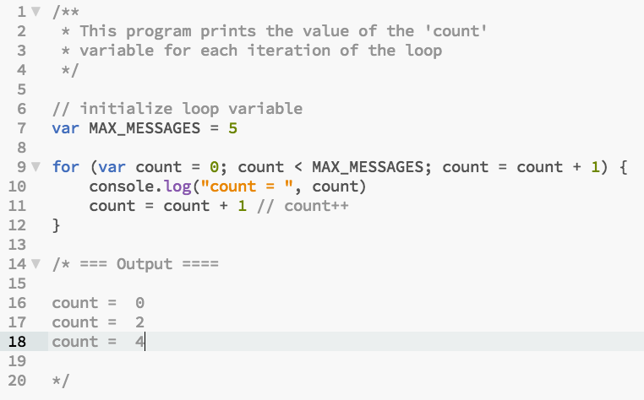
Example-04.js

Slide 137
‘for’ Loop Variation
All parts of the ‘for’ loop statement is optional
Provides flexibility in when to initialize
When to test and exit loop
When to perform condition variable(s) updates

Slide 138
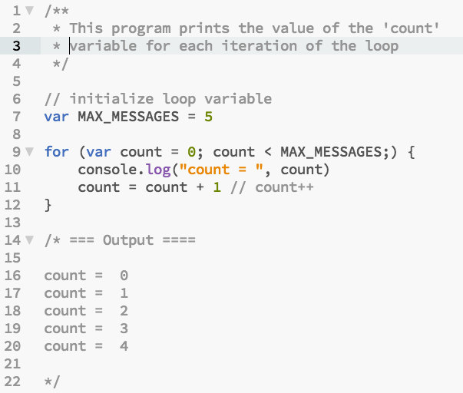
Example-05.js

Slide 139
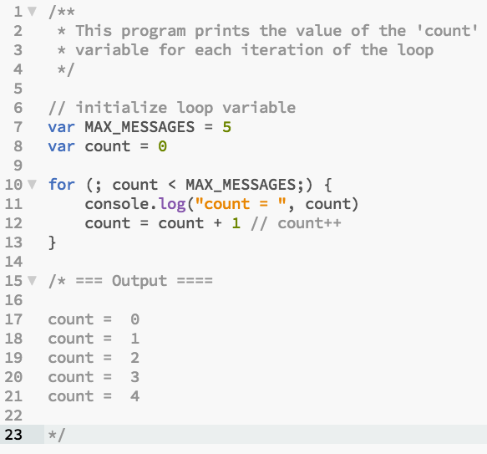
Example-06.js

Slide 140
Using ‘continue’ in Loops
The ‘continue’ keyword in a loop is used to skip one or more iteration

Slide 141
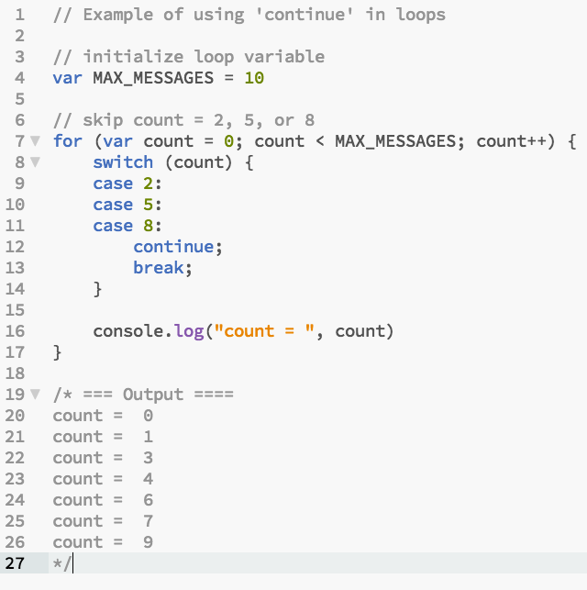
Example-07.js

Slide 142
‘infinite’ Loop
An ‘infinite’ loop is used when:
The number of iterations is not known at loop ‘initialization’
Possible an external condition will be used to ‘break’ out of the loop
Some form of complex computation will be used to ‘break’ out of the loop
The developer wishes to express the intend that this loop will not terminate

Slide 143
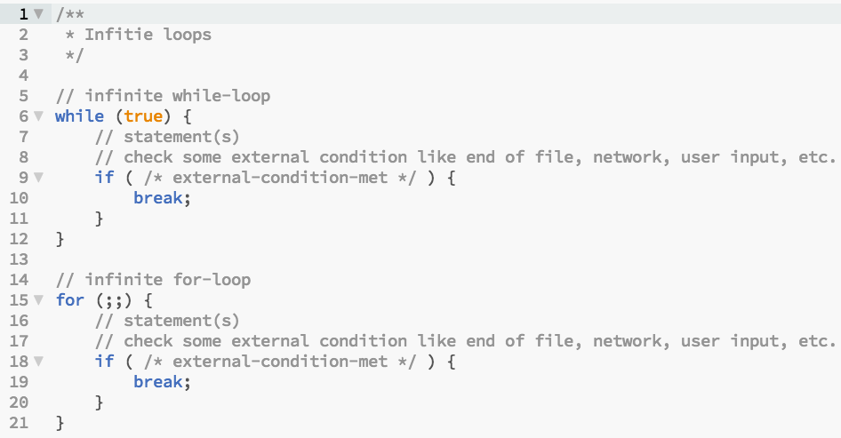
Example-08.js

Slide 144
Chapter 5 – JavaScript
#43 – Section 19
Statements and Expressions

Slide 145
Topics
Statements
Expressions
Types of Expressions
Reference:
MDN Statements and Declarations: https://developer.mozilla.org/en-US/docs/Web/JavaScript/Reference/Statements
MDN Expressions and Operators: https://developer.mozilla.org/en-US/docs/Web/JavaScript/Reference/Operators

Slide 146
Program
Program
Statement
Statement
Statement
…
Statement

Slide 147
Statement
Statement
Expression
Non-Expression
Contain Expression(s)
NOTE:
A statement can span multiple lines. For example, ‘if’ and ‘for’ statements.
Multiple statements can be on one line if separated by ‘;’.

Slide 148
Definition : Expression
What is an ‘Expression’?
Verrol’s definition:
When evaluated/computed, an expression produces a single value
Some Process
value
Expression
NOTE: An expression’s value can always be assigned to a variable.

Slide 149
Definition: Value
A value is an abstraction to represent a computed result
A variable is a named abstraction to recall or reference a value

Slide 150
Example : Expressions
Single value
5
‘verrol’
Mathematical
5 + 9
x * 20
Relational
x < 10
i > 20
Logical
(i > 20) || (x < 10)
isOpen && isValid
Bitwise
0x100FFA | 0x100B
0x3920A & 0x4
Functional
function() { … }
i++

Slide 151
Logical Operator: AND, &&
Operand 1 | Operand 2 | Result
True | True | True
True | False | False
False | True | False
False | False | False

Slide 152
Logical Operator: OR, ||
Operand 1 | Operand 2 | Result
True | True | True
True | False | True
False | True | True
False | False | False

Slide 153
Logical Operator: NOT, !
Operand | Result
True | False
False | True

Slide 154
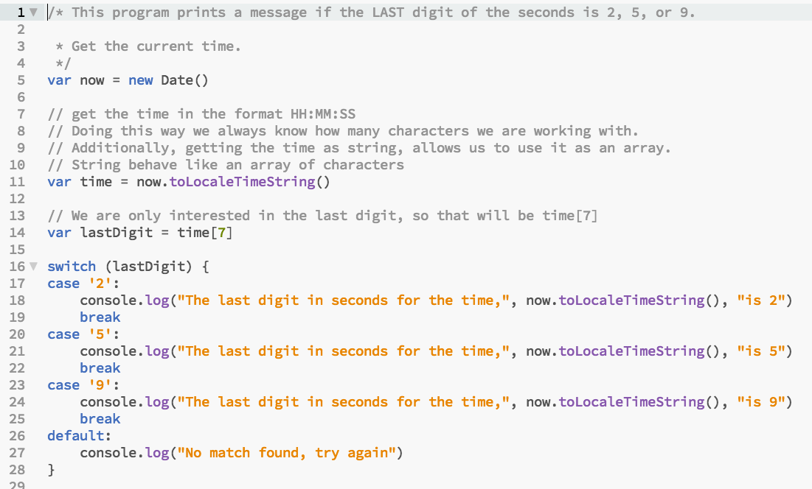
C05S17 - Example-01.js

Slide 155
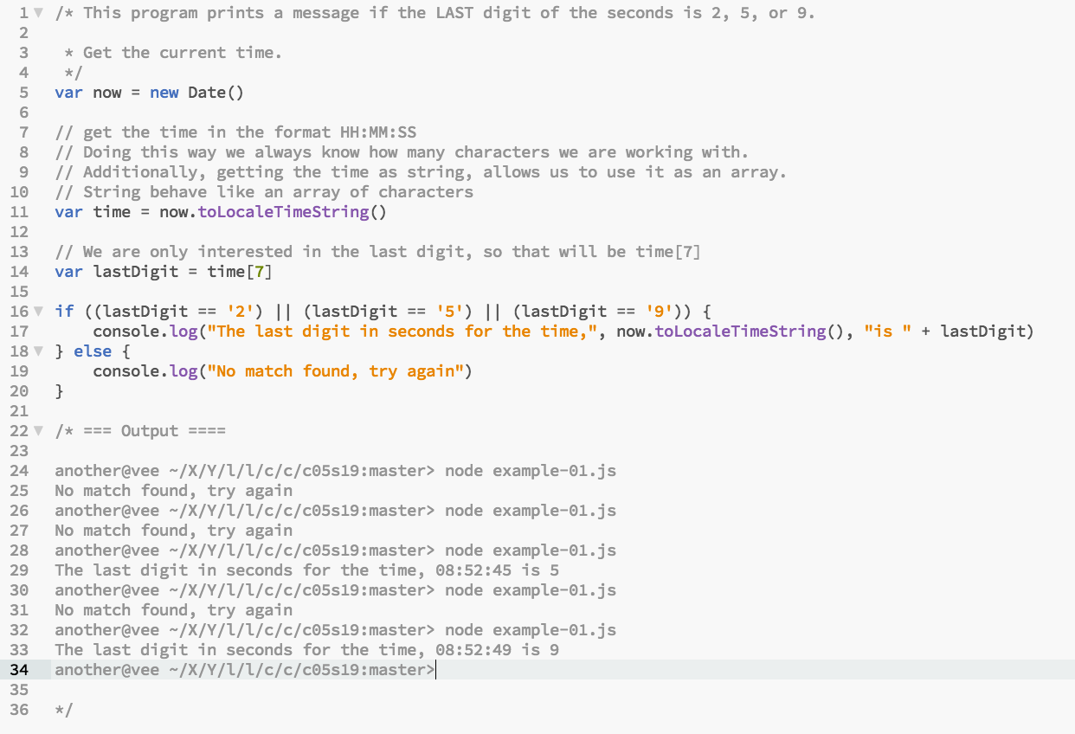
Example-01.js

Slide 156
C05S18 - Example-07.js

Slide 157
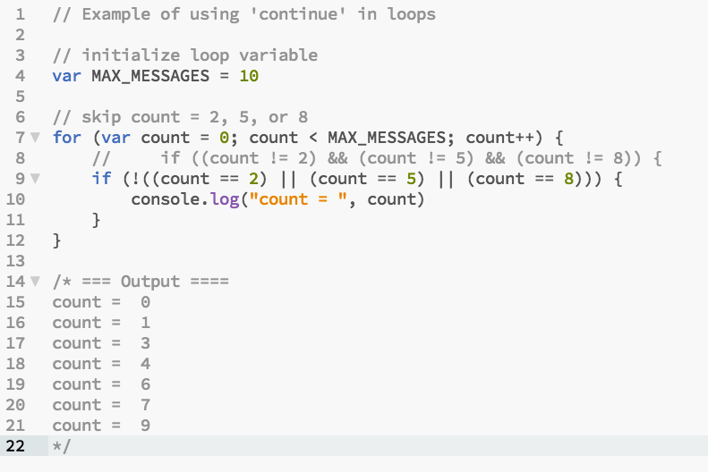
Example-02.js

Slide 158
Truth Table
Count | Count == 2 | Count == 5 | Count == 8 | ! (…) | Result
0 | F | F | F | T | T
1 | F | F | F | T | T
2 | T | - | - | F | F
3 | F | F | F | T | T
4 | F | F | F | T | T
5 | F | T | - | F | F
6 | F | F | F | T | T
7 | F | F | F | T | T
8 | F | F | T | F | F
9 | F | F | F | T | T

Slide 159
Chapter 5 – JavaScript
#44 – Section 20
Serialization With JSON

Slide 160
Topics
What is Serialization?
What is JSON
Reference:
JSON Specification: http://www.json.org/

Slide 161
Problem: Exchanging Values
How to get the value of a computation in computer A to computer B?
Computer A
channel
Computer B
NOTE: The ‘channel’ is just an abstraction for how the two computers
are connected.
Examples:
USB drive/disk
Email
CD/DVD/Tape
Network
Etc.

Slide 162
Definition : Serialization
What is ‘Serialization’?
Verrol’s definition:
A method of transforming values in computer memory to a representation suitable for computer-to-computer interchange.
Value
Format X
Value
Format A
channel
Value
Format A

Slide 163
Demo
Simple value Serialization:
Example-01.js
Nested JavaScript Object Serialization:
Example-02.js
Deserialization:
Example-03.js

Slide 164
Conclusion
Serialization, and by extension de-serialization, gives you the ability to easily transfer values from one computer to another.

Slide 165
Chapter 5 – JavaScript
#45 – Section 21
MISC: Variable Scope

Slide 166
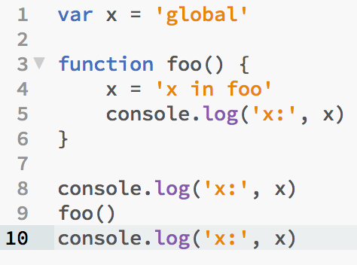
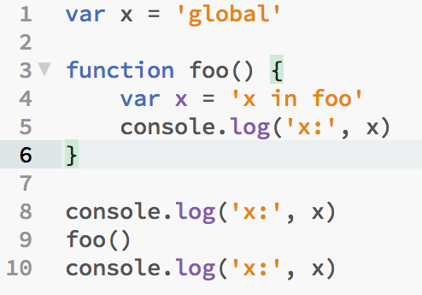
What Is Going On Here?
Example-01.js
Example-02.js
x: global
x: x in foo
x: x in foo
x: global
x: x in foo
x: global

Slide 167
Topics
Variable Scope
Global
Non-Global
Execution Context (or Environment)
Browser Client
NodeJS Application

Slide 168
Variable Scope
A ‘scope’ is a logical home for variables
Each variable below to one and only one ‘scope’
Scope can be nested, but never overlap
Variable resolution start from inner to outer/parent scope
There is always one scope present, the ‘global’ scope
Reference: http://speakingjs.com/es5/ch16.html

Slide 169
Global Scope
Always present
Contains variables (objects and properties) provided by the environment

Slide 170
JS Engine Liberation
Web Browser
NodeJS Application
JS
Engine
JS
Engine
Where is my JavaScript running?

Slide 171
Global Variables
Web Browser | NodeJS
console | console
document | __dirname
window | __filename
 | module

Slide 172
Demo
JavaScript in the browser
Example-03.html
JavaScript in NodeJS
Example-04.js
Example-05.js

Slide 173
Non-Global Scope
Scope created by a Function
Functions are first-class citizens in JavaScript
Functions are used to define Classes

Slide 174
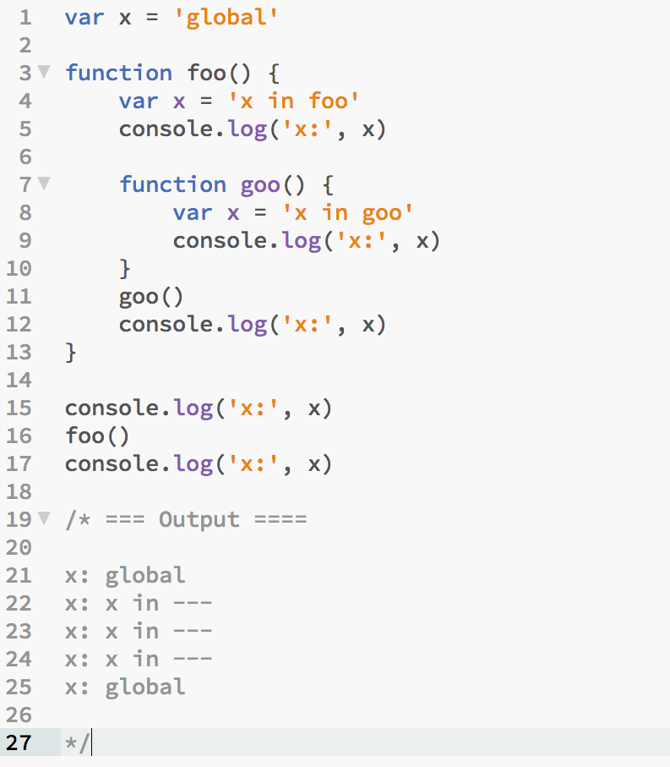
Test

Slide 175
Chapter 5 – JavaScript
#46 – Section 22
MISC: IIFE

Slide 176
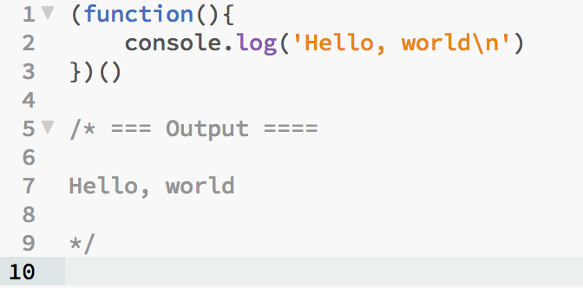
IIFE – Immediately-Invoke Function Expression
Quite simply, it is a function expression that is invoked immediately
Syntax:
(<anonymous function>)(…)
Example:

Slide 177
From Function Definition To IIFE
Example code sample 01 - 05

Slide 178
Chapter 5 – JavaScript
#47 – Section 23
MISC: Closure

Slide 179
Closure
Definition - Closure:
are functions that refer to independent (free) variables. In other words, the function defined in the closure 'remembers' the environment in which it was created.
Verrol’s Definition – Closure:
Are functions which continues to reference variables after the scope which created them expires.
JavaScript Closure - https://developer.mozilla.org/en-US/docs/Web/JavaScript/Closures

Slide 180
Illustration
Global Scope
Variables

Slide 181
Illustration
Global Scope
Variables
function foo(){
var x = 5
}
foo()
x = 5

Slide 182
Illustration
Global Scope
Variables
function foo(){
var x = 5
function goo(){
console.log(x)
}
return goo;
}
var g = foo()
x = 5
g()
x = 5

Slide 183
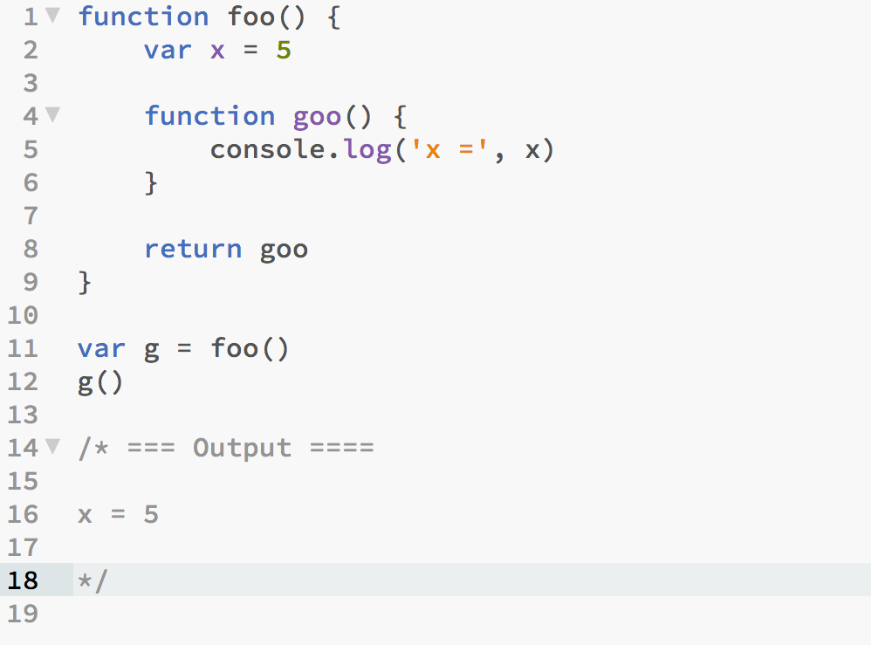
Demo – Example-01.js

Slide 184
Illustration
Global Scope
Variables
function foo(){
var x = 5
}
foo()
x = 5; reference-count = 1

Slide 185
Illustration
Global Scope
Variables
function foo(){
var x = 5
function goo(){
console.log(x)
}
return goo;
}
var g = foo()
x = 5; reference-count = 2
g()
x = 5; reference-count = 1

Slide 186
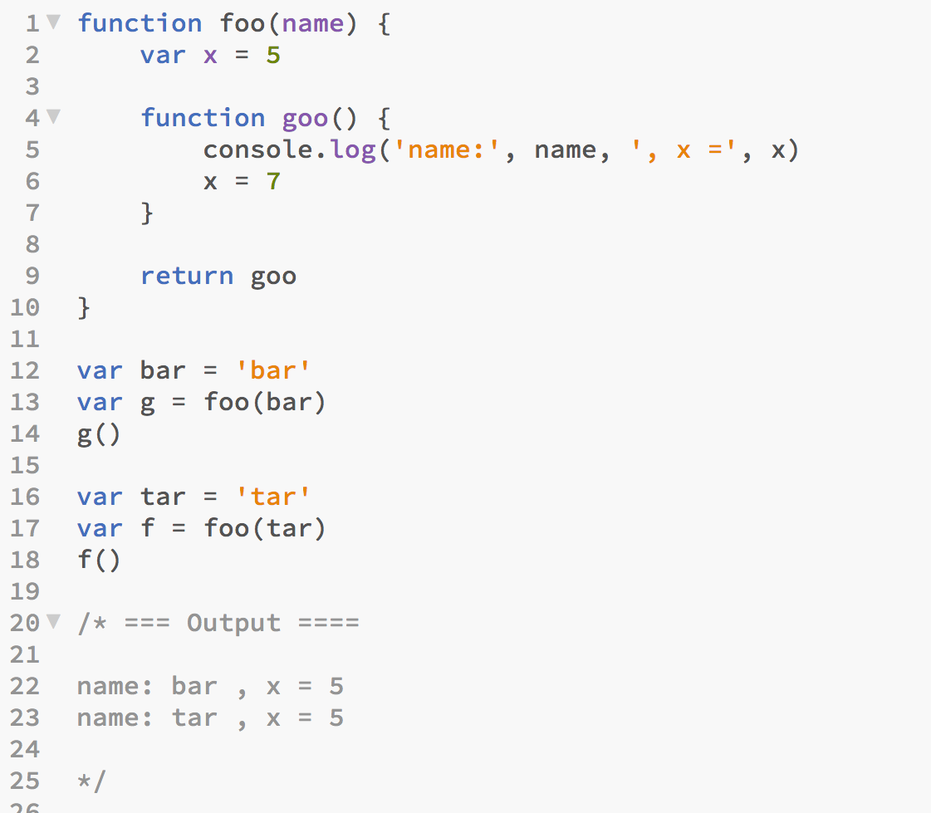
Demo – Example-02.js

Slide 187
Illustration
Global Scope
Variables
function foo(name){
var x = 5
function goo(){
console.log(‘name =‘, name, ‘, x =‘, x)
}
return goo;
}
var bar = ‘bar’
bar = ‘bar’; reference-count = 1
var g = foo(bar)
x = 5; reference-count = 2
bar = ‘bar’; reference-count = 3
g()
x = 5; reference-count = 1
bar = ‘bar’; reference-count = 2
var tar = ‘tar’
tar = ‘tar’; reference-count = 1
var f = foo(tar)
x = 5; reference-count = 2
tar = ‘tar’; reference-count = 3
f()
x = 5; reference-count = 1
tar = ‘tar’; reference-count = 2

Slide 188
Chapter 6 – AngularJS
#48 – Section 1
Up and Running with AngularJS

Slide 189
Topics
A Simple AngularJS Application
What is a AngularJS?
What is a Web Application Framework?
What is a Framework vs. Library?

Slide 190
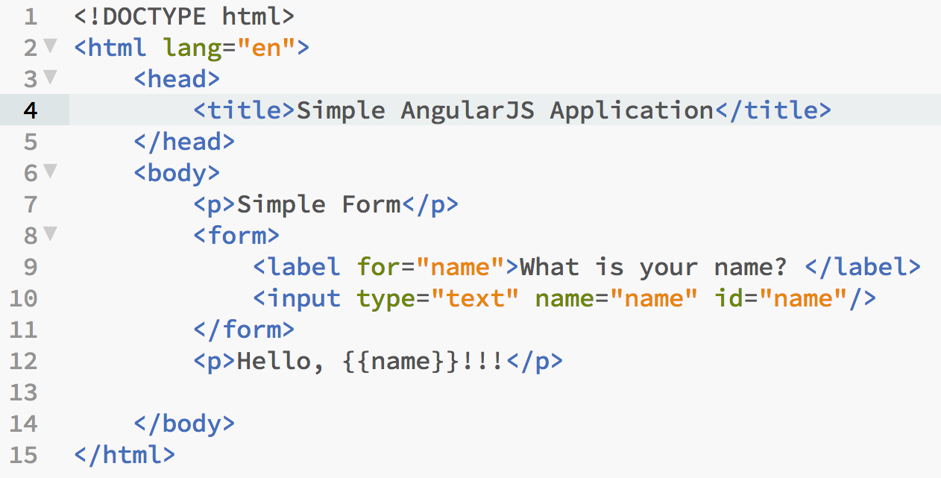
Demo – No AngularJS: Example-01.html

Slide 191
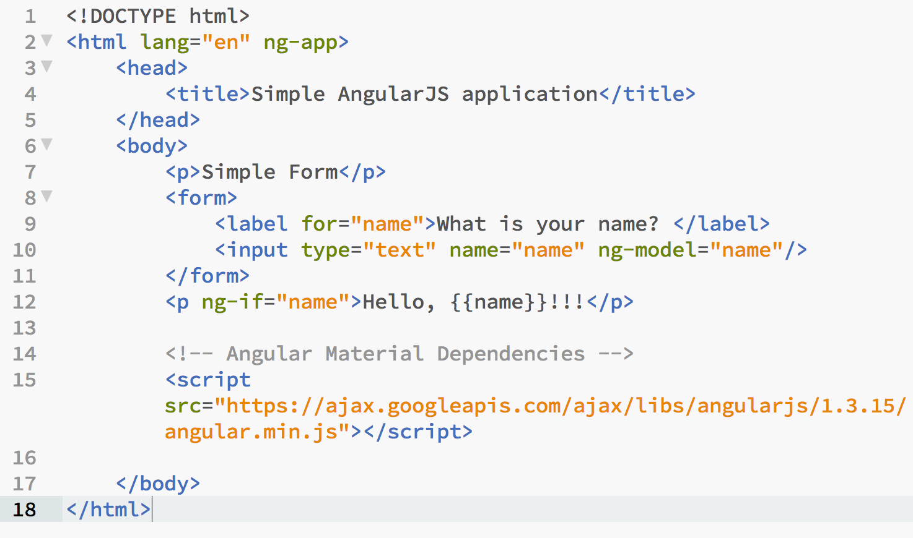
Demo – AngularJS: Example-02.html

Slide 192
What is …?
What is a AngularJS?
A web application framework used to build Single Page web Applications (SPA).
What is a Web Application Framework?
A framework provides basically two things:
collection of libraries which provides reusable code
mechanism to call your code at key points of its life-cycle
What is a Framework vs. Library?
Libraries are a collection of classes and methods intended for reuse.
Your code uses or is built on one or more libraries.
Hence, libraries don’t implement life-cycle
What is are SPAs?
A way of constructing web applications that makes them more responsive and relies heavily on RESTful APIs.

Slide 193
Framework vs. Library Illustrated
Application
Application
Life Cycle
Management
liba
libb
libc
liba
libb

Slide 194
Framework/Library :Pros vs. Cons
 | Framework | Library
Pros | Less to do, hence faster to create finished product | More flexibility
Cons | Very authoritative, less flexibility Can be invasive | Don’t do most of the heavy lifting

Slide 195
Chapter 7 – NodeJS
# – Section
HTTP, Web Browser, & Web Server

Slide 196
Topics
What is a Server?
What is a Client?
Web Server and Browser Communication
What is HTTP?

Slide 197
Server & Client
Broadly speaking:
Server : provides one or more services a client needs
Client : makes requests to a server to use a provided service
Example:
Service – a business providing any number of services
Car wash
Restaurant
Client – typically a customer

Slide 198
Server & Client Interaction
Service A
Service B
client
Service C
server

Slide 199

Computer Server & Client

Slide 200
HTTP: Communication On The Web
HTTP – Hypertext Transport Protocol
Protocol – The rules for communication
The two parties communicating are:
Client : The web browser (or HTTP client)
Server: The web server (or HTTP server)
HTTP is simple
Made up of REQUEST/RESPONSE
Client makes REQUEST
Server sends RESPONSE to client REQUEST
NOTE: The sever ‘never’ initiates an exchange

Slide 201
Web Browser
Web Browser
HTML
CSS
a.html
JS
Engine
b.css
c.js

Slide 202
JavaScript In The Web Browser
Can manipulate:
HTML & CSS that is loaded
Can create HTML & CSS
Have access to the DOM
Document Object Model
An in memory representation of HTML and CSS
DOM is a class with methods and attributes

Slide 203
NodeJS
NodeJS Application
JS
Engine
2
1
OS (Linux, Mac OS X, Windows)
a.js
b.js
c.js

Slide 204
JavaScript In NodeJS
Have access to the OS
Can read files from the filesystem
Can create files on the filesystem
Can perform network communication
Open network ports
Etc.

Slide 205
Example Page Request
Send me ‘index.html’
index.html
here it is
app.css
Web browser
app.js
Web server

Slide 206
Web Browser & Web Server
Web Browser
HTTP/Web Server
Request:
GET ‘/a.js’
1
4
Response:
function foo(){
…
}
3
2
JS
Engine
a.js
b.js
index.html

Slide 207
Demo: Web Browser & Server
Objective:
Demonstrate Browser Client Request To Server
Demonstrate Server Response
Server can’t serve files it doesn’t have
Server respond with requested file

